Slide 1

Understanding The Advanced Reporting Database
John Knight
Senior Engineer
Blackboard Inc.
July 19th

Slide 2

Overview
Introduction
Architecture Overview
Sample Crystal Report Templates
Sample Queries
Best Practices
Questions

Slide 3
Now a word from our lawyers…
Any statements in this presentation about future expectations, plans and prospects for Blackboard and other statements containing the words "believes," "anticipates," "plans," "expects," "will," and similar expressions, constitute forward-looking statements within the meaning of The Private Securities Litigation Reform Act of 1995. Actual results may differ materially from those indicated by such forward-looking statements as a result of various important factors, including the factors discussed in the "Risk Factors" section of our most recent 10-K filed with the SEC. In addition, the forward-looking statements included in this press release represent the Company's views as of April 11, 2005. The Company anticipates that subsequent events and developments will cause the Company's views to change. However, while the Company may elect to update these forward-looking statements at some point in the future, the Company specifically disclaims any obligation to do so. These forward-looking statements should not be relied upon as representing the Company's views as of any date subsequent to April 11, 2005. Blackboard, in its sole discretion, may delay or cancel the release of any product or functionality described in this presentation.

Slide 4
Introduction
Origins of the ASR Database
  Blackboard 6 Enterprise Feature
  Balance data retention vs. database performance
Accessing the ASR Database
  Each virtual installation contains a stats database following convention of bbuid_stats. Default is bb_bb60_stats
  User id with same name. Default password is same as bb_bb60 user (please change)

Slide 5
Architecture Overview
Schema Description
  Schema Elements
  Activity Accumulator Details
Background Task Manager
  Bb-tasks.xml Details
  Synchronization Processes
  Tracking Event Manager
  Summarization Process
  Activity Accumulator Purge
Known Isssues

Slide 6
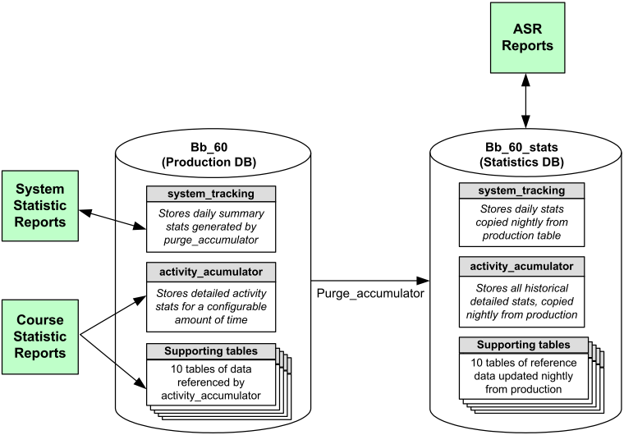
Schema Description

Slide 7
ASR Schema Elements
Table Name(s)
Data Stored
Data Rentention
in main schema
ACTIVITY_ACCUMULATOR
End user events.
Up to 360 days of data
SYSTEM_TRACKING
Daily summary stats generated
by summarization task in
PurgeAccumulator process
No limit (never purged)
APPLICATION
COURSE_MAIN
COURSE_ROLES
COURSE_USERS
DATA_SOURCE
INSTITUTION_ROLES
NAVIGATION_ITEM
SYSTEM_ROLES,USERS
USER_ROLES
Stores supporting data
referenced by
ACTIVITY_ACCUMULATOR
for ASR Reporting
No limit. Tables are
never purged
automatically.

Slide 8
Activity Accumulator Dictionary
Column
Description
PK1
Primary Key
EVENT_TYPE
Type of Event Posted
USER_PK1
Relates to USERS.PK1
COURSE_PK1
Relates to COURSE_MAIN.PK1
GROUP_PK1
Relates to GROUP.PK1
FORUM_PK1
Relates to FORUM_MAIN.PK1
INTERNAL_HANDLE
Relates to NAVIGATION_ITEM.INTERNAL_HANDLE
CONTENT_PK1
Relates to COURSE_CONTENTS.PK1

Slide 9
Activity Accumulator Dictionary
Column
Description
DATA
Additional information dependant on event type.
TIMESTAMP
Date/Time the event was posted
STATUS
1 unless error occurred
MESSAGES
Error message details
SESSION_ID
Relationship to SESSIONS.PK1

Slide 10
Activity Accumulator Events
Event Type
Description
Relationships
LOGIN_ATTEMPT
A user attempted to login to the system. Captures the session id of the attempted login.
SESSION_ID
LOGOUT
A user clicked the logout button
SESSION_ID
USER_PK1
SESSION_INT
A user connected to the system and a session was created
SESSION_ID
PAGE_ACCESS
A page was accessed
SESSION_ID
USER_PK1
NAVIGATION_ITEM
COURSE_ACCESS
A page within a course was accessed
SESSION_ID
USER_PK1
COURSE_PK1
NAVIGATION_ITEM

Slide 11
Activity Accumulator Events
Event Type
Description
Relationships
CONTENT_ACCESS
A content item with tracking turned on was accessed. Note many content accesses may be generated for a single COURSE_ACCESS.
SESSION_ID
USER_PK1
COURSE_PK1
CONTENT_PK1
MODULE_ACCESS
A module was accessed.
SESSION_ID
USER_PK1
MODULE_PK1 is stored in DATA in format PK1_1
TAB_ACCESS
A click on a tab. Note this only tracks the switch to the tab, not each hit under the tab.
SESSION_ID
USER_PK1
TAB_PK1 is stored in DATA
ERROR
An error occurred. Note this is seldom used; normally errors are logged in the appropriate file.
SESSION_ID
USER_PK1

Slide 12
Background Task Manager
Initiates background tasks managed through java TimerTask
Tasks are defined in bb-tasks.xml in blackboard/config directory
Task may be set to run after a set number of miliseconds, or scheduled to run at a specific time of day
Load Balanced installations take note bb-tasks.xml must be edited on secondary servers

Slide 13
Bb-tasks.xml Details
<task-entry key="bb.stats.purging" version="60">
<task classname="blackboard.platform.tracking.PurgeApplicationTask">
<property name="delay" value="21600000"/>
<property name="period" value="86400000"/>
<property name="xml.registered.delay" value="1:00"/>
<property name="xml.registered.period" value="24"/>
<property name="days_to_keep“ value="180"/>
<property name="target" value="live"/>
<property name="dev_null" value="NUL"/>
<property name="command-line" value="C:\bbdeploy\installs\windows-mssql-bb60\blackboard\tools\admin\PurgeAccumulator.bat"/>
task-entry-key provides a unique id for each task
Delay and period define task schedule
  Delay: how long to wait before first execution
  Period: how often
xml.registered.delay and period provide more specific schedule control
Tasks may have specific custom properties such as command-line script to execute.

Slide 14
Tracking Event Manager Task
Description
  Monitors activity accumulator event buffer
  Writes buffer to database in background
Task Entry Key
  bb.task.queue
Schedule
  Run every 2 seconds after initialization

Slide 15
Synchronization Task
Description
  Synchronizes data between production and ASR databases.
  New activity_accumulator records are copied over
  Other tables are synchronized with production
Task Entry Key
  Part of PurgeAccumulator process (bb.stats.purging)
Schedule
  Runs at 1 am by default every 24 hours.

Slide 16
Summarization Task
Description
  Summarizes key information on a daily basis into system_tracking table.
  Allows for generation of historical reports such as number of courses on July 18.
Task Entry Key
  Part of PurgeAccumulator process (bb.stats.purging)
Schedule
  Runs at 1 am by default every 24 hours.

Slide 17
Activity Accumulator Purge
Description
  Removes records from production activity accumulator based on “days_to_keep” property.
  Provides an automated way to minimize tablespace growth in production database.
Task Entry Key
  Part of PurgeAccumulator process (bb.stats.purging)
Schedule
  Runs at 1 am by default every 24 hours.

Slide 18
Sample Crystal Report Templates
Report Name
Description
Course_Access_Department_chart
Displays pie chart noting course access by Department name (as identified in the user account creation process). User selects start and end dates for the report.
Course_Availability_chart
Displays pie chart noting number of available and unavailable courses on the system along with a total count of courses on the system.
Module_Access_Course_Role_chart
Displays pie chart noting module access by course role (course builder, grader, guest, instructor, student, teacher's assistant). User selects start and end dates for report.
Tool_Access_Course_Role_chart
Displays tool access data by course role (course builder, grader, guest, instructor, student, teacher's assistant). User selects start and end dates for report.

Slide 19
Sample Crystal Report Templates
Report Name
Description
Tool_Access_Instructor_chart
Displays pie chart noting tool access for course role=instructor. User selects start and end dates for report.
Tool_Access_Instructor_Department_chart
Displays tool access data by department for course role=instructor. User selects start and end dates for report.
Tool_Access_Portal_Role_chart
Displays tool access data by portal role (student, faculty, staff, alumni, prospective student, guest, other, observer). User selects start and end dates for report.
Tool_Access_Student_chart
Displays pie chart noting tool access for course role=student. User selects start and end dates for report.

Slide 20
Sample Query
Course Usage by department
  SELECT U.DEPARTMENT, count(*)
  FROM USERS U,
  ACTIVITY_ACCUMULATOR AA
  WHERE AA.USER_PK1 = U.PK1
  AND AA.EVENT_TYPE = ‘COURSE_ACCESS’
  GROUP BY U.DEPARTMENT

Slide 21
Best Practices
Mirror ASR database to separate database server if possible
Change password on the bb_bb60_stats database (requires update to bbadmin database)
If you have not mirrored; make sure to run reports at non-peak times.
Use explain plan, or query analyzer to ensure good performance of queries

Slide 22
Questions

