Slide 1

Marist College Band
Database Designed by Cassandra Graves

Slide 2
Table of Contents
03 Executive Summary
04 Entity-Relationship Diagram
05 Tables
05 Participants Table
06 Ensembles Table
07 EboardPositions Table
08 KKPsiMembers Table
09 TBSMembers Table
10 EboardMembers Table
11 ConcertInsts Table
12 PepInsts Table
13 MarchingInsts Table
14 Conductors Table
15 Students Table
16 Employees Table
17 EnrolledIn Table
18 Views
18 GreekLifeMembers
19 PaidBoardMembers
20 Reports
20 StudentInstrumentRoster
21 Stored Procedures
21 EnsembleEnrolled
22 Security
22 Admin Role
22 Leader Role
23 Implementation Notes
24 Known Problems
25 Future Enhancements

Slide 3
Executive Summary
Overview The Marist College Band involves over 150 students in a number of ensembles. All members participate in the Symphonic Band, Marching Band and Pep Band. The other ensembles become available to join once a member of the large ensemble. With no Music Major available, all performers continue playing at Marist purely for the enjoyment and love of music. As one of the most well known organizations on campus, the Band has become ambassadors not only for the Music Department, but for all of Marist College!
Objectives The Marist Band has been growing tremendously over the last 28 years. To continually support the growing Band program, this database will help maintain details about the band’s past, keep up to date with the band’s present and pave the way for the band’s future.

Slide 4
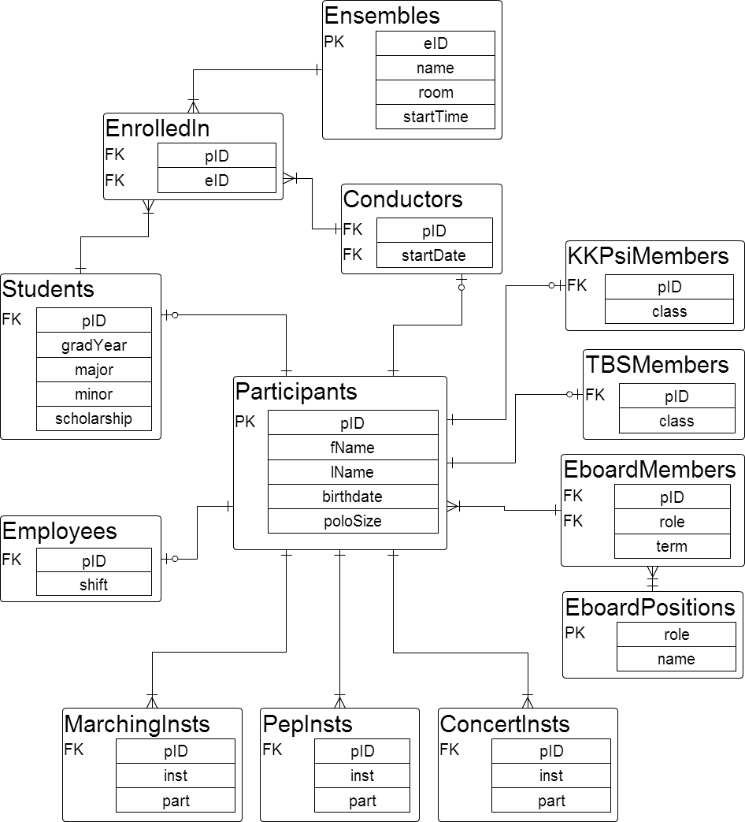
Entity-Relationship Diagram

Slide 5
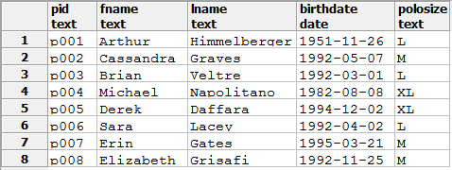
Tables
Participants Table Anyone involved in the band program will later be organized into roles. This table defines the basic information about each person. CREATE TABLE Participants(
pID TEXT NOT NULL,
fName TEXT NOT NULL,
lName TEXT NOT NULL,
birthdate DATE,
poloSize TEXT,
PRIMARY KEY(pID)
);
Functional Dependencies
pID → fName, lName, birthdate, poloSize
Sample Data:

Slide 6
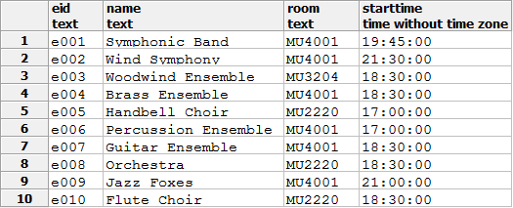
Tables
Ensembles Table There are a variety of ensembles at Marist College for band members to become a part of once a full member of the band. CREATE TABLE Ensembles(
eID TEXT NOT NULL,
name TEXT NOT NULL,
room TEXT,
startTime TIME,
PRIMARY KEY(eID)
);
Functional Dependencies
eID → name, room, startTime
Sample Data:

Slide 7
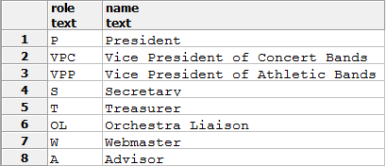
Tables
EboardPositions Table There are many tasks that need to get done on a week to week basis. An elected group of band members hold positions on this executive board and take care of anything that needs to be done. CREATE TABLE EboardPositions(
role TEXT NOT NULL,
name TEXT NOT NULL,
PRIMARY KEY(role)
);
Functional Dependencies
role→ name
Sample Data:

Slide 8
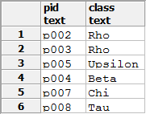
Tables
KKPsiMembers Table Members of the band may be asked to join the Honorary Band Fraternity, Kappa Kappa Psi. One goal for this organization is to serve the band. CREATE TABLE KKPsiMembers(
pID TEXT NOT NULL REFERENCES Participants(pID),
class TEXT
);
Functional Dependencies
pID→ class
Sample Data:

Slide 9

Tables
TBSMembers Table Members of the band may be asked to join the Honorary Band Sorority, Tau Beta Sigma. One goal for this organization is to serve the band. CREATE TABLE TBSMembers(
pID TEXT NOT NULL REFERENCES Participants(pID),
class TEXT
);
Functional Dependencies
pID→ class
Sample Data:

Slide 10
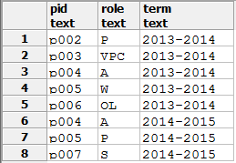
Tables
EboardMembers Table The specific band members that are elected into executive board positions serve the band for the following academic year. CREATE TABLE EboardMembers(
pID TEXT NOT NULL REFERENCES Participants(pID),
role TEXT NOT NULL REFERENCES EboardPositions(role),
term TEXT
);
Functional Dependencies
pID→ role, term
Sample Data:

Slide 11
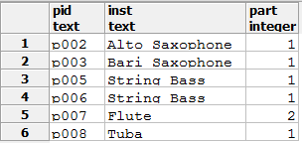
Tables
ConcertInsts Table As talented musicians, many band members play a variety of concert and pep instruments throughout their time with the Marist Band. Concert Instruments perform in the various ensembles. CREATE TABLE ConcertInsts(
pID TEXT NOT NULL REFERENCES Participants(pID),
inst TEXT,
part INT
);
Functional Dependencies
pID→ inst, part
Sample Data:

Slide 12
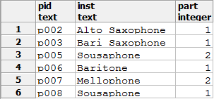
Tables
PepInsts Table As talented musicians, many band members play a variety of concert and pep instruments throughout their time with the Marist Band. Pep Instruments are used at Marist basketball games. CREATE TABLE PepInsts(
pID TEXT NOT NULL REFERENCES Participants(pID),
inst TEXT,
part INT
);
Functional Dependencies
pID→ inst, part
Sample Data:

Slide 13
Tables
MarchingInsts Table As talented musicians, many band members play a variety of concert and pep instruments throughout their time with the Marist Band. Marching Instruments are used at Marist football games during the half time show. CREATE TABLE MarchingInsts(
pID TEXT NOT NULL REFERENCES Participants(pID),
inst TEXT,
part INT
);
Functional Dependencies
pID→ inst, part
Sample Data:

Slide 14

Tables
Conductors Table There are many faculty members who conduct the different ensembles, most conduct more than one ensemble! CREATE TABLE Conductors(
pID TEXT NOT NULL REFERENCES Participants(pID),
startDate DATE
);
Functional Dependencies
pID→ startDate
Sample Data:

Slide 15
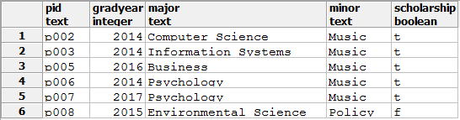
Tables
Students Table Many of the band members are also current Marist Students who lead very different academic lives outside of the band. Details pertaining to college enrollment are located here.
CREATE TABLE Students(
pID TEXT NOT NULL REFERENCES Participants(pID),
gradYear INT NOT NULL,
major TEXT,
minor TEXT,
scholarship BOOLEAN
);
Functional Dependencies
pID→ gradYear, major, minor, scholarship
Sample Data:

Slide 16

Tables
Employees Table Some band members receive work study from the college, and can satisfy this with a position within the Music Department, helping do the day to day operations of the program.
CREATE TABLE Employees(
pID TEXT NOT NULL REFERENCES Participants(pID),
shift TEXT NOT NULL CHECK(shift='day' or shift='night')
);
Functional Dependencies
pID→ shift
Sample Data:

Slide 17
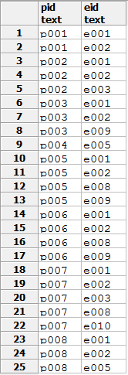
Tables
EnrolledIn Table Keeping track of every ensemble each musician is in is difficult, but this helps keep the attendance record straight!
CREATE TABLE EnrolledIn(
pID TEXT NOT NULL REFERENCES Participants(pID),
eID TEXT NOT NULL REFERENCES Ensembles(eID)
);
Functional Dependencies
pID eID→
Sample Data:

Slide 18
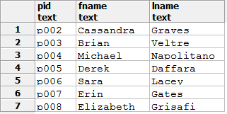
Views
GreekLifeMembers View Compiles a list of band members who should report to all crews and be at set up before each rehearsal and be overall a more involved band member than their peers, regardless of whether they are a member of the Fraternity or Sorority.
CREATE OR REPLACE VIEW GreekLifeMembers AS
select p.pID, p.fName, p.lName
from Participants as p
where p.pID in (select pID
from TBSMembers)
or p.pID in (select pID
from KKPsiMembers)
;
Sample Data:

Slide 19

Views
PaidBoardMembers View Points out those members of the executive board that also get paid to work in the department. This is helpful for these employees to schedule office hours and take on extra assignments from the executive board.
CREATE OR REPLACE VIEW PaidBoardMembers AS
select p.pID, p.fName, p.lName, e.shift, em.role, em.term
from Participants as p, Employees as e, EboardMembers as em
where p.pID = e.pID
and p.pID = em.pID
order by em.term asc;
Sample Data:

Slide 20
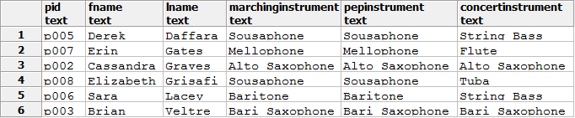
Reports
StudentInstrumentRoster Report Lists the students involved in the Marist Band and what kind of instrument they play in the Concert, Pep and Marching Bands.
select p.pID, p.fName, p.lName,
mar.inst as MarchingInstrument,
pep.inst as PepInstrument,
con.inst as ConcertInstrument
from Participants as p, Students as s,
MarchingInsts as mar, PepInsts as pep, ConcertInsts as con
where p.pID = s.pID
and mar.pID = p.pID
and pep.pID = p.pID
and con.pID = p.pID
order by p.lName ASC;
Sample Data:

Slide 21


Stored Procedures
EnsembleEnrolled Procedure Returns the number of registered participants in the requested ensemble. Will not return values if no one is enrolled and therefore, is not an active ensemble.
create or replace function EnsembleEnrolled(text, REFCURSOR) returns refcursor as
$$
declare
ensembleNumber text := $1;
resultset REFCURSOR := $2;
begin
open resultset for
select ens.eID, ens.name,COUNT(p.pID)
from Ensembles as ens, EnrolledIn as ei, participants as p
where ens.eID = ei.eID
and ei.pID = p.pID
and ens.eID = ensembleNumber
group by ens.eID;
return resultset;
end;
$$
language plpgsql;
Sample Data:
select EnsembleEnrolled('e008', 'results');
Fetch all from results;
select EnsembleEnrolled('e001', 'results');
Fetch all from results;

Slide 22
Security
Admin Role The admin, or administrator, is able to completely manipulate the Marist College Band database. Only certain individuals will be able to have sign in access as the admin.
create role admin;
grant all privileges
on all tables in schema public
to admin;
Leader Role The leader, a responsible person who needs to query against the database, is able to see the database and make queries on it. Again, only certain individuals will be able to have sign in access, even as a leader.
create role leader;
grant select
on all tables in schema public
to leader;

Slide 23
Implementation Notes
This is a highly important database to exist for the future of the Marist College Band. As the group is growing, it is getting harder to keep perfect records on the group. Being able to put all of the information in about every band member will help tremendously with organization. Keeping track of members involved in each of the various ensembles, requesting the roster or count of the number of participants in any ensemble, the instrument a member plays (and more) are all very common inquiries. Putting in all of this data initially was and would continue to be time consuming, but once caught up to present-day, it would only require a minor number of insertions and/or updates. The sky is the limit as far as what other information this database can and should hold. As long as it remains secure, it could gather even more personal details like street address and phone number of everyone involved.

Slide 24
Known Problems
The database is currently as bare-bones as it could get. The minimal details and example participants does not bring out the true and ultimate potential that this database has. The only way to know what else to add into the database is by experiencing the band program. While there are many consistent things that occur year to year, each year brings new and different challenges that need to be observed and accounted for. With that said, as the band program grows, the database and type of detail to it will grow. Right now, the problems lie with needing to figure out where the future growth of the database is and planning accordingly. As a graduating senior of the program, I’ve seen a lot of change, but not nearly as much change as will come in the next year, 5 years, 10 years…so who knows how much more information the database will need until the time has come! So for the time being, the miniature Marist College Band database is perfectly suited for the details I’ve experienced with the program.

Slide 25
Future Enhancements
Besides any events that are unforeseeable in the future that would need to be taken into account for this database to remain current and helpful, there were a few things I could have accomplished for this version of the database. For starters, getting the entire 100+ member band in all of the corresponding tables, plus the orchestra members or any other extraneous members to add in to the group would have been more helpful to have in the database. The example numbers of enrolled and other specifics to the tables are a poor reflection of how grand this band has become even to this day. With more data would come more ideas as to how leaders could view it. More time and more patience would be a help to improving the database in the future. But once all of the data is in, this table will be extremely useful for future presidents and executive board members of the Marist College Band!

