Slide 1
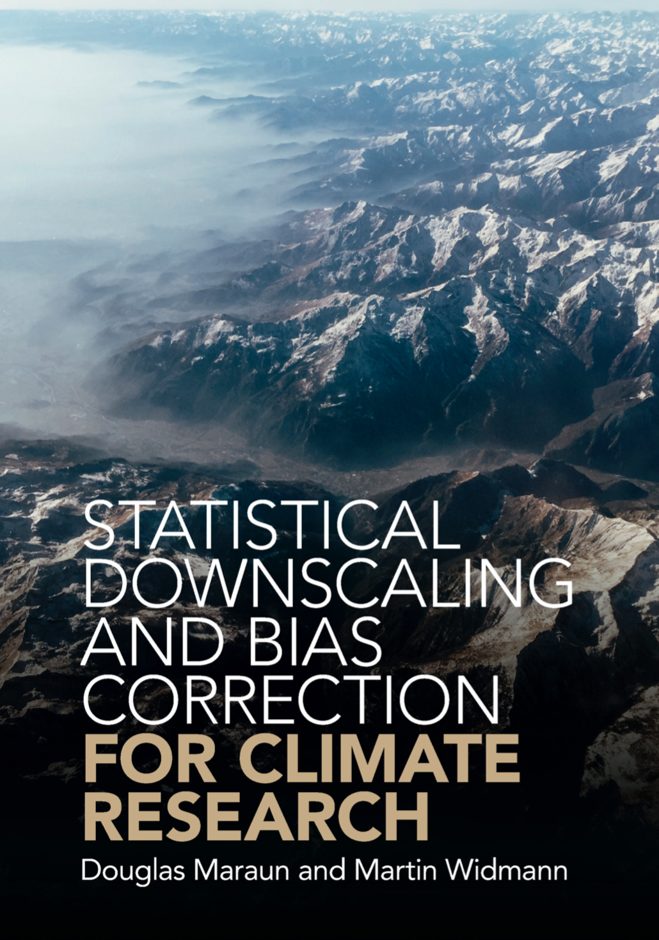
Statistical Downscaling and Bias Correction for Climate Research - An Introduction Overview by Risa Ueno
Book published in 2018
Reference to widely used approaches - statistical downscaling, bias correction and weather generators
Underlying assumptions, skill and limitations
Climate modelling and uncertainties
Observational data types
User needs
Guidelines for practitioners
Evaluation of regional climate projections
Use of downscaled information in practice

Slide 2
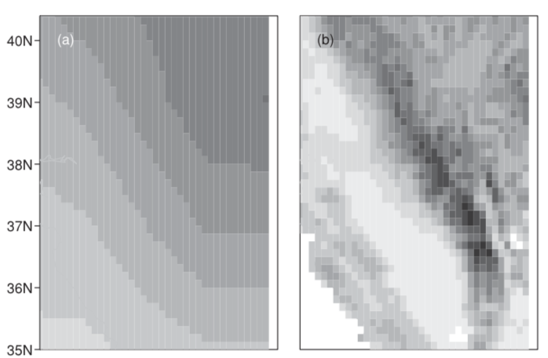
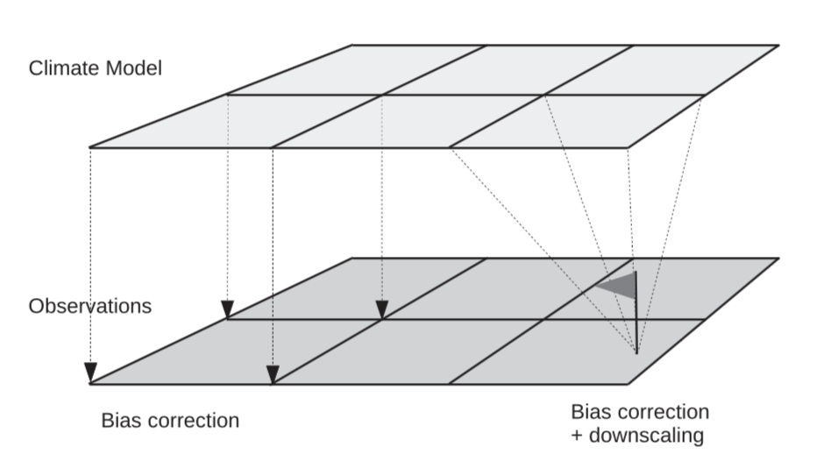
Rationale of Downscaling
Rationale of Downscaling
(Chapter 4 of book)
(Chapter 4 of book)
Problem: GCMs and RCM projections are substantially biased compared to real-world climate and often do not provide the resolution desired by impact modellers.
Downscaling bridges the gap by using additional information from smaller scales not present in GCMs to derive information about local-scale climate
Want better projections in specific locations under changing climate
Dynamical downscaling employs RCM to simulate the atmosphere and its coupling with the land-surface at a higher resolution over a limited domain (boundary conditions from GCM).
Statistical downscaling derives empirical links between large and local scales and applies these to future climate model output.

Slide 3
Rationale of Downscaling
(Chapter 4 of book)
Must include relevant predictors representing the regional variability and influence on changing climate.
Influence of the predictors on the variable of interest on long timescales must be well-represented and may be extrapolated (stationarity assumption).
Downscaling output always conditional on driving model – relevant processes should be well represented by the GCM. The stronger the inconsistency between the GCM and the real climate, the lower the confidence in future projections.
Ultimately calls for the selection of suitable GCMs!

Slide 4
Requirements
(Chapter 5 of book)
Downscaled information should be:
Credible
Model must produce physically plausible output
Defensible
Associated uncertainties are comprehensively characterised
“Ensembles of climate models are required to assess the uncertainties of climate projections. A climate projection based on a single climate model cannot be defensible.”
Salient
Addresses the relevant issues in a given context e.g. time-horizon of interest
→ Actionable
Provides evidence strong enough to guide real-world decisions

Slide 5
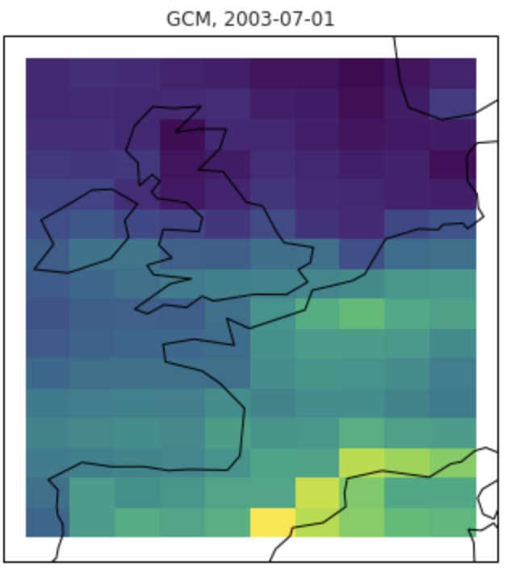
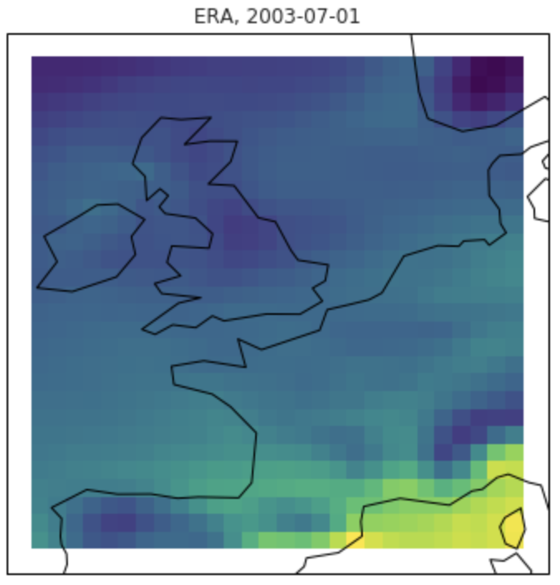
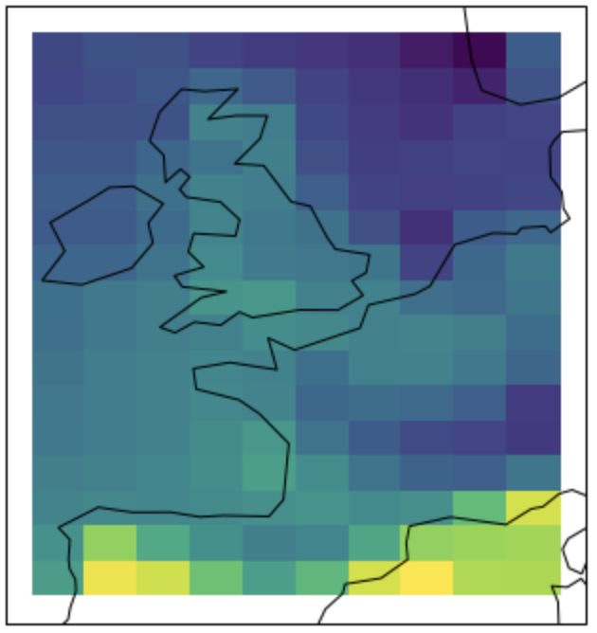
Set-up of Statistical Downscaling
(Chapter 10 of book)
1. Calibration - Learn mapping y ~ F(x)
Historical
Predictor(s), x
Predictand (observed), y
2. Apply f(・)
Future
?
Predictor(s) (model simulation of future), x’
Predictions, y’

Slide 6
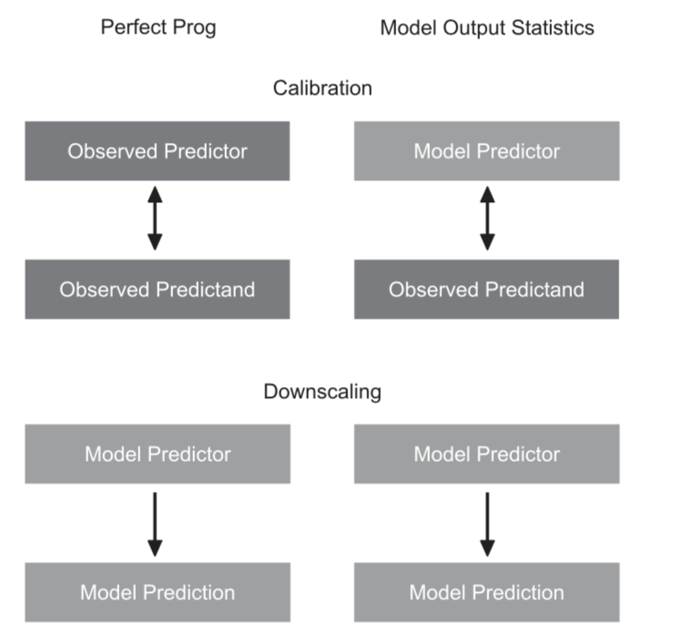
Perfect Prognosis vs. Model Output Statistics
(Chapter 10 of book)
Perfect Prognosis
X and y can be different variables e.g. use geopotential height and humidity fields to downscale precipitation.
For PP to be sensible, the predictors need to be “perfectly” simulated – it cannot correct model biases
The predictor on specific date corresponds directly to the predictand at the same date. Calibration can make use of temporal sequence of pairs of predictors and predictands (x_{i}, y_{i}) e.g. use regression models
Model Output Statistics
X and y are the same variables - corrects model biases
Free-running climate models not in synchrony with observations – only long-term distribution calibration possible
Conceptually simpler than PP, but evaluation of SD more difficult

Slide 7
Model Output Statistics
(Chapter 12 of book)
Idea is to estimate some distributional properties of the climate system (e.g. long-term means, variances, quantiles) in climate models and observations, and then infer a transfer function that maps the model property onto observed property.
“Internal climate variability is in fact a severely limiting factor for a reliable bias estimation. Even on 30-year timescales, many climatic properties are substantially affected by long-term modes of climate variability. Thus, a considerable fraction of any estimated model bias will simply be a random component. Long time-series are therefore essential.”
MOS popular in practice:
Recently quite standard in the production of national and global climate change projections and have served as input for impact studies and assessment reports¹
Bias corrected data has increasingly been made available through online portals by climate service providers and coordinated modelling experiments.
1. Gangopadhyay et al. 2011, Girvetz et al. 2013, Hagemann et al. 2013, Warszawski et al. 2014, Cayan et al. 2013, World Bank 2013, Georgakakos et al. 2014

Slide 8
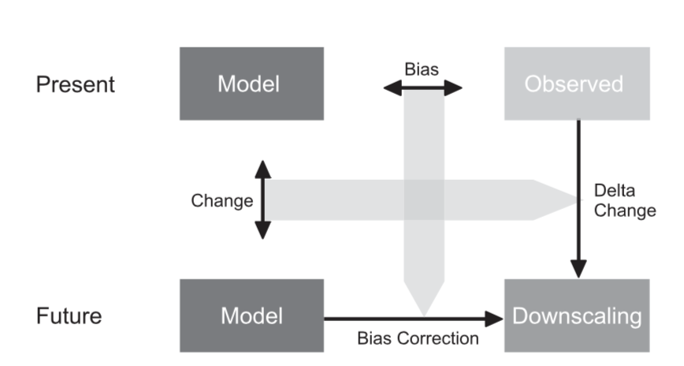
Delta Change vs. Direct Bias Correction
(Chapter 12 of book)
Delta change utilises only changes simulated by GCM (assumes this change is representative of this location). The statistical characteristics apart from the changes are still those of the observed data.
May be preferable if trust in the model is low apart from the mean response to external forcing
Variations:
Exponential/power law transformations (Leander and Buishand, 2007)
Rescaling mean precipitation and anomalies separately (Engen-Skaugen, 2007)
Using separate corrections for precipitation occurrence and intensity (Schmidli et al., 2006)

Slide 9
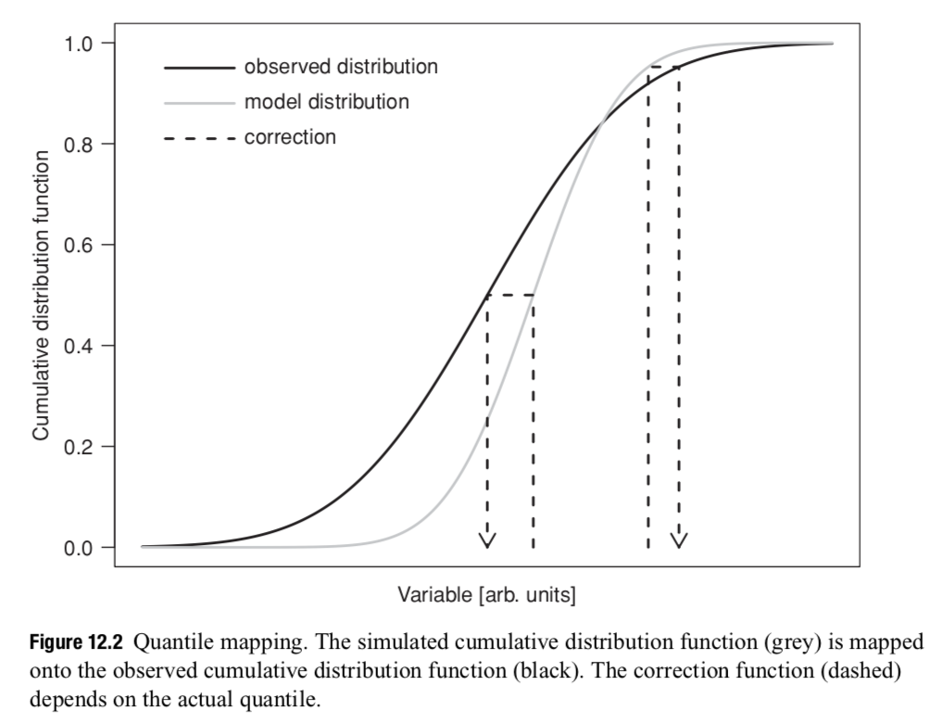
Quantile Mapping
(Chapter 12 of book)
Quantile mapping adjusts different quantiles individually
Findings suggest climate model biases often do not only affect the long-term mean but also variance or the tail behaviour e.g. higher temperature biases in tails, precipitation biases may even change signs (Christensen et al., 2008)
Variations:
Parametric model approximations e.g. normal distribution for temperature and gamma distribution for precipitation
Use different distributions for tails
Employ extreme value models (Michelangeli et al. 2009, Kallache et al. 2011)

Slide 10
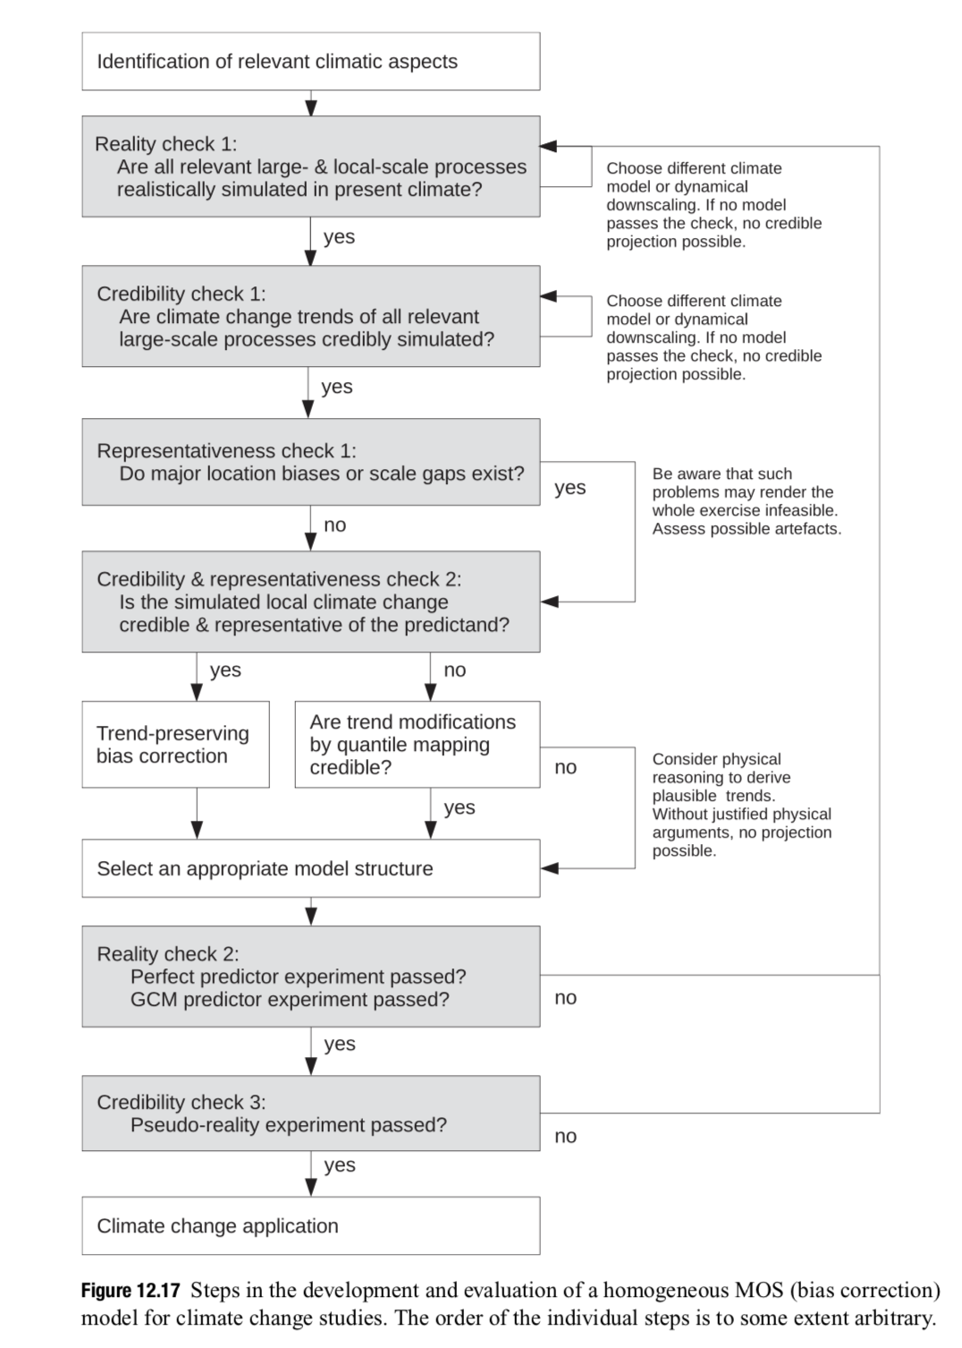
(End of MOS section)

Slide 11
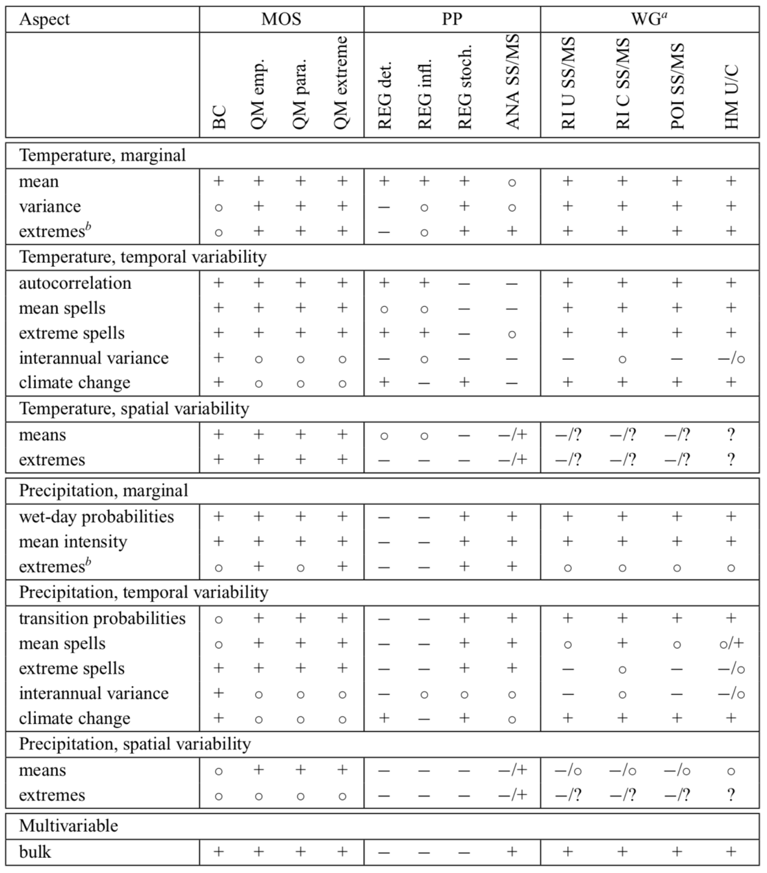
Performance of different statistical downscaling methods for daily resolution, p259.
“+”: should work reasonably well based on empirical evidence and/or expert judgement
“◦”: problems may arise depending on the specific context
“−”: weak performance either by construction or inferred from empirical evidence
“?”: not studied
Statements about extremes refer to moderate events occurring at least once every 20 years. This table is necessarily to some extent subjective.

Slide 12
Some Key Points
No method performs well for all aspects – best method is context dependent
It is important to understand relevant influences on the particular regional climate phenomena and how credibly they are simulated.
If large-scale dynamical processes control the regional phenomenon of interest, uncertainties will be high. Here a careful model evaluation is required to select GCMs that credibly simulate them.
A simulated distribution that is very different from the observed one may signify fundamental model error. MOS adjusts biases but it cannot overcome errors resulting from a substantial misrepresentation of relevant processes – garbage in, garbage out problem (Hall 2014).
To represent uncertainties due to model imperfections and internal climate variability, one should always consider ensembles of GCMs (ch.9). When selecting GCMs to downscale, one should carefully balance the need to comprehensively sample uncertainties against the need to discard ill-performing models.
Urgent problem - pressure to rapidly deliver information, but more research is needed (some authors argue climate models are not yet skillful enough for direct application in adaptation planning).
Notes:
Large-scale internal modes of variability (PDO, AMO) timescales of several decades and have a strong impact on surface climate - internal variability responsible for ~30% of the uncertainty of 30-year projections of decadal mean temperature at the regional scale and ~50% for precipitation projections at the continental scale (Hawkins and Sutton 2009, 2011). Many GCM have difficulties in realistically simulating ENSO feedbacks, undermining the credibility of ENSO projections (Bellenger et al. 2014, Chen et al. 2015).
Last point – to this they say, Model ensembles do provide useful information, which is likely more defensible than an ad-hoc expert opinion or an extrapolation of observed trends – in particular because model ensembles can at least partly sample associated uncertainties.

Slide 13
Types of Observational Data
(Chapter 7 of book)
Observational data, both gridded and station data, should not naively be considered true.
Station data
Available station data is often affected by substantial systematic errors.
Users of observational data should have a rough understanding of the quality of the underlying station time-series e.g. were they homogenised to improve estimates, and if so, how?
Gridded data
Uses statistical model that translates point values with irregular spacing into full fields of grid-box area averages
Problems in regions where measurements are sparse - the sparser the network, the more the results are dominated by the statistical model.
Reanalysis data
Obtained by assimilating observations into weather forecasting models. It combines empirical information with a dynamical model and yields physically consistent state estimates, which cannot be obtained by a merely statistical interpolation of the observations.
Substantial biases may exist for variables that are not assimilated, such as precipitation.

