Slide 1

SLR Stage Report
Reporter: Chen Jing

Slide 2
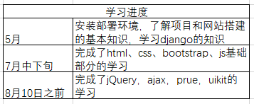
Learning
In this project, I am mainly responsible for the front-end development work. Before that, I have no project experience and no knowledge of front-end development technology, so I spent more time learning, and the following is my learning schedule.
Tabel1 Learning Schedule
1

Slide 3
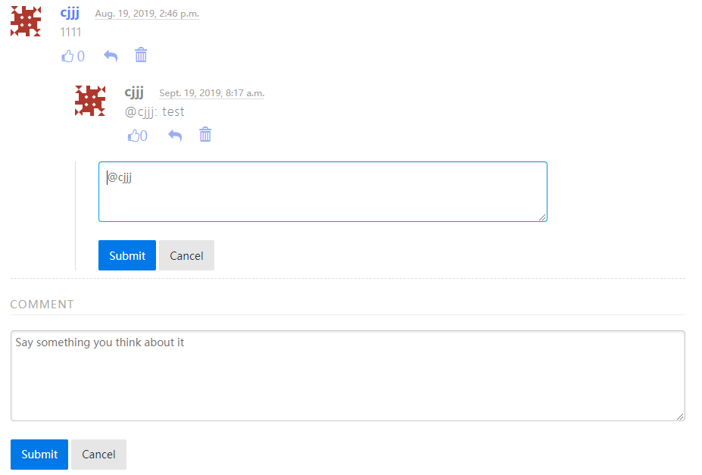
Working
On August 10, we started our project development. Tasks mainly include two functions: comment function and group management function. The following is the final result
Tab2 Comments
2

Slide 4
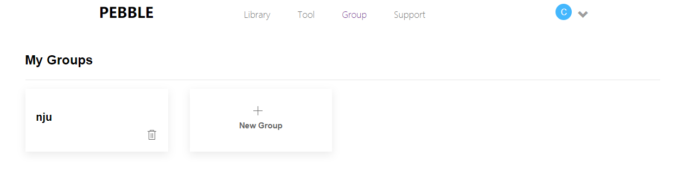
Working
Tab3 Group
3

Slide 5
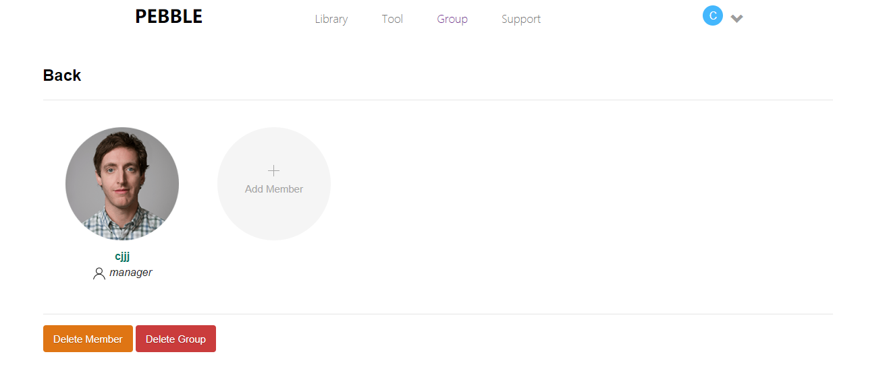
Working
Tab4 Member Management
4

