Slide 1

ITC 6001 – INTRODUCTION TO BIG DATA
Project Presentation
Presented by
Kapsalis C. & Stavrogiannis C.

Slide 2
Q1 – Data Description
We worked on a dataset with information on user activity (listening to and tagging artists, following other users) on the platform ‘last.fm’.
We checked for the existence of duplicate values (based on the primary keys of each data file) and found none
Basic statistics on the variables under study:
1892 users
17632 artists
11946 tags.
We present sample rows of the data files we used in our analysis; the ‘primary key’ of each data object is highlighted in green.
user_artists.dat
tags.dat
userID | artistID | weight
2 | 51 | 13883
2 | 52 | 11690
2 | 53 | 11351
2 | 54 | 10300
2 | 55 | 8983
tagID | tagValue
1 | metal
2 | alternative metal
3 | goth rock
4 | black metal
5 | death metal
artists.dat
id | Name | url | pictureURL
1 | MALICE MIZER | http://www.last.fm/music/MALICE+MIZER | http://userserve-ak.last.fm/serve/252/10808.jpg
2 | Diary of Dreams | http://www.last.fm/music/Diary+of+Dreams | http://userserve-ak.last.fm/serve/252/3052066.jpg
3 | Carpathian Forest | http://www.last.fm/music/Carpathian+Forest | http://userserve-ak.last.fm/serve/252/40222717...
4 | Moi dix Mois | http://www.last.fm/music/Moi+dix+Mois | http://userserve-ak.last.fm/serve/252/54697835...
5 | Bella Morte | http://www.last.fm/music/Bella+Morte | http://userserve-ak.last.fm/serve/252/14789013...
user_taggedartists-timestamps.dat
userID | artistID | tagID | timestamp
2 | 52 | 13 | 1238536800000
2 | 52 | 15 | 1238536800000
2 | 52 | 18 | 1238536800000
2 | 52 | 21 | 1238536800000
2 | 52 | 41 | 1238536800000

Slide 3
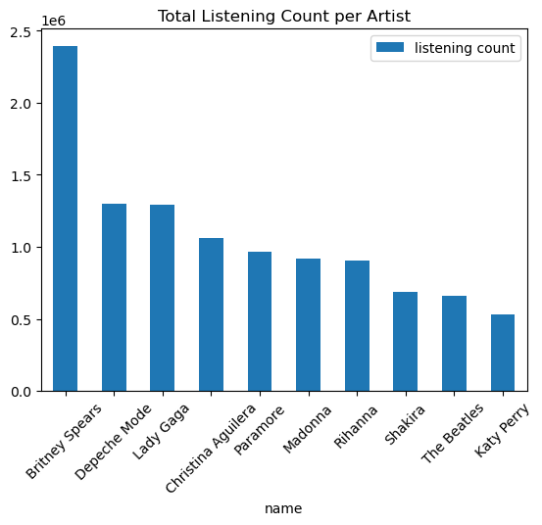
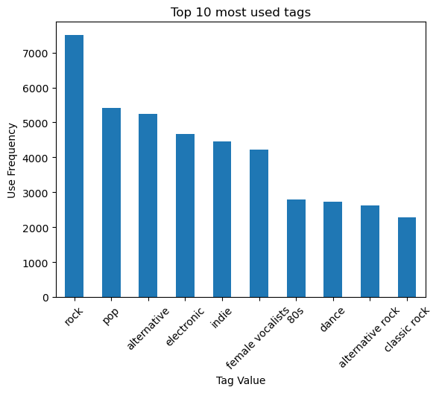
It is clear that there are a few artists with much higher following than the rest; similarly, some tags (mainly genre-related) are used much more than others.
Q1 – Frequency Plots
These observations were further studied in order to extract insights on the activity level of the various cohorts (with regards to the various music genres) of last.fm’s user base, as well as its homogeneity as a whole.

Slide 4
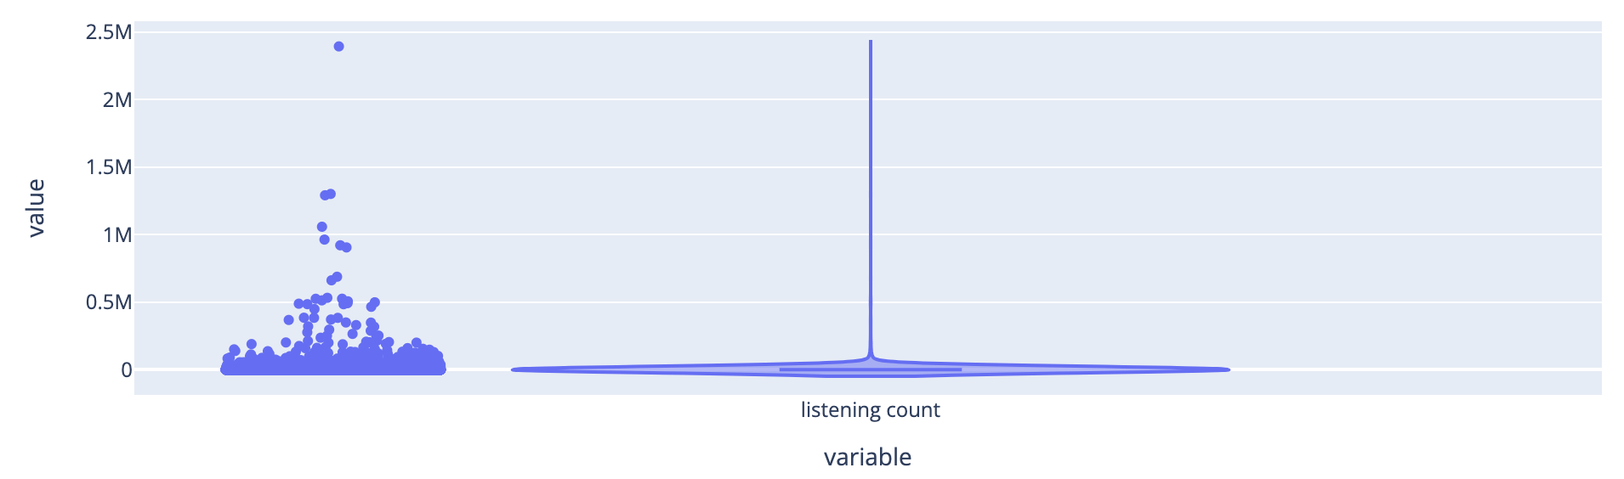
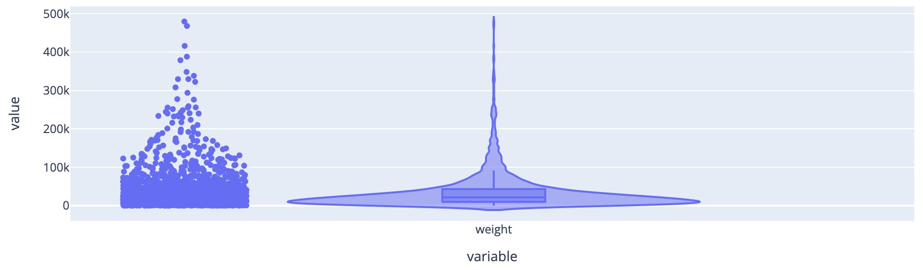

Q1 – Outlier Detection using the Z-Score Method
Formula: $Z=\frac{Χ−μ}{σ}$, where X: a value of the random variable, μ: the (true-population) mean, and σ: the standard deviation of the variable’s distribution
Z-Score Threshold we considered: 3
Total Listening Count of Artists: 0.48% of relevant data points were classified as outliers.
Total Listening Time for Users: 2.27% of data points classified as outlier values

Slide 5
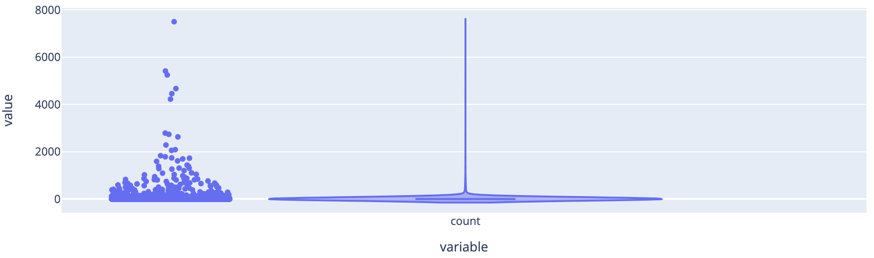
Q1 – Outlier Detection using the Z-Score Method
Total Frequency of Tags Usage: 0.57% of values
It is cleared from the provided violin plots that the distributions of the underlying random variables heavily departed from the normality assumption of the Z-Score method, and significant (positive) asymmetry was observed in each case.
As an alternative method we used the IQR method; it assumes symmetry from which our data depart, but its less strict hypotheses make it more efficient in outlier detection in our case.

Slide 6
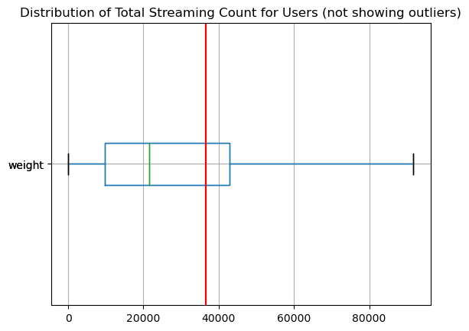
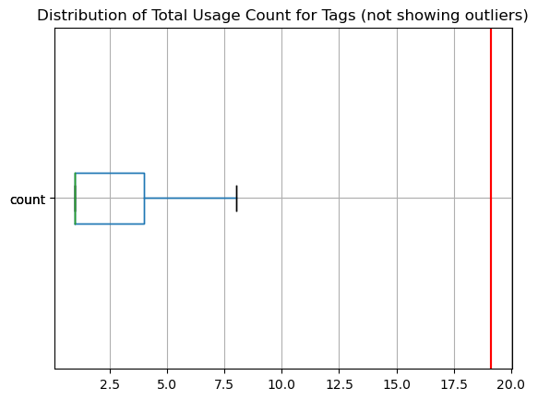
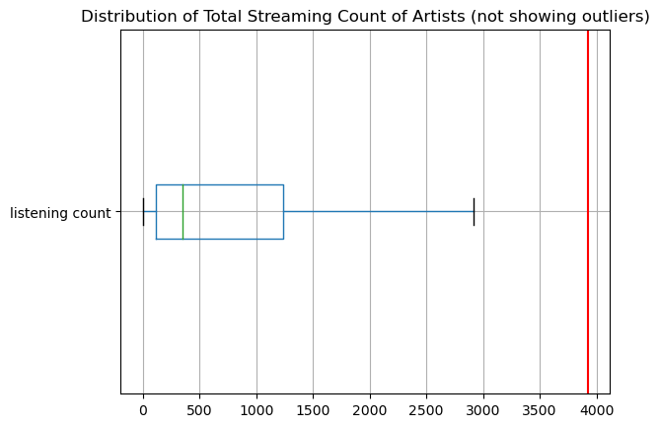
Q1 – Outlier Detection using the Z-Score Method
Indeed, even though this method is as well invalid in this case, it does prove more efficient in outlier detection:
Tag usage: 13.33%
Listening count: 14.14%
Listening time: 8.51%

Slide 7
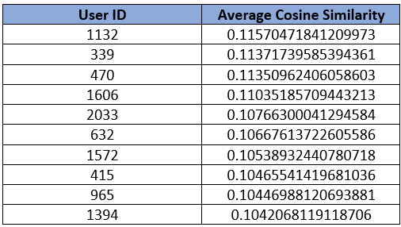
Q2 - Similar Users Cosine Similarity
Process Followed
We create a pivot table from the 'user_artists.dat' data.
In the above interaction matrix rows represent users, columns represent artists, and values correspond to the 'weight' of interactions. Missing values are filled with zeros.
An “algebraic” approach using dot product and np.linalg.norm
The second method utilized the cosine_similarity() function offered by python and sklear library.
This approach, beyond a more complete solution offers a manner to validate our results by comparing the resulted csv file derived from both methods discussed above

Slide 8
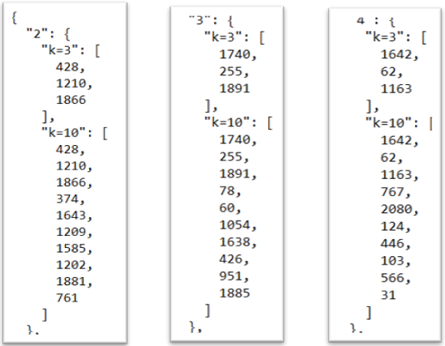
Q2- Similar Users K-Neighbors
To gain a deeper understanding of user communities, we extend our analysis by performing k-means clustering.
This technique groups users into clusters based on their similarity. For both k=3 and k=10, we identify clusters that encapsulate users with similar artist preferences.
For each user, the k-nearest neighbors are determined based on the cosine similarity calculated in the previous step
A dictionary, 'neighbors_dict,' is created to store neighbors for each user for k=3 and k=10.
k-nearest neighbors for both k=3 and k=10 is stored in the above JSON file

Slide 9
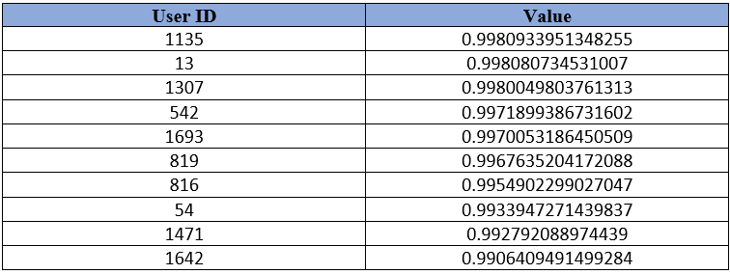
Q2 – Additional Observations
We calculate the average similarity for each user with their k=3 , k=10 neighbors as well as all users focusing on the top ten users.
Average similarity for each user with their k-neighbors for k=3

Slide 10
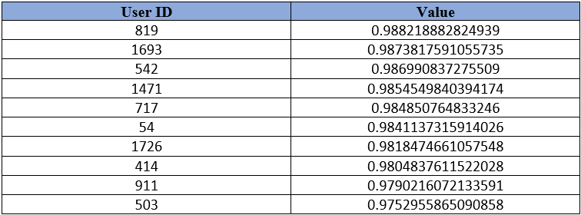
Q2 – Additional Observations
Average similarity for each user with their k-neighbors for k=10

Slide 11
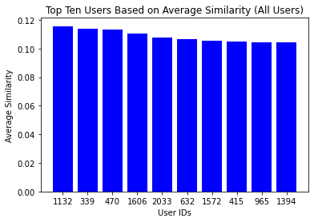
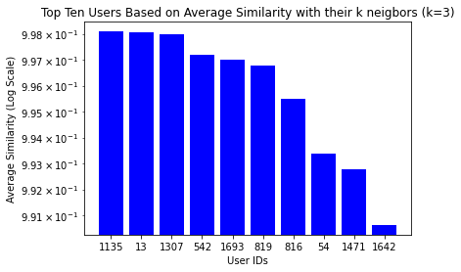
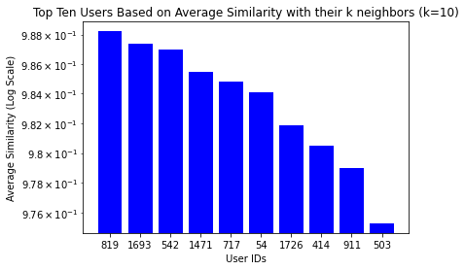
Q2-Additional Observations
Bar plots indicating the average similarity between k-neighbors for k=3 and k=10 as well the average similarity between all user, for the top ten users in each category.

Slide 12
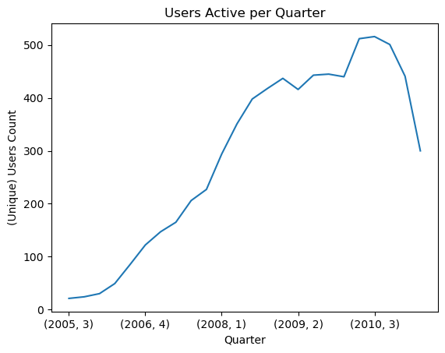
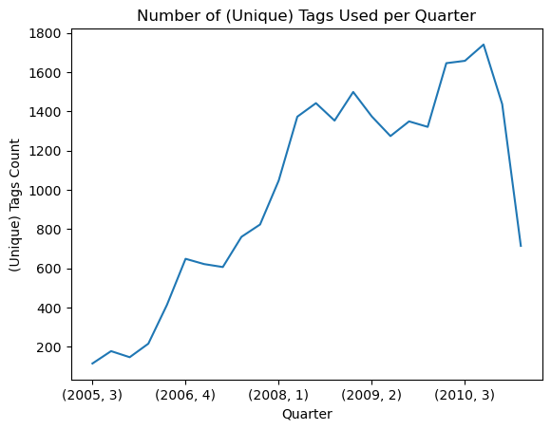
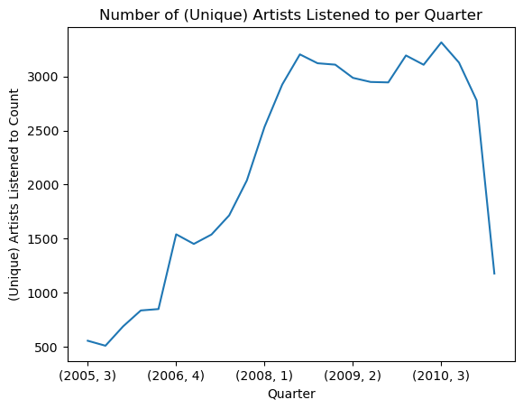
Q3 – Displaying the Activity per Interval
Interval chosen: quarter (24 in total)
To showcase possible seasonal effects in data points.
After processing the given timestamps (in the “user_taggedartists-timestamps.dat” file) in order to extract the year and quarter each observation falls into (and dropping rows containing measurement errors), we got the following results displayed here
Soaring activity up to the third quarter of 2010, followed by a big drop after some changes implemented by the administration of the platform, we met by a significant part of its user base with significant content.

Slide 13
Q3 – Detecting the most Active Items per Interval
We found the 5 most popular artists (based on the tagging activity of users on them) and the 5 most used tags in each quarter.
There could be cases of quarters in which less than 5 artists where assigned tags, or that less than 5 tags were applied; we checked for these cases and found zero.
The resulting dataframes look as displayed here.
quarter | artist_id | freq
(2005, 3) | 11892 | 13
(2005, 3) | 599 | 11
(2005, 3) | 227 | 8
(2005, 3) | 707 | 7
(2005, 3) | 59 | 7
Something interested we decided to further analyze was the frequency in which those popular artists and tags (included in the previous corrresponding dataframes) were at the top of quarterly rankings.
quarter | tag_id | freq
(2005, 3) | 2191 | 47
(2005, 3) | 17 | 46
(2005, 3) | 370 | 45
(2005, 3) | 1 | 41
(2005, 3) | 3496 | 36

Slide 14
Q3 – Detecting the most Active Items per Interval
We found that some tags dominated in the rankings more than others, whereas we found no clearly dominating artists.
Rock-related tags dominates in 22 out of the 24 intervals (i.e. 87.5% of them) under study.
There is no unique artist dominating in the quarterly rankings, and those that appeared on the top of them the most are mixed among the musical genres; 2 of them are pop musicians (Christina Aguilera, Britney Spears) and the other 2 (Depeche Mode, Blood Ruby) venture mainly in the rock genre.
This tells us that, even though pop artists have extremely loyal fans that stream their songs much more than fans of other music genres (as Figure 1: Total Listening Count per Artist shows us), the rock fans user cohort of last.
tagID | count | tagValue
73 | 21 | rock
2191 | 1 | college rock
79 | 1 | alternative
24 | 1 | pop
artistID | count | name
292 | 3 | Christina Aguilera
11892 | 2 | Blood Ruby
289 | 2 | Britney Spears
72 | 2 | Depeche Mode
972 | 1 | t.A.T.u.

Slide 15
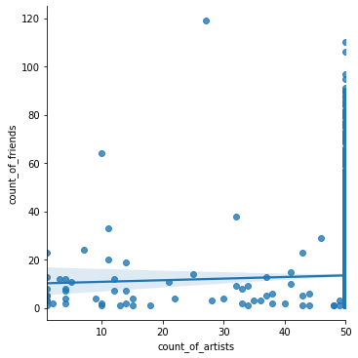
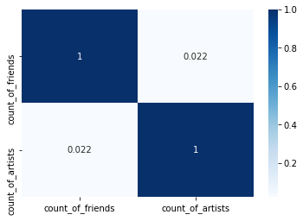
Q4- Comparing prolific user
Correlation between the number of artists a user listens to and the number of friends
Correlation between a user's total listening time and the number of friends
Correlation Between Artists & Friends
correlation coefficient: 0.0224
This is indicating a weak positive correlation.
This suggests limited evidence supporting a direct relationship between the number of friends a user possesses and the number of artists they listen to.

Slide 16
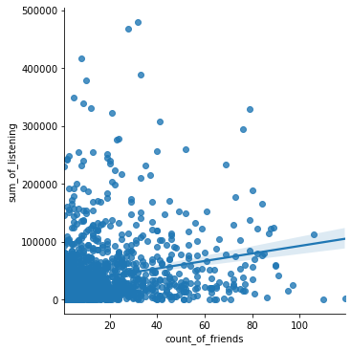
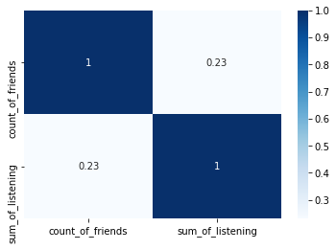
Q4- Comparing prolific user
Correlation Between Listening Time & Friends
correlation coefficient: 0.2306
moderate positive correlation.
This suggests that users with more friends tend to have a higher total listening time, potentially influenced by shared music interests or recommendations.

Slide 17
Thank you!
Q&A
GitHub repository:
https://github.com/stavrogiannisACG/ITC6001-Final-Project/tree/main

