Slide 1
Lecture Summary
Introduction
Agenda
Notes

Slide 2
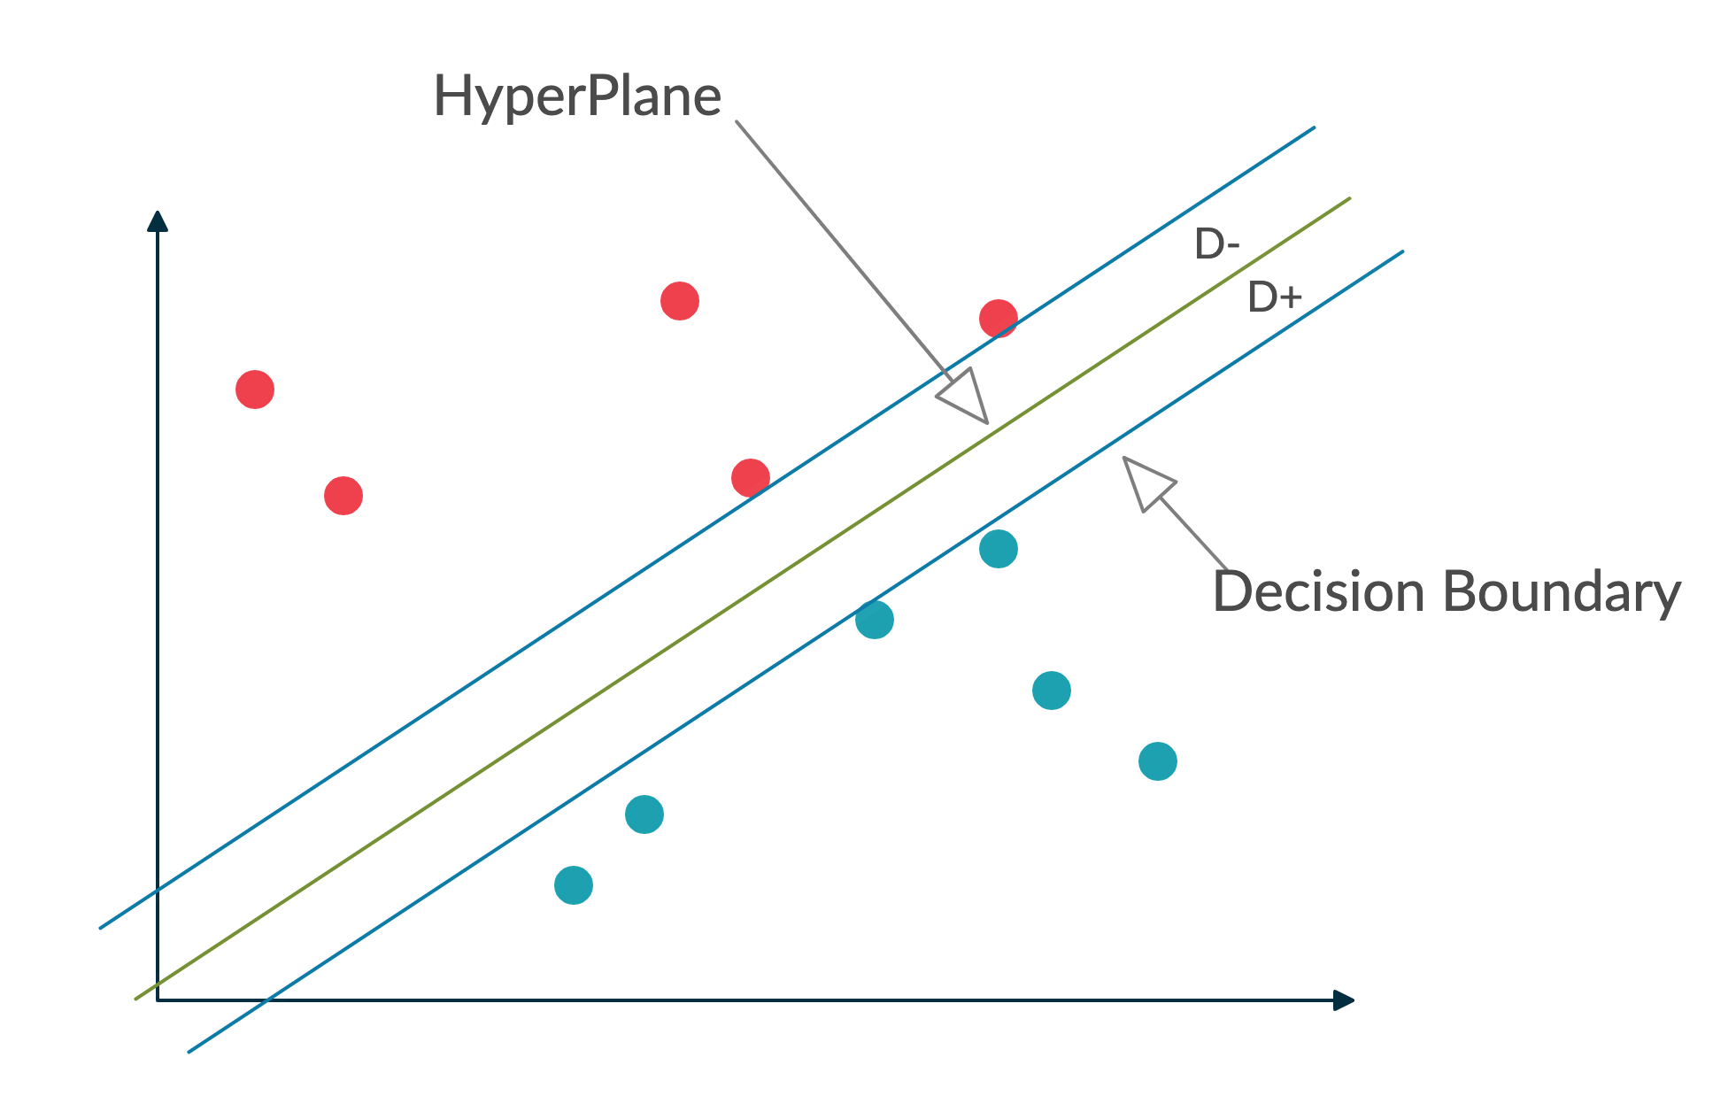
SVM Classifier
HyperPlane
Decision Boundaries
Positive and negative distance
Margin
Support Vectors

Slide 3
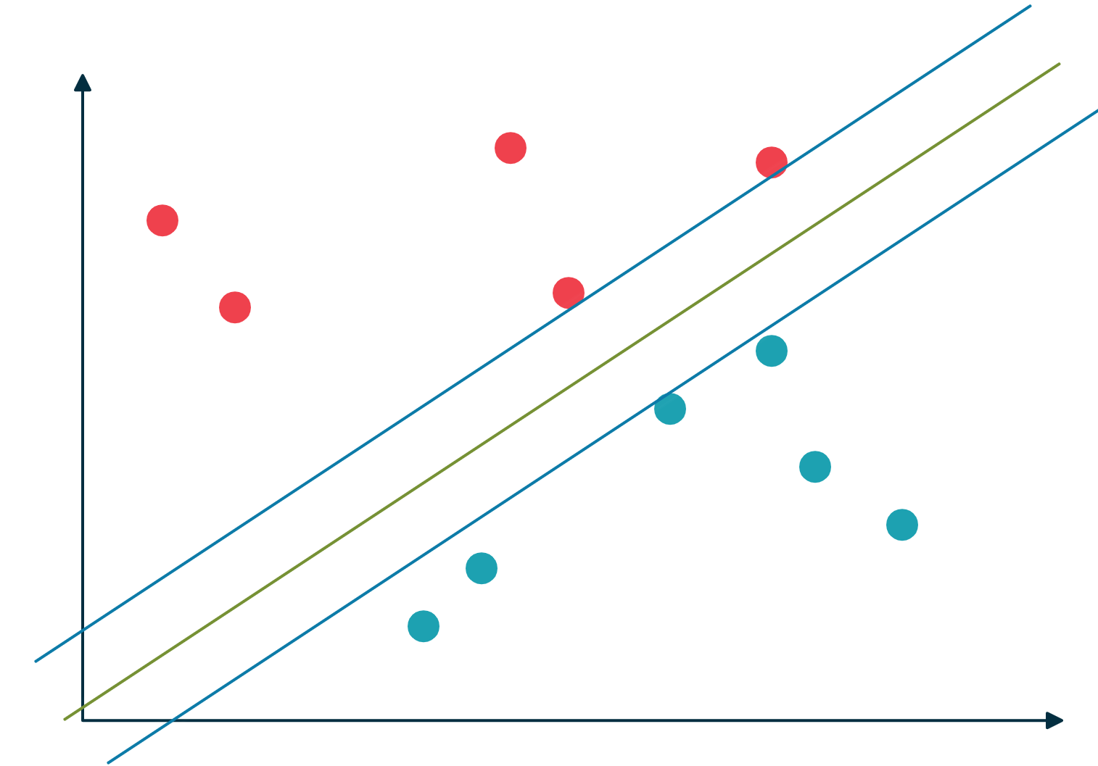
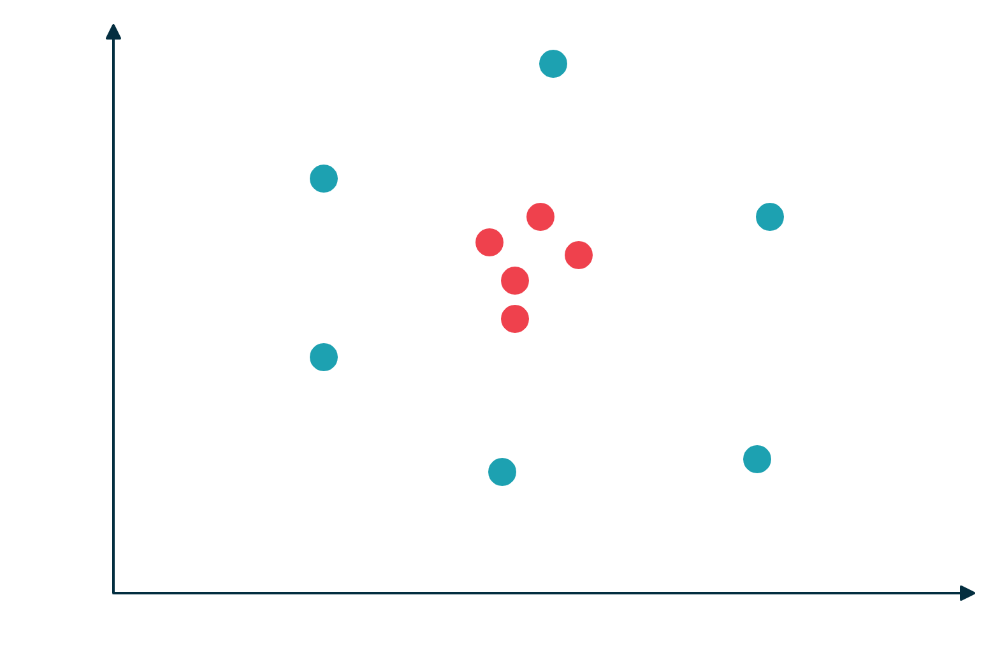
Linear SVM
Non Linear SVM

Slide 4
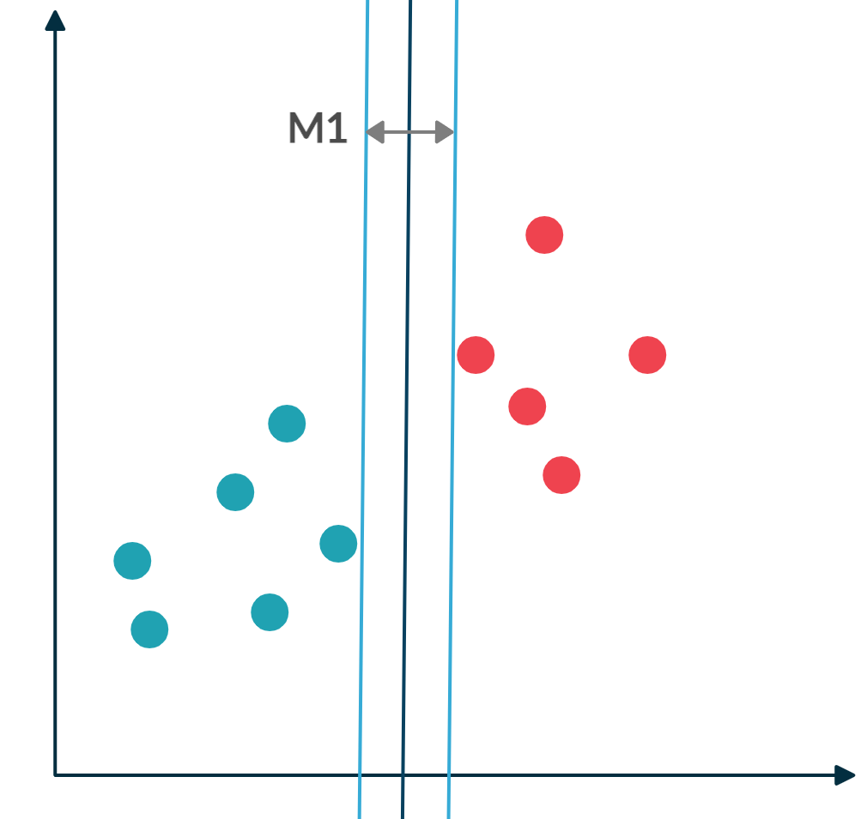
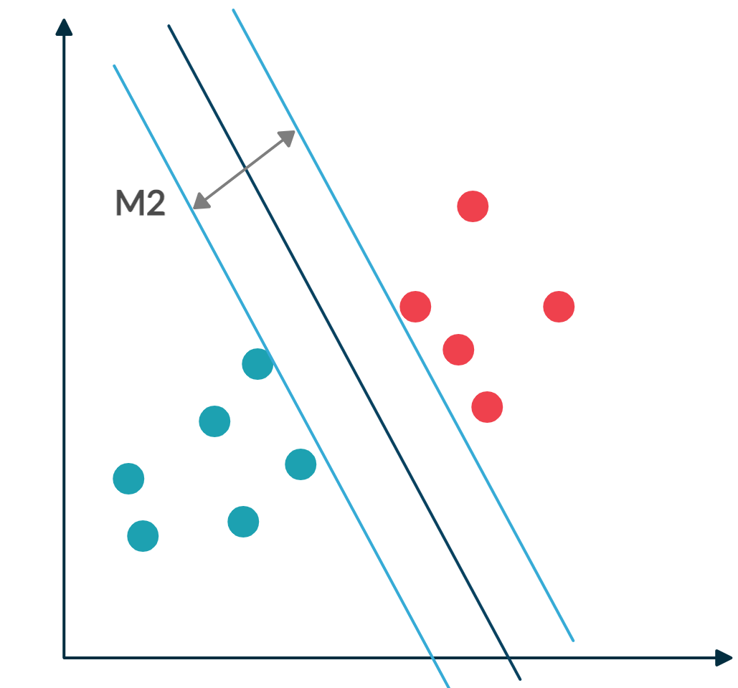
Maximal Margin Hyperplane

Slide 5
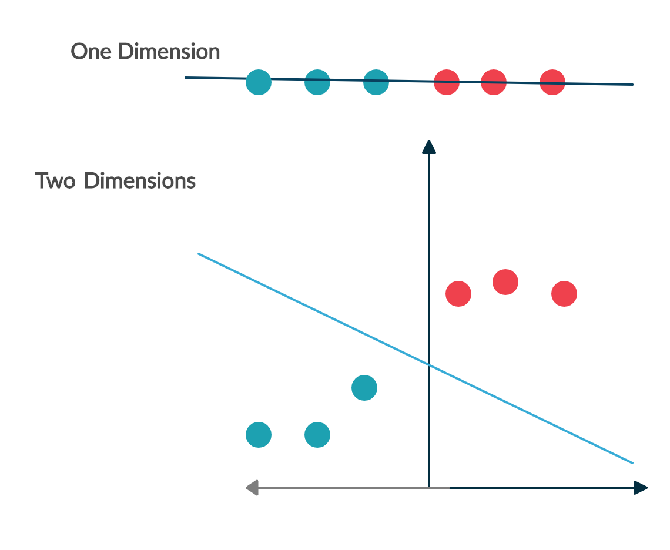
Non Linear SVM
Kernel Function
Lower
Dimension
Kernel Function
Higher
Dimension

Slide 6
