Slide 1
Agenda
Curse of Dimensionality
Overfitting
Dimensionality reduction
PCA
Notes

Slide 2
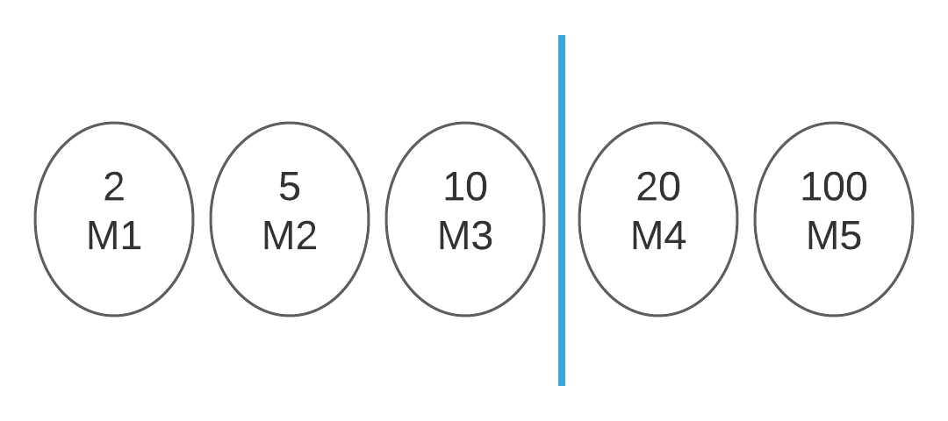

Slide 3
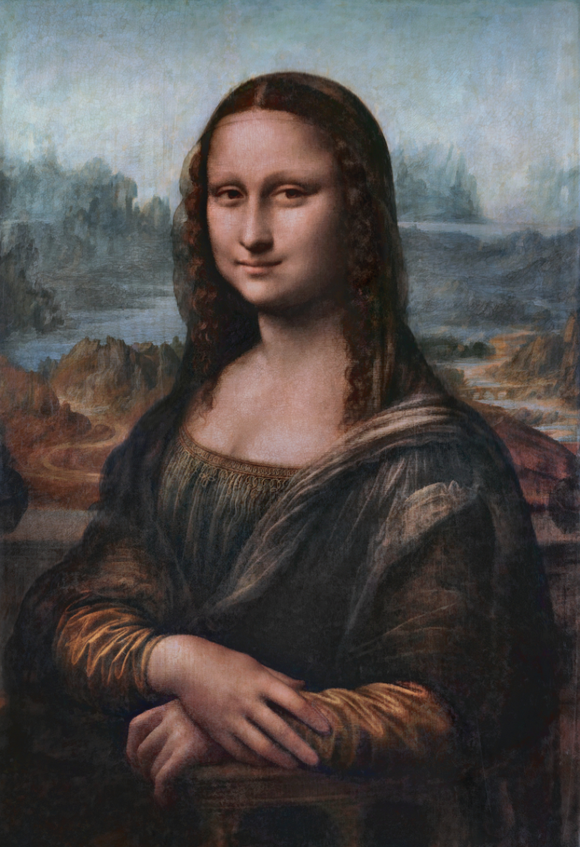

Slide 4
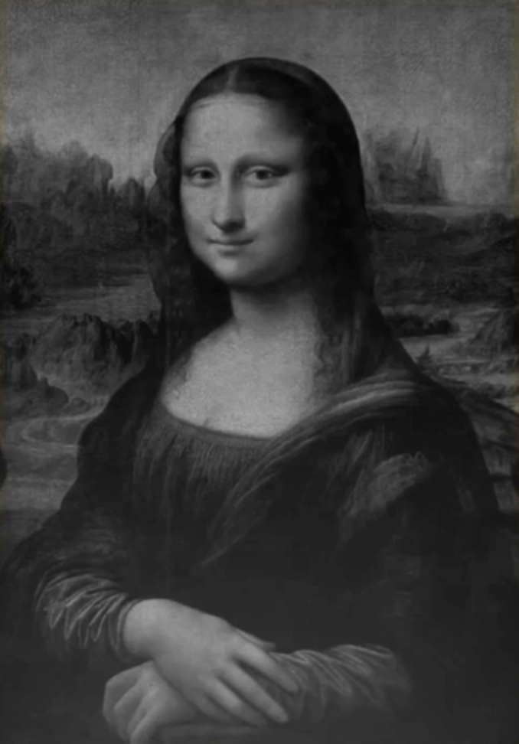

Slide 5
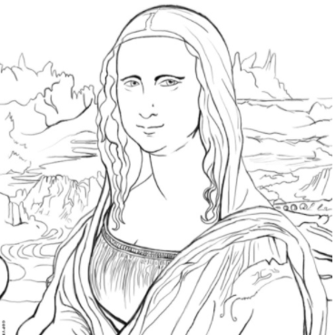
Source: Discovering Davinci

Slide 6
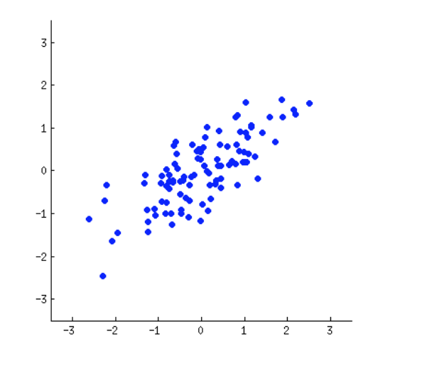

Slide 10
References
Stack Exchange:
https://stats.stackexchange.com/questions/2691/making-sense-of-principal-component-analysis-eigenvectors-eigenvalues
PCA by Code heroku

