Slide 1
COMPANY BANKRUPTCY PREDICTION USING MACHINE LEARNING
Guide : Sri. P. Praveen Yadav
Assistant Professor, CSE Department.
Team Members :
199X1A0543 ->C. Madhu
199X1A0535->A. Pramod
199X1A0556->K. Shiva Kumar

Slide 2
ABSTRACT
Bankruptcy?
Bankruptcy is legal proceeding initiated when a person or business is unable to repay outstanding debts or obligations.
Bankruptcy prediction is always a topical issue. The activities of all business entities are directly or indirectly affected by various external and internal factors that may influence a company in solvency and lead to bankruptcy.
The main aim of this project is to develop a prediction model to decide whether a company will bankrupt or not in the following year.

Slide 3
INTRODUCTION
Bankruptcy occur when debts which are not paid to creditors in full are forgiven for the owners.
If we file for bankruptcy, it may be tough for us to get a new loan if we plan to start afresh.
So, it’s better to check the current status of the company and by using the current technologies the company will know that whether I will survive or not in following years based on the current economic conditions.
By knowing this will enable the company to take precautionary measures.

Slide 4
LITERATURE SURVEY
The data were collected from the Taiwan Economic Journal for the years 1999 to 2009. Company bankruptcy was defined based on the business regulations of the Taiwan Stock Exchange.
EI Altman, The Journal of Finance
Z = 1.2*X1 + 1.4*X2 + 3.3*X3 + 0.6*X4 + 1*X5
In this project, we need to get lot of information (parameters) about the company from the client.

Slide 5
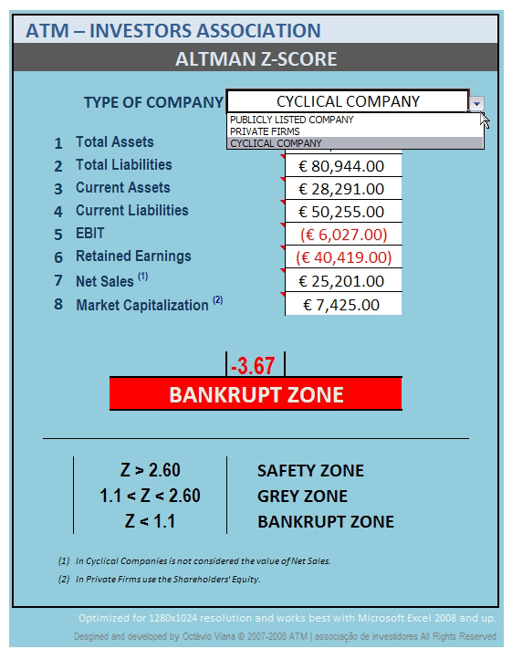

Slide 6
EXISTING AND PROPOSED SYSTEMS
EI Altman – Z-Score formula
Zikeba et al. (2016) - Boosted Decision Tree
Quynh and Thi Lan Phuong (2020) – Fair Voting, Random Forest Algorithm
Ren (2020) – Financial indicators
Gradient Boosting

Slide 7
Software And Hardware Requirements
Google Colab
Jupyter Notebook
Python
Intel i5
4GB RAM
Windows10

Slide 8
DATASET USED
Dataset was obtained from Kaggle’s Dataset.
Attributes of the dataset are:
Operating profit rate
Cash flow rate
Assets
Liabilities
Expenses
Total income
Gross profit sales
Total asset turnover

Slide 9
CLASSIFICATION ALGORITHMS
Decision Tree
Decision Tree is a flowchart –like structure in which each internal node represents a test on feature and leaf nodes represents a class labels
Gradient Boosting
Gradient Boosting is a popular boosting algorithm. In gradient boosting, each predictor corrects its predecessor’s error.

Slide 10
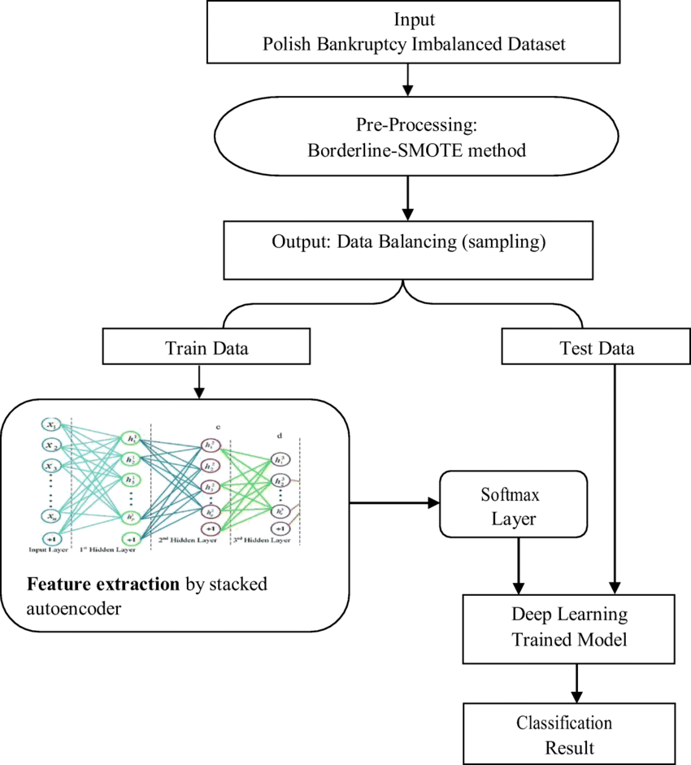
Flow Chart
Data Splitting

Slide 11
IMPLEMENTATION
Importing Libraries and Dataset
Importing the dataset
Import all necessary python modules and libraries such as sklearn, pandas, numpy and ensemble
Data Analysis
In this we check the null values in the dataset if there is any null value present in the dataset then data cleaning is performed.
Checking info of the dataset to know the dimensions of the dataset.
Dropping unnecessary features in the dataset.

Slide 12
Data Preprocessing
In this stage we perform data preprocessing and feature scaling on the dataset.
Training a Models
Here, we train Decision tree and Gradient Boosting Algorithms and compare their model accuracy performance.
Principle Component Analysis (PCA)
PCA, it is popular unsupervised learning technique for reducing the dimensionality of the data.

Slide 13
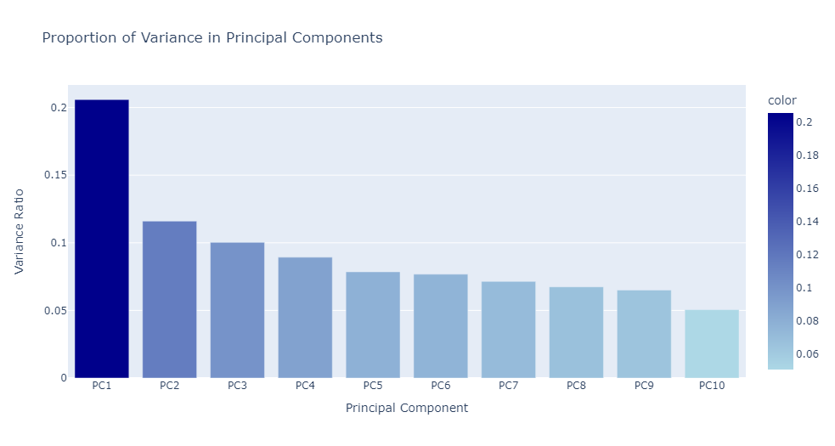
DATA VISUALIZATION
Here, we take n=10 components, plotting the graph based on components explained variance ratio.

Slide 14
RESULTS
MODELING AND EVALUATION
Before applying PCA, the models accuracy scores are
Decision Tree = 95.16%
Gradient Boosting = 96.19%
After applying PCA, the models accuracy scores are
Decision tree = 95.01%
Gradient Boosting = 96.24%

Slide 15
CONCLUSION
For given financial client information and parameters we consider that will help whether the given client will go bankrupt or not.
So based on the model accuracy score we conclude that our model will give better result.
Bankruptcy is important to find a suitable tool to assess the future development of any company in the market.

Slide 16
REFERENCES
Edward I. Altman. 1968. Financial ratios, discriminant analysis and the prediction of corporate bankruptcy.
https://en.m.wikipedia.org/wiki/Altman_Z-score#
Given financial client data, let's try to predict whether a given client will go bankrupt or not.
https://www.kaggle.com/code/gcdatkin/bankruptcy-prediction/notebook

Slide 17
THANK YOU

