Slide 1
DESKTOP VIRTUAL ASSISTANT
Guide : K. V .Rameswara Reddy
Team Members :
199X1A0543 →C. Madhu
199X1A0535 →A. Pramod
199X1A0560 →K. V . Chandan Kumar

Slide 2
ABSTRACT
A desktop virtual assistant, is an application program that understands natural language voice commands and completes tasks for the user.
It can act as a basic daily schedule reminder, note writer, and a search tool.
This project works on voice input and give output through voice and displays the text on the screen.
The main agenda of our voice assistance makes people smart and give instant and computed results

Slide 3
LITERATURE SURVEY
Freecodecamp.org
Indiantts.com
www.computerworld.com
www.pocket-lint.com
Codewithharry
https://pypi.org/

Slide 4
EXSTING AND PROPOSED SYSTEMS
Google Assistance
Microsoft Cortana
Samsung Bixby
Amazon Alexa
Apple Siri

Slide 5
Software And Hardware Requirements
VS CODE
GOOGLE COLAB
PYTHON
INTEL i5 OR AMD RYZEN
4 GB RAM
Windows 10

Slide 6
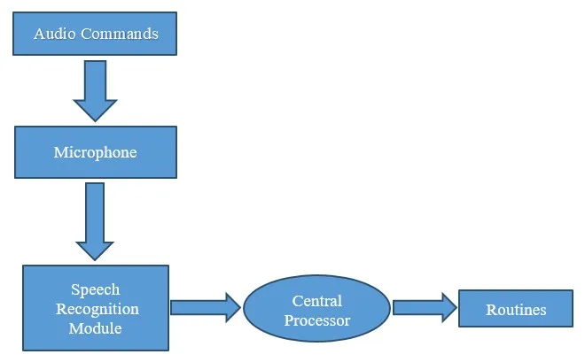
HOW IT WORKS ?

Slide 7
METHODS AND TECHNIQUES USED
speak() used to speak
Install pyttsx3 for text-to-speech library
pypiwin32 wheel
Main Function
Wishme()
Datetime()
speechRecognition

Slide 8
Wikipedia
To search something on wikipedia
Webbrowser
To search something on browser
To open Youtube
To open Google
To open Stack Overflow
OS
To interact with operating system
os.startfile

Slide 9
To open the VS Code program
Codepath
To know the current date & time
Datetime()
To send Email
Smtplib it allows us to send emails and route mails between mail servers
Sendmail present in SMTP module
Sender

Slide 10
Receiver
Message
*enable the less secure apps in Gmail Account
To play music
What is SAPI5 ?
Microsoft developed speech API
Helps in synthesis and recognition of voice
What is voiceId
Voice[0].id = Male voice
Voice[1].id = Female voice

Slide 11
To open Notepad
To open cmd
To open camera…sp.
JSON (Javascript Object Notation)
To search something on youtube
Pywhatkit, playonyt
To search something on google
To send whatsapp message
To get the random joke

Slide 12
To give an random advice
To know the News headlines, News API
To know the trending movies, Tmdb API
To know the current weather
To restart computer, os
To shutdown computer, os
To take screenshot, PyAutoGui
To open the facebook, instagram
To know the current location

Slide 13
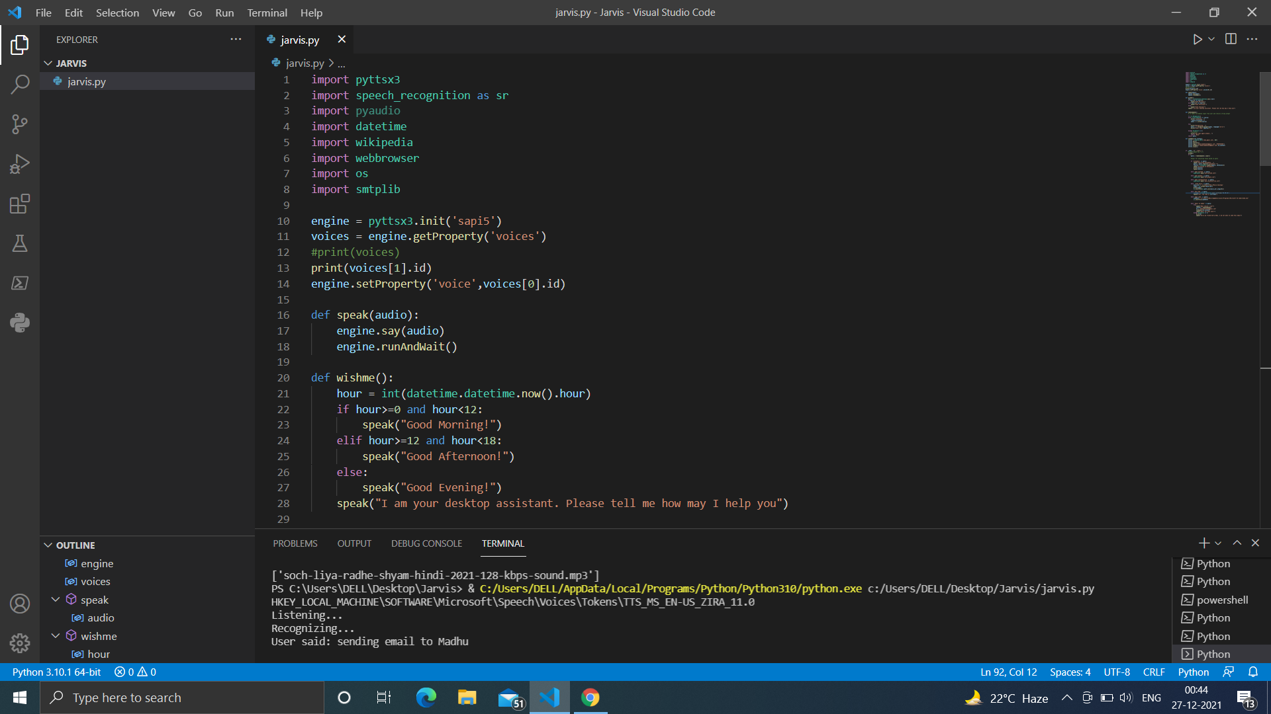


Slide 14
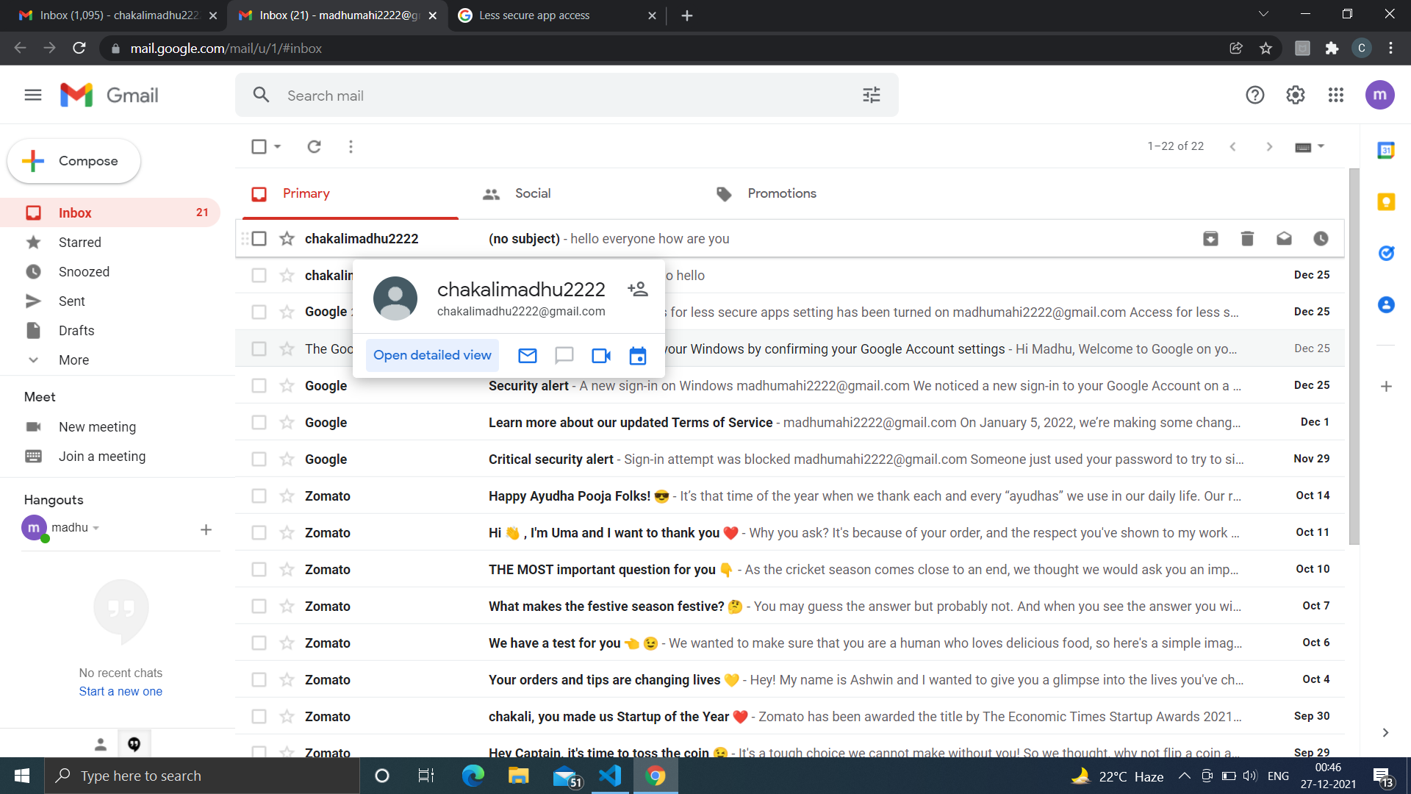

Slide 15
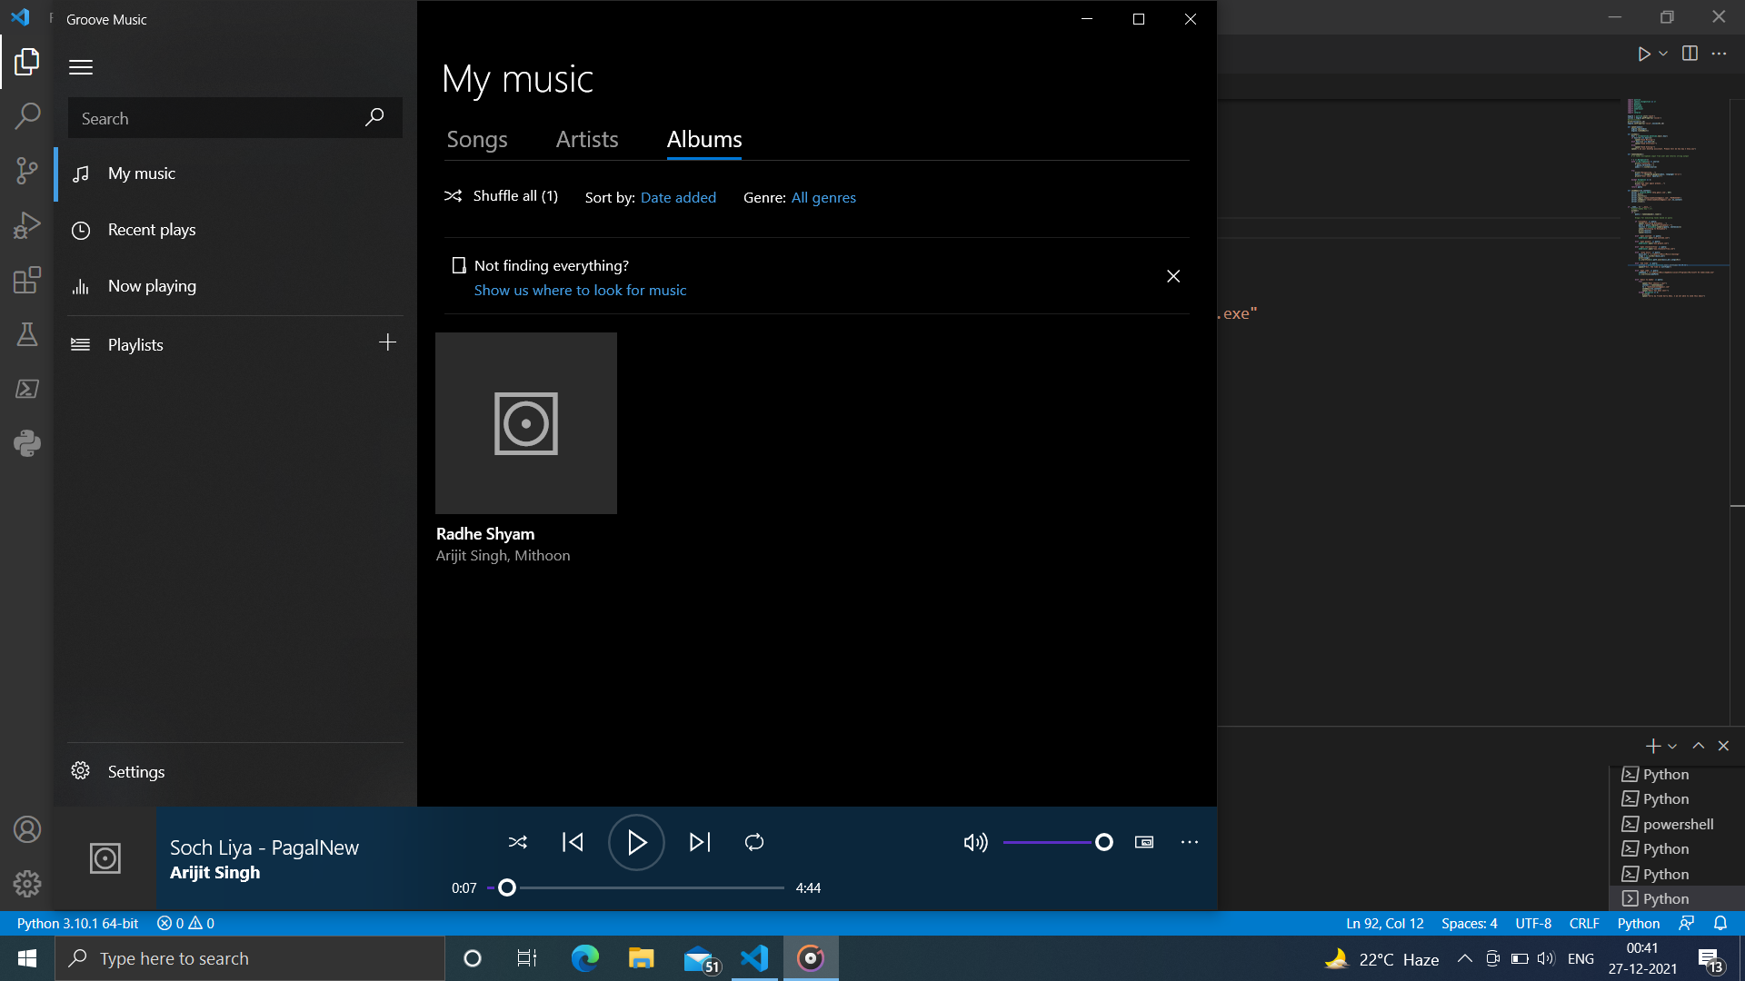

Slide 16
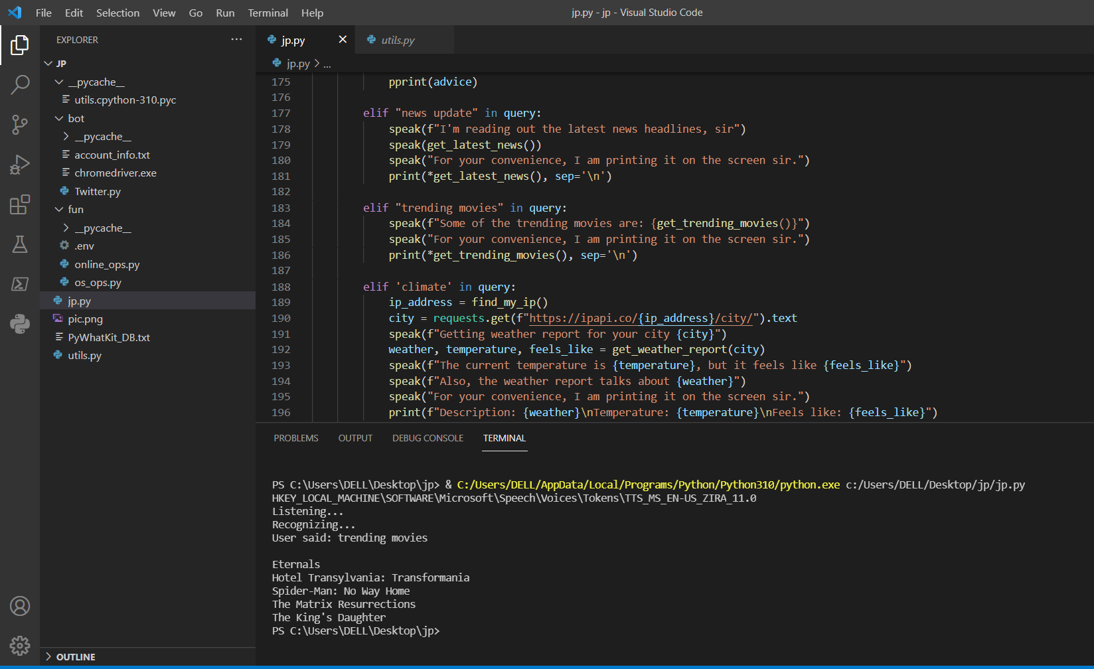

Slide 17
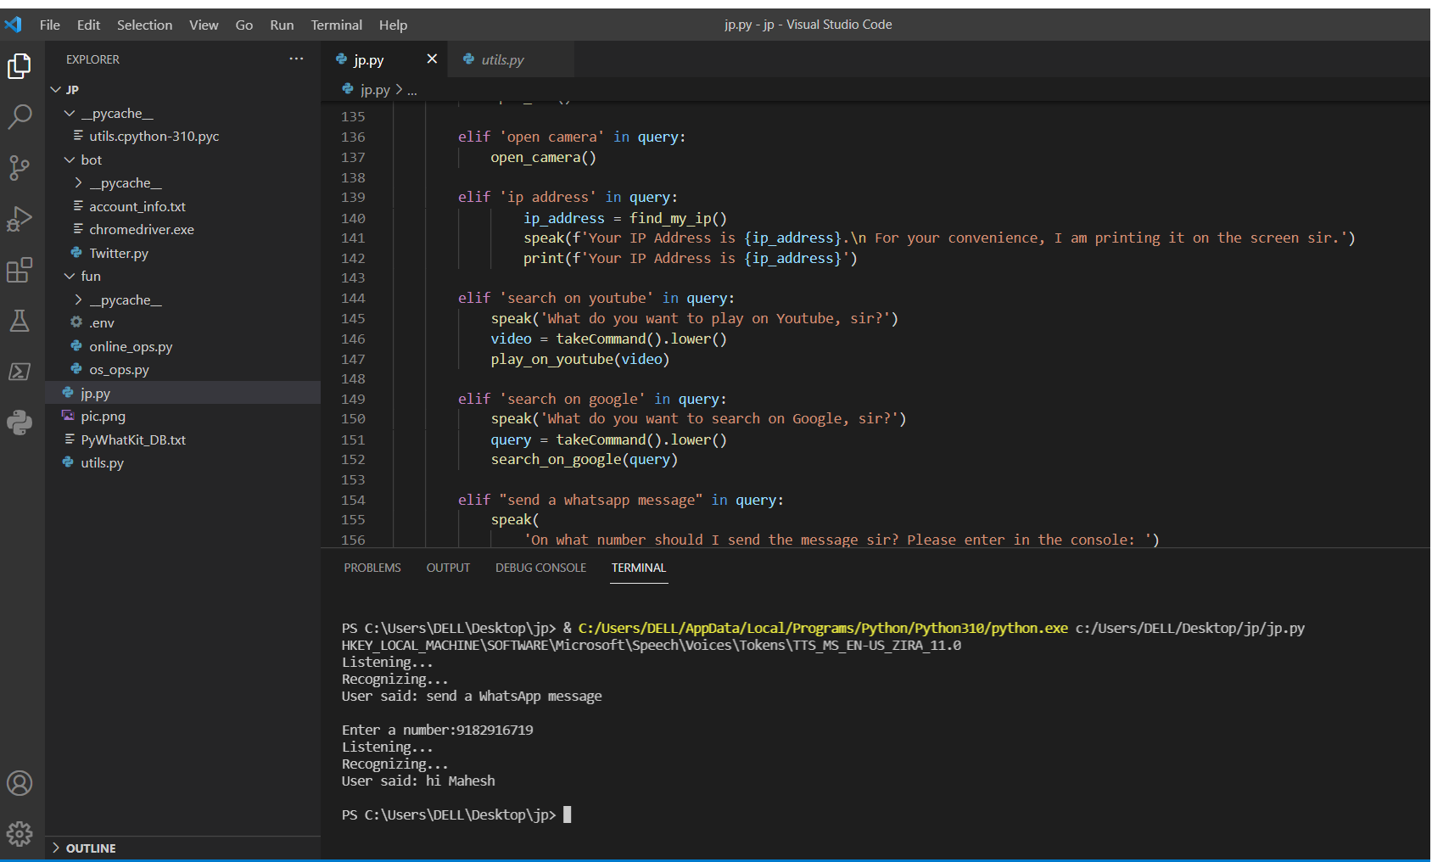

Slide 18
THANK YOU

