Slide 1
AI FOR OUR FATE

Slide 2
What is intelligence?

Slide 3
What is AI?
Definition
AI vs Machine Learning
Models
Myths

Slide 4
In Space:

Slide 5
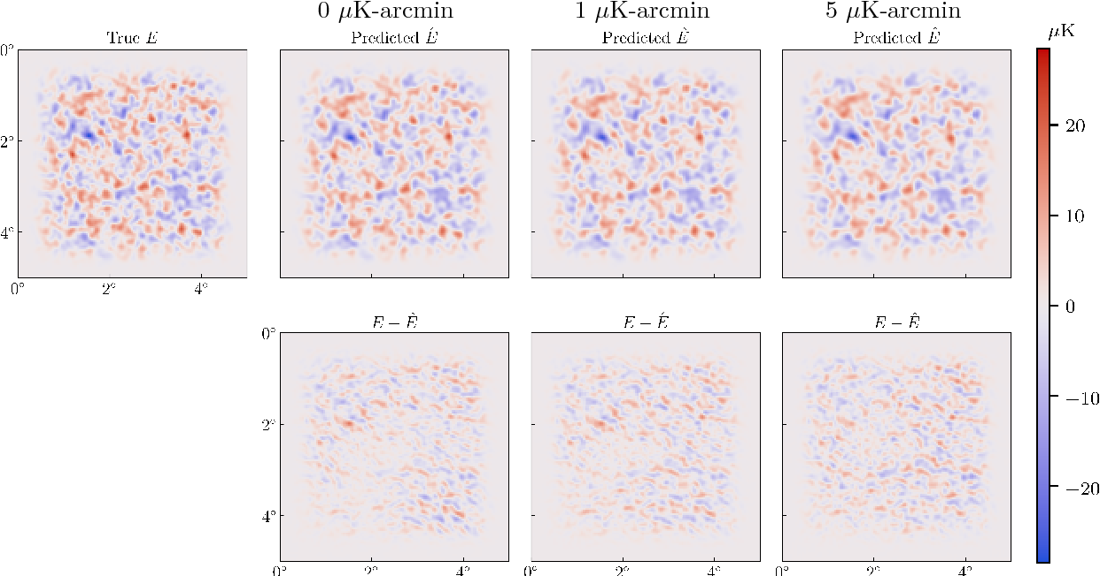
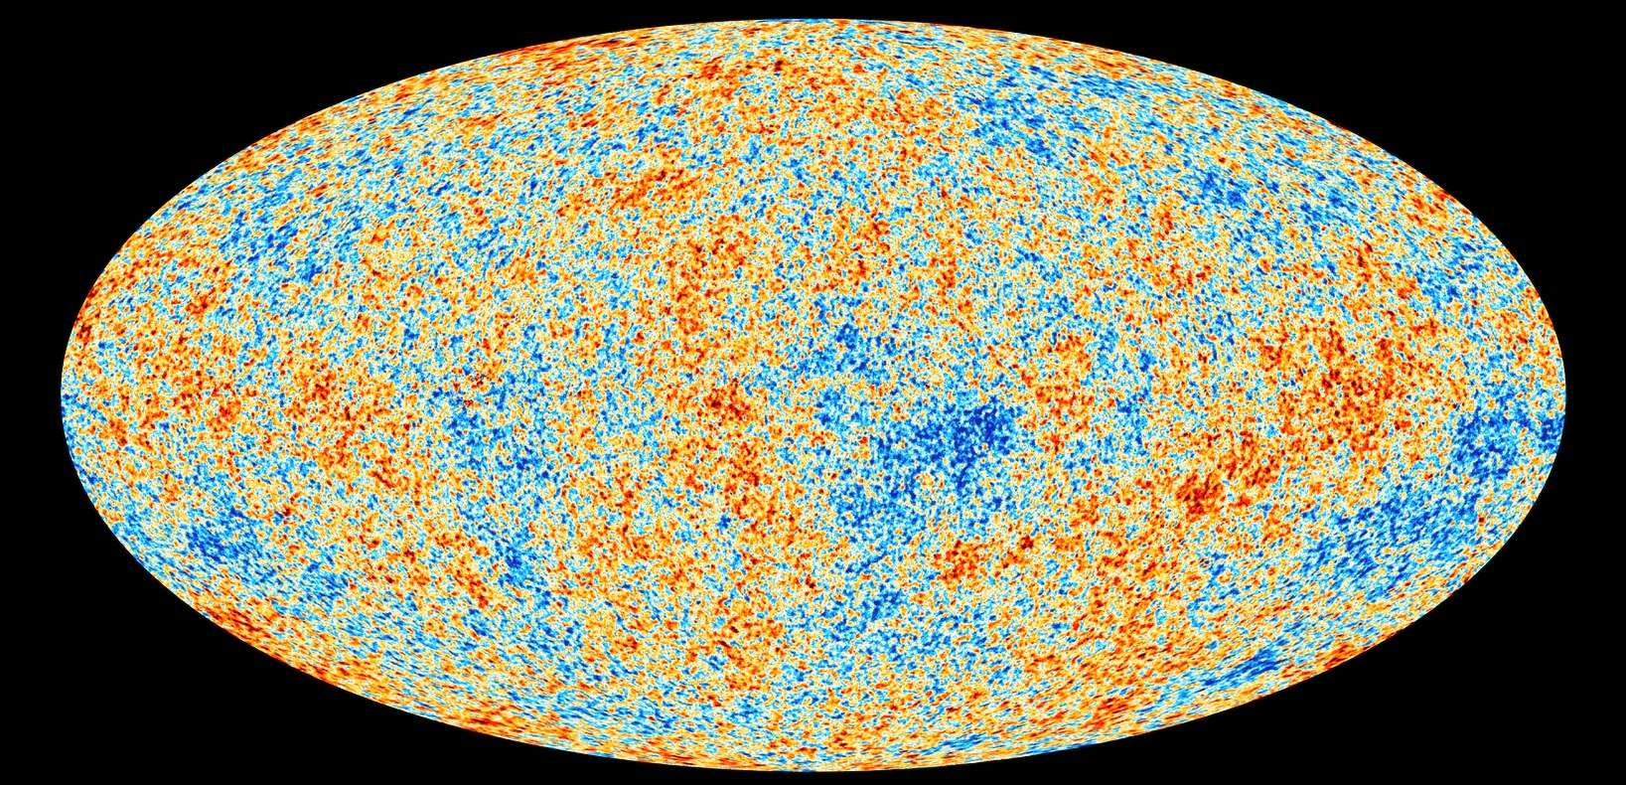
DeepCMB, cleaning the cosmic microwave background

Slide 6
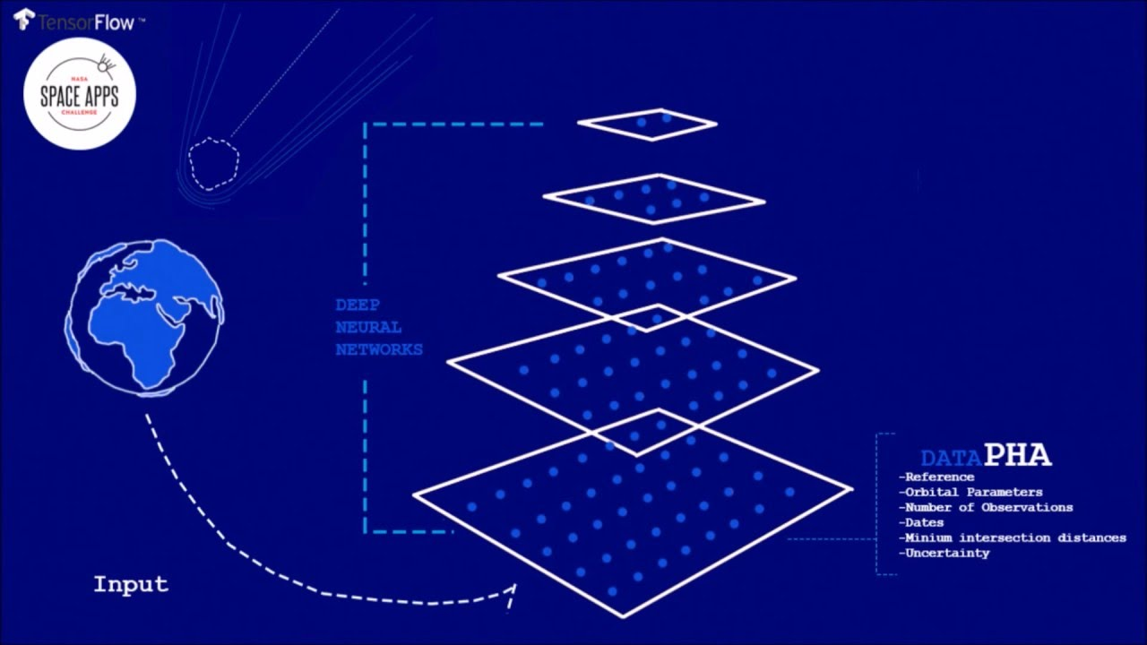
Deep Asteroid Software Model

Slide 7
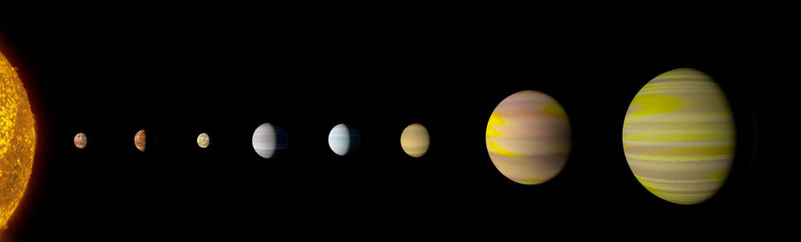
a Sun-like star, and it’s 8 exoplanets, 2,545 light years from Earth.

Slide 8
For the planet:

Slide 9
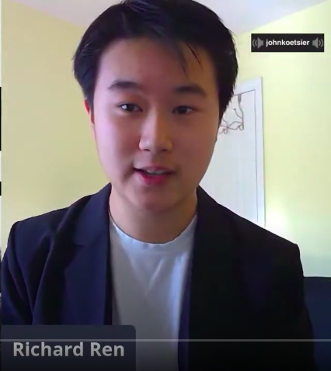
Richard Ran,
High school student

Slide 10
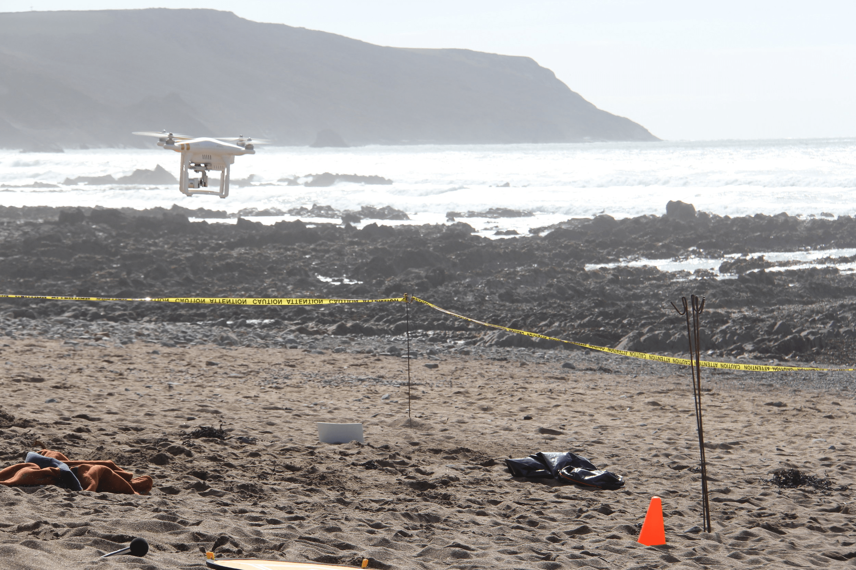
Plastic Tide project

Slide 11
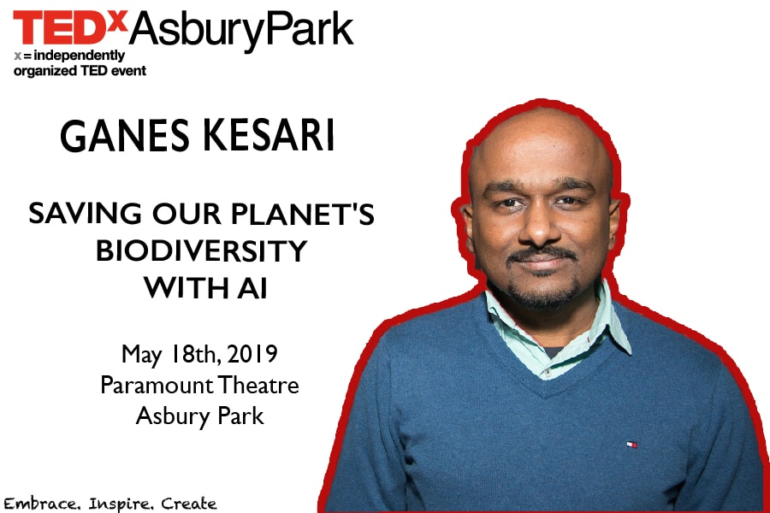
Ganes Kesari

Slide 12
For humanity:

Slide 13



Add and social media...

Slide 14
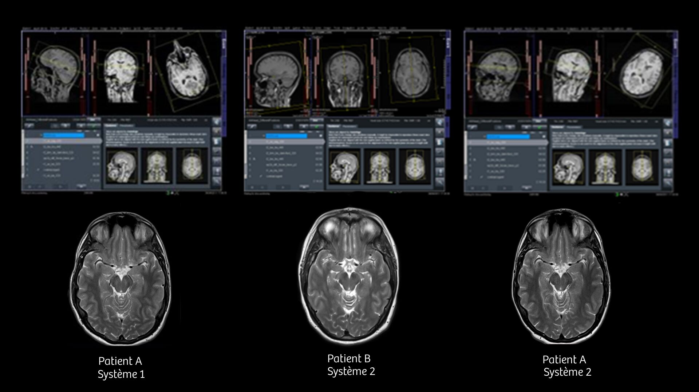
Medical imagery

Slide 15

Babylon health

Slide 16
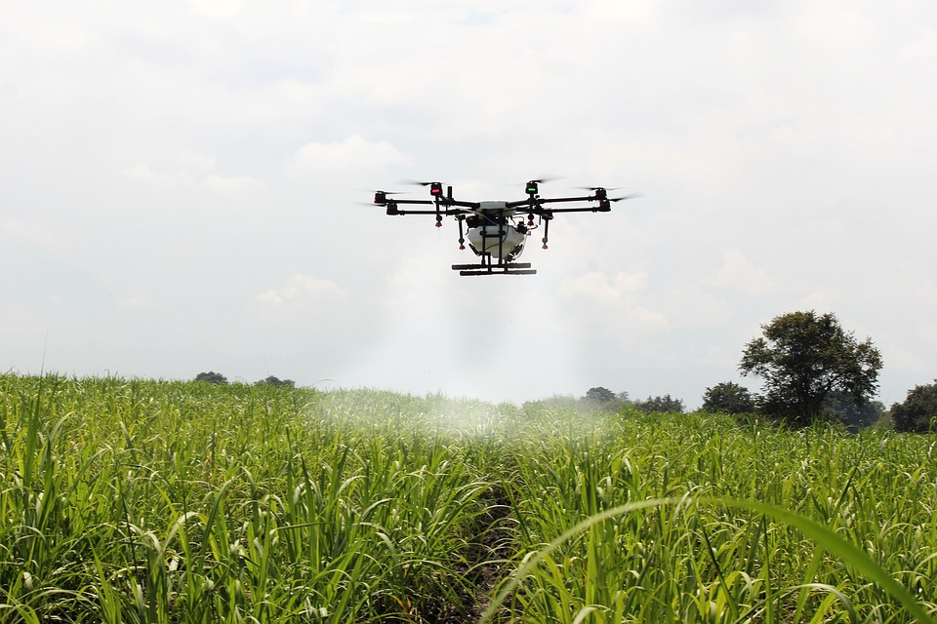
FARM VIEW PROJECT

Slide 17
Last words...

Slide 18
Thank you.

