Slide 1

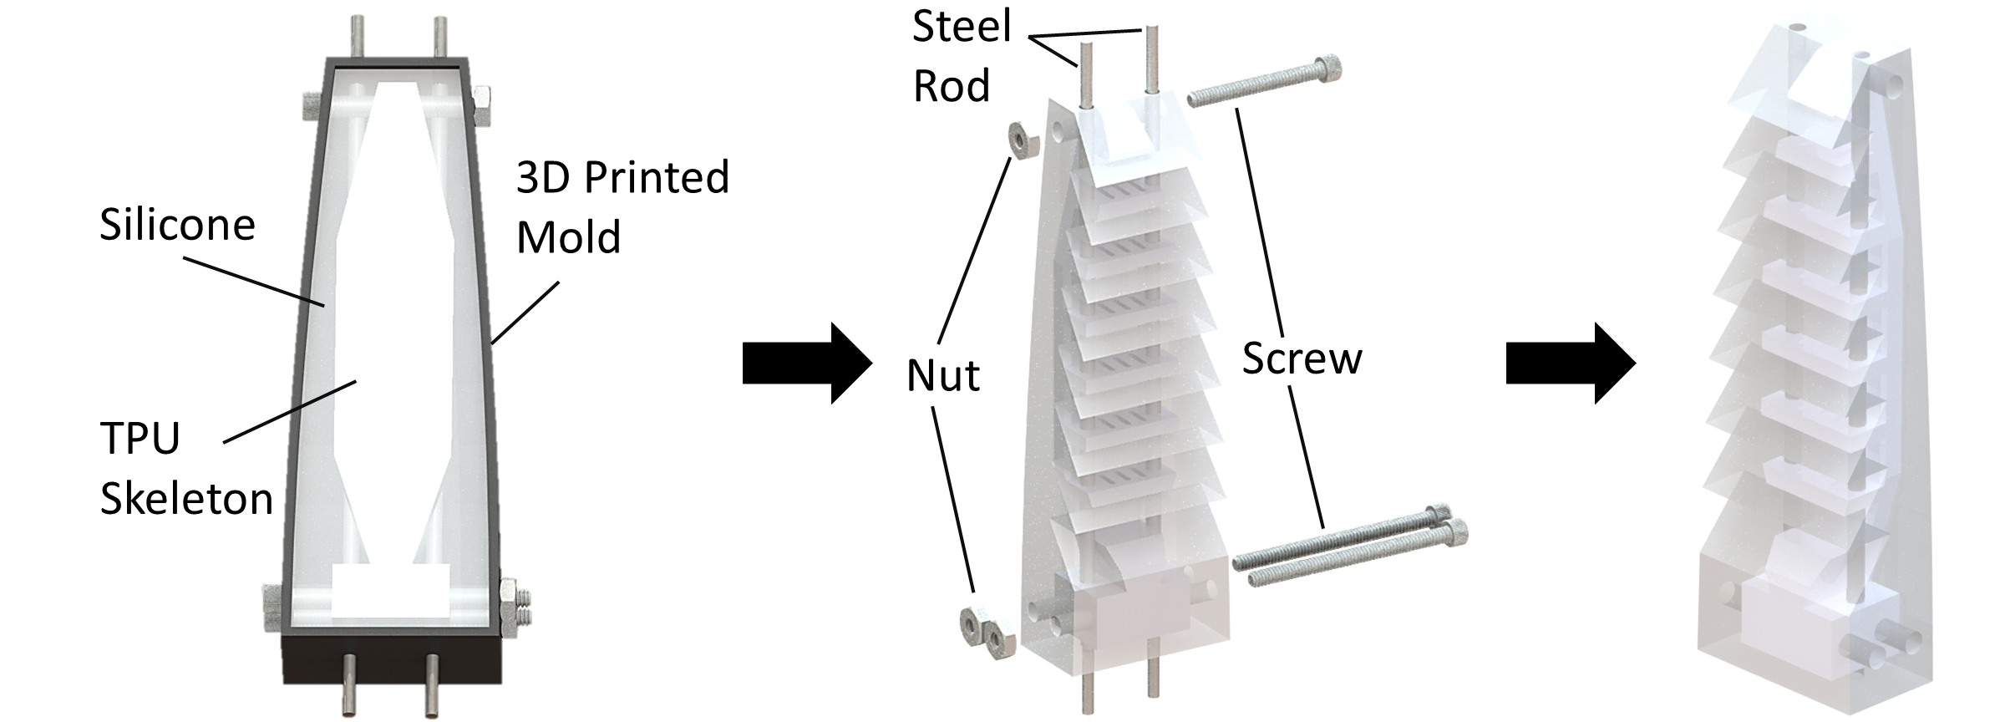
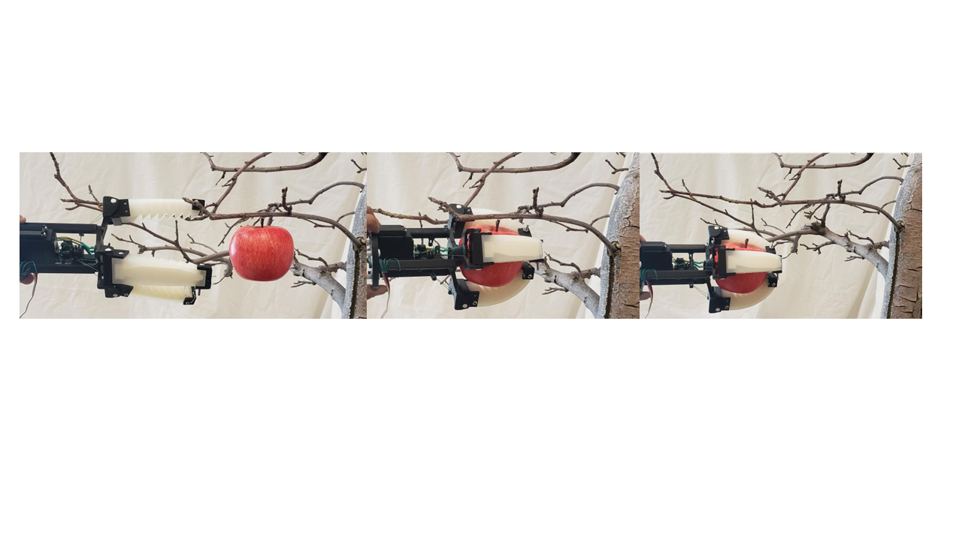
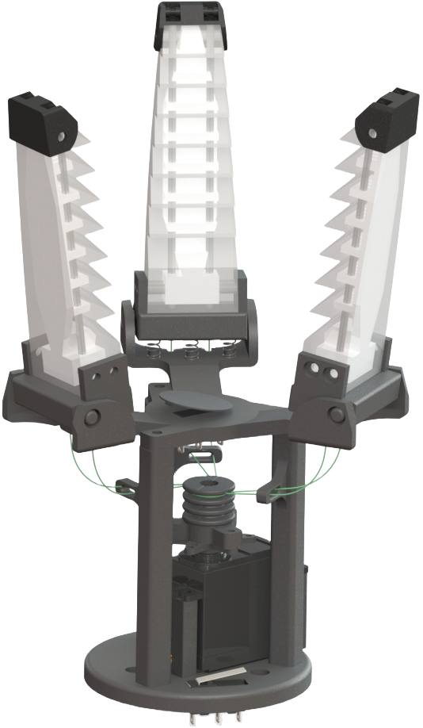
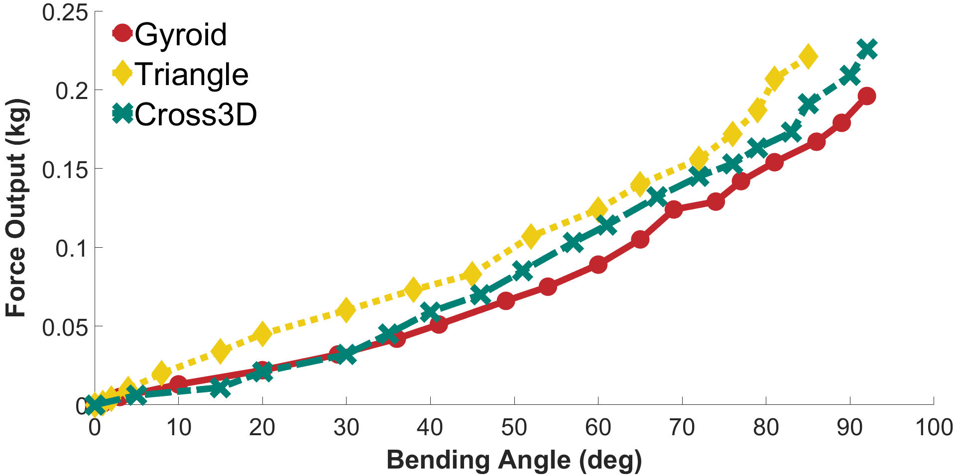



Design of a Lightweight Soft Electrical Apple Harvesting Gripper
Christopher Ninatanta, Ryan Cole, Ian Wells, Justin Pilgrim, Jacob Benedict, Ryan Taylor, Ryan Dorosh, Manoj Karkee, and Ming Luo, Member, IEEE
Mechanically–Intelligent Autonomous Robotics (MIAR) Laboratory, Department of Mechanical and Material Science Engineering, Washington State University
ABSTRACT:
Washington State is the nation’s leader in apple production, contributing over $4 billion dollars to the U.S. GDP in 2022^{[1]}.To address the issues of increasing costs and labor shortages, we are developing a Low-Cost and Rapid Response Soft-Growing Manipulator for apple harvesting^{[2]}. The robot’s soft body is currently unable to withstand pressures above 10psi, the payload is limited to 1.4kg. With some apple varieties weighing over 0.3kg, the remaining payload must be under 1.1kg. For the system to work properly, a lightweight end-effector must be used.
MANUFACTURING:
The outer surface of the fingers are made from Dragon Skin 30, a soft silicone rubber chosen for its material properties. However, the silicone alone proved too flexible during harvesting. To increase rigidity a rigid skeleton made from thermoplastic polyurethane(TPU) a flexible 3D printable material, was embedded into the silicone.
FIELD EVALUATION:
Currently the three grippers have undergone testing in a simulated lab environment using artificial apples of uniform size. During the 2023 apple harvesting season, each of the grippers will be tested in a commercial orchard. These tests will evaluate the rate of successful apple picks in a real-world situation.
FUTURE WORK:
Currently in development is a new prototype gripper that would allow the gripper to perform a twisting motion during its picking action. To further evaluate the gripper’s performance, it will be attached to a rigid robot.
DESIGN AND SPECIFICATIONS:
Silicon Fingers with TPU Skeleton
FORCE ANALYSIS:
Three printing patterns for TPU skeletons were chosen, gyroid, triangle, and cross3D which were tested for their force output and bending angle. Out of these the cross3D pattern performed the best. Each of the printing patterns were field tested to compare picking success rate.
REFERENCES:
[1] “USDA/NASS 2019 State Agriculture Overview for Washington,” www.nass.usda.gov, Jul. 04, 2023. https://www.nass.usda.gov/Quick_Stats/Ag_Overview/stateOverview.php?state=WASHINGTON (accessed Jul. 08, 2023).
[2] R. Dorosh et al., "Design, Modeling, and Control of a Low-Cost and Rapid Response Soft-Growing Manipulator for Orchard Operations," in Proc. IEEE/RSJ Int. Conf. Intell. Robots Syst. (IROS), 2023.
Acknowledgements:
Pulley
OVERALL DIMENSIONS:
Height: 0.21m
Weight: 0.326kg
Collaborators: Drs. Manoj Karkee (BSysE), Qin Zhang (BSysE), and Matthew D. Whiting (Horticulture)
Funding Agencies:
Servo Motor

