Slide 1

Project Title -
Seasonal Agriculture Performance Analysis
Name : Chinthakunta Roselyn
College : Matrusri Engineering College
AICTE STU ID : STU6596eb960d3f51704389526

Slide 2

PROBLEM STATEMENT
(Agricultural activities are influenced by seasonal variations in environmental conditions, farming practices, resource availability and market conditions. As a result, agricultural performance may differ from one season to another. However, raw agricultural data does not clearly explain how agricultural performance changes across seasons or what patterns can be observed in different seasonal conditions. The problem is to analyze the given agricultural dataset and investigate seasonal differences in agricultural performance by identifying meaningful patterns, trends, relationships and variations within the available data.

Slide 3
Project Description
This project focuses on analyzing agricultural data to understand how different factors affect crop production and profitability. The dataset contains information about farms, crops, seasons, weather conditions, soil properties, irrigation methods, fertilizers, pesticides, water usage, yield, production, revenue and profit.
We performed data cleaning and exploratory analysis to understand the dataset and then analyzed important relationships between different factors. For example, we studied how rainfall, temperature, soil pH, nutrients, irrigation, water usage and disease or pest risk are related to crop yield. We also compared different crops and irrigation methods based on their yield and profitability.
The main aim of this project is to use data analysis and visualization to identify useful patterns in farming data and understand which factors are associated with better crop performance, efficient resource usage and profitability.

Slide 4

WHO ARE THE END USERS?
Farmers – to understand crop yield, water usage and profit.
Agricultural officers – to help farmers make better decisions.
Agricultural researchers – to study farming patterns.
Agricultural companies – to understand crop production and farming practices.
Government departments – to support agricultural planning and development.

Slide 5

Technology Used
  Python – Programming language used for the project
  Pandas – Used for data cleaning and analysis
  Matplotlib – Used for creating graphs and visualizations
  Seaborn (sns) – Used for creating attractive statistical graphs
  Google Colab – Used to write and run the Python code onlin

Slide 6
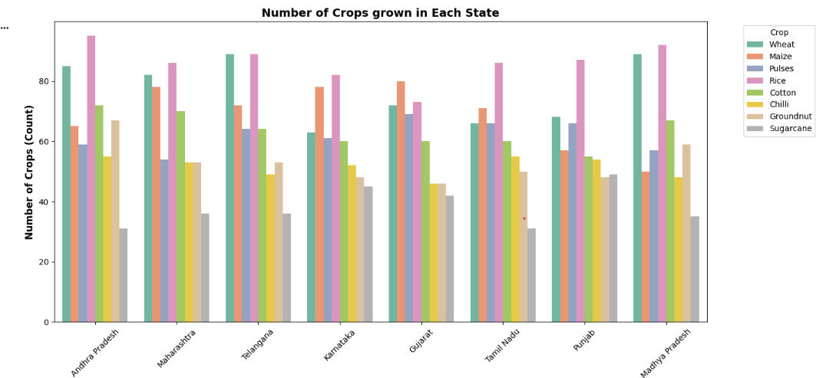
RESULTS

Slide 7
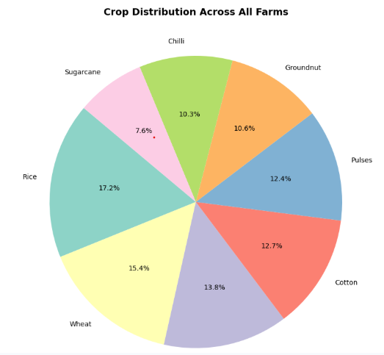
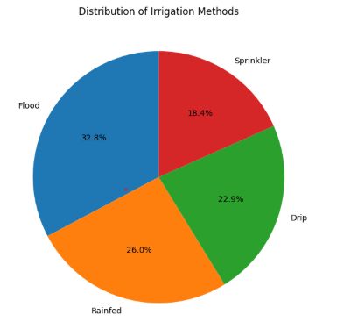
RESULTS

Slide 8
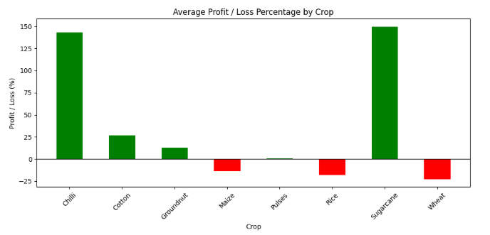
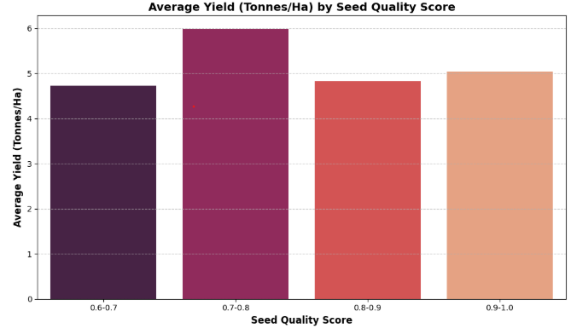
RESULTS

Slide 9
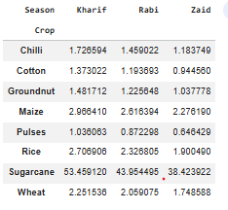
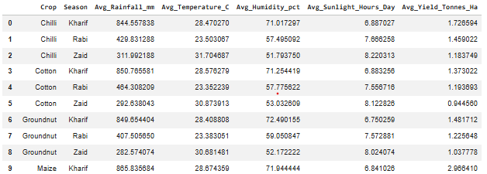
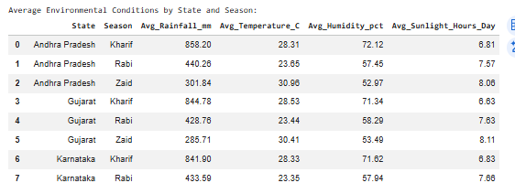
RESULTS
Average Yield w.r.t Each in Different Seasons
Average Yield in different environmental conditions with respect to each crop in different seasons
Environmental conditions of each season in different states

Slide 10
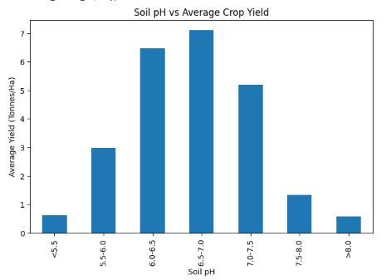
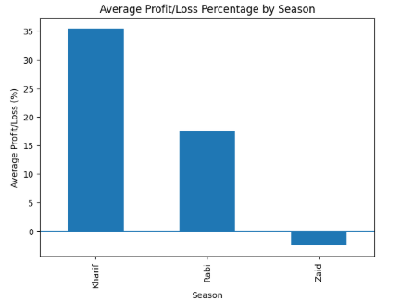
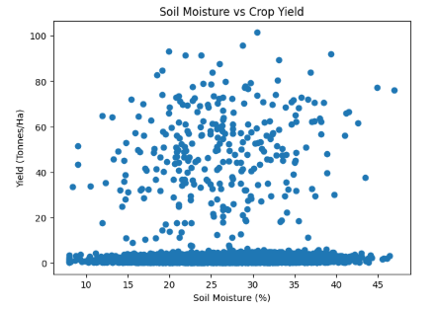
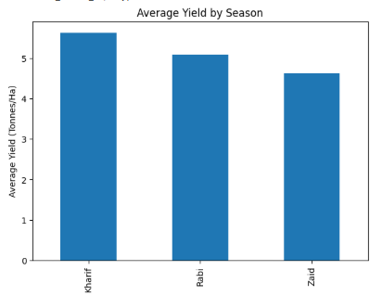
RESULTS

Slide 11
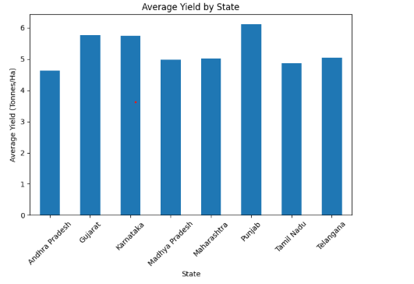
RESULTS

Slide 12
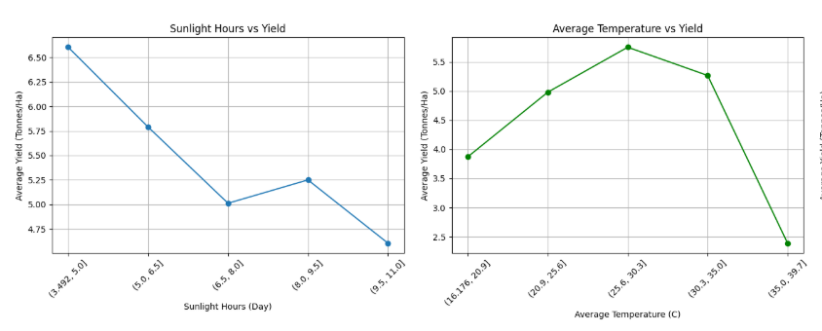
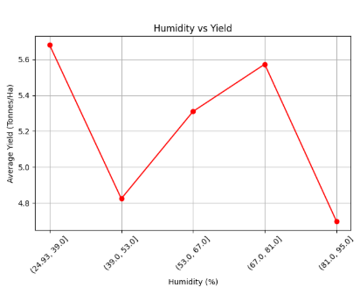
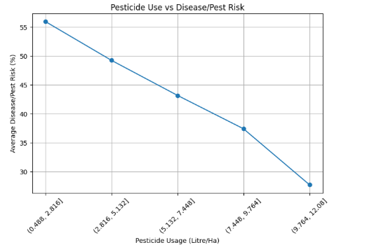

Slide 13
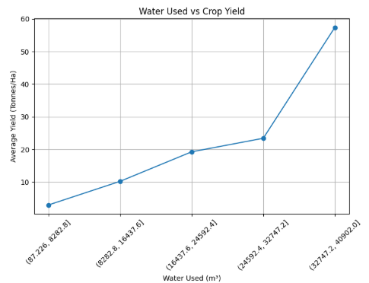
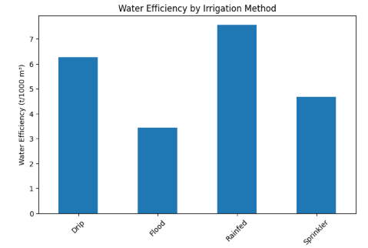
RESULTS

Slide 14
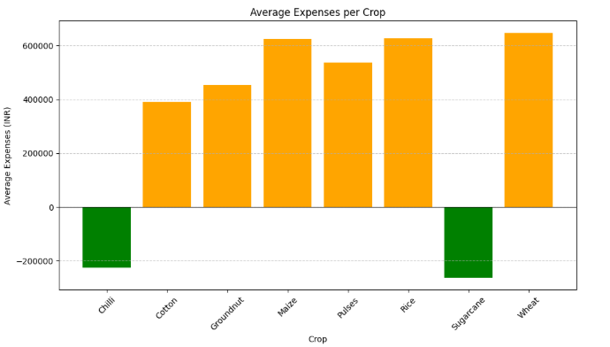
RESULTS

Slide 15
Future scope
Crop yield prediction using machine learning.
Weather-based analysis to help farmers plan crops.
Smart irrigation recommendations to reduce water wastage.
Disease and pest prediction for early action.
Crop and fertilizer recommendations based on soil conditions.
Real-time agricultural dashboard to monitor farm performance.
Mobile application so farmers can easily access the results.

Slide 16
GitHub Link
https://github.com/C-ROSELYN/Seasonal-Agriculture-Performance-Analysis.git

Slide 17
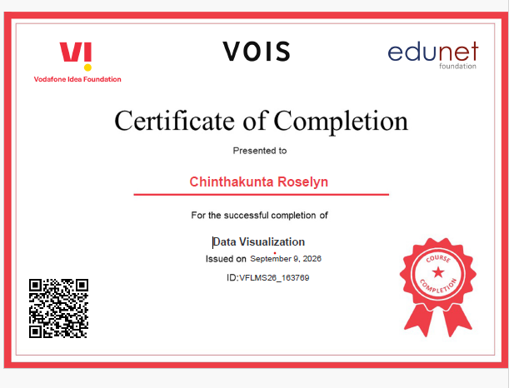
VOIS Course completion certificate -
Course name- Data Visualization

Slide 18
Thank you
.
.

