Slide 1


Citizens depend heavily on government portals for services such as land records, healthcare, and tax filings. Yet, at crucial times, they often face repeated “server down” or “try later” errors. While some outages are genuine, others create suspicion of misuse to delay or deny access. This uncertainty erodes public trust and disproportionately affects vulnerable groups who rely most on timely digital services. There is a strong need for a transparent system to monitor outages, distinguish real failures from suspicious ones, and restore confidence in digital governance.
Problem Statement

Slide 2
Expected Solutions:
•AI-based Service Blackout Detector for transparent monitoring of government portals
Continuously tracks uptime, errors, and outage durations
Uses pattern analysis to distinguish genuine failures (e.g., overload, maintenance) from suspicious outages during critical periods
Citizen-facing dashboard to visualize outages, flag irregularities, and promote accountability
Tamper-proof records (e.g., blockchain) to ensure logs cannot be altered or erased
Restores digital trust and ensures fair, inclusive access for all citizens

Slide 3
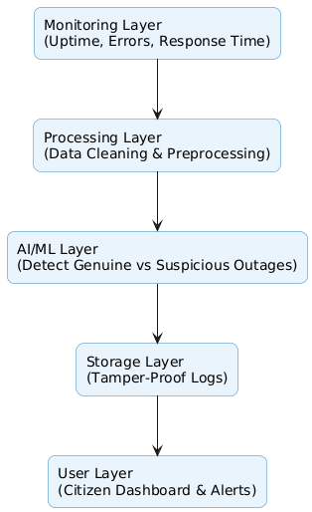
Technical Architecture

Slide 4
How is Microsoft Azure used? (minimum 1 azure service to be used)
.
Azure Monitor – watches govt portals and tracks downtime in real time
Azure ML – spots patterns and flags suspicious outages
Azure SQL / Cosmos DB – safely stores outage logs and history
Immutable Storage / Blockchain Service – keeps records tamper-proof
Power BI – shows outages clearly on a citizen-friendly dashboard
Azure AD – secures access for both citizens and administrators

Slide 5
Tech Diagram, Stack & GitHub Repo Link

