Slide 1
Autonomous Driving
By: Cameron Schwindaman, Tasmia Rahman, Joey Hyun

Slide 2
Introduction & Problem Statement
In this project, we developed an autonomous navigation system capable of following the center of a line using real time camera footage while detecting real-time regulatory signs.
The main objective is to ensure safe and reliable navigation by maintaining lane alignment, stopping or adjusting behavior for traffic signs and executing avoidance strategies when obstacles obstruct the lane.

Slide 3
Task Progress
BRAINSTORM
DESIGN AND TEST
PUT IT TOGETHER
TWEAK
01
02
03
04
Discussion and defining the ROS package architecture, especially deciding the number of nodes and their tasks.
Get the backbone for all of the nodes ready. Also make sure all of the nodes are working correctly individually by adding test cases for each of the nodes.
Get working on the decision making node and make sure it uses results from the other nodes to make an informed decision
Now try refining your traffic sign detection by further training if required. Also try to tweak with the values for the PID controller

Slide 4
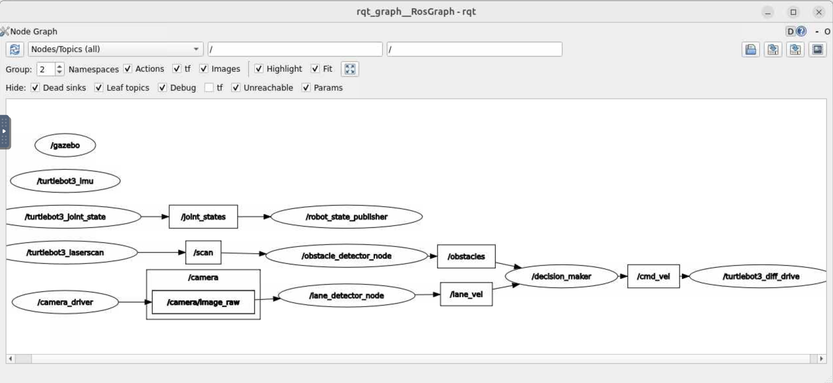
Approach & Architecture
We developed a ROS2 package named autonomous_driving which is composed of four nodes: sign_detector_node, lane_detector_node, obstacle_detector_node, and decision_making_node.
These four nodes work together to make the robot move along a lane following traffic regulatory signs and detecting obstacles along the way.
Lane Detector published Twist, Obstacle Detection published MarkerArray and Sign Detection published sign names as strings to the Decision Maker.

Slide 5
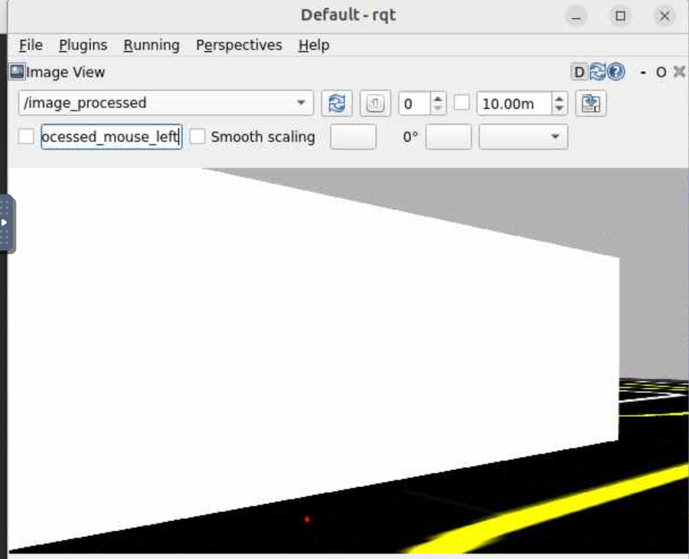
Lane Following
This ROS2 node uses a PID (Proportional Integral Derivative) controller to stay in the center of the desired lane.
It constantly calculates the linear and angular speed of the robot using the PID algorithm and publishes it to the /cmd_vel
If no lane is detected, the turtlebot stops with a linear and angular velocity of 0 being published to /cmd_vel
Challenge: The standard color masking failed because the walls are the same color as the white lane lines, causing the turtlebot to steer into the wall. This resulted in the implementation of a smart filter to ignore walls if there was too many white pixels.

Slide 6
Sign Detection
Sign detection was very similar to the previous lab and used YOLOv8 model on a custom dataset of images
Trained sign images from autorace track and the dataset includes stop, left turn, right turn, etc
Some of the signs don’t do anything such as tunnel or construction but it still gets recognized. Right turn, left turn, and stop all affect the turtlebot
Publishes detected sign names to /signs/detected as a string. Examples include “Stop Sign” and “Right Turn”

Slide 7
Obstacle Avoidance
A ROS Node was developed to publish the centroids of the nearby objects to the /obstacles topic.
If two objects are very close to each other, then only centroid is published for those two objects and it appears as one object
The centroids are published published as a MarkerArray to /obstacles which can be viewed in RViz.

Slide 8
Decision Maker
This node used all of the previous nodes to actually move the turtlebot throughout the track
Used a state machine with the states Lane_Following, Stopped_for_Sign, Avoiding_Obstacle, Turning_Right, Turning_Left, and Searching.
Obstacle avoidance overrides everything and stop signs take priority over turns. Turtlebot lane follows when no obstacles/signs are in sight.
When an obstacle is detected it will either turn left or right to avoid the obstacle depending on where the obstacle is in terms of the turtlebot vision. It also continuous avoiding for 0.5 seconds to prevent it from hitting the obstacle again.
When a sign is detected such as Stop it first adds to a list called recently stopped to ensure it doesn’t get stuck in a loop of always stopping. For Right and Left the sign needs to visible for 0.5 seconds and it rotates in place without moving forward just enough for the robot to turn and use the lane following.
Decision maker receives inputs from all 3 other nodes and determines its next state based on priority rules and then executes that command. It publishes /cmd_vel to the turtlebot.

Slide 9
Demonstration
https://mediaspace.msu.edu/media/ECE%20434%20Final%20Project%20Video%20Demo/1_0xrodg5x

Slide 10
Results & Challenges
The system was fairly successful in following lanes, following traffic signs as well as avoiding obstacles.
Big challenge was getting the turning right for avoiding obstacles and left and right turns. If the robot turned too much it would go off the track and if it turned too little it would not turn or hit the obstacle. Fine tuning took a good amount of time.
Another challenge was the turtlebot actually detected signs from across the track which would cause it to do random things. For this a visibility timer and distance detection was added to make sure it only got affected by signs directly in front of it.

Slide 11
Conclusion & Future Work
Performance was reliable for the most part but fell due to abrupt lane changes and sensitivity of lighting
Future work involves improving robustness and extending bahavior for more complex traffic behavior scenarios
LIDAR or depth sensing could also be integrated to improve obstacle detection accuracy and detection
Multi-lane navigation with lane changes and overtaking behaviors

