Slide 1
Initial Results with EEGLAB
Cynthia Steinhardt

Slide 2
Initial steps – to be confirmed
load in data
Use channel locations (in this case a predefined set) – may not be correct names and locations, but same used for sample data
Performed baseline subtraction
Calculated ICAs
Plotted at the given locations on the brains
Tried same condition in two different locations
Tried same location with two conditions

Slide 3
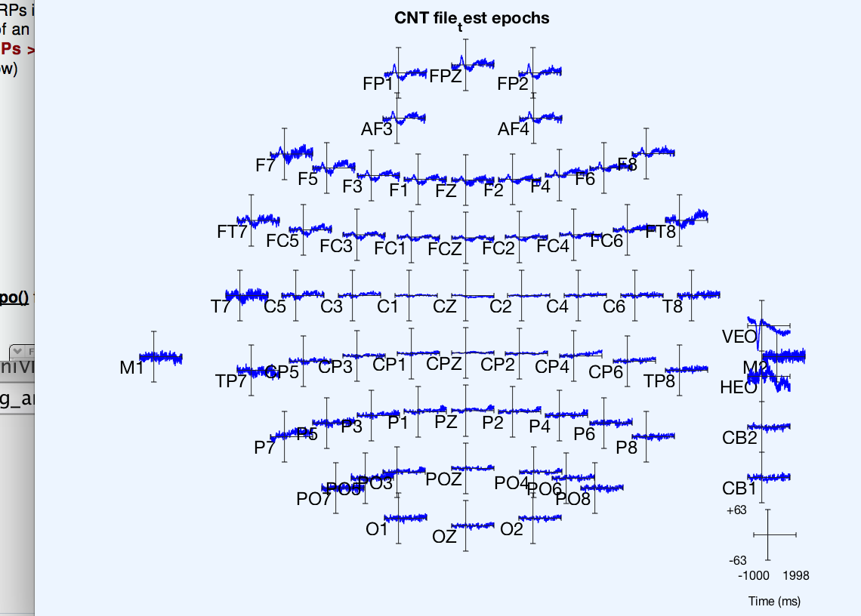
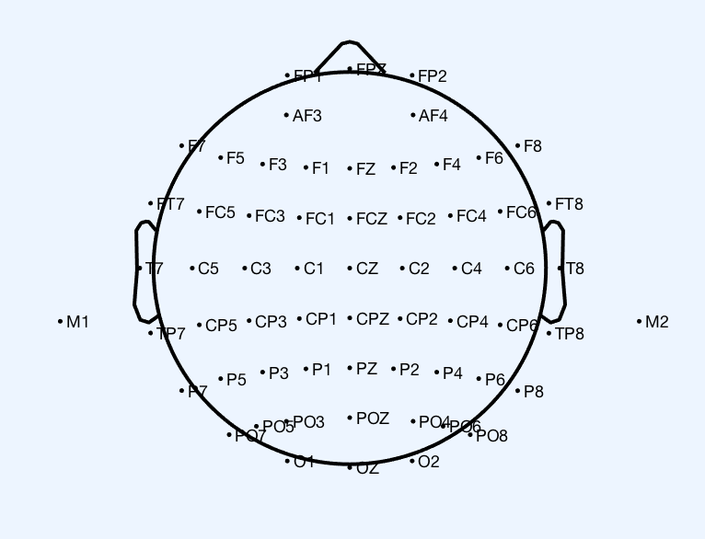
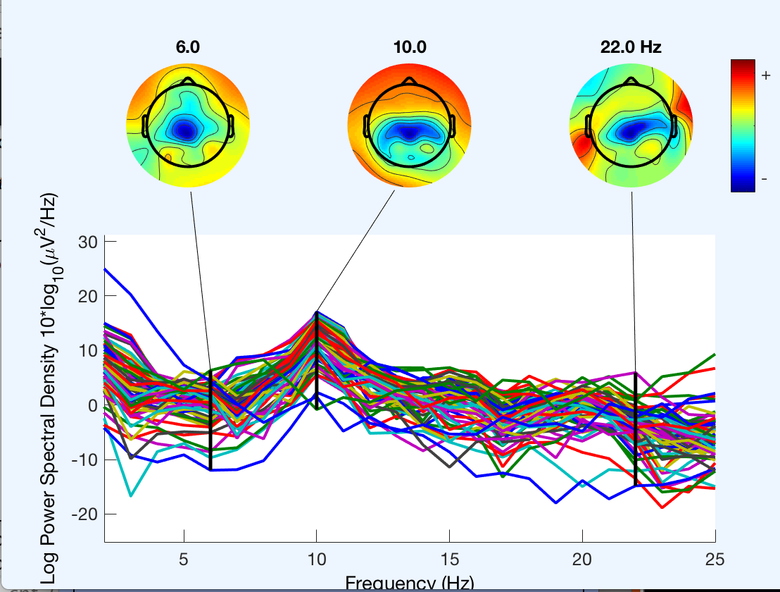
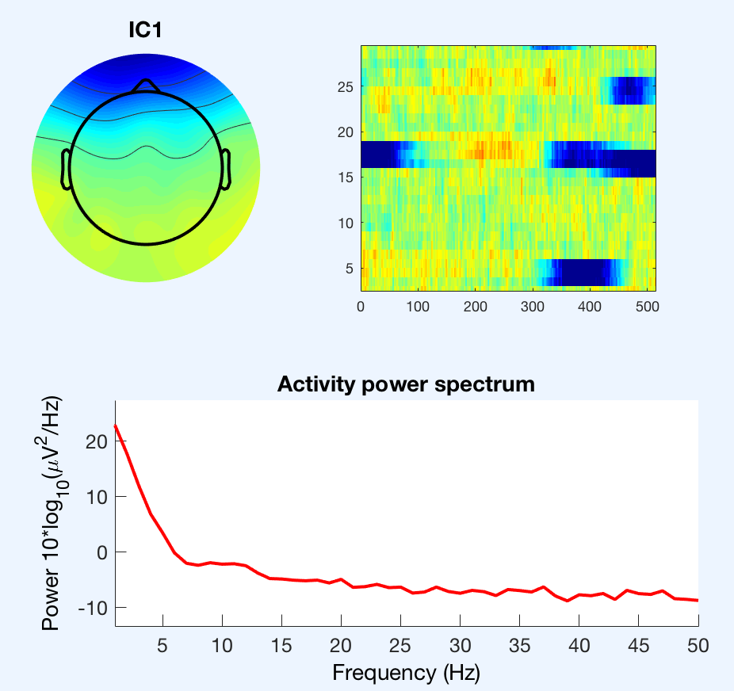
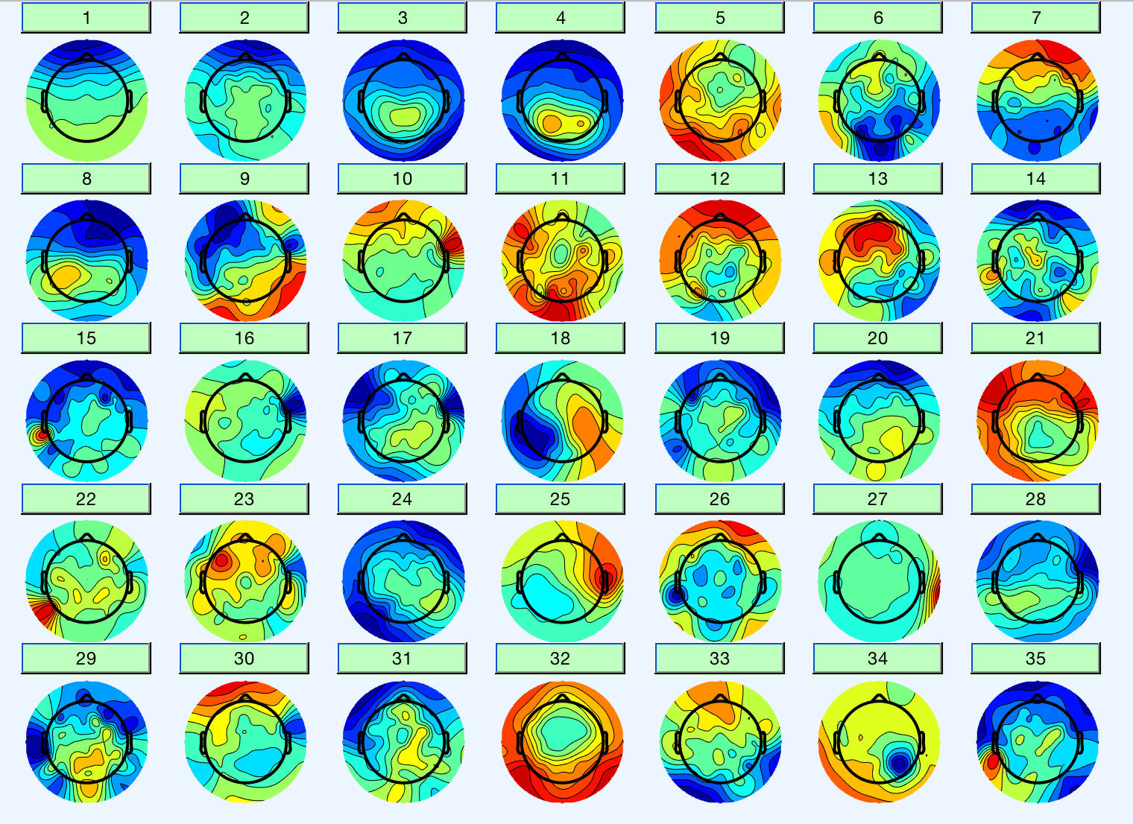
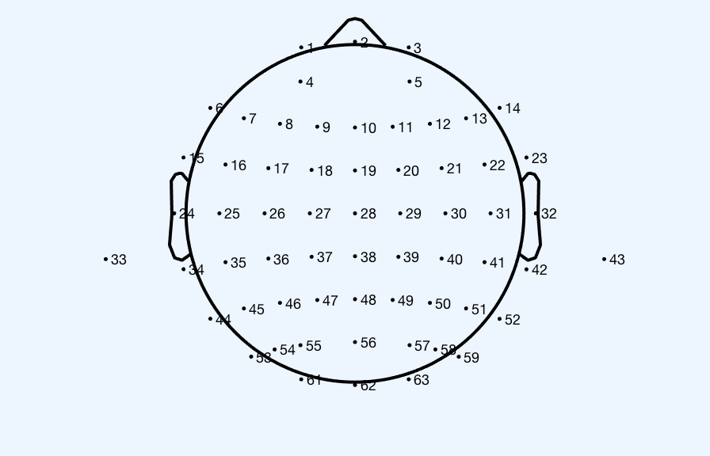
A04_pinky_c1_1.cnt
A04_pinky_c1_1.cnt
ERPs to average epoch
ICs of the pinky (using ICA)

Slide 4
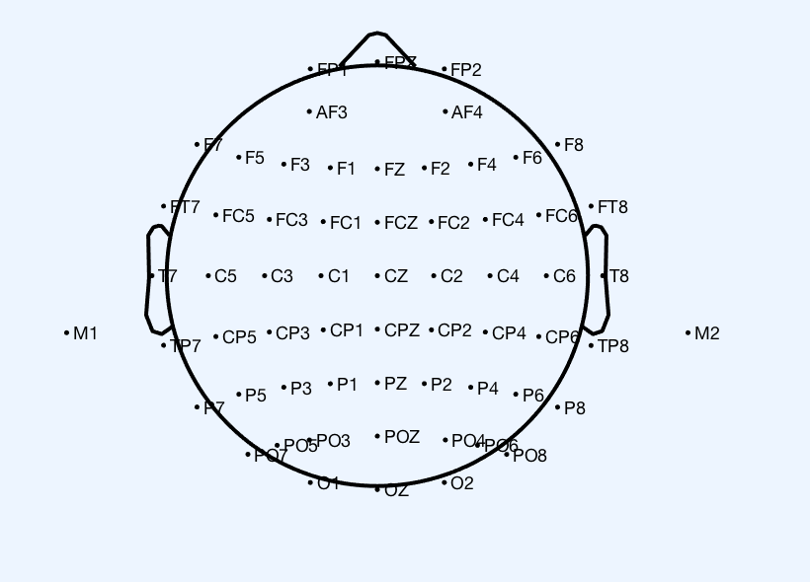
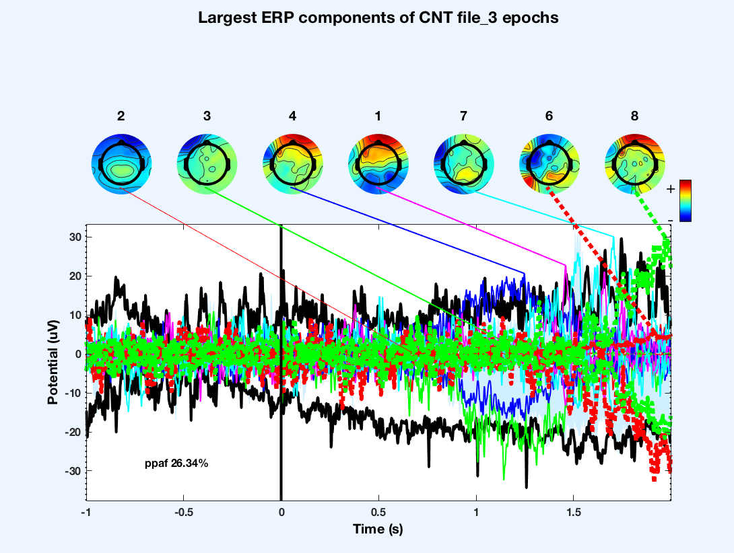
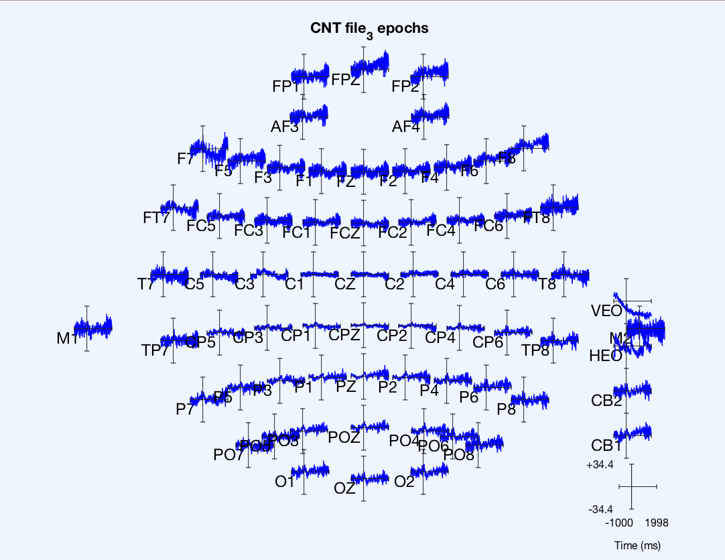
A04_pinky_c2_1.cnt

Slide 5
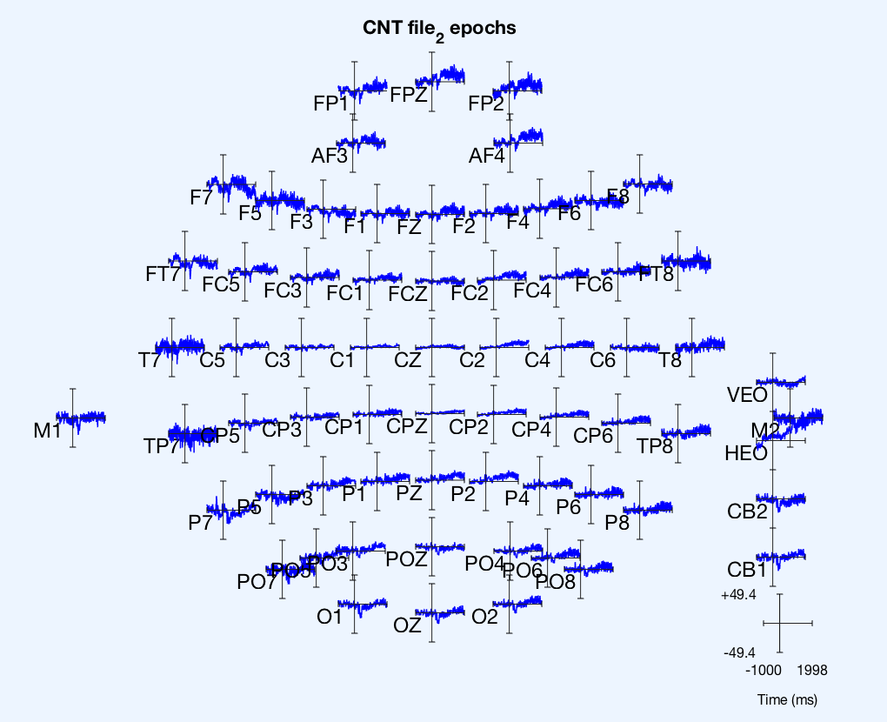
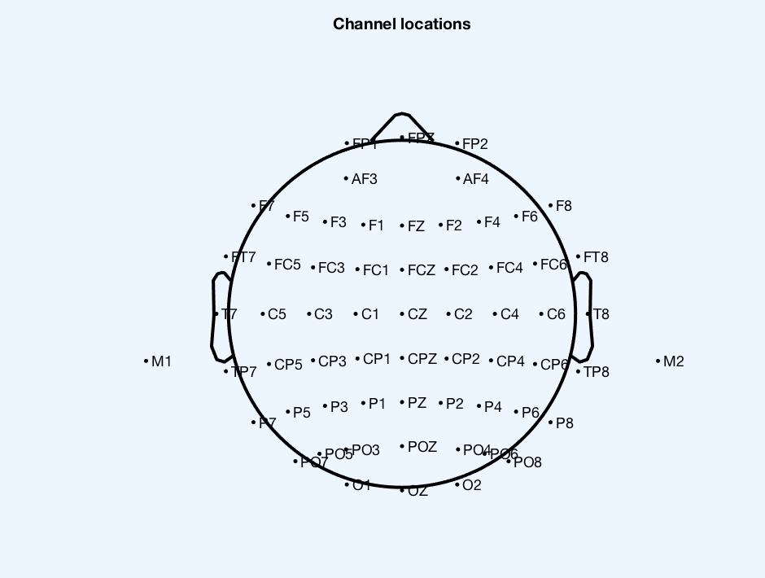
A04_thumb_c1_1.cnt
Different ERPs
Same mapping

Slide 6
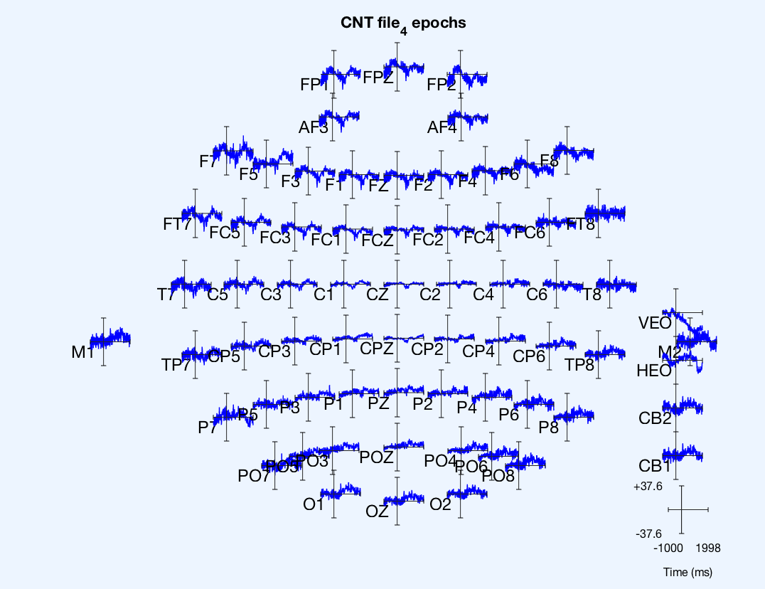
A04_thumb_c2_1.cnt

Slide 7
Resources
https://sccn.ucsd.edu/wiki/A03:_Importing_Channel_Locations#Retrieving_standardized_channel_locations
https://sccn.ucsd.edu/wiki/A03:_Importing_Channel_Locations#Retrieving_standardized_channel_locations
ftp://sccn.ucsd.edu/pub/eeglabtutorial5.00b.pdf

