Slide 1
Modeling Sensory Feedback as a Control System
Cynthia Steinhardt

Slide 2
Overview
Solve the open-loop prosthetic system
Solve the closed-loop prosthetic system
Future test integration of stimulation signals (EEG, VR psychophysics)
with a new sensor*

Slide 3
Overview of Open-loop Control System
Sensor
readout
stimulation
EMG
Actuation
signal
human
prothetic
z
w
u₂
q
H
K₂
P
(movement)
Solving it: Need a reference signal (r)
reference
signal
r
q
H⁻¹
H
K₂
P

Slide 4
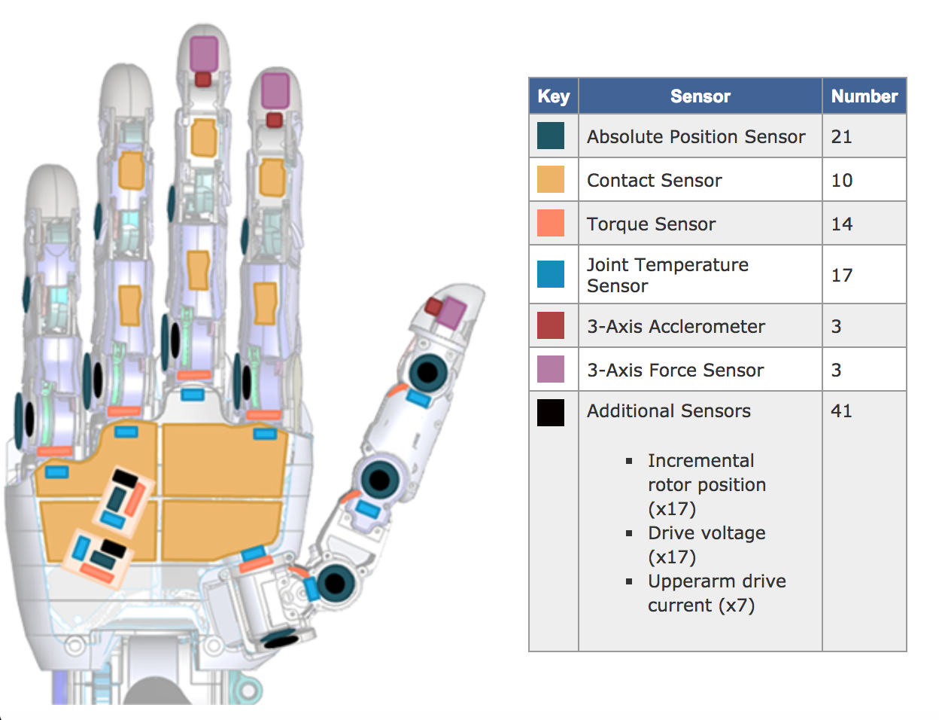
Getting a r(t) for complex motions in VR
SIMULATING IN THE VIE
Allows single finger actuation
K₂ , P defined in VIE
Allows different recording inputs and sensor modeling
COLLECTING r(t)
Produce glove like APL limb:
10 contact sensors
Absolute position sensors*
Record r(t) for:
Picking up different shape objects
Writing with a pen*

Slide 5
Overview of Closed-loop Control System
reference
signal
EMG
Actuation
signal
Sensor
readout
stimulation
human
prothetic
r
z
w
u₂
q
H
K₂
P
+
-
u₁
K₁
Use feedback control from sensor readout to further correct prosthetic trajectories
H_infinity modeling, direct error signals, etc.

Slide 6
Opening the H Box
Internal-state
I
reference
signal
EMG
Actuation
signal
Sensor
readout
stimulation
prothetic
r
z
w
u₂
q
H
K₂
P
+
-
u₁
K₁
Use feedback control from sensor readout to further correct prosthetic trajectories
Use feedback control to make well-integrated feedback signals to human

Slide 7
Internal State assessment
EEG-recording while performing a VR task
Assess signals while interacting with objects compared to intact human
Machine learn stimulation patterns that evoke similar pattern
Psychophysics in Virtual Reality
Assess perceived distance (proprioception) and weight of object compared to simulation and model prediction
Assess loading of perception if give multiple signals (e.g. temperature and weight). (Location of upper limb and several fingers)

Slide 8
Experimental Set-up
Initial: stimulation (z)
vibrotactile (several frequencies of stimulation
different areas of intact/amputated limb).
EMG recording on myoband
pressure sensors with current basic force algorithm at hand locations
Additions: moving from external to internal stimulation
Stimulation based algorithm
More neuromorphic pressure sensors
Multi-site vibrotactile stimulation (~10 sites) like APL limb

