Slide 1
Frito-Lay Talent Management Analysis
Presenter: Cameron Stewart
Company: DDSAnalytics

Slide 2
Executive Summary
Objectives
Provide insights on Job Role
Explore contributors to Attrition
Predict Attrition
Explore contributors to Monthly Income
Predict Monthly Income
Attrition Statistics (2017)
US Turnover Rate is between 12-15% annually
Global Turnover Rate is 10.9% annually
Monthly Income
How do you decide fair value?
It goes deeper than Job Title
Data Notes
36 variables provided
870 observations
No missing values identified
Test Set for Attrition and Monthly Income of 300 observations
source - https://www.talentlyft.com/en/blog/article/242/hr-metrics-how-and-why-to-calculate-employee-turnover-rate#:~:text=According%20to%20the%20U.S.%20Bureau,above%20the%20average%20turnover%20rates

Slide 3
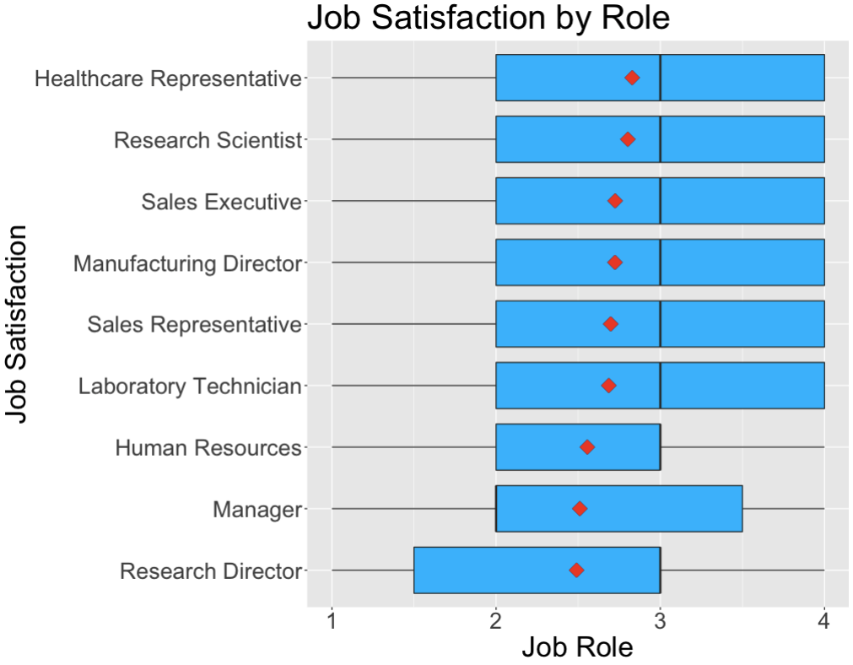
Job Role Insights
Job Satisfaction by Role
Healthcare Representative has the highest mean
Research Director has the lowest mean
Manager has the lowest median

Slide 4
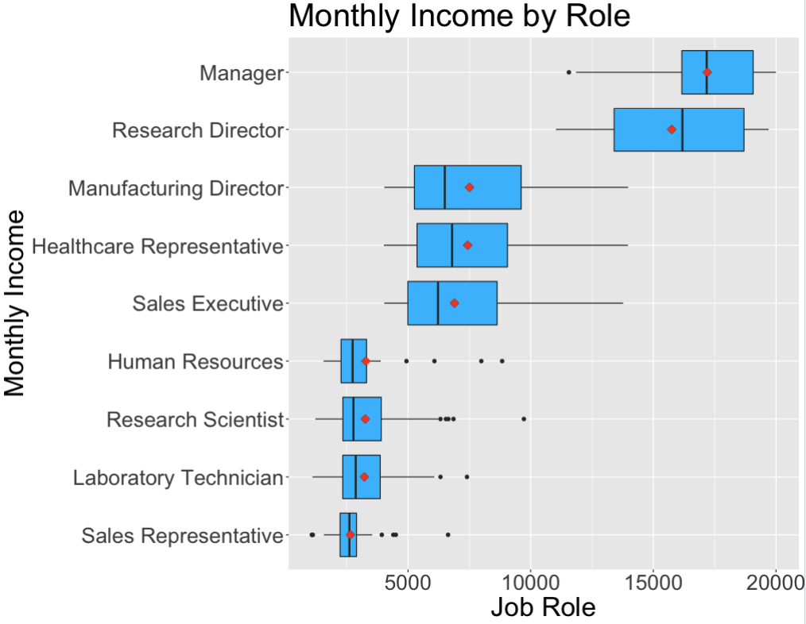
Job Role Insights
Monthly Income by Role
Manager has the highest mean
Sales Representative has the lowest mean
Notice there are essentially 3 tiers

Slide 5
Predicting Attrition
Comparing 2 machine learning algorithms to predict Attrition:
KNN
Naïve Bayes
Requirements:
Sensitivity ≥ 60%
Specificity ≥ 60%
Positive Class is ‘No’
Imbalanced Sample in Attrition:
16.09% of values were employees who left the company
Used random over-sampling of minority value to create an even split in Attrition responses
Notes:
Used p-value of 0.0017 to account for simultaneous comparisons

Slide 6
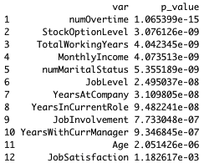
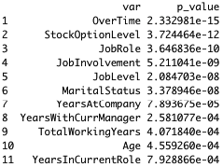
Predicting Attrition
KNN:
Only takes numerical variables
Transformed all ordinal or binary categorical variables to numerical
Scaled all values based on normal distribution
Compared significance of variables based on Wilcoxon Rank Sum Test (top)
Naïve Bayes:
Takes numerical and categorical variables
Compared significance of variables based on Chi-Squared Test (bottom)
Wilcoxon Rank Sum Test Result (p-value ≤ 0.0017)
Chi-Squared Test (p-value ≤ 0.0017)
Notes:
Used p-value of 0.0017 to account for simultaneous comparisons

Slide 7
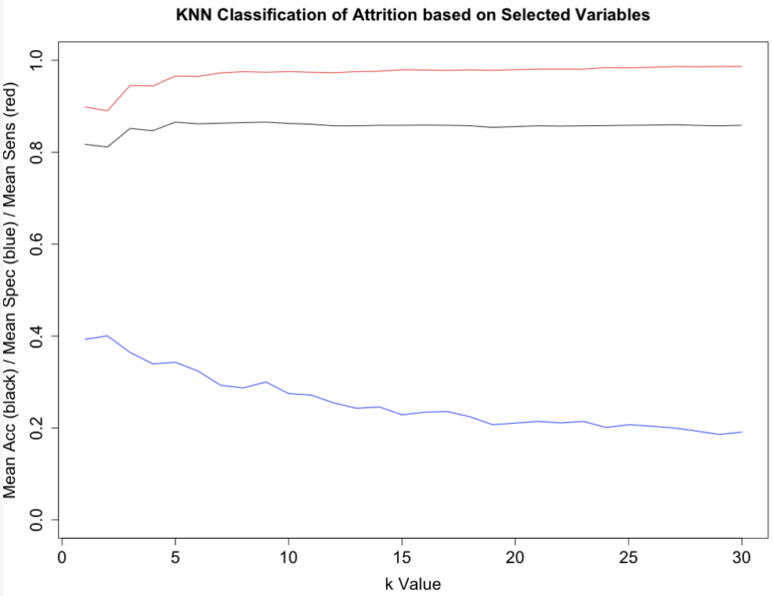
Predicting Attrition
KNN
*Any reduction in parameters resulted in a lower Sensitivity
Accuracy – Black
Specificity – Blue
Sensitivity - Red
Notes:
Used p-value of 0.0017 to account for simultaneous comparisons

Slide 8
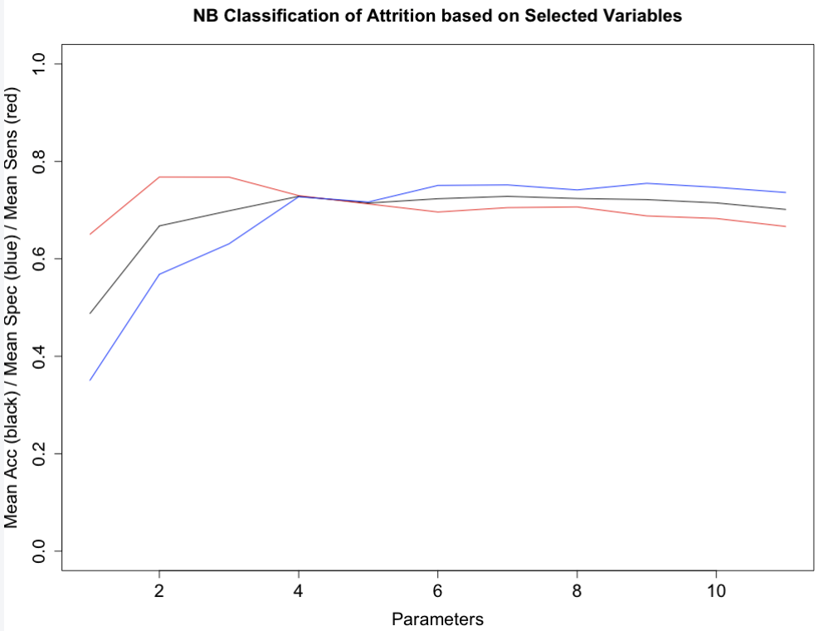
Predicting Attrition
Naïve Bayes
*Selecting the top 4 parameters based on results
Accuracy – Black
Specificity – Blue
Sensitivity - Red
Notes:
Used p-value of 0.0017 to account for simultaneous comparisons

Slide 9
Predicting Attrition
Naïve Bayes
Model Variables:
Overtime
Stock Option Level
Job Role
Job Involvement
Model Results on Training Set:
Accuracy = 0.6712
Sensitivity = 0.6877
Specificity = 0.6548
Next Steps:
Predict test values based on model
Predicted values stored in file named Case2PredictionsStewartAttrition.csv in GitHub
Link to repository:
https://github.com/C-Stewart-GH/CaseStudy2DDS
Notes:
Used p-value of 0.0017 to account for simultaneous comparisons

Slide 10
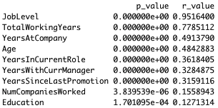
Predicting Monthly Income
Model Type:
Multiple Linear Regression
Requirements:
RMSE < $3000
Significant variables (numerical only) based on two sample t-test along with correlation coefficient (R):
Notes:
Used p-value of 0.0017 to account for simultaneous comparisons

Slide 11
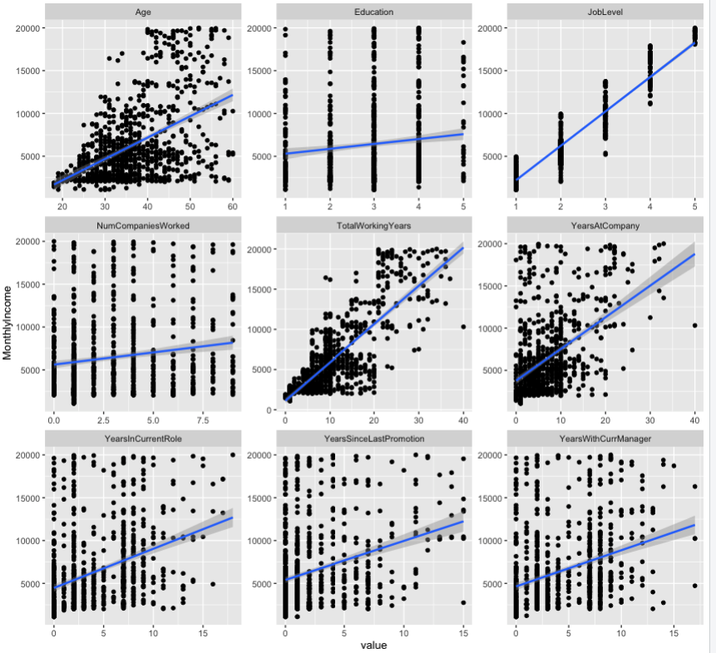
Predicting Monthly Income
Review Plots of all the selected numerical variables
Looking for variables not meeting the MLR assumptions:
Such as Age has inconsistent standard deviation
We look if a variable would be better represented by a curved relationship
Such as Total Working Years
We look if variables would fit better with log transform
Job Level improved
Notes:
Used p-value of 0.0017 to account for simultaneous comparisons

Slide 12


Predicting Monthly Income
Using a Chi-Squared Test, we determined which categorical variables are significantly related to Monthly Income:
None were significant under the criteria of p-value ≤ 0.01 that we used on the numerical variables
The most significant categorical variable was Job Role so we will test this in the model
Next we use Chi-Squared Test to see if there are any interactions with Job Role would make sense to test:
Notes:
Used p-value of 0.0017 to account for simultaneous comparisons

Slide 13
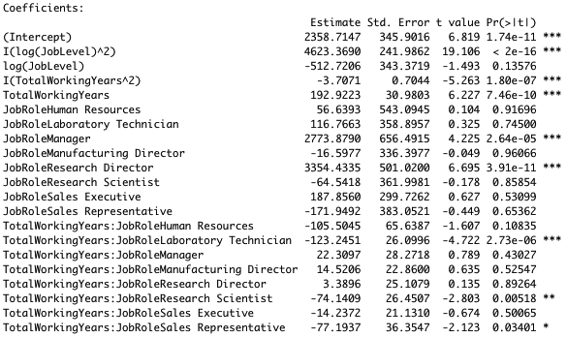
Predicting Monthly Income
Putting it all together, we test the Selected Values and potential interactions to find the simplest model that provides the lowest AIC.
The final model based on iterating through the different combinations:
Model Variables:
Log(JobLevel)^2
Log(JobLevel)
TotalWorkingYears^2
TotalWorkingYears
JobRole
TotalWorkingYears*JobRole
RMSE from final model: $973.84 (which beats the <$3000 requirement)
Notes:
Used p-value of 0.0017 to account for simultaneous comparisons

Slide 14
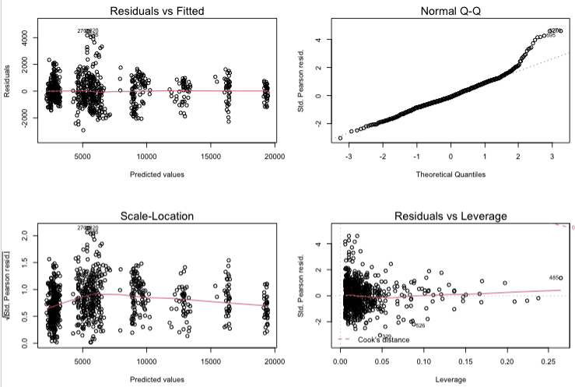
Predicting Monthly Income
Final residual and influential point plots:
Next Steps:
Predict test values calculated based on model
Predicted values stored in file named Case2PredictionsStewartSalary.csv in GitHub
Link to repository:
https://github.com/C-Stewart-GH/CaseStudy2DDS
Notes:
Used p-value of 0.0017 to account for simultaneous comparisons

Slide 15
Conclusion and Next Steps
We provided insight into the relationship of Job Role to Job Satisfaction and Monthly Income
We walked through the variable selection process to predict Attrition using Naïve Bayes and Monthly Income using Multiple Linear Regression
Next Steps
Follow up on results of Test Data
Implement models to improve talent management program
Review future opportunities to leverage Data Science in the company
Notes:
Used p-value of 0.0017 to account for simultaneous comparisons

Slide 16
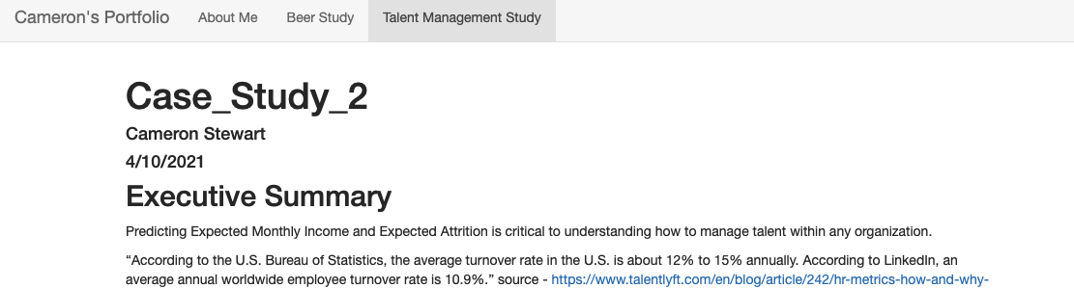
Links
Personal website updated with this study
https://c-stewart-gh.github.io/C_Stewart.github.io/
Final YouTube Link
https://youtu.be/XJ5SvUdAJTo
GitHub Link
https://github.com/C-Stewart-GH/CaseStudy2DDS
Notes:
Used p-value of 0.0017 to account for simultaneous comparisons

