Slide 1
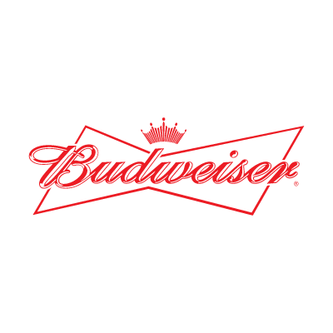

Exploratory Analysis of Brewery and Beer Data Sets
Customer: Budweiser
Presenters: Adam Alidra and Cameron Stewart

Slide 2
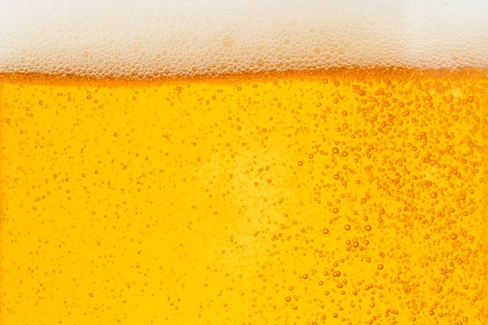

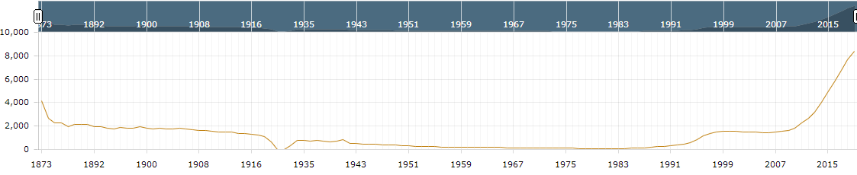
Executive Summary
Key Notes on provided Beer and Brewery Data Sets
The Breweries listed are all US Breweries and all Beers listed are Craft Beers
The data references 51 states (Washington D.C. included as a ‘state’)
High level findings on the broader US Brewery and Craft Beer Market from public data
U.S. beer volume sales down 2% in 2019, while craft brewer sales continued to grow at rate of 4% by volume¹
Craft brewer sales reached 13.6% of the U.S. beer market by volume¹
Historical U.S. Brewery Count¹
¹https://www.brewersassociation.org/statistics-and-data/national-beer-stats/#:~:text=Summary,grew%20the%20most%20for%20taprooms.

Slide 3
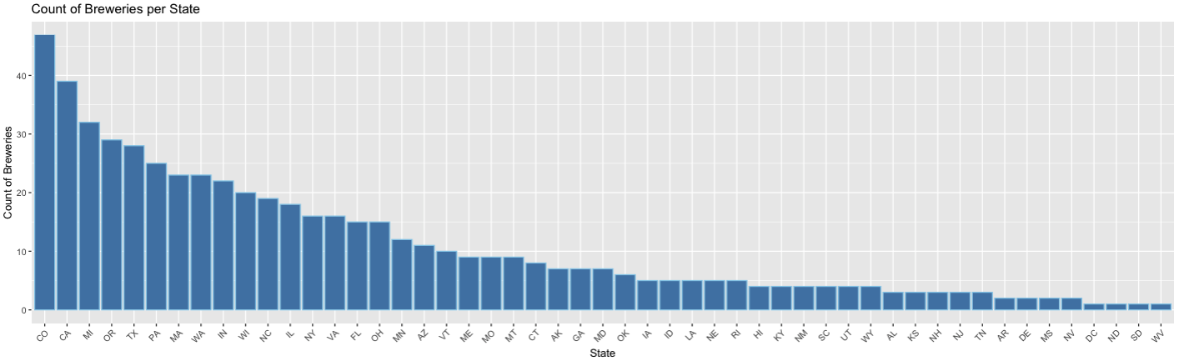
Breweries by the Numbers
Findings
558 Total Breweries listed in the Breweries data set
Top 25% of states contain over 60% of the Breweries
CO and CA have the most Breweries in total

Slide 4
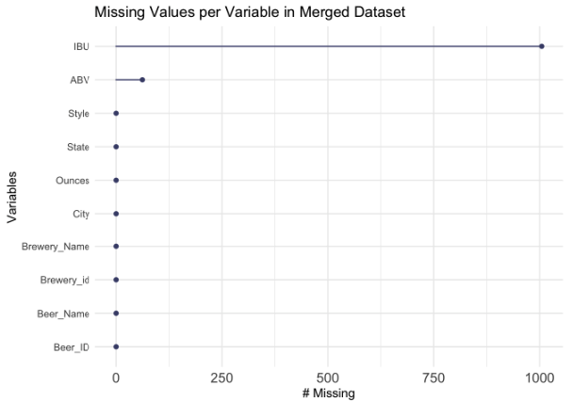
Analyzing Missing Values
Findings
No NA values in Breweries data set
Merged data sets produce a combined 1067 NA values (all of which are found in the Beer data set)
1005 NA values are from the IBU column
62 NA values are from the ABV column

Slide 5
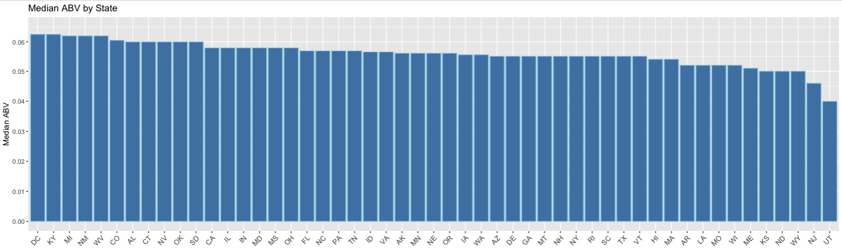
Median ABV by State
Findings
DC and KY are tied for the highest ABV at 6.25%
UT has the lowest median ABV by a significant margin at 4.00%
84% of states have a median ABV between 5% - 6% (inclusive)
Notes:
Mention ABV is Alcohol by volume and what values mean
Mention DC and KY are tied for the highest
The variation between most of the states is rather small
Indicated by 84% of the medians lie between 5-6%
Mention UT has the lowest (I would theorize cultural factors are driving this)

Slide 6
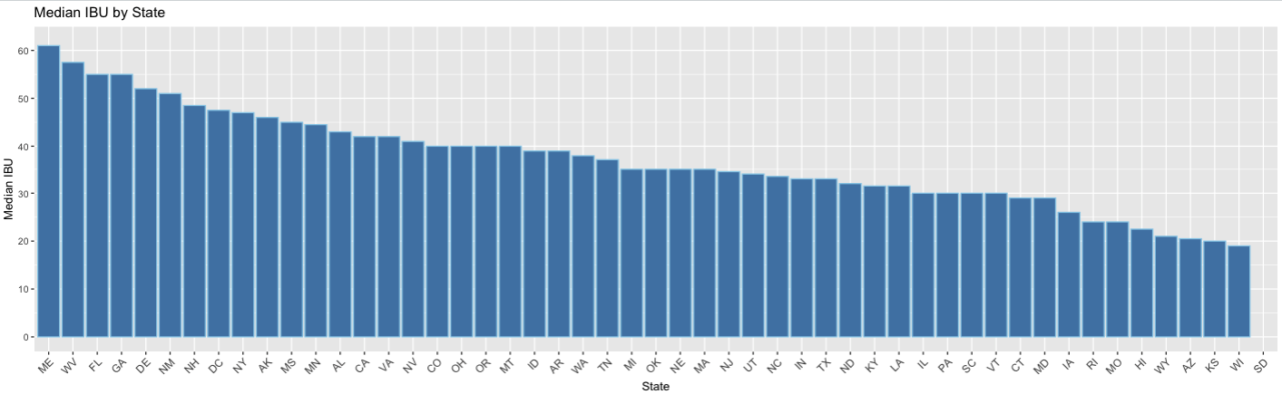
Median IBU by State
Findings
ME has the highest median IBU
WI has the lowest median IBU
SD has no IBU data in the provided data sets (shown without bar below)
Notes:
Mention IBU and what values mean
Looking at the data we can see ME has the highest IBU and WI has the lowest median
Overall we can see a steady decline from approximately an IBU of 60 to an IBU of 20
This data has a bit more range than ABV
SD NAs

Slide 7
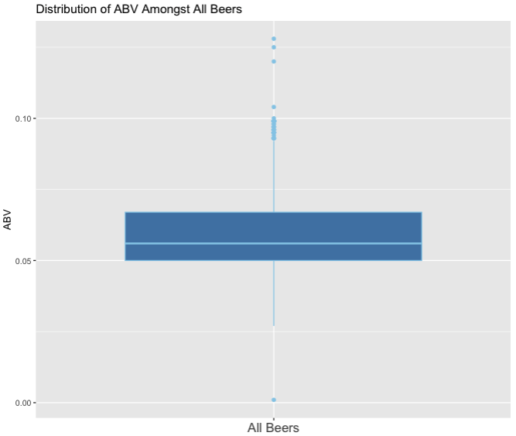
Maximum Values and ABV Distribution
Maximum Values for Individual Beers
Oregon’s Bitter Bitch Imperial IPA has the highest IBU of 138
Colorado’s Lee Hill Series Vol. 5- Belgian Style Quadrupel Ale has the highest ABV at 12.8%
ABV Distribution Findings
The box plot is slightly right skewed which signifies higher dispersion in ABV in Q3 and Q4
Median ABV amongst all analyzed beers is 5.6%
There are significantly more outliers at the higher end of ABV than the lower end
Small subset of ABV outliers in top quartile hovering at or just below 10% ABV
Notes:
Max values – what are they for
ABV Distribution
Box plot
Slightly right skewed with median of 5.6%
Outliers on upper end
Cluster of outliers around just below 10%

Slide 8
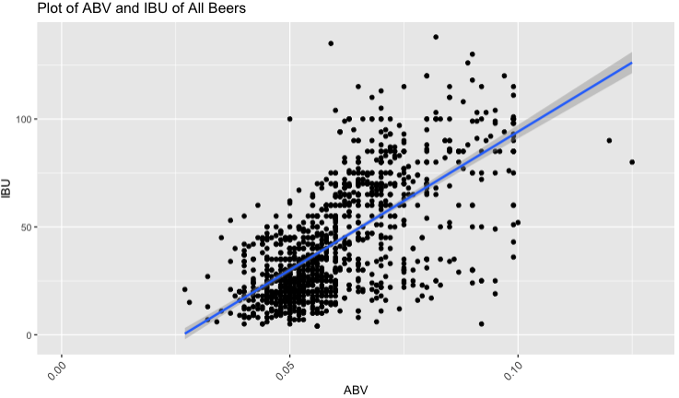
ABV to IBU Relationship
Findings
As ABV increases (x-axis), the IBU value (y-axis) also tends to increase showing a moderate relationship (R = 0.67)
45% of the variability in IBU can be explained by ABV (and vice versa)
Further investigation into to the effect of Style on ABV and IBU variables would likely improve prediction capability
Notes:
Axis definitions
Positive trend
Moderate relationship based on the R-value 0.67
Using R^squared we know that 45% of the variability in IBU can be explained by ABV (and vice versa)
Beer style is another factor likely driving variation in these two factors

Slide 9
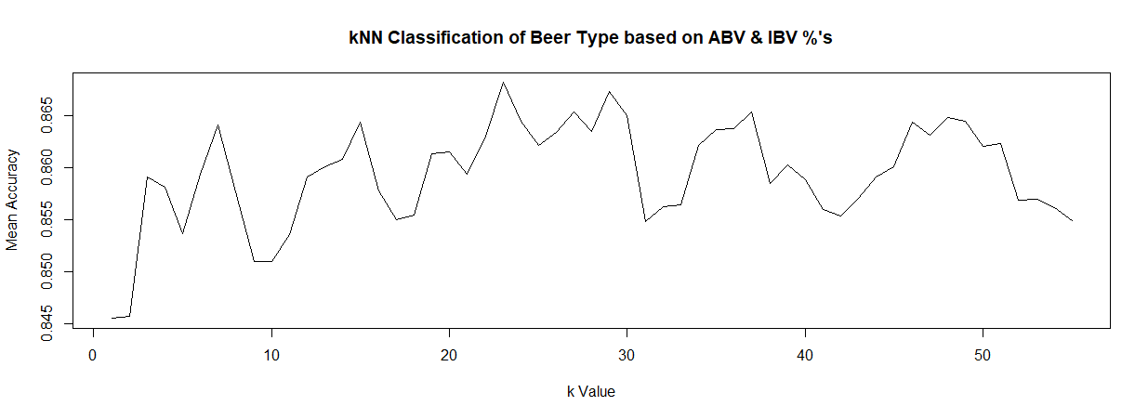
k-NN Classification of Beer Types by ABV & IBU %’s
Sample size of 15 beers tested over 55 separate training and test iterations
Only IPA and Other Ale Style beers sampled
Result: Mean Accuracy of 86.81% (or 820) discrete beer styles classified correctly based on provided ABV & IBV %’s
IPA’s were correctly identified (sensitivity) 84.18% of the time, while Other Ales were correctly classified 86.41%
Based on total data set of 944 beers

Slide 10
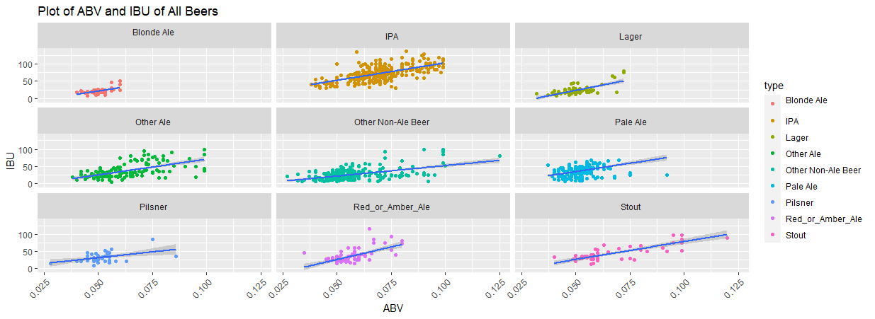
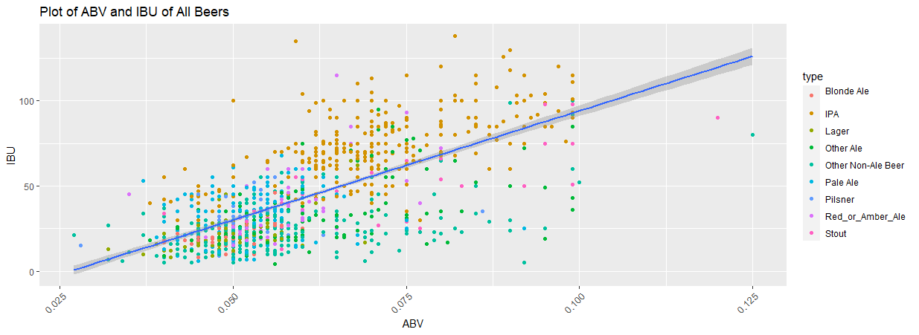
Categorization of All Beers- Contrasting Visual Representations
Notes:
Blond Ales are consistently on the lower end of ABV with a few outliers stretching into higher ABV content
Pale Ale’s, Pilsner, and Lager’s also, by and large, appear to be on the lower end of ABV & IBU %’s with the exception of a few outliers, either extending to higher ABV, IBU, or both
Stouts on the other hand are the most sporadic in terms of expected ABV% albeit they appear to represent the smallest sample size of beers amongst types

Slide 11
NaiveBayes Analysis of Beer Types by ABV & IBU %’s
Model 1: 20 Iterations
1403 beers evaluated across 10 categories
1 ‘catch-all’ category: “Other Non-Ale Beers”
70%/30% Training/Test Split
Mean Accuracy of 44.58% discrete beer styles classified correctly based on provided ABV & IBV %’s
The likelihood a beer type classification did not align to the probable ABV and IBV %’s was accurately identified (specificity) 86.53% of the time
Model 2: 50 Iterations
1403 beers evaluated across 10 categories
1 ‘catch-all’ category: “Other Non-Ale Beers”
70%/30% Training/Test Split
Mean Accuracy of 44.99% discrete beer styles classified correctly based on provided ABV & IBV %’s
The likelihood a beer type classification did not align to the probable ABV and IBV %’s was accurately identified (specificity) 86.47% of the time

Slide 12
kNN and NaïveBayes Comparative Considerations
Data sets between models varied by 32.7% in total number of objects (values)
Inclusion of a wider range of Beer Types and classifications (by an additional 8 categories)
A-priori probabilities of Blond Ale, Pilsner, Red or Amber Ales, and Stouts, in the Naïve Bayes model, signal
In respect to Naïve Bayes modeling, more iterations, as expected improved accuracy of proper classification of Beer Style respective to ABV and IBV values

Slide 13
Appendix

Slide 14
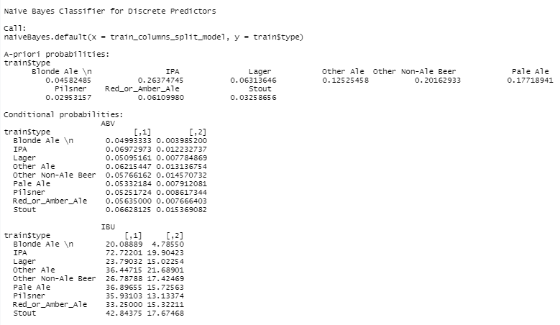
Naive Bayes Classifier for Discrete Predictors (iterations= 20)
Mean Accuracy:
.44.58%
Mean Sensitivity:
58.04%
Mean Specificity:
86.53%

Slide 15
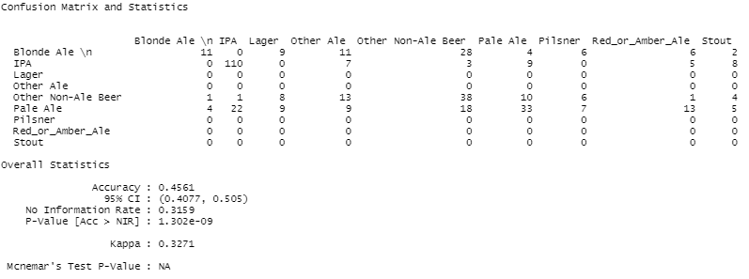
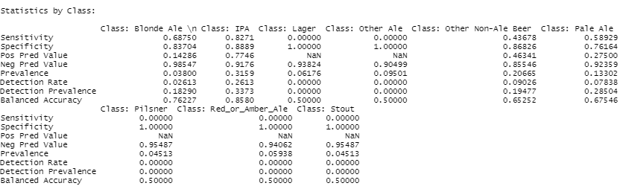
Naive Bayes Classifier for Discrete Predictors (iterations= 20)

Slide 16
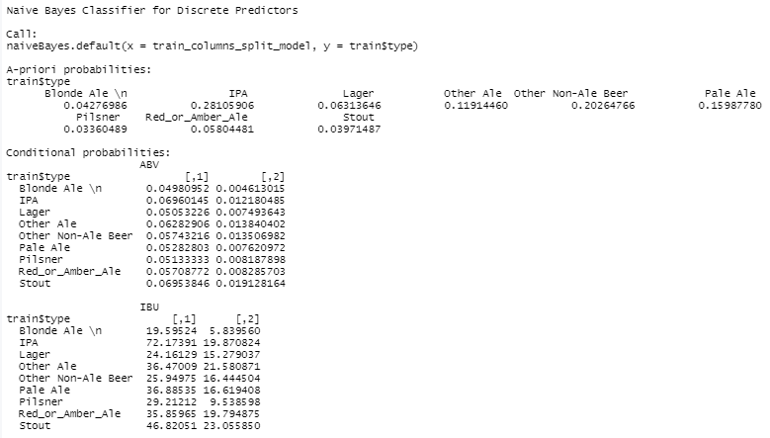
Naive Bayes Classifier for Discrete Predictors (iterations= 50)
Mean Accuracy:
.44.99%
Mean Sensitivity:
61.68%
Mean Specificity:
86.47%

Slide 17
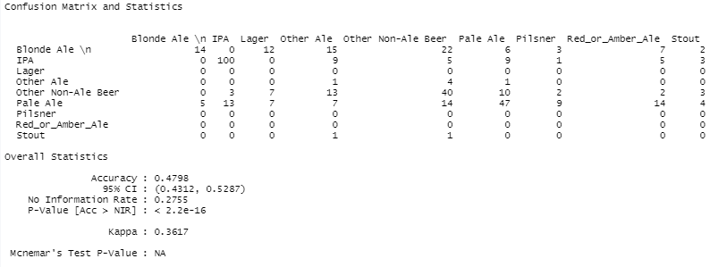
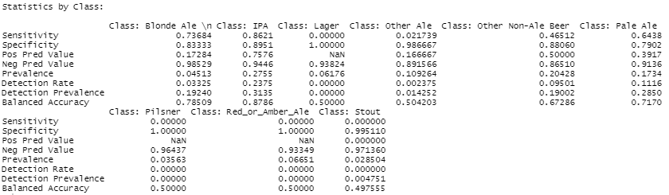
Naive Bayes Classifier for Discrete Predictors (iterations= 50)

Slide 18
THANK YOU!

