Slide 1
Time Series Project
Cameron Stewart & Ana Elsa Glaser

Slide 2
Data Description
Who
What
When
Where
Why
COVID-19 Case Data
Source: John Hopkins University
Date Range: September 2000 – present
Google Mobility Data
Google
Date Range: September 2000 – present
Vaccination Doses Administered
Google
Date Range: September 2000 – present
COVID Test Data
Source
Date Range: September 2000 – present

Slide 3
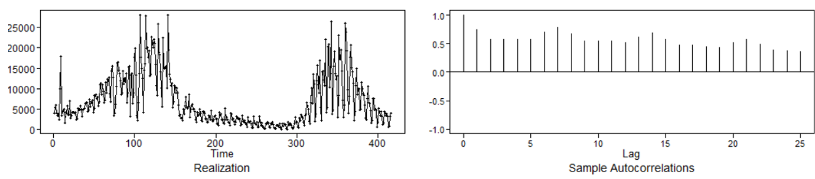
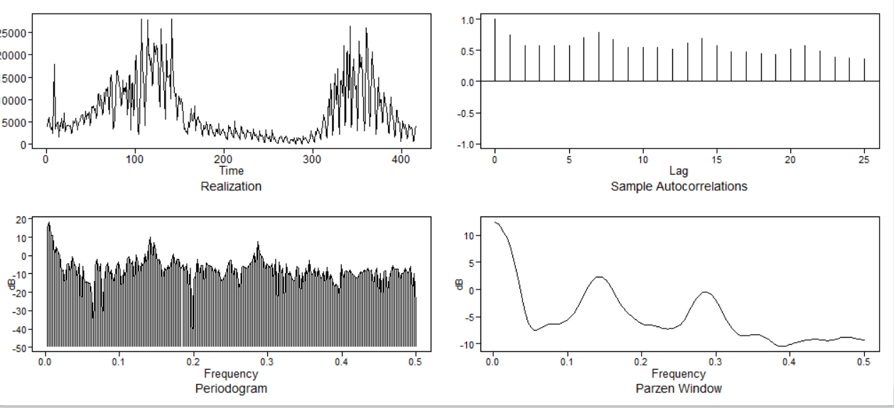
Data Profile: COVID-19 cases
OBSERVATIONS
Realizations appear to wander
ACF: Positive sinusoidal with slow dampening
Spectral density: confirms wandering and a periodic trend

Slide 4
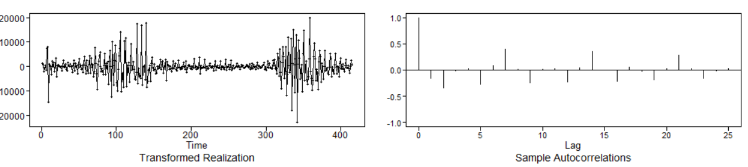
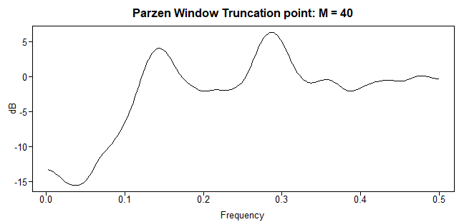
Data Profile
OBSERVATIONS
Took the first difference
Seasonality of 7 days observed, wonder if 3 days would also apply?
Spectral density: also has two periods

Slide 5
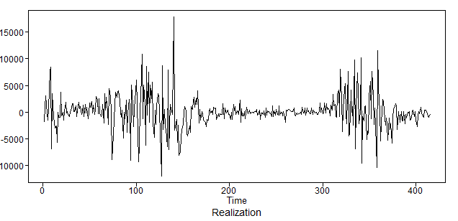
Forecast

Slide 6
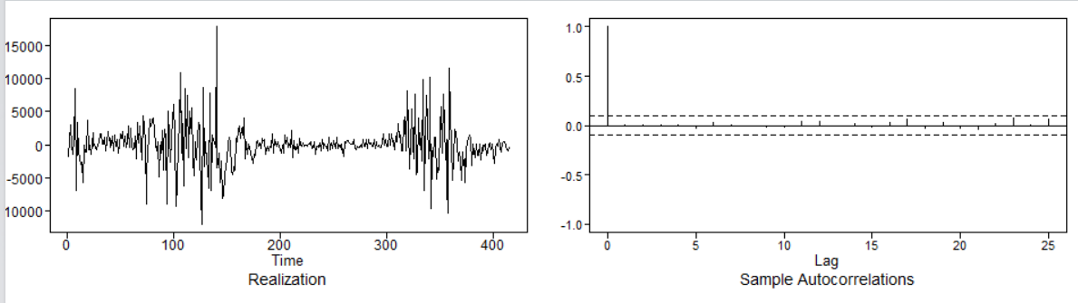
Residuals

Slide 7
Strategy for the rest of the analysis

