Slide 1
Time Series Project
Cameron Stewart & Ana Elsa Glaser

Slide 2
Data Description
Who
What
When
Where
Why
COVID-19 Case Data
Source: John Hopkins University
Date Range: September 2000 – present
Google Mobility Data
Google
Date Range: September 2000 – present
Vaccination Doses Administered
Google
Date Range: September 2000 – present
COVID Test Data
Source
Date Range: September 2000 – present

Slide 3
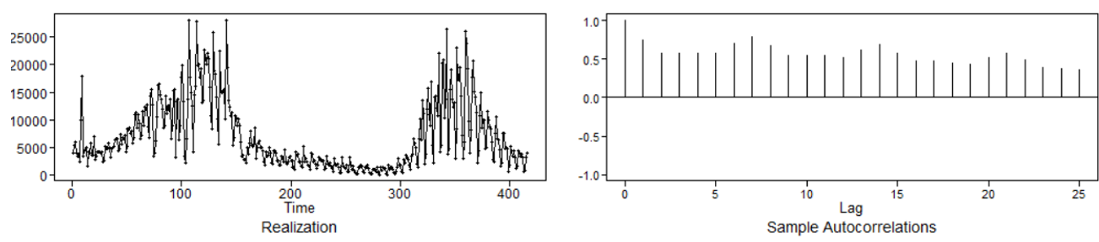
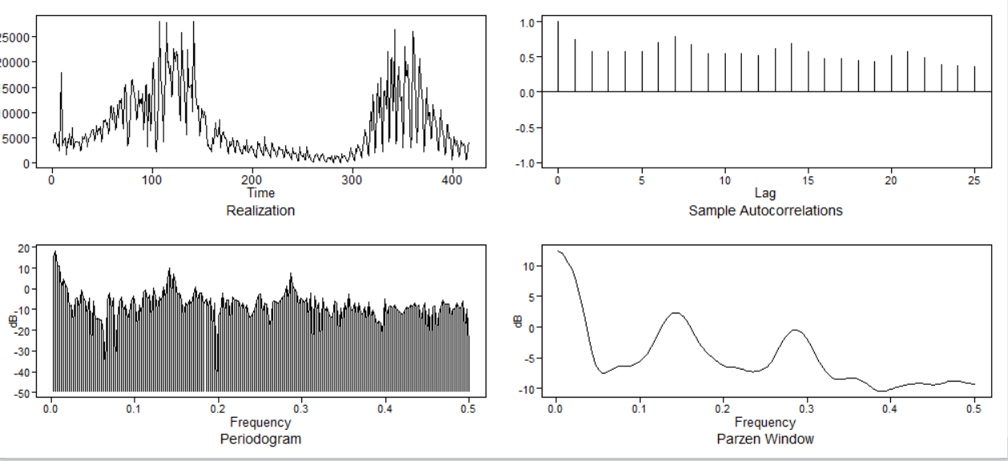
Data Profile: COVID-19 cases
OBSERVATIONS
Realizations appear to wander
ACF: Positive sinusoidal with slow dampening
Spectral density: confirms wandering and a periodic trend

Slide 4
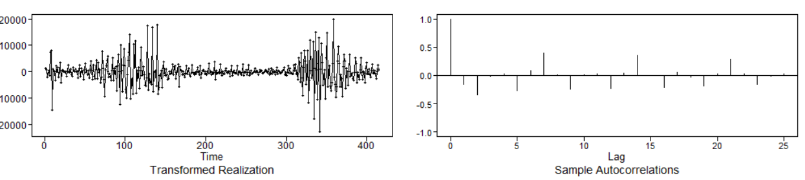
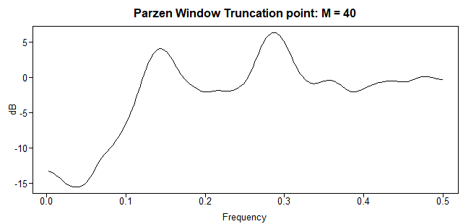
Data Profile
OBSERVATIONS
Took the first difference
Seasonality of 7 days observed, wonder if 3 days would also apply?
Spectral density: also has two periods

Slide 5
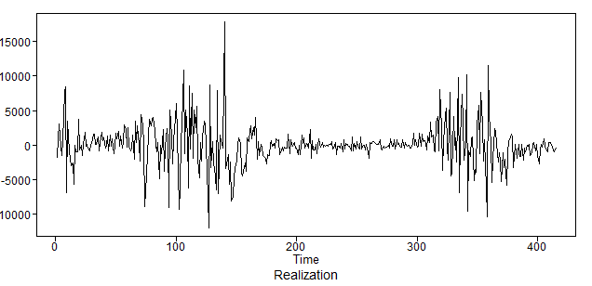
Forecast

Slide 6
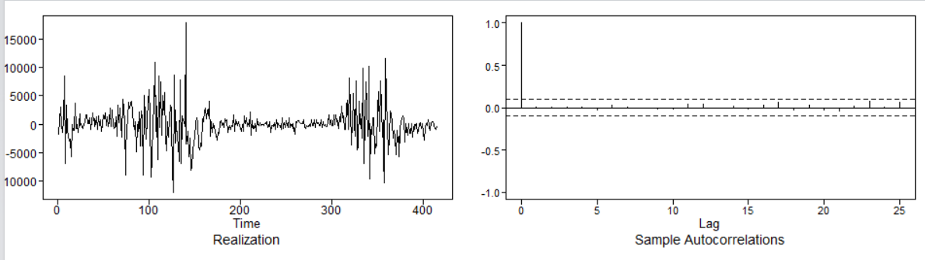
Residuals

Slide 7
My Sources
Vaccine Information:
https://www.dshs.texas.gov/coronavirus/immunize/vaccine.aspx
Testing Information:
https://www.dshs.texas.gov/coronavirus/testing.aspx

Slide 8
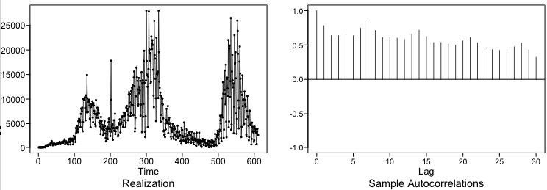
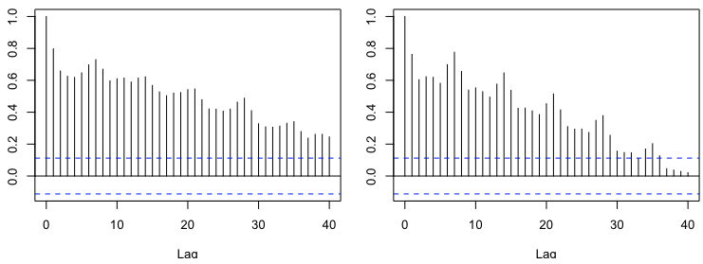
Is our data stationary?
From the realization, we can see the data wanders without a constant mean. Therefore, the realization is not stationary. This is confirmed by the slowly dampening positive positive ACF values. Without an additional realization, we would be speculating on constant variance. It does appear the variance increases with the magnitude of cases. Constant autocorrelations appear to be met by similar first and second half ACFs. To account for the stationarity, we explored a differencing approach and seasonal approach. We confirmed a combination of these did not lead to an effective model using ASE.
First and Second Half ACFs

Slide 9
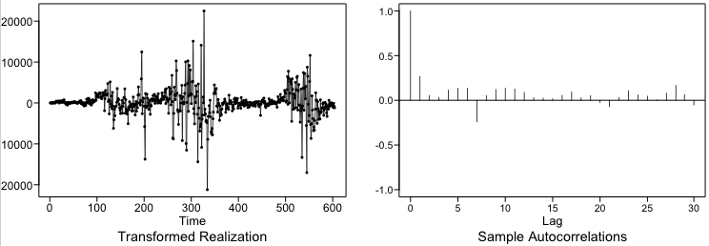
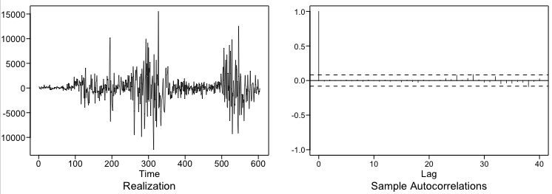
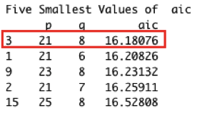
Identify Seasonal Model
Remove Seasonality of 7 Days

Slide 10
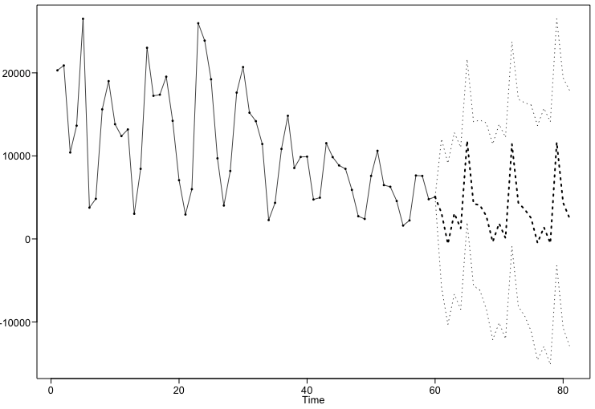
RW RMSE ARIMA(21,0,8) with s = 7
Rolling Window RMSE:
Short Term Forecast – 7 Days
3457 Cases
Long Term Forecast – 21 Days
4271 Cases

Slide 11
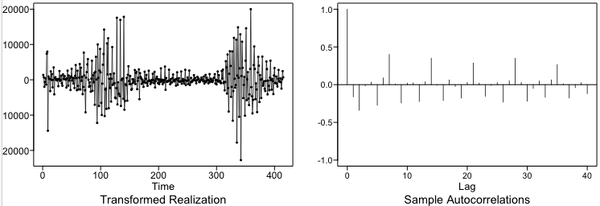
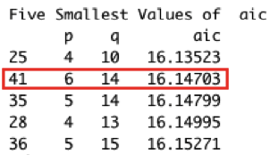
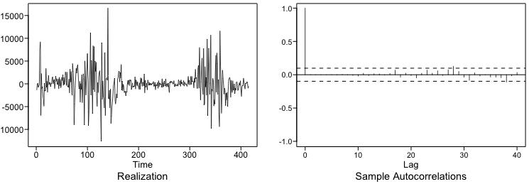
Identify Differencing Model
Remove (1-B) term

Slide 12
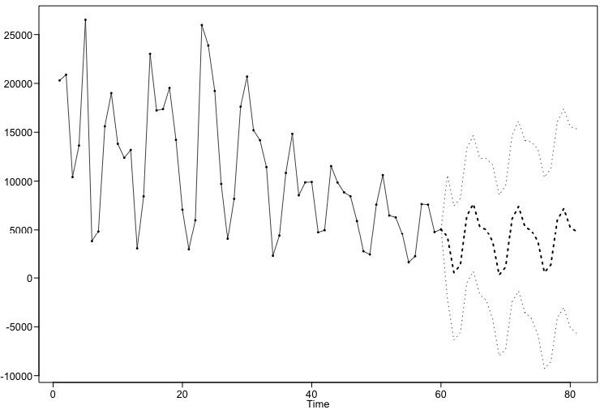
RW RMSE ARIMA(6,1,14)
Rolling Window RMSE:
Short Term Forecast – 7 Days
2981 Cases
Long Term Forecast – 21 Days
3806 Cases
BOTH ARE LOWER!!

Slide 13
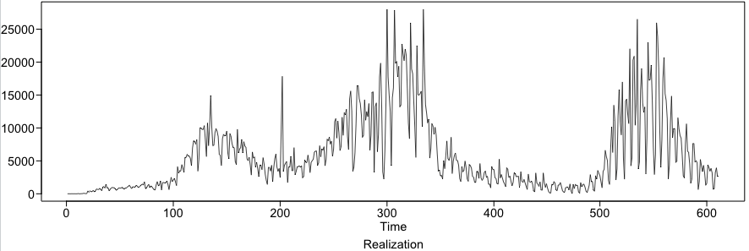
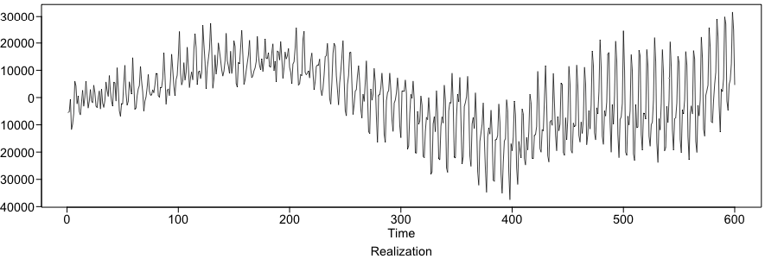
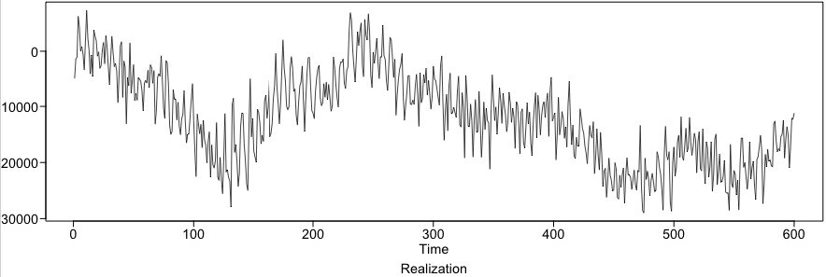
Compare Randomly Generated Plots
Original Realization
ARIMA(21,0,8)
with s = 7
ARIMA(6,1,14)

Slide 14
Strategy for the rest of the analysis
Investigate models with regressors such as:
Google Mobility Data
Vaccination Doses
Covid Tests Taken
Investigate using models such as:
Vector AR Models
Neural Network Models

Slide 15
THANK YOU!

