Slide 1
Marketing Campaign Performance Report
Generated: 2025-12-03 07:46:10
Key Metrics Snapshot
• Total Impressions: 149,000
• Total Clicks: 7,250
• Total Spend: $14,403.75
• Total Visits: 6,520
• Avg CTR: 4.87%
• Avg CPC: $1.99

Slide 2
Executive Summary
Digital marketing performance from January 1 to January 10, 2024, showed a total of 149,000 impressions, 7,250 clicks, and $14,403.75 in spend, resulting in an average ROI of 0.45. The top-performing campaigns were Festival Sale, Flash Sale, and New Year Blast. Overall, the performance metrics indicate room for improvement.
Key Insights:
• Total Impressions: 149,000
• Total Clicks: 7,250
• Total Spend: $14,403.75
Recommendations:
• Optimize campaign targeting and ad creative to improve average CTR and ROI.
• Analyze and adjust bidding strategies to reduce average CPC.
• Prioritize and allocate budget to top-performing campaigns, such as Festival Sale and Flash Sale.

Slide 3
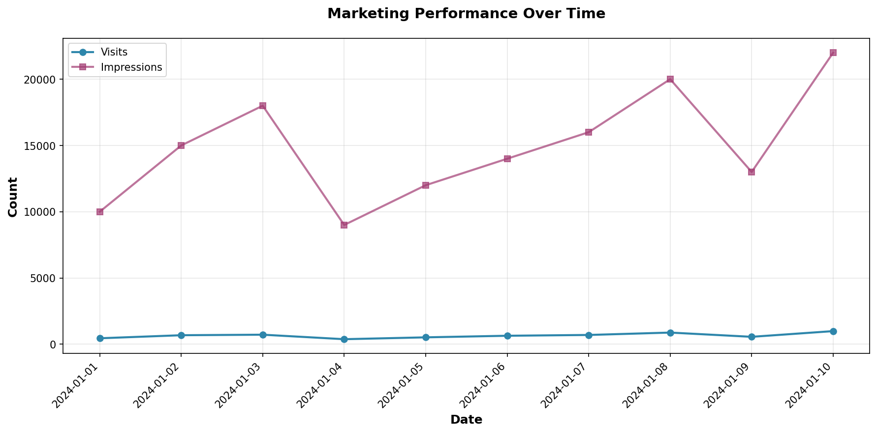
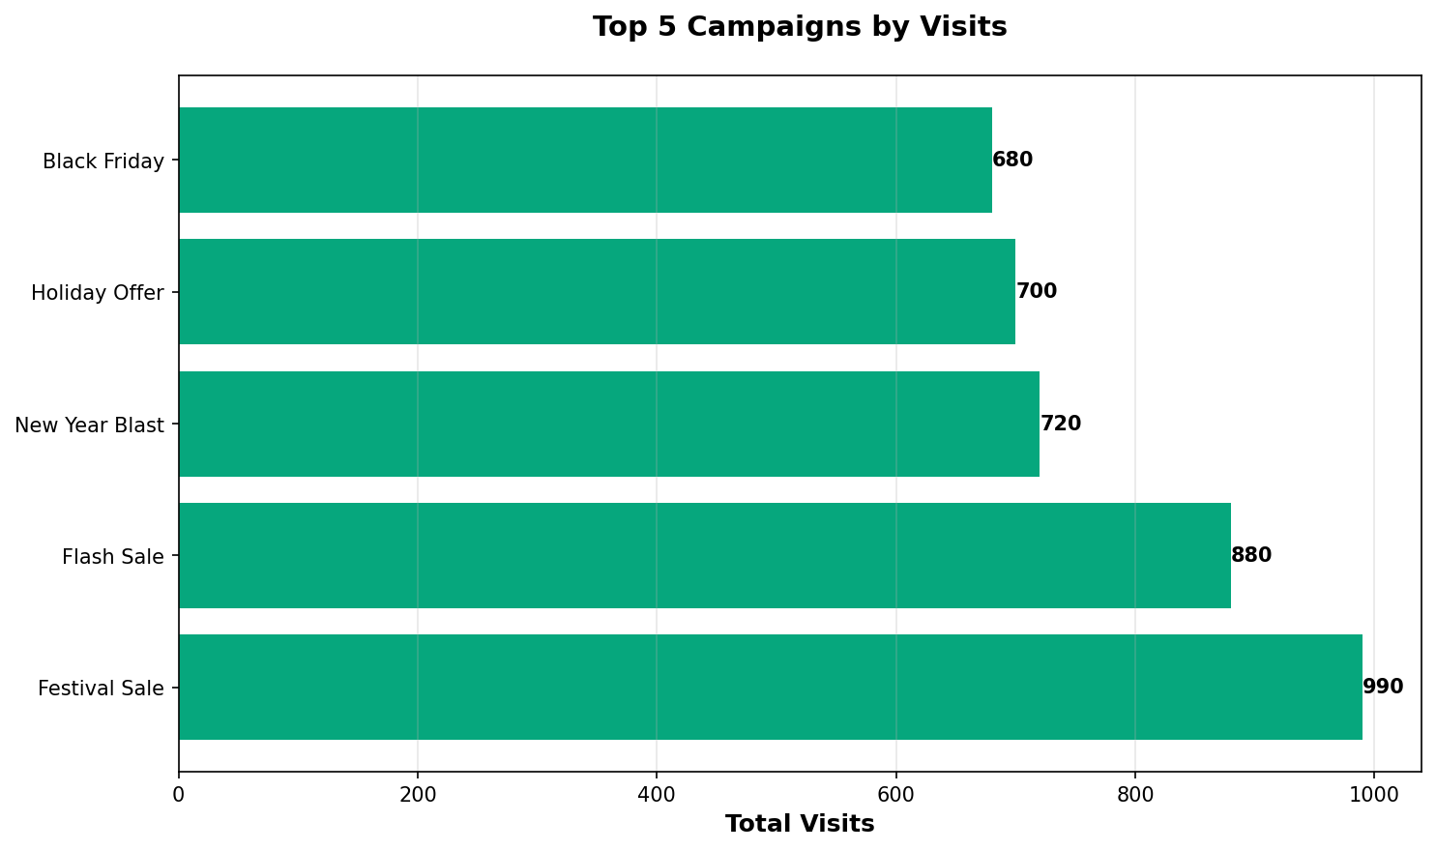
Key Visuals

Slide 4
Top 5 Campaigns
1. Festival Sale
• Visits: 990
• Clicks: 1,100
• Spend: $2,200.30
• CTR: 5.00%
2. Flash Sale
• Visits: 880
• Clicks: 950
• Spend: $1,900.00
• CTR: 4.75%
3. New Year Blast
• Visits: 720
• Clicks: 820
• Spend: $1,700.00
• CTR: 4.56%
4. Holiday Offer
• Visits: 700
• Clicks: 800
• Spend: $1,600.40
• CTR: 5.00%
5. Black Friday
• Visits: 680
• Clicks: 750
• Spend: $1,500.75
• CTR: 5.00%

Slide 5
Appendix: Key Metrics
Total Impressions: 149,000
Total Clicks: 7,250
Total Spend: $14,403.75
Total Visits: 6,520
Average CTR: 4.87%
Average CPC: $1.99

