Slide 1
Introduction to Data Science
Part 3: Numpy and basic linear algebra

Slide 2
Numpy
Numpy array creation
Array access and operations
Basic linear algebra

Slide 3
Numpy
Stands for Numerical Python
Is the fundamental package required for high performance computing and data analysis
It provides
ndarray for creating multiple dimensional arrays
Standard math functions for fast operations on entire arrays of data without having to write loops
Tools for reading/writing array data
Linear algebra tools
etc.
Notes:
是高性能计算和数据分析所需的基本软件包
用于对整个数据数组进行快速操作的标准数学函数，无需编写循环

Slide 4
ndarray vs list of lists
Say you have grades of three exams (2 midterms and 1 final) in a class of 10 students.
grades =
How to get final exam grade of student 0?
grades[0][2]
How to get grades of student 2?
grades[2]
How to get grades of all students in midterm 1?
How to get midterm grades of the first three students (or all female students, or those who failed final)?
How to get mean grade of each exam?
How to get (weighted) average exam grade for each student?
[[79, 95, 60],
[95, 60, 61],
[99, 67, 84],
[76, 76, 97],
[91, 84, 98],
[70, 69, 96],
[88, 65, 76],
[67, 73, 80],
[82, 89, 61],
[94, 67, 88]]

Slide 5
ndarray vs list of lists
In [5]: gArray[0,2]
Out[5]: 60
In [7]: gArray[2,:]
Out[7]: array([99, 67, 84])
In [8]: gArray[:, 0]
Out[8]: array([79, 95, 99, 76, 91, 70, 88, 67, 82, 94])
In [9]: gArray[:3, :2]
Out[9]:
array([[79, 95],
[95, 60],
[99, 67]])
gArray = array(examGrades)
In [3]: gArray
Out[3]:
array([[79, 95, 60],
[95, 60, 61],
[99, 67, 84],
...,
[67, 73, 80],
[82, 89, 61],
[94, 67, 88]])

Slide 6
ndarray
ndarray is used for storage of homogeneous data
i.e., all elements must be the same type
Every array must have a shape
And a dtype
Supports convenient slicing, indexing and efficient vectorized computation
Avoid for loops, and much more efficient
In [15]: type(gArray)
Out[15]: numpy.ndarray
In [16]: gArray.ndim
Out[16]: 2
In [17]: gArray.shape
Out[17]: (10, 3)
In [18]: gArray.dtype
Out[18]: dtype('int32')

Slide 7
Creating ndarrays
In [65]: np.array([[0,1,2],[2,3,4]])
Out[65]:
array([[0, 1, 2],
[2, 3, 4]])
In [66]: np.zeros((2,3))
Out[66]:
array([[ 0., 0., 0.],
[ 0., 0., 0.]])
In [67]: np.ones((2,3))
Out[67]:
array([[ 1., 1., 1.],
[ 1., 1., 1.]])
In [69]: np.eye(3)
Out[69]:
array([[ 1., 0., 0.],
[ 0., 1., 0.],
[ 0., 0., 1.]])
In [70]: np.arange(0, 10, 2)
Out[70]: array([0, 2, 4, 6, 8])
np.array
np.zeros
np.ones
np.eye
np.arange
np.random
In [295]: np.random.randint(0, 10, (3,3))
Out[295]:
array([[8, 7, 6],
[0, 8, 9],
[9, 0, 4]])

Slide 8
Numpy data types
In [34]: gArray.astype(float64)
Out[34]:
array([[ 79., 95., 60.],
[ 95., 60., 61.],
...,
[ 82., 89., 61.],
[ 94., 67., 88.]])
int8, int16, int32, int64
float16, float32, float64, float128
bool
object
String
Unicode
gArray.astype
64 bits
In [79]: num_string = array(['1.0', '2.05', '3'])
In [81]: num_string
Out[81]:
array(['1.0', '2.05', '3'],
dtype='<U4')
In [82]: num_string.astype(float)
Out[82]: array([ 1. , 2.05, 3. ])

Slide 9
Array operations
In [87]: arr = array([[0,1,2],[3,4,5]])
In [88]: arr * 2
Out[88]:
array([[ 0, 2, 4],
[ 6, 8, 10]])
In [90]: arr ** 2
Out[90]:
array([[ 0, 1, 4],
[ 9, 16, 25]])
In [91]: 2 ** arr
Out[91]:
array([[ 1, 2, 4],
[ 8, 16, 32]], dtype=int32)
Between arrays and scalars
Between equal-sized arrays: elementwise operation
In [94]: arr * arr
Out[94]:
array([[ 0, 1, 4],
[ 9, 16, 25]])
In [95]: arr / (arr+1)
Out[95]:
array([[ 0. , 0.5 , 0.66666667],
[ 0.75 , 0.8 , 0.83333333]])

Slide 10
Speed difference between for loop and vectorized computation
def mySum(inputList):
s = 0
for i in range(len(inputList)):
s += inputList[i]
return s
In [118]: a = np.random.rand(1000000,1)
...: %timeit a**2
...: %timeit [a[i]**2 for i in range(1000000)]
1.72 ms ± 25.3 µs per loop (mean ± std. dev. of 7 runs, 1000 loops each)
1.02 s ± 7.34 ms per loop (mean ± std. dev. of 7 runs, 1 loop each)
Vectorization is more than 600 times faster!
In [148]: timeit mySum(a)
1.84 s ± 42.4 ms per loop (mean ± std. dev. of 7 runs, 1 loop each)
In [149]: timeit np.sum(a)
1.08 ms ± 167 µs per loop (mean ± std. dev. of 7 runs, 1000 loops each)
In [150]: timeit reduce(lambda x, y: x+y, a)
1.93 µs ± 22.5 ns per loop (mean ± std. dev. of 7 runs, 1000000 loops each)
Vectorization is 1700 times faster than for loop.
Reduce is even slower than for loop here.
In [151]: timeit map(lambda x: x**2, a)
181 ns ± 0.778 ns per loop
map appears to be very fast, but it is just because it is lazy – actual calculation has not been done yet.
Notes:
map看起来非常快，但这只是因为它是懒惰的-实际计算还没有完成。

Slide 11
Array indexing and slicing
Somewhat similar to python list, but much more flexible
In [152]: gArray
Out[152]:
array([[79, 95, 60],
[95, 60, 61],
[99, 67, 84],
...,
[67, 73, 80],
[82, 89, 61],
[94, 67, 88]])
In [153]: gArray[0]
Out[153]: array([79, 95, 60])
In [154]: gArray[1:3]
Out[154]:
array([[95, 60, 61],
[99, 67, 84]])
In [155]: gArray[0][2]
Out[155]: 60
In [156]: gArray[0,2]
Out[156]: 60
In [157]: gArray[:, 2]
Out[157]: array([60, 61, 84, 97, 98, 96, 76, 80, 61, 88])

Slide 12
Array indexing and slicing (cont’d)
In [152]: gArray
Out[152]:
array([[79, 95, 60],
[95, 60, 61],
[99, 67, 84],
...,
[67, 73, 80],
[82, 89, 61],
[94, 67, 88]])
In [160]: gArray[:2, [0, 2]]
Out[160]:
array([[79, 60],
[95, 61]])
In [175]: gArray[[0, 2], :]
Out[175]:
array([[79, 95, 60],
[99, 67, 84]])
In [200]: gArray[[0,2]][:,[0,2]]
Out[200]:
array([[79, 60],
[99, 84]])
In [177]: gArray[[0, 2], [0, 1, 2]]
Traceback (most recent call last):
...
IndexError: shape mismatch: ...
In [178]: gArray[[0, 2], [0, 2]]
Out[178]: array([79, 84])
In [272]: gArray[np.ix_([0, 2], [0, 2])]
Out[272]:
array([[79, 60],
[99, 84]])
list

Slide 13
Array slices are views
In [202]: gArray[0,:]=100
In [203]: gArray
Out[203]:
array([[100, 100, 100],
[ 95, 60, 61],
[ 99, 67, 84],
...,
[ 67, 73, 80],
[ 82, 89, 61],
[ 94, 67, 88]])
In [254]: arr2 = gArray.copy()
In [255]: arr2 is gArray
Out[255]: False
In [258]: arr2[1,:]=100
In [260]: gArray[1,:]
Out[260]: array([95, 60, 61])
Use .copy() to make a copy of an array explicitly.

Slide 14
Boolean indexing
# select record for those who had # <= 70 in final
In [265]: gArray[gArray[:, 2]<70,:]
Out[265]:
array([[95, 60, 61],
[82, 89, 61]])
# select record for female students
In [262]: female = [ True, False, True, True, False, True, False, False, False, False]
In [263]: gArray[female, :]
Out[263]:
array([[100, 100, 100],
[ 99, 67, 84],
[ 76, 76, 97],
[ 70, 69, 96]])
# anything < 70 is changed to 70
In [267]: gArray[gArray < 70] = 70
In [268]: gArray
Out[268]:
array([[100, 100, 100],
[ 95, 70, 70],
[ 99, 70, 84],
...,
[ 70, 73, 80],
[ 82, 89, 70],
[ 94, 70, 88]])

Slide 15
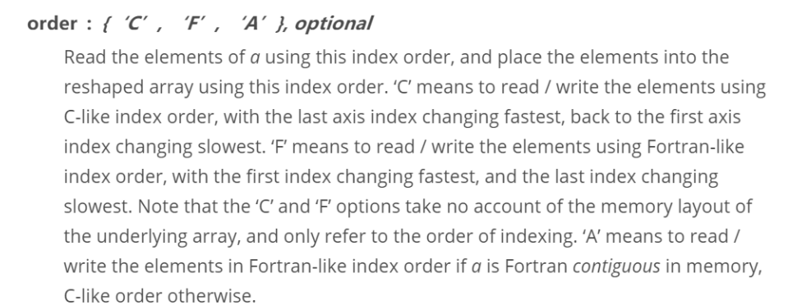
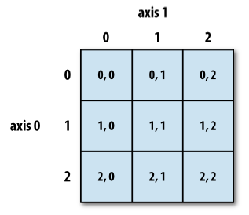
Reshaping and transposing
In [280]: In [77]: np.arange(6).reshape((2,3))
Out[280]:
array([[0, 1, 2],
[3, 4, 5]])
In [281]: In [77]: np.arange(6).reshape((2,3), order='F')
Out[281]:
array([[0, 2, 4],
[1, 3, 5]])
In [290]: np.arange(6).reshape(2,3).T
Out[290]:
array([[0, 3],
[1, 4],
[2, 5]])

Slide 16
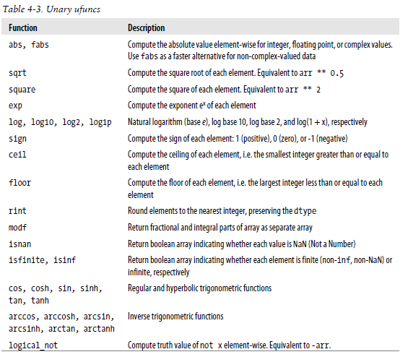
Fast element-wise functions

Slide 17
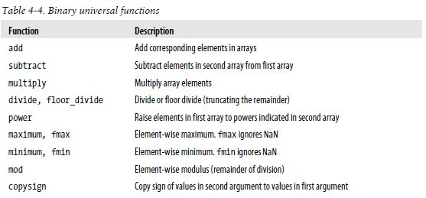
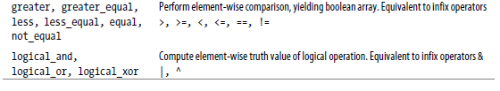
https://docs.scipy.org/doc/numpy/reference/

Slide 18
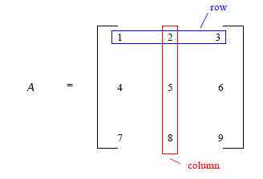
Matrix
A matrix is a rectangular array of numbers organized in rows and columns
If a matrix A has m rows and n columns, then we say that A is an m x n matrix

Slide 19
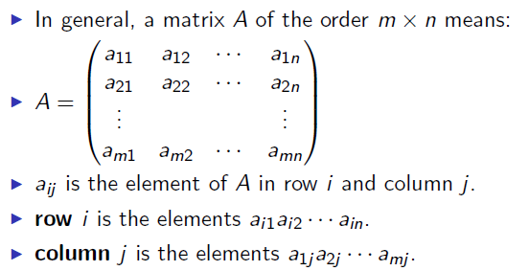
Matrix

Slide 20
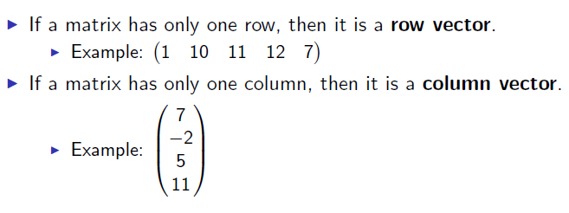
Vectors

Slide 21
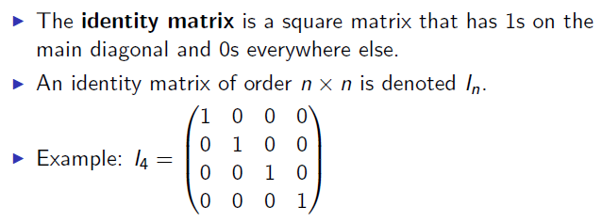
Identity matrix

Slide 22
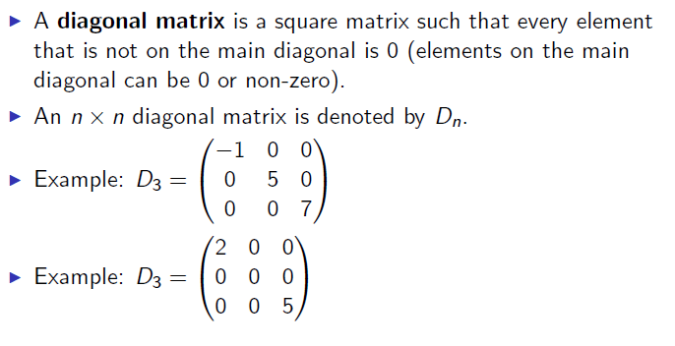
Diagonal matrix

Slide 23
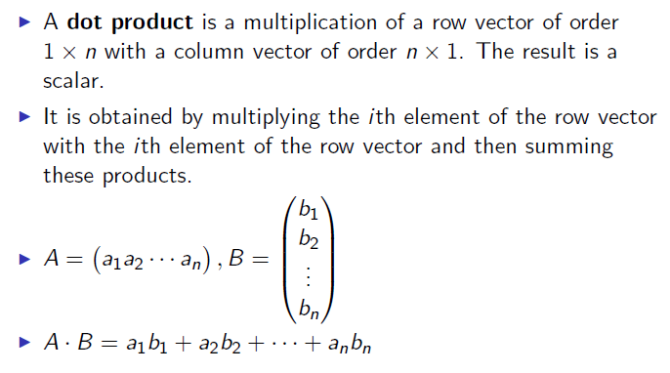
Dot product
In [303]: a = b = np.arange(5)
In [305]: a
Out[305]: array([0, 1, 2, 3, 4])
In [306]: b
Out[306]: array([0, 1, 2, 3, 4])
In [307]: a.dot(b)
Out[307]: 30

Slide 24
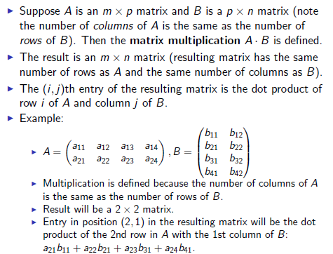
Matrix multiplication

Slide 25
In [152]: gArray
Out[152]:
array([[79, 95, 60],
[95, 60, 61],
[99, 67, 84],
...,
[67, 73, 80],
[82, 89, 61],
[94, 67, 88]])
79 | 95 | 60
95 | 60 | 61
99 | 60 | 61
…
67 | 73 | 80
82 | 89 | 61
94 | 67 | 88
76.2
70.9
83.4
…
74.0
75.7
83.5
0.3
0.3
0.4
x
=
In [321]: gArray.dot([0.3, 0.3, 0.4])
Out[321]: array([ 76.2, 70.9, 83.4, 84.4, 91.7, 80.1, 76.3, 74. , 75.7, 83.5])
What is being calculated here?

Slide 26
In [152]: gArray
Out[152]:
array([[79, 95, 60],
[95, 60, 61],
[99, 67, 84],
...,
[67, 73, 80],
[82, 89, 61],
[94, 67, 88]])
In [329]: scaling = [1.1, 1.05, 1.03]
In [330]: diag(scaling)
Out[330]:
array([[ 1.1 , 0. , 0. ],
[ 0. , 1.05, 0. ],
[ 0. , 0. , 1.03]])
In [331]: gArray.dot(diag(scaling))
Out[331]:
array([[ 86.9 , 99.75, 61.8 ],
[ 104.5 , 63. , 62.83],
[ 108.9 , 70.35, 86.52],
...,
[ 73.7 , 76.65, 82.4 ],
[ 90.2 , 93.45, 62.83],
[ 103.4 , 70.35, 90.64]])
What are we doing here?

Slide 27
In [152]: gArray
Out[152]:
array([[79, 95, 60],
[95, 60, 61],
[99, 67, 84],
...,
[67, 73, 80],
[82, 89, 61],
[94, 67, 88]])
In [337]: gArray.max(axis=0)
Out[337]: array([99, 95, 98])
In [338]: maxInExam = gArray.max(axis=0)
In [339]: gArray.dot(diag(100/maxInExam)).round()
Out[339]:
array([[ 80., 100., 61.],
[ 96., 63., 62.],
[ 100., 71., 86.],
...,
[ 68., 77., 82.],
[ 83., 94., 62.],
[ 95., 71., 90.]])
What are we doing here?

Slide 28
Speed difference between for loop and matrix multiplication
In [361]: maxInCol = a.max(axis=0)
In [362]: maxInCol.shape
Out[362]: (100,)
In [363]: timeit [[a[j,i]*100/maxInCol[i] for i in range(100)]
for j in range(10000)]
13min 44s ± 17.7 s per loop (mean ± std. dev. of 7 runs, 1 loop each)
In [355]: a = rand(10000, 100)
In [356]: timeit a.dot(100/a.max(0))
1.25 ms ± 34.3 µs per loop (mean ± std. dev. of 7 runs, 1000 loops each)
In [357]: timeit [a[:,i]*100/max(a[:,i]) for i in range(100)]
82.8 ms ± 951 µs per loop (mean ± std. dev. of 7 runs, 10 loops each)
In [358]: timeit [[a[j,i]*100/max(a[:,i]) for i in range(100)] for j in range(10000)]

Slide 29
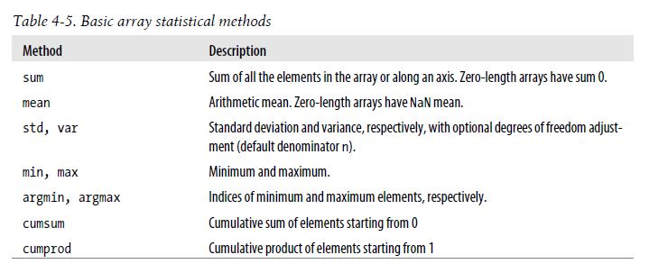
In [394]: a=randint(0, 5, size=(3,3))
In [395]: a
Out[395]:
array([[4, 1, 2],
[2, 2, 1],
[1, 1, 4]])
In [396]: a.sum()
Out[396]: 18
In [397]: a.sum(axis=0)
Out[397]: array([7, 4, 7])
In [398]: a.sum(1)
Out[398]: array([7, 5, 6])
In [405]: (a > 2).any(1)
Out[405]: array([ True, False, True], dtype=bool)

Slide 30
numpy.sort()
In [407]: a.sort()
In [408]: a
Out[408]:
array([[1, 2, 4],
[1, 2, 2],
[1, 1, 4]])
In [410]: a.sort(0)
In [411]: a
Out[411]:
array([[1, 1, 2],
[1, 2, 4],
[1, 2, 4]])

Slide 31
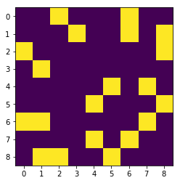
Adjacency matrix for a graph
In [603]: n=friends.max()
...: frdGraph = zeros((n+1,n+1))
...: frdGraph[friends[:,0],friends[:,1]]=1
...: frdGraph[friends[:,1],friends[:,0]]=1
...: imshow(frdGraph)
...: xticks(range(9))
In [604]: friends
Out[604]:
array([[0, 2],
[0, 6],
[1, 3],
[2, 3],
[4, 5],
[3, 7],
[4, 7],
[5, 8],
[6, 7]], dtype=int64)

Slide 32
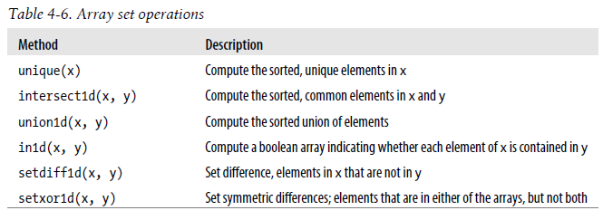
In [654]: edgeList
Out[654]:
array([['Amy', 'Frank'],
['Amy', 'Katy'],
['Emma', 'James'],
...,
['Cindy', 'Rose'],
['Tim', 'John'],
['Katy', 'Rose']],
dtype='<U5')
In [676]: names, indices = unique(edgeList, return_inverse=True)
In [677]: names
Out[677]:
array(['Amy', 'Cindy', 'Emma', 'Frank', 'James', 'John', 'Katy', 'Rose', 'Tim'], dtype='<U5')
In [678]: indices
Out[678]: array([0, 3, 0, ..., 5, 6, 7], dtype=int64)
In [715]: reshape(indices,(-1, 2)).T
Out[715]:
array([[0, 0, 2, ..., 1, 8, 6],
[3, 6, 4, ..., 7, 5, 7]], dtype=int64)

Slide 33
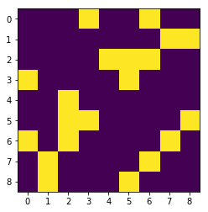
In [654]: edgeList
Out[654]:
array([['Amy', 'Frank'],
['Amy', 'Katy'],
['Emma', 'James'],
...,
['Cindy', 'Rose'],
['Tim', 'John'],
['Katy', 'Rose']],
dtype='<U5')
In [676]: names, indices = unique(edgeList, return_inverse=True)
In [677]: names
Out[677]:
array(['Amy', 'Cindy', 'Emma', 'Frank', 'James', 'John', 'Katy', 'Rose', 'Tim'], dtype='<U5')
In [710]: n = indices.max()
...: frdGraph2 = zeros((n+1,n+1))
...: frdGraph2[indices[::2], indices[1::2]] = 1
...: frdGraph2[indices[1::2], indices[::2]] = 1
...: imshow(frdGraph2); xticks(range(n+1))

Slide 34
Sparse matrix support
In scipy.sparse
Necessary for larger sparse graphs (e.g. social networks)
Most real world networks are sparse
Memory efficiency is crucial for applications
https://docs.scipy.org/doc/scipy/reference/index.html

