Slide 1
The History Engine
How latent supply-chain chokepoints are made, mapped, and woken up
The claim: supply-chain power sleeps in a latent zone of critical but invisible commodities.
A sedimentation mechanism builds it (H1); a two-factor score built from public data separates
real latent chokepoints from false alarms, graded against seven real-world reveals (H2a);
and how hard one wakes up follows criticality × unpreparedness (H2b, validated).
Chunyang Zhang · advisor meeting · August 2026
Notes:
One-sentence claim, then the three verbs that organize the talk: made (H1), mapped (H2a), woken (H2b).

Slide 2
THE QUESTION
Why do chokepoints get discovered only after they blow up?
In 2022 the world learned that roughly half of semiconductor-grade neon came from two purification firms in Mariupol and Odesa, Ukraine. It learned this after the missiles hit (Reuters, March 2022).
On July 3, 2023, China restricted gallium and germanium exports. The move set off an industry scramble — U.S. supplier AXT filed for export permits the next day (Reuters, July 4, 2023) — even though China's 98% share of low-purity gallium had been sitting in USGS yearbooks for a decade (USGS MCS 2023).
The standard tools ask who is cheapest (comparative advantage) or who should worry (criticality ratings). Neither asks who has been quietly stacking cards in the dark.
98.2%
China's share of global low-purity gallium output (USGS Mineral Commodity Summaries 2023)
394 articles
all English supply-chain coverage of gallium in the 24 months before it was restricted (author's measurement, Media Cloud)
21–27 months
the July 2023 top ten holds synthetic diamond plus eight rare earths — all restricted in 2025 (graded against MOFCOM announcements)
Notes:
Open with neon, then cut to gallium. The three numbers on the right: the card was huge, nobody was looking, and we can see it coming.

Slide 3
FRAMEWORK
Three axes, three different treatments
1
Reflexivity Will it hear the prediction?
A design rule, not a variable: predict only structural facts — capacity, installed circuits — never prices or policy timing. Structure, once in place, does not easily change, and that is what makes it assessable years ahead. (Soros 2013; Grunberg & Modigliani 1954; Lucas 1976)
2
Visibility Is anyone watching?
Measured ourselves: context-filtered news counts on the Media Cloud archive (Roberts et al. 2021) — 100 commodities × 6 dates = 600 cells. Search terms are generated by outcome-blind mechanical rules and adversarially audited; corrections happen only under result-blind triggers, with both versions reported.
3
Criticality Does it hurt when cut?
Imported: USGS supply-risk scores (Nassar & Fortier 2021) plus China's production share at the stage actually restricted (DOE 2022; USGS MCS 2023; SCRREEN 2023). All numbers were published by others before these controls existed, which closes off any tuning accusation.
Two formulas: latent power (stock) = criticality × invisibility, the cards asleep in the dark. Awakening intensity (flow) = criticality × pre-event unpreparedness, how much it hurts when a card is played.
Notes:
The treatment itself is a contribution: gate off what can't be predicted, measure what nobody has measured, import what is mature.

Slide 4
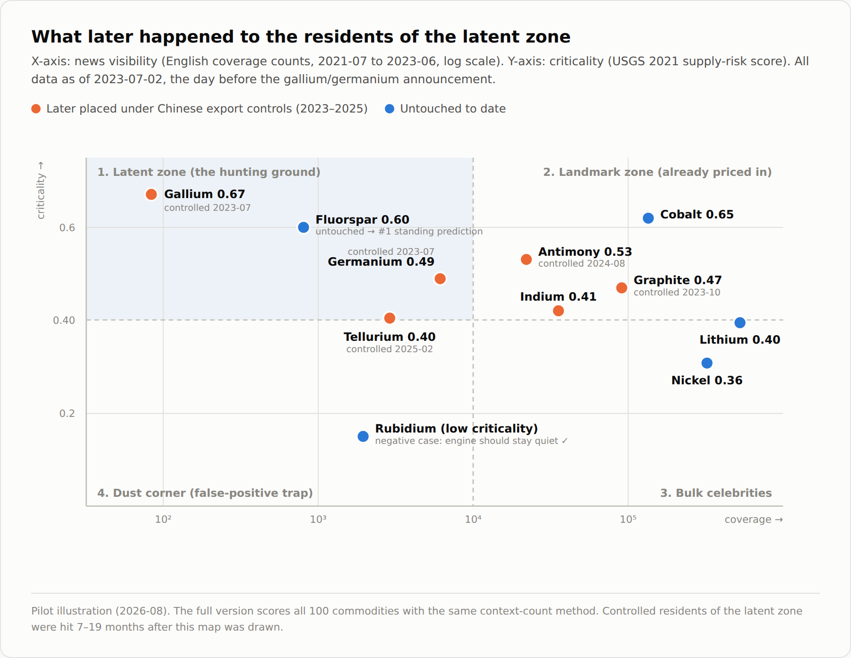
FRAMEWORK · VISIBILITY × CRITICALITY
The map: the hunting ground is the top-left quadrant
1 · Latent zone: big cards nobody watches. The hunting ground: heavy rare earths, bismuth, germanium, tellurium, indium.
2 · Landmark zone: big cards everyone watches, so no information advantage: lithium, cobalt, magnesium.
3 · Bulk celebrities: loud but not lethal: gold, copper.
4 · Dust corner: dark and harmless. The false-positive trap (thallium, kyanite); only the criticality gauge separates it from the latent zone.
Data: Media Cloud news counts; USGS 2021 supply-risk scores (Nassar & Fortier 2021); control status from MOFCOM announcements.
Notes:
Pilot scatter. Restricted residents of the latent zone were hit 7 to 19 months after the map was drawn. Fluorspar is still untouched and is the number-one standing prediction.

Slide 5
DESIGN OVERVIEW
The design: one mechanism, one map, two tests
H1 · Mechanism
H2a · Map test
H2b · Awakening test
Why does the latent zone exist?
Does the assessment hold up against reality?
Does the intensity formula hold?
A deep case of gallium riding alumina: sedimentation, the capacity ratchet, and a 44-plant census. Output: Figures 1 and 2.
→
The framework scores every commodity for latent power. Seven export-control rounds (2023–25, the complete set) serve as grading events — the moments the card-holder shows its hand. The aim is to validate the chokepoint assessment, not to forecast policy.
→
Among commodities that did get restricted, do the more latent ones hit harder? Three thermometers: attention, stocks, commodity prices.
How the two tests interlock: H2a's misses (graphite and molybdenum were restricted without being flagged) land quietly in H2b precisely because they were not latent. Each test digests the other's residuals.
Notes:
Why export controls as the answer key: the only event set that is complete, officially dated, and triggered by an actor who knows its own cards. A natural experiment.

Slide 6
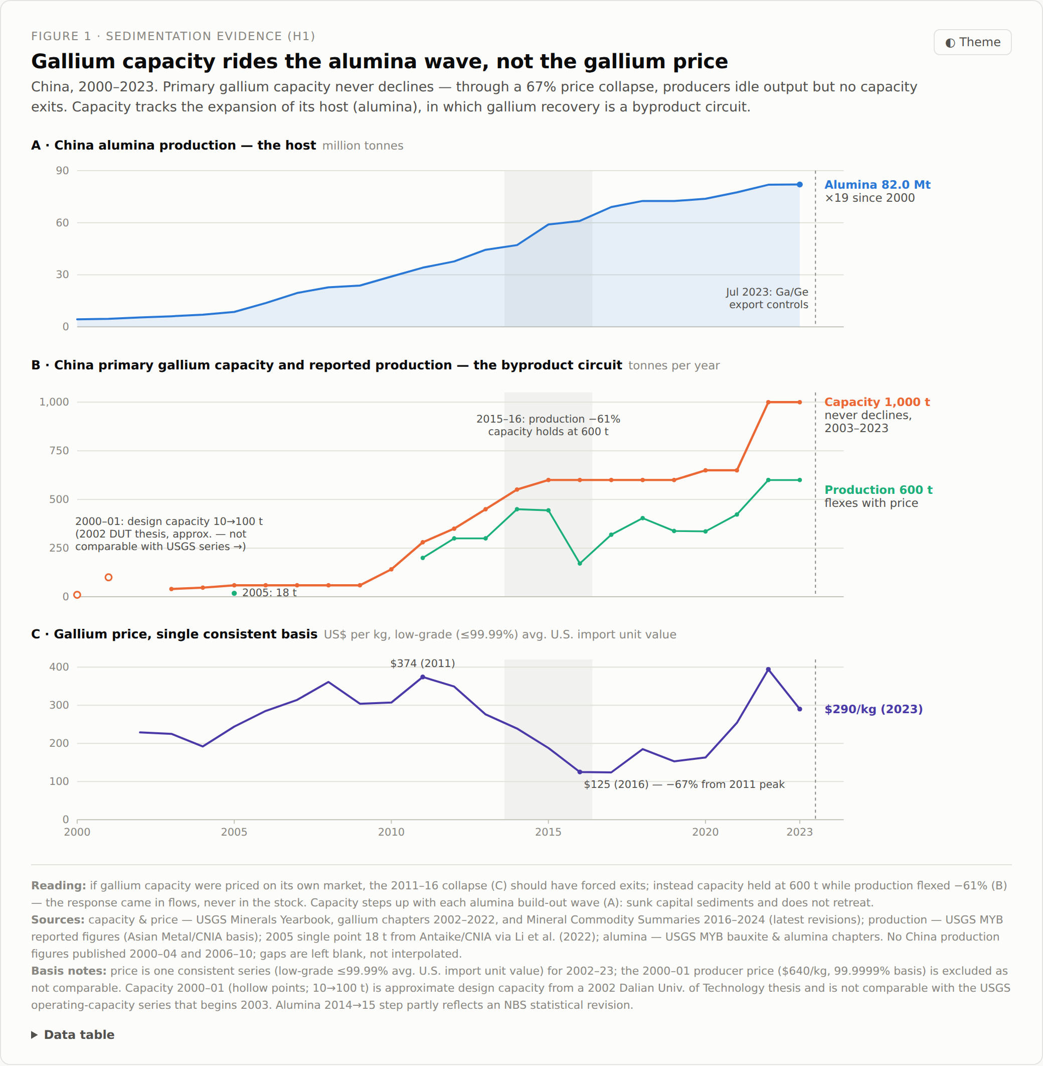
MECHANISM · WHY THE ZONE EXISTS
H1 · Sedimentation: capacity is a ratchet, the market only adjusts flow
0 declines in 21 yrs
times Chinese gallium capacity fell in the USGS record; it holds at 1,000 t and only ever rises
−67% / −61% / 0
2011→2016: price collapsed, output was cut, capacity did not move
×19
growth of the host (alumina) over the same period; gallium capacity rode along and settled
Sources: USGS Minerals Yearbook (gallium chapters 2002–2022) & Mineral Commodity Summaries 2016–2024; production basis Asian Metal/CNIA. Full basis notes inside Figure 1.
Notes:
Why no regression: too few datable facilities, and permit dates mostly reflect the 2017 rollout of the permit system. Careful descriptive evidence with sourcing per data point is stronger here.

Slide 7
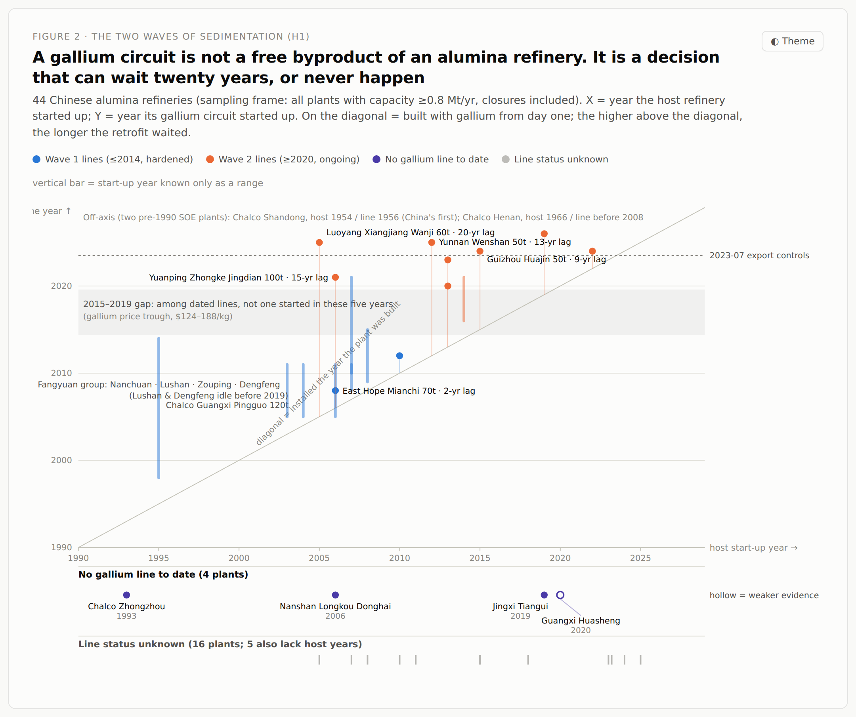
MECHANISM · 44-PLANT CENSUS, FULL EXTERNAL SAMPLING FRAME
H1 · Two waves: the circuit is a decision, not a chemical freebie
Wave 1, ≤2014: fixed what China was holding in July 2023.
2015–19 gap: gallium price trough; not a single new line.
Wave 2, ≥2020: prices recovered and the controls lit the map. Reflexive erosion, caught on camera.
The clincher: Xiangjiang Wanji built its refinery in 2005 and added a gallium line in 2025. Its own filing: “adds 60 t of gallium, alumina capacity unchanged.”
Outsourced circuits: the Fangyuan model ran lines at six sites. Installing is nearly free and keeping is free, so nothing ever gets torn out.
Sources: MEE environmental-impact filings, listed-company disclosures & investor Q&A, China Nonferrous Metals News (2019 survey), SHFE registered-brand list (2024), Mysteel capacity tables. Cell-level sourcing in host_vintage_gallium.csv.
Notes:
The bridge to H2: stacking share inside a host generates no news. High criticality with low visibility is a manufactured equilibrium, not something the market has not gotten around to noticing.

Slide 8
MAP TEST · DESIGN
H2a · Seven exams: lock yourself into the day before the announcement
A
B
C
D
E1
E2
2023-07
2023-10
2024-08
2025-02
2025-04
2025-10
Ga, Ge
graphite (tightened)
antimony
W, Te, Bi, Mo, In
7 heavy rare earths
5 rare earths + diamond
Procedure: pre-cutoff data only → score all 100 commodities → take the top ten → let the real world grade it (precision@10 plus specificity).
1
Cutoff discipline information frozen per exam; D and E1 pull back to before the US actions that triggered them, so no retaliation expectations leak in
2
Pool defined externally USGS list: 86 commodities plus 14 lanthanides, 100 rows, nothing added or dropped. Pool closed out Aug 15: 88 rows share-valued from pre-cutoff sources, 11 documented-NA (USGS states no data exists)
3
Criticality imported scores and shares as published by USGS in 2021, before any of these controls existed
4
Terms by rule, then audited queries generated from USGS row names by outcome-blind rules; 23 mechanical overrides, all audited for direction — none affects the headline, two disclosed
Official texts: MOFCOM Announcements No. 23 & 39 (2023), No. 33 (2024), No. 10, 18, 55–58, 61–62 (2025), archived with URLs. Criticality inputs: Nassar & Fortier (2021); element shares: DOE (2022), USGS MCS (2023), SCRREEN (2023).
Notes:
Framing discipline: this is not sanction prediction. It verifies the map. When the card-holder shows its hand, do the cards come from the zone? Each lock blocks one specific cheating accusation.

Slide 9
MAP TEST · RESULTS · COMPLETED POOL
H2a · Results: the cards came almost entirely from the pre-marked zone
9–10 of 10
Diamond ×6
1 false light
per exam: 9/9/9/10/10 hits, p from 7.4×10⁻⁶ down to 2.0×10⁻¹⁰; in E2 the six commodities announced swept ranks 1–6
flagged in every exam's top ten, 21–27 months early (E2: #5); after its restriction, US media wrote zero articles in 30 days — only stocks read it
wollastonite, a 75%-share filler mineral on no critical list — the on-record cost of running without a criticality gate
The headline fact: on July 2, 2023, the day before the gallium announcement, the completed pool's top ten holds eight heavy rare earths, synthetic diamond (#7), and yttrium — nine picks, all restricted in 2025, 21–27 months later. Rank 9 is wollastonite, the one false light.
Where common sense bet wrong, the engine bet right: the neodymium and praseodymium everyone talks about never made the top ten, and remain unrestricted. Bismuth (68 pre-control articles) and tellurium (32) ranked and were later restricted.
Misses are diagnosable, bets are public: graphite was not flagged (not latent), nor molybdenum (40% share). Fluorspar — repeatedly top-five, untouched — is the standing prediction; wollastonite is its falsifying twin: restricted, it becomes a hit; if fluorspar never is, the engine loses its bet. Both outcomes are written down.
Diamond re-pulled with the corrected term (24-month counts 32–48 vs 3–4 before): it drops from #1 to #7 but stays in every top ten; all hit counts unchanged. Ground truth: MOFCOM announcements; hypergeometric exact tests.
Notes:
Cluster level answers the obviousness objection: take the whole rare-earth family off the board and the independent hits on bismuth, tungsten, tellurium, indium, gallium, germanium, antimony are still at the 1-in-a-million level.

Slide 10
MAP TEST · PAIRWISE, ON MATCHED POOLS
H2a · What the ablation can and cannot show
On raw precision, precise share alone now edges the product by one. Reported as is. The factors are collinear inside the rare-earth cluster; H2a cannot separate them — H2b does.
What the product buys in H2a: ranking quality — the product puts diamond at #7 (share alone leaves it 13th) — and robustness: on coarse group-level shares the product holds 7/10 while share alone falls to 5/10.
Invisibility alone → 4/10: materially worse; darkness without a stake is mostly dust.
USGS score only → 2/10: a different ruler rather than an ablation; it picks niobium, cobalt, tantalum — Washington's worries, not Beijing's cards.
All specifications ranked on the matched completed pool (exam A; n stated per bar). Earlier unmatched-pool and 57-row figures are superseded and archived.
Notes:
If asked why share-only wins by one: say it plainly — collinear factors, H2a can't separate them; the product's H2a value is diamond at #1 and coarse-data robustness; separation is H2b's grid, two slides on.

Slide 11
AWAKENING TEST · DESIGN
H2b · The awakening test: same controls, darker beforehand, louder bang?
Attention jump
context news in the 30 days after the announcement, over the pre-event monthly average. Covers all 21 restricted commodities, including those with no traded price, plus 58 placebos. (Media Cloud)
Stock CAR
5-day abnormal return of pure-exposure A-share names against the CSI 300; 24 ticker-events. (exchange daily quotes)
Commodity price
offshore price change after the announcement. The domestic price falls when exports are blocked, so the onshore-offshore gap is the power reading. One-month and longest windows. (Benchmark Mineral Intelligence; archived trade quotes, point-level sourcing on file)
Two instrument calibrations (kept in the methods notes):
Placebos: a fixed-seed draw of 20 never-restricted commodities, same windows, same template. Median ×1.26 — announcement months do not lift news across the board.
Dark against dark: equally invisible commodities jump ×23.2 when restricted (n=17, diamond included) and ×1.03 when not. The multiples are not an artifact of small baselines.
Notes:
Conditioning on 'was restricted' removes the player's strategy from the equation. This is the cleanest exam room the formula will ever get.

Slide 12
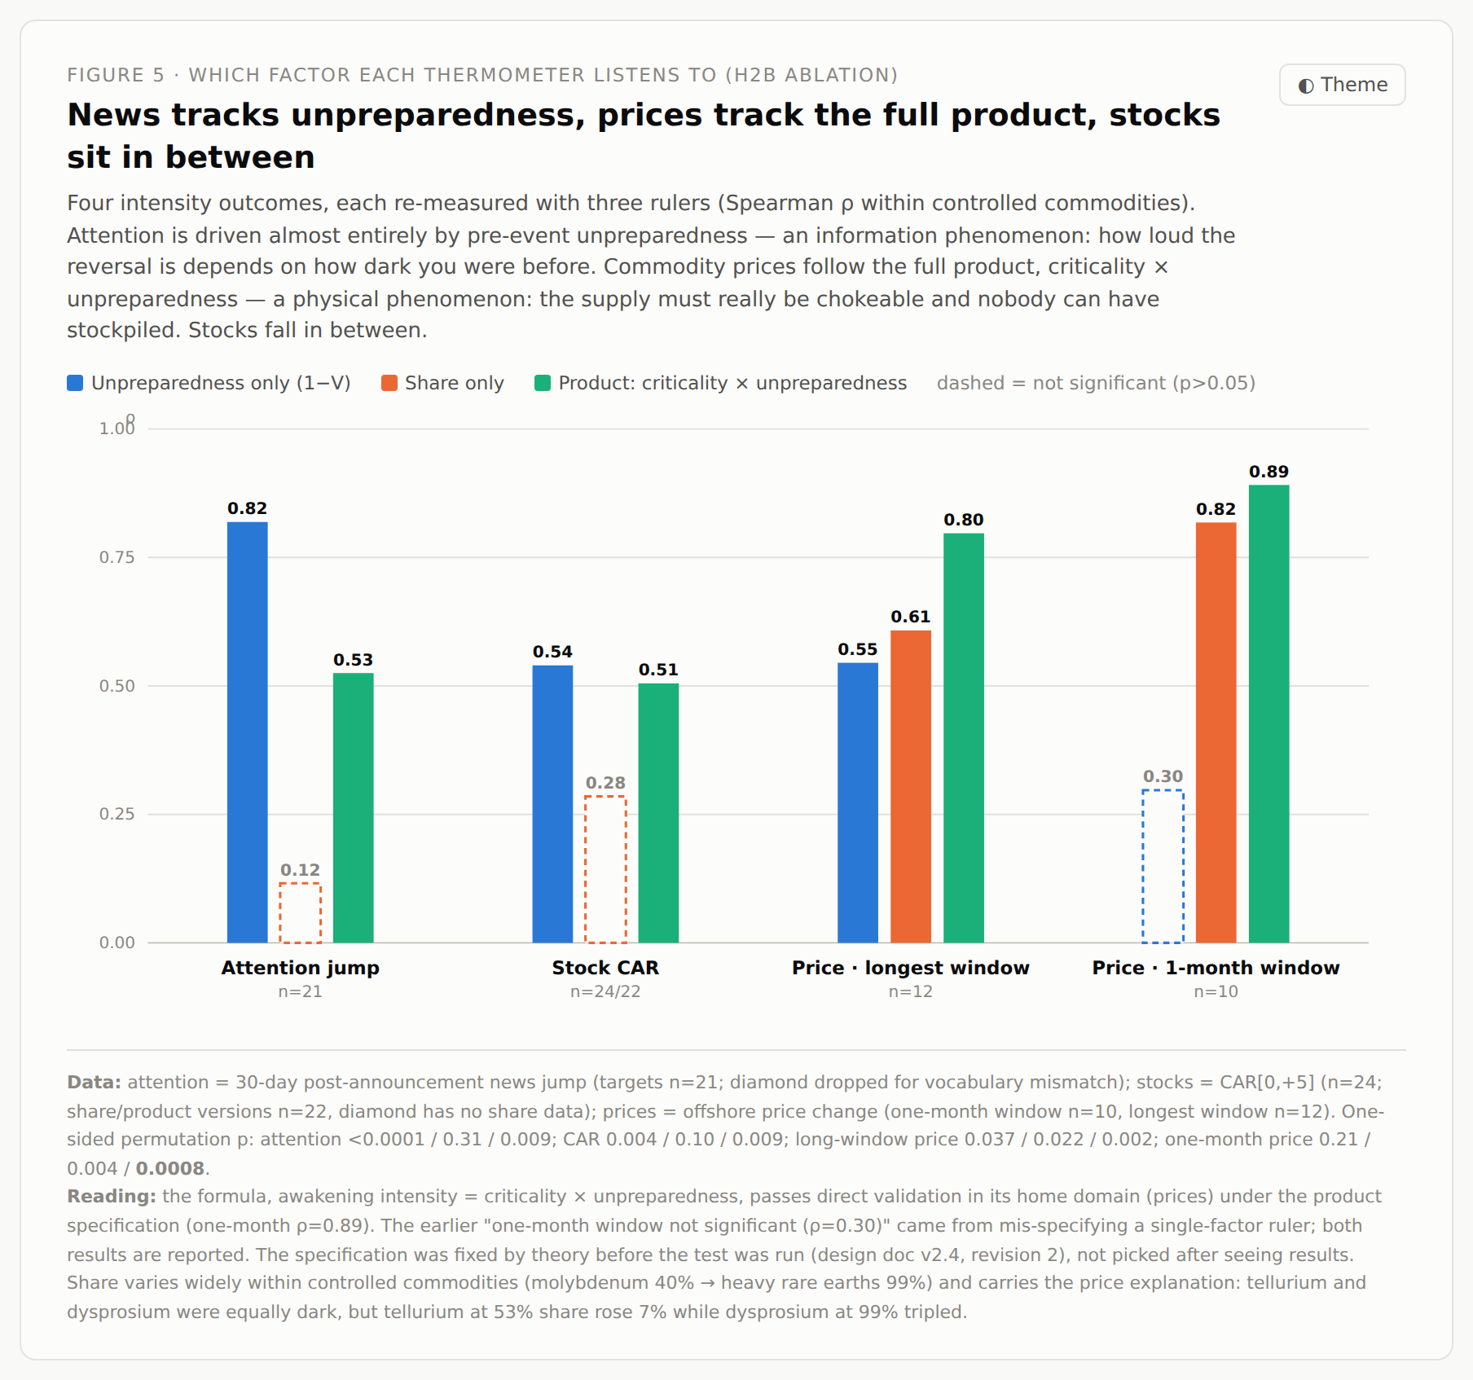
AWAKENING TEST · DIVISION OF LABOR
H2b · Results: the formula passes in its home domain
ρ = 0.89
price intensity against criticality × unpreparedness (one-month window, p=0.0008); the product beats either factor alone
×12.9 vs ×1.26
median attention jump, restricted commodities (n=22, diamond restored) against placebos (p<0.00001); latent ×23.2 vs landmark ×4.8 (p=0.0065)
ρ = 0.54
stock abnormal returns against pre-event latency (p=0.004)
Grid shown = n=21 sample. With diamond restored (n=22): attention column reads 0.66 / 0.09 n.s. / 0.36 (p=0.051) — both reported; other columns unchanged.
Notes:
The division of labor: news listens to unpreparedness (an information phenomenon), prices listen to the full product (a physical one: chokeable supply times empty warehouses), stocks sit in between.

Slide 13
AWAKENING TEST · CASES
Two exhibits: the negative space, and instruments covering for each other
Antimony: the card everyone saw coming
Diamond: the map flagged it, the news never did
Its price had already risen 200% before the controls; one foot was in the landmark zone. When the controls landed:
attention ×3.2, among the lowest in the target group
offshore price up just 12% in a month
antimony stocks opened at their peak and closed up under 2%
All three instruments went quiet at once. Nothing was left to reveal, so nothing moved.
The completed pool flags synthetic diamond in every exam's top ten, 21–27 months before its October 2025 restriction. And when it hit:
zero US articles in the 30 days after the announcement — even with the corrected search term; a real zero, not a vocabulary artifact
no offshore quote, so no price thermometer at all
Only the stock market read it: the two listed producers returned +25% in five days. Some commodities never cross the newsroom threshold — the best proof that the three instruments cover each other's blind spots.
Yunnan Germanium (deeply latent): three straight limit-up days, +37.8% abnormal return in five. The market pays only for power it did not see coming.
Stock data: exchange daily quotes vs CSI 300 — Yunnan Germanium 002428.SZ, Power Diamond 301071.SZ, Huanghe Whirlwind 600172.SH. Antimony price: trade-press assessments.
Notes:
Antimony is the theory's negative space. Diamond shows the darkest commodity being read only by the most sensitive of the three instruments.

Slide 14
METHOD · AUDIT TRAIL
The rigor file: every correction is on paper
Complete-set audit
Locks and audits
every MOFCOM announcement of 2023–25 checked number by number; the seven exams are the full set of physical mineral controls, nothing picked, nothing skipped
scoring formula and term map frozen and archived, then attacked by their own drafter: 23 candidate term overrides, zero effect on headline results
Seven logged corrections
Bets on the record
from a gallium price-series splice to a retracted collinearity claim; each error's discovery, fix, and retired numbers are in writing
fluorspar as the standing #1 prediction; wollastonite as the on-record false light (its restriction would flip it to a hit); the suspension orders expiring November 2026 as a dated bet — pass and fail conditions written in advance
Design principle: each part blocks one specific attack. Steps that were cut (panel regression, the 2×2 table, GDELT as the main source) are logged along with the reasons for cutting them.
Notes:
Present the honesty clauses as a feature: for every question a referee could raise, the file already holds a first-move answer.

Slide 15
Conclusions, and what comes next
1
Made the latent zone is not a market oversight. Byproduct economics keeps producing it, because stacking share inside a host generates no news (H1).
2
Mapped a two-factor score from public data separates real latent chokepoints from false alarms; across seven reveals the cards played came almost entirely from the marked zone, diamond was flagged in every top ten 21–27 months early, and one false light is on record (H2a, p down to 10⁻¹⁰).
3
Woken awakening intensity = criticality × unpreparedness, validated directly in prices (ρ=0.89). The market pays only for power it never priced (H2b).
Next: data and tests are complete and audited; writing starts now (outline set: 9 sections, 5 figures, 3 tables).
Three things I would like your judgment on:
1. Venue: is this an IPE / political science paper, or does the theory-plus-prediction package fit a general-interest journal better?
2. Collaboration: I plan to invite a computational co-author for replication and benchmark packaging, with the theory and data complete. How should author contributions be structured?
3. The standing predictions (fluorspar; the November 2026 suspension expiry): main text or appendix? How do you weigh the payoff of a public bet against its risk?
Notes:
Close on the three verbs, then hand the advisor three real decisions rather than a status report.

Slide 16
REFERENCES
References and data sources
Data
Theory
U.S. Geological Survey. Mineral Commodity Summaries, 2016–2024 editions; Minerals Yearbook, gallium chapters 2002–2022.
Nassar, N.T. & S.M. Fortier (2021). Methodology and Technical Input for the 2021 Review and Revision of the U.S. Critical Minerals List. USGS Open-File Report 2021–1045.
MOFCOM, PRC. Announcements No. 23, 39 (2023); No. 33, 46 (2024); No. 10, 18, 55–58, 61, 62, 70, 72 (2025). Official texts, archived with URLs.
U.S. Department of Energy (2022). Rare Earth Permanent Magnets: Supply Chain Deep Dive Assessment. February 2022.
SCRREEN project (2023). Critical raw materials factsheets. EU Horizon 2020.
Benchmark Mineral Intelligence (2026). Quarterly price assessments: natural and synthetic graphite, anodes.
Media Cloud news archive — Roberts, H., et al. (2021). Media Cloud: Massive Open Source Collection of Global News on the Open Web. Proc. ICWSM 15.
SSE/SZSE daily quotes and CSI 300 index (via Yahoo Finance API).
MEE environmental-impact disclosures; listed-company announcements and investor Q&A; China Nonferrous Metals News (2019 plant survey); SHFE registered-brand list (2024); Mysteel / CIB Futures / Founder CIFCO alumina capacity tables (2023–2025).
Reuters (2022-03-11). “Ukraine halts half of world's neon output for chips, clouding outlook.” Carried by CNN and CNBC.
Reuters (2023-07-04). “US firm AXT applying for permits after China restricts chipmaking exports.”
Farrell, H. & A.L. Newman (2019). Weaponized Interdependence: How Global Economic Networks Shape State Coercion. International Security 44(1): 42–79.
Soros, G. (2013). Fallibility, Reflexivity, and the Human Uncertainty Principle. Journal of Economic Methodology 20(4): 309–329.
Grunberg, E. & F. Modigliani (1954). The Predictability of Social Events. Journal of Political Economy 62(6): 465–478.
Lucas, R.E., Jr. (1976). Econometric Policy Evaluation: A Critique. Carnegie-Rochester Conference Series on Public Policy 1: 19–46.
Merton, R.K. (1948). The Self-Fulfilling Prophecy. Antioch Review 8(2): 193–210.
Berger, P.L. & T. Luckmann (1966). The Social Construction of Reality. Anchor Books.
Graedel, T.E., et al. (2015). Criticality of Metals and Metalloids. PNAS 112(14): 4257–4262.
Hughes, T.P. (1969). Technological Momentum in History: Hydrogenation in Germany 1898–1933. Past & Present 44: 106–132.
Callon, M. (1991). Techno-economic Networks and Irreversibility. In J. Law (ed.), A Sociology of Monsters. Routledge.
URL-level sourcing for every data point: evidence_manifest.csv, host_vintage_gallium.csv, h2b_activation.csv, and the notes block inside each figure.
Notes:
Backup slide. Point to it if asked where any number comes from; the manifest files carry per-cell URLs and access dates.

