Slide 1
Project Presentation Can a Decision making AI be implemented into a Turn-based battle System?
C00204076
Brandon Seah-Dempsey

Slide 2
What is my Project?
The purpose of this project is the research of different AI models and to see which models I can utilise.
Research into the use and functionality of the models that are intended to be used.
Use research to create and implement the AI models into a decision making of an NPC.

Slide 3
Purpose of AI
The purpose of the AI is see if a Decision making AI can be utilised into an NPC enemy of a Turn-based battle system.
And see if this addition can make this style of gameplay more enjoyable and still be challenging.
The reason for this is due to many Turn-based AIs relying on too much RNG, leading to frustration and annoyance.

Slide 4
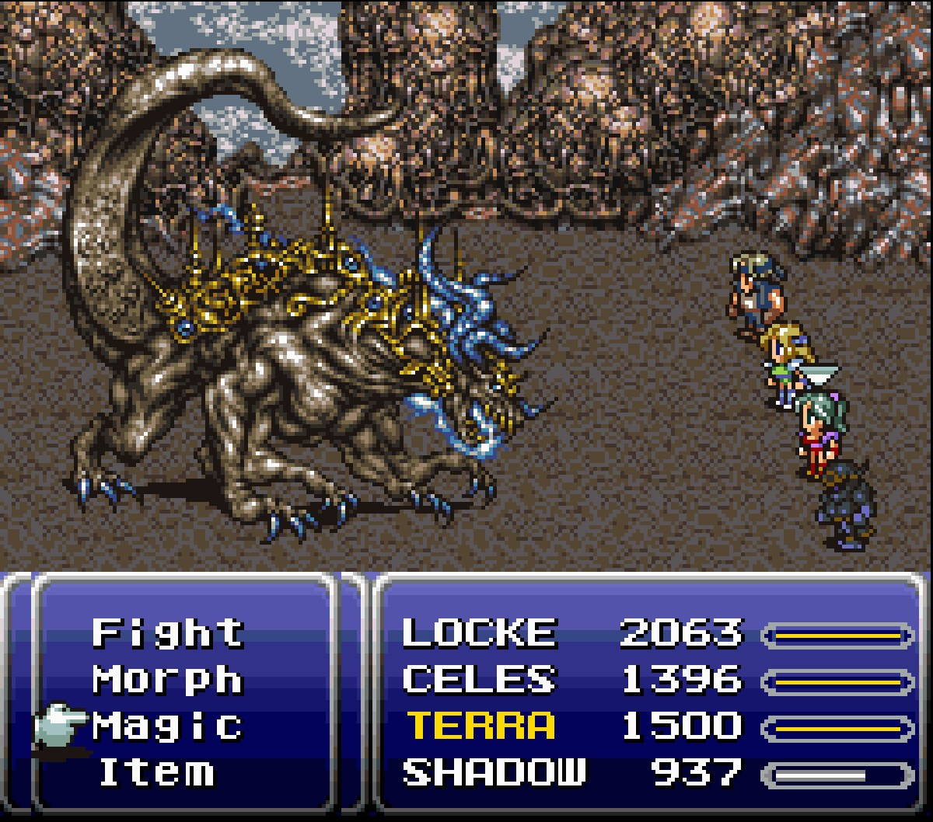
Description of Project
This project will be a 2D game in Unity made similarly to turn-based RPGs, such as Final Fantasy 6.
Project will use a mouse to interact with UI and control player.
And the project will be for the Player to beat the Enemy to win.

Slide 5

Controls of Project
Controls are simple.
The user simple uses the mouse to click the buttons of the UI.
The buttons are used to choose an attack type for the Player use on the Enemy.

Slide 6
What I have Researched?
I have researched into AI used in video games that apply a form of learning.
I researched into different AI models and techniques that could be utilized with my project, i.e. Hidden Markov Model and Behavior Tree.
And looked into a detailed articles of the workings and functionality of AIs used in video games, i.e. Alien Isolation.

Slide 7
Research is from?
Research on AI was taken from websites, articles, online documents, and video games.
An online article and video detailing the inner workings and functionality of the AI it’s describing:
https://becominghuman.ai/the-perfect-organism-d350c05d8960

Slide 8
Research is from?
I also found articles, forums and tutorials on how to create some of these patterns and models:
https://hub.packtpub.com/building-your-own-basic-behavior-tree-tutorial/
https://code.4noobz.net/decision-tree-simple-example/

Slide 9
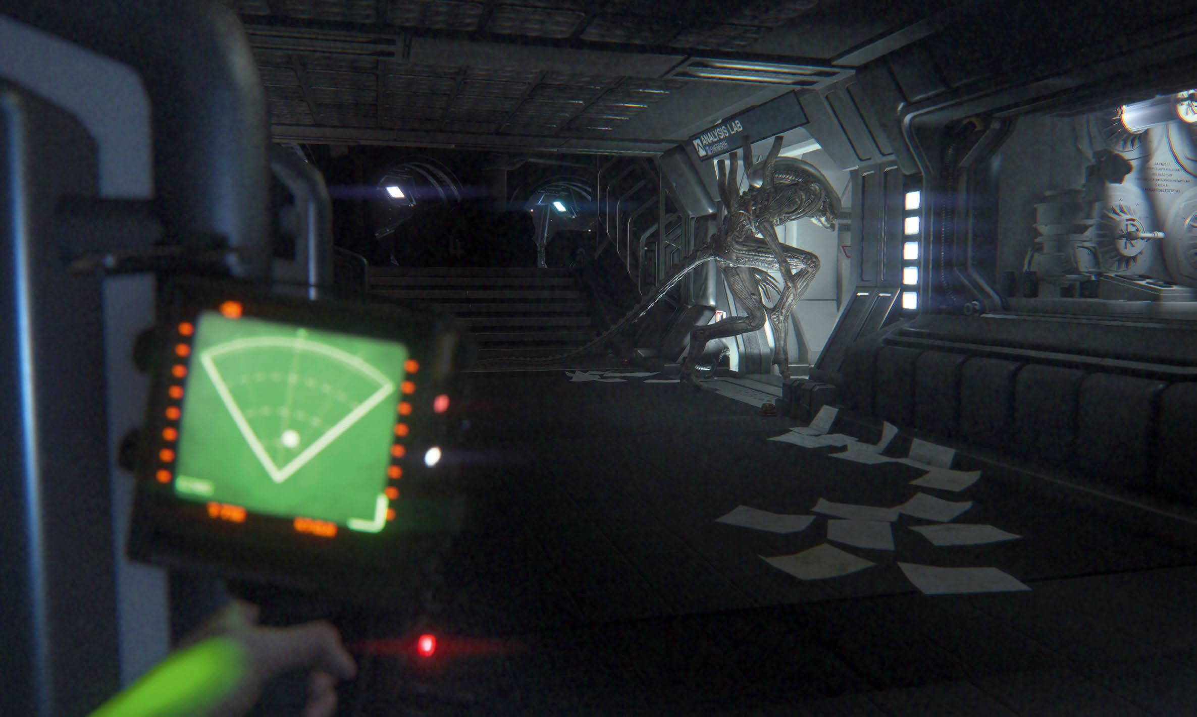
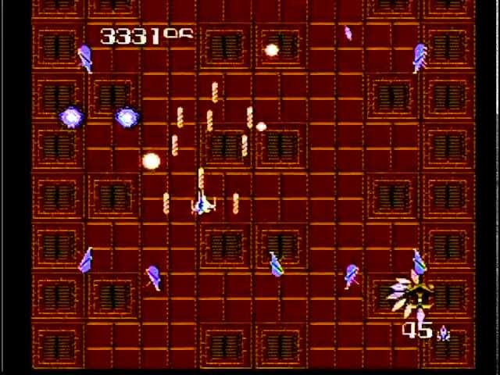
Description of Research
To start off my research, I first looked into various video games and their uses of AI.
Studying and learning how they worked and were utilised.
While trying to understanding the overall impact they had on the game itself.

Slide 10
Description of Research
From there I began looking at different documents and websites online discussing about learning and decision making in AIs.
These discussions also provided and a guide on replicating these models which I had utilised for my project.

Slide 11
Description of Research
I then begin looking into different AI models and techniques that I could replicate and utilise.
Until I found some appropriate models that I could utilise for my project.

Slide 12
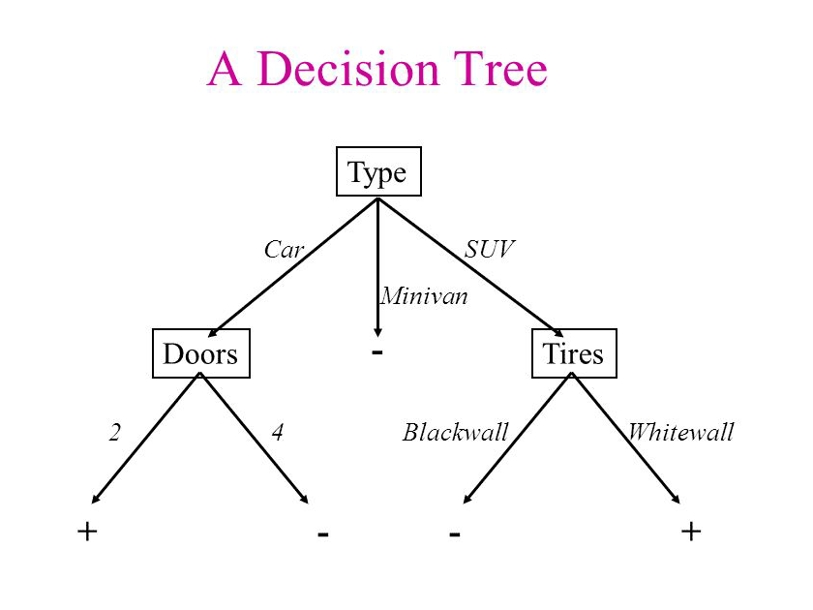
Description of Research:
Decision Tree
A decision support tool that uses a tree-like model of decisions and their possible consequences.
Includes chance event outcomes, resource costs, and utility.
Can be used to display an algorithm that only contains conditional control statements.

Slide 13
Description of Research:
Decision Tree
Use in project:
Resource cost based decision making, i.e AI makes decision based off a Priority value with the highest being chosen.
Fast to execute; and easy to implement and modify.
Can be simple and used to making decision with already calculated data.

Slide 14
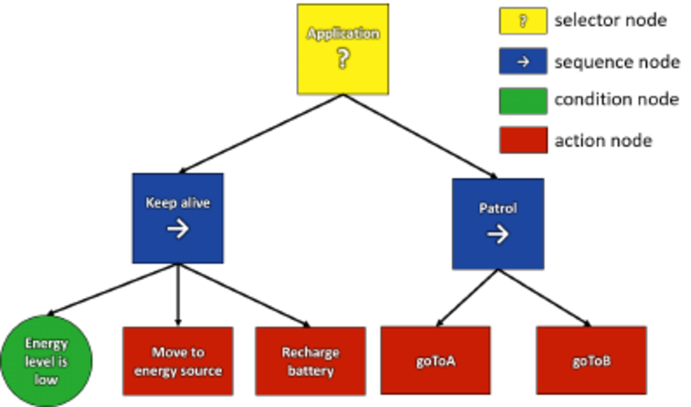
Description of Research:
Behaviour Tree
A mathematical model of plan of action, used in switching between a set amount of task in response to certain conditions.
Has an ease of human understanding and less error prone.

Slide 15
Description of Research:
Behaviour Tree
Use in project:
Useful in creating complex task using simple ones.
Can be used given impression of AI learning by locking most behaviours and have them unlocked under certain conditions;
i.e. Player is weak to fire unlock behaviour to keep attack with fire until dead.

Slide 16
Methods of implementation:
Decision Tree
Using my research, I created my Decision tree by first creating a base Client Class to hold all data used.
Then create a abstract Decision to evaluate Client and be derived to create a DecisionQuery and DecisionResult .
DecisionQuery will be the acting Tree and the DecisionResult will be the result and response.

Slide 17
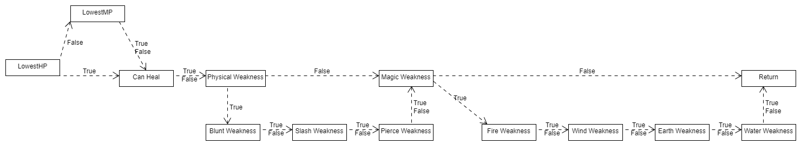
Methods of implementation:
Decision Tree
Within the DecisionQuery, will verify if conditions are met based off the Client; returning Positive(yes) or Negative(yes).
And the DecisionResult will hold the final result from DecisionQuery based on the Positive or Negative.

Slide 18
Methods of implementation:
Behaviour Tree
To create my Behaviour Tree, I first needed to create a Node class acting as the base Class to be derived from to create the other classes.
A NodeStates enum to represent every state of the Node; Success, Failure and Running.
A Selector Class, to select and run Nodes.

Slide 19
Methods of implementation:
Behaviour Tree
A Sequence Class, similar to the Selector but instead will need to have all the Node return Success, in order to run through all the Nodes.
And an Action Node, which will act as a leaf Node in the tree by passing in some logic via a delegate.
From there NodeStates Nodes are created to a piece of code until Success is returned.

Slide 20
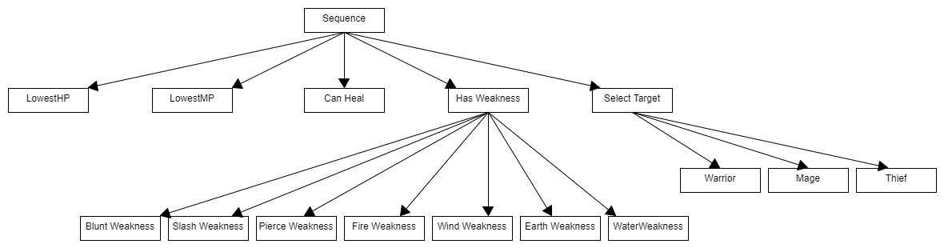
Methods of implementation:
Behaviour Tree
These Nodes would be added to a Node Root and either add to a Selector or Sequence Roots.
And finally the Selector or Sequence Roots are evaluated, in order to run the sequence of Nodes.

Slide 21
Implemented Feature Set
A functional Behaviour and Decision Tree that takes data from both the Player and Enemy; and make decision based off it.
A functional Turn-Based Battle system similar to Final Fantasy.
Turn-Based Battle system makes use of a State Machine to determine the different states of the Player or Enemy during their turn.

Slide 22
What I Have Achieved?
I have managed to create a functional Turn-Based battle system through the use of a Finite State machine.
Successfully integrated a Decision and Behaviour Tree into an NPC Enemy.
Have the NPC use the Trees to make decision on which player to attack and what attack to used based off the Trees.

Slide 23
Notable Problems
Decision making depends on data from Players and Enemy Attacks.
Depending on amount use, may or may not give the results you desire.
Depending on the decisions, a lot of data may be needed.

Slide 24
Conclusion
A decision making AI can be implemented in a Turn-Based battle system.
Models, such as a Behaviour Tree, are the most promising to utilised.
Results depend on the amount of data they use.

Slide 25

Demo Video

Slide 26
Questions and Answers

