Slide 1

Software Development Year 4 Data Science Presentation Project Title: Machine Learning Portfolio
By Tomas Smitas
Student No: C00276177
Date: 2025
Supervisor: Dr Greg Doyle

Slide 2

Deployment

Slide 3
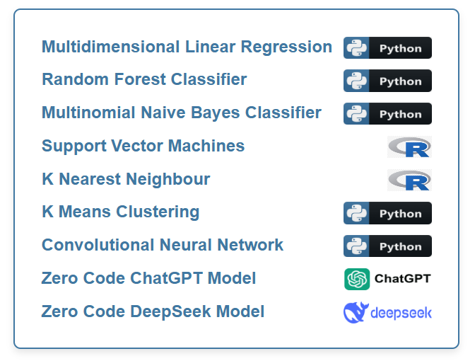
Menu

Slide 4
Support Vector Machines
Used to predict if a flight will be delayed by more than 15 minutes
Nycflights13 dataset from Bueuro of Transport Statistics
Dataset size: 336,776 rows
Data consists of columns like departure time, arrival time, distance and the target value delay time

Slide 5
Challenges & Opportunities
Using R code
Using RStudio
New Libraries from R

Slide 6
Tools & Technologies
R: The programming language used to build and implement the flight delay prediction model. R’s statistical capabilities are leveraged to preprocess and analyse flight data.
e1071: Provides the Support Vector Machines (SVM) implementation for training and predicting flight delays. This library is critical for building and evaluating the SVM model.
dplyr: Used for data manipulation and preprocessing, allowing for efficient cleaning, filtering, and feature selection of the flight dataset.
ggplot2: Used for visualising the flight dataset, allowing for effective exploration of relationships between variables, such as delays, departure times, and other flight-related features, to better understand the data and assist in model evaluation.

Slide 7
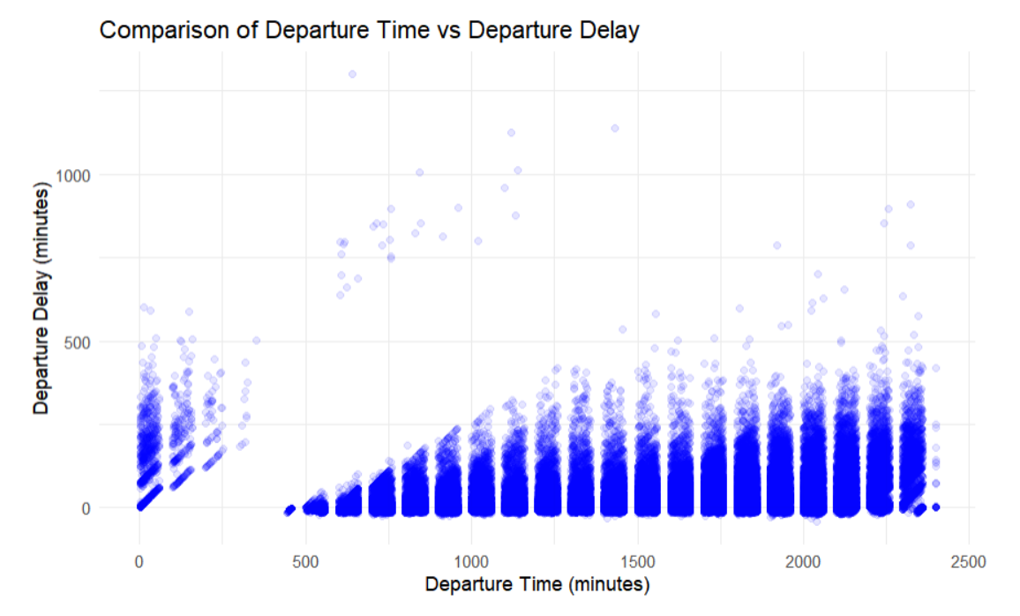
Data visualisation/ Data insights
Shortages of air traffic control personnel
Poor visibility

Slide 8
Training the Model
Data split into 70% training and 30% for testing

Slide 9
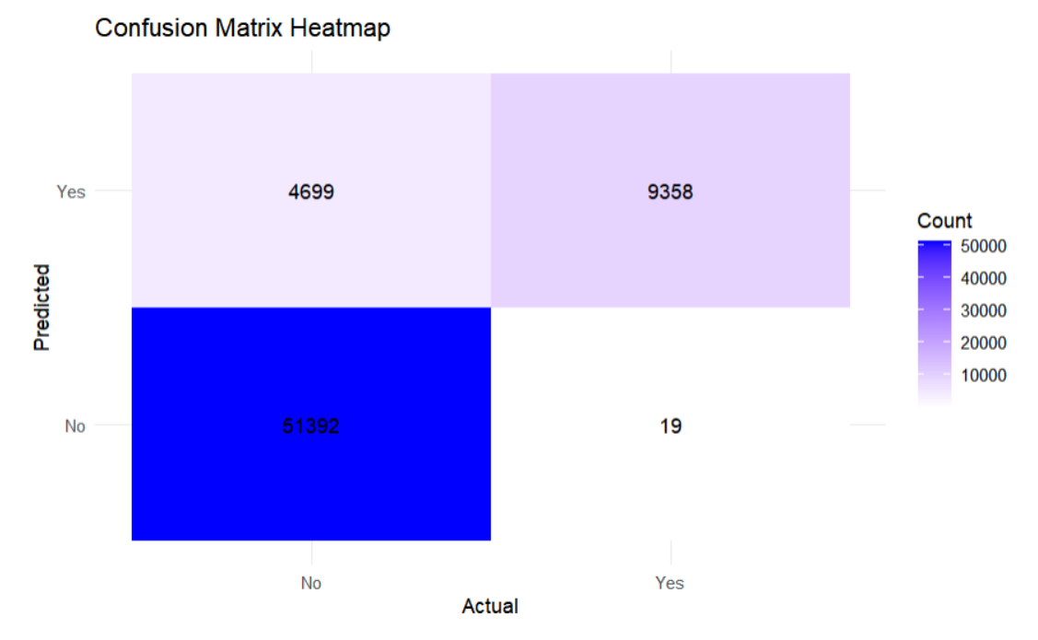
Model Evaluation
Accuracy: 93%~

Slide 10
Conclusions
R is good at visualisation
R is poor at training the model
R was a lot more complex than Python
Would use R again for data visualisation
Wouldn’t use R to train the model

Slide 11

Zero Code ChatGPT & DeepSeek models
Trying to create a fully functioning model that can make reliable predictions using a zero code approach
Prompted it to make a general Neural Network
General prompts to increase chances of a success

Slide 12
Challenges & Opportunities
Potential to drastically decrease the time to make a model
Potential to drastically increase productivity
Anything produced can’t be claimed as our own
If the code is not understood well, it will be costly to maintain

Slide 13
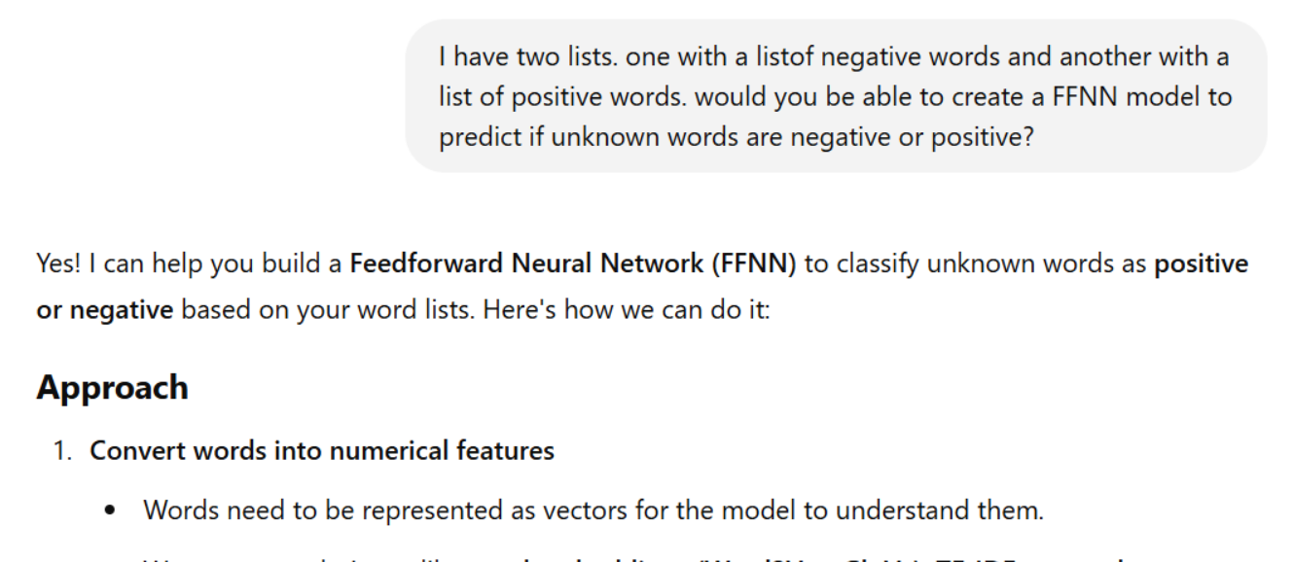
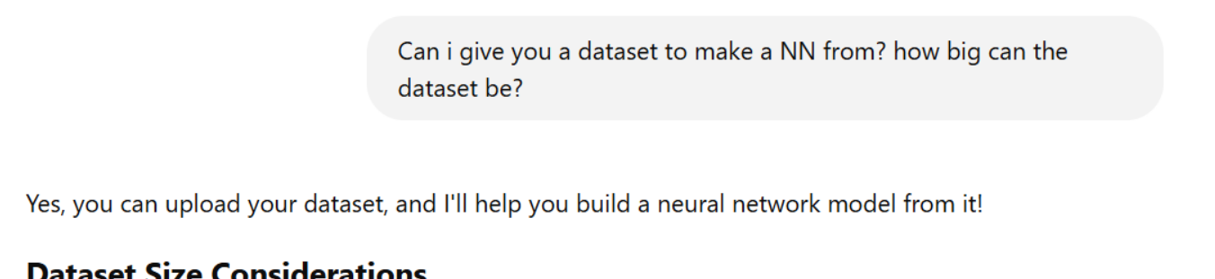
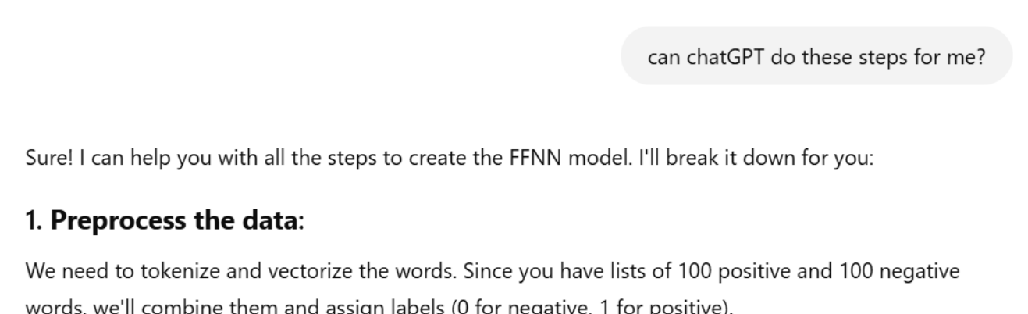
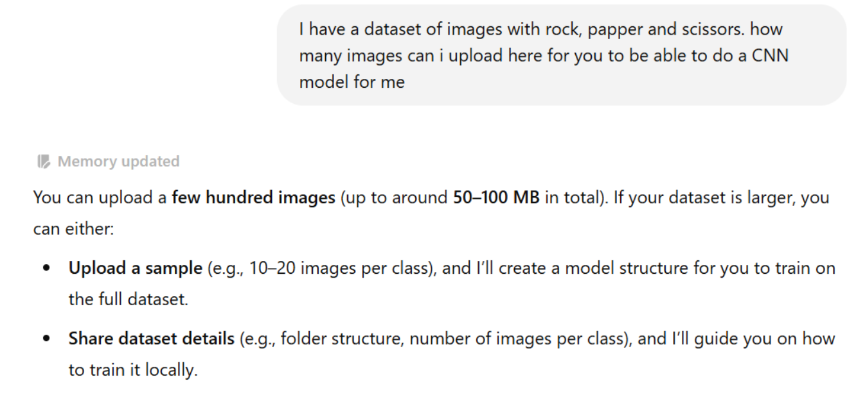


ChatGPT Prompt Summary

Slide 14
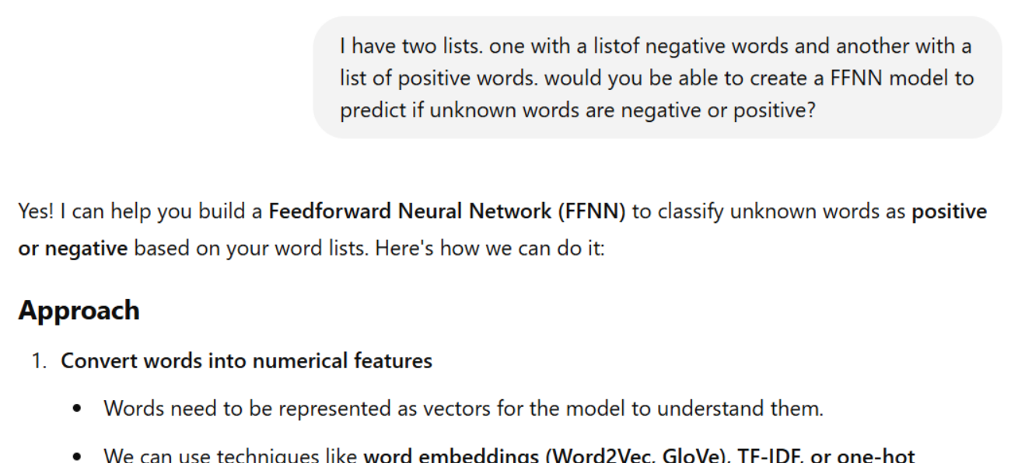
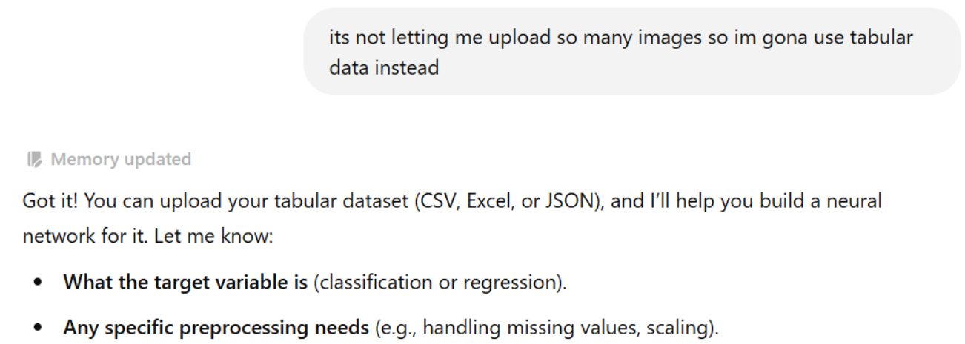
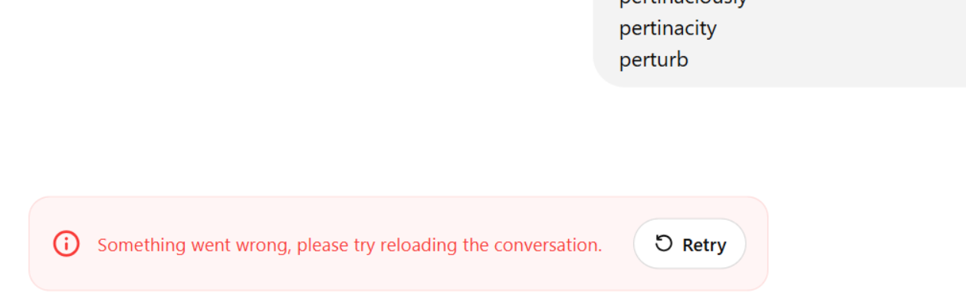
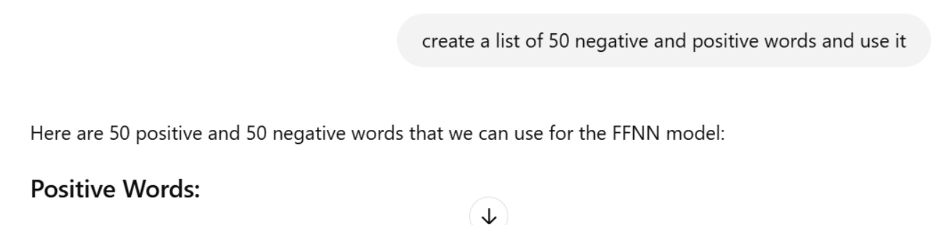




ChatGPT Prompt Summary

Slide 15
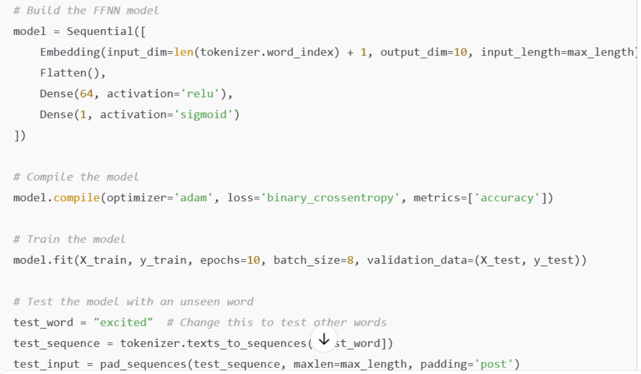
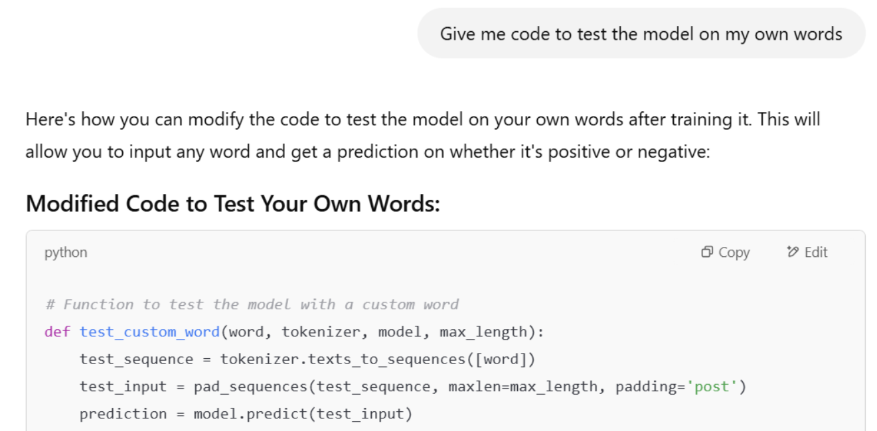

ChatGPT Prompt Summary

Slide 16
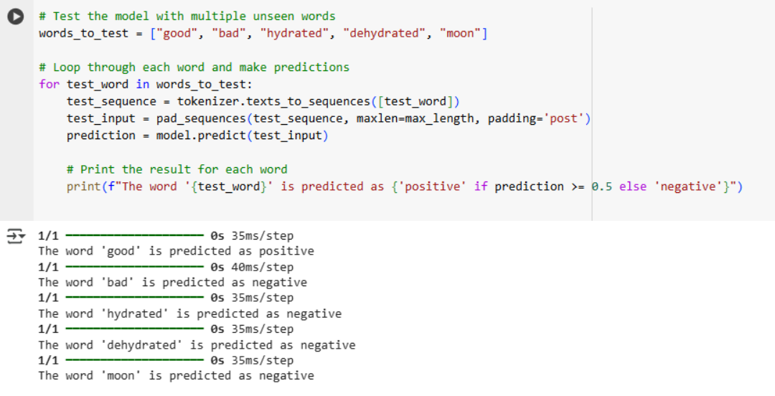
ChatGPT Evaluation

Slide 17
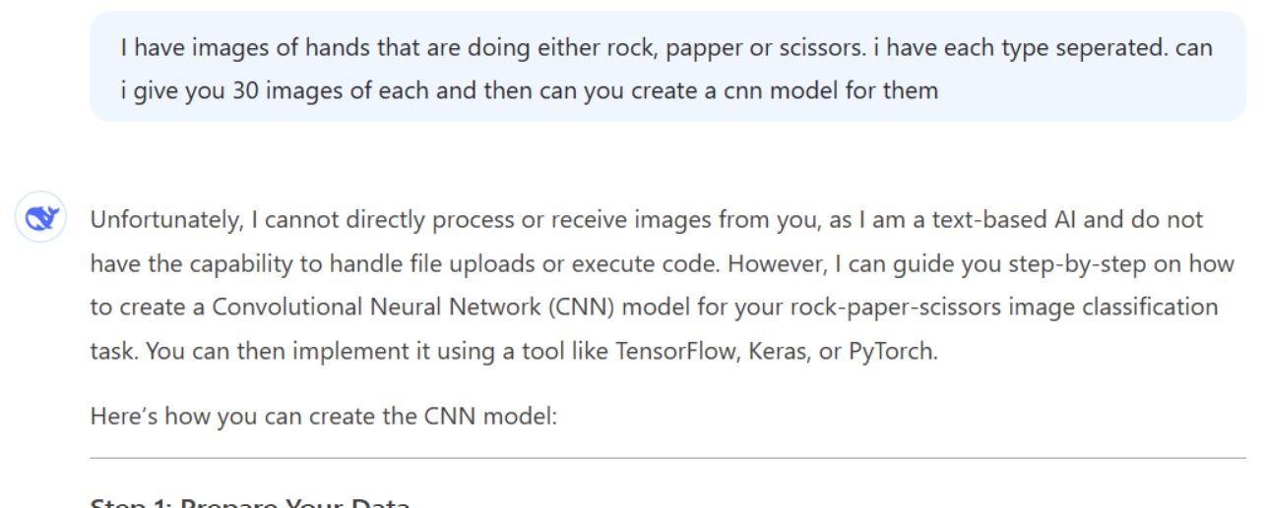
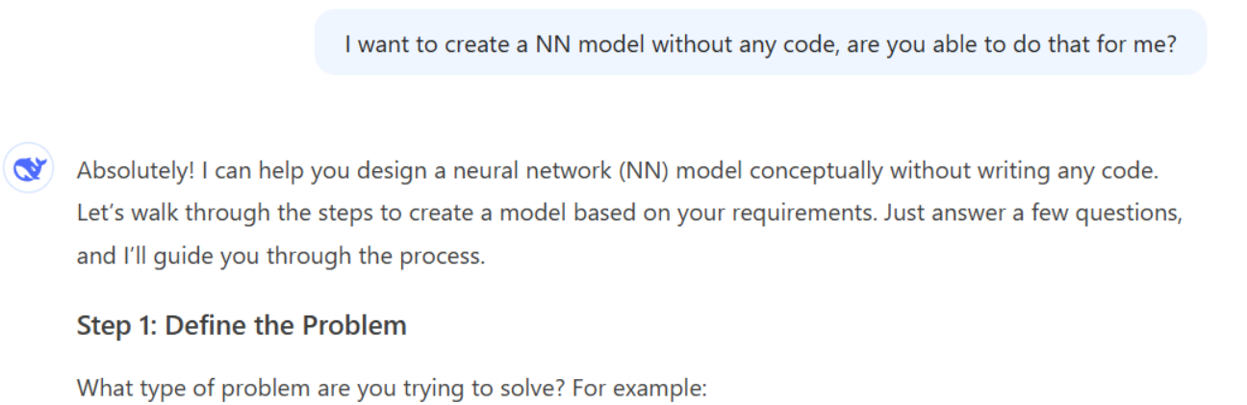
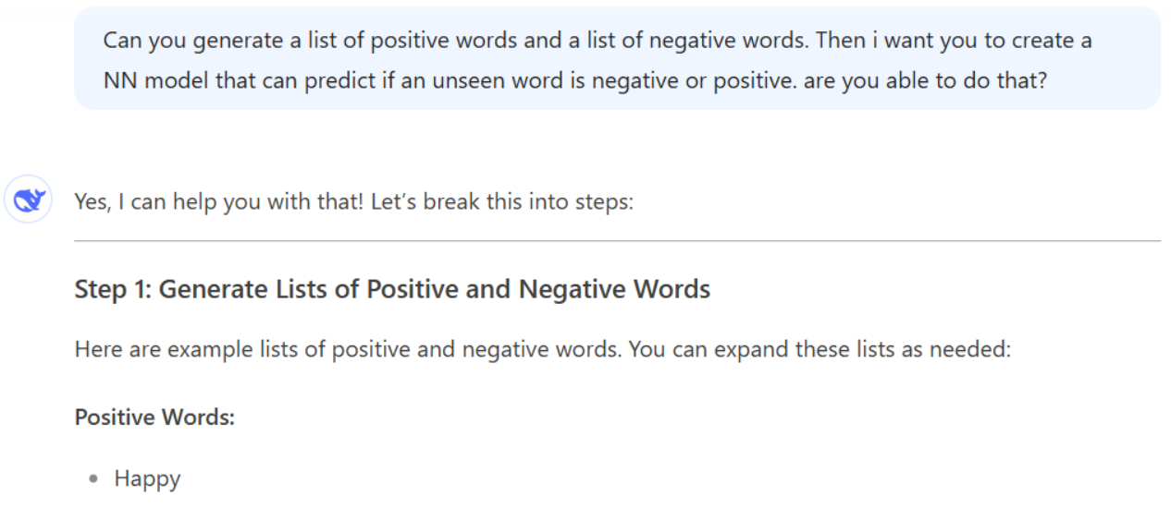
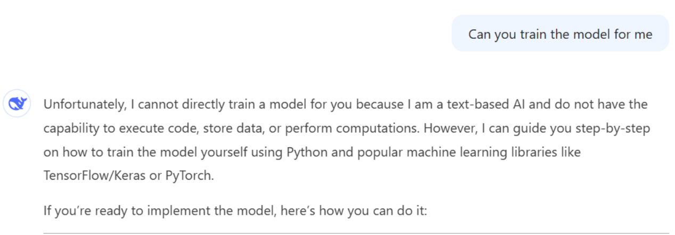


DeepSeek Prompt Summary

Slide 18
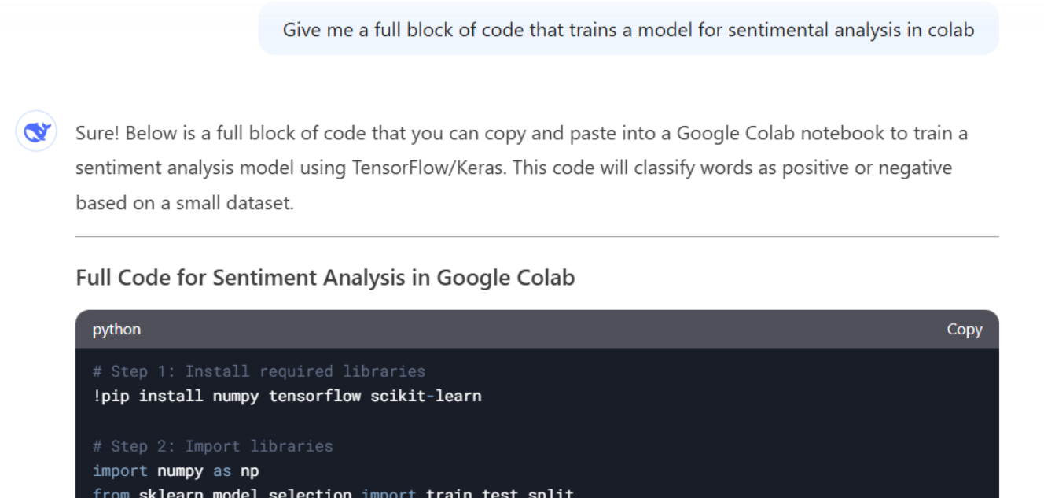
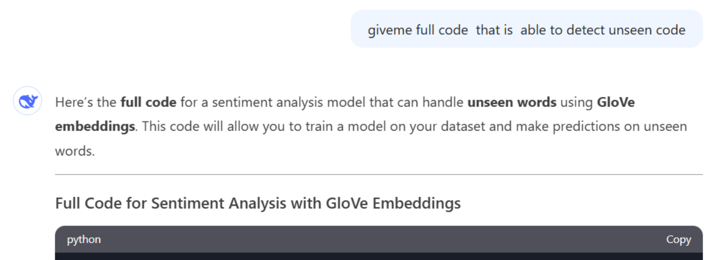
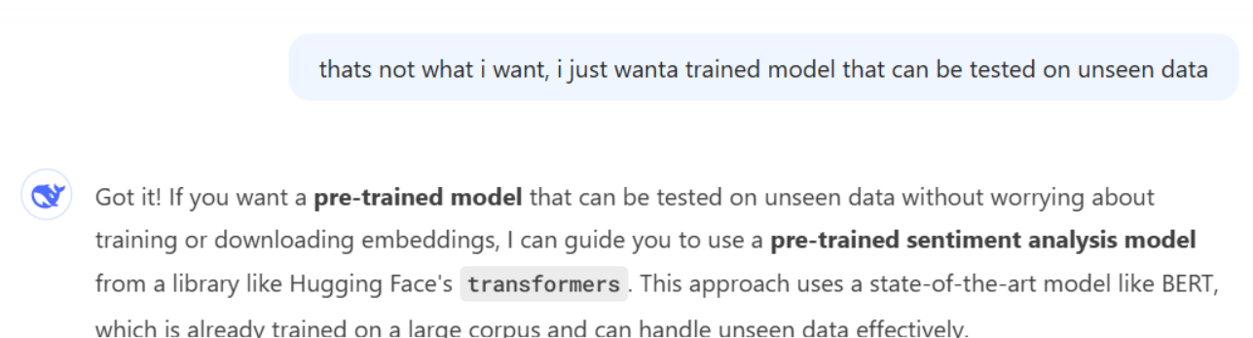



DeepSeek Prompt Summary

Slide 19
Conclusions
Can be used to drastically increase the time it takes to produce a model
Hard to get a good accurate model without adjusting it multiple times
Premium versions of each generative AI may help
It can be used to assist development but will not do it for you

Slide 20
References
Questions?
Website Demo Link
Support Vector Machines Dataset: https://www.transtats.bts.gov/Homepage.asp
Flight Delay Article: https://www.travelandtourworld.com/
Lecturer Dr. Greg Doyle's notes
Jake Vanderplas: https://github.com/jakevdp/PythonDataScienceHandbook
ChatGPT: https://chatgpt.com/
DeepSeek: https://www.deepseek.com/

