Slide 1

Software Development Year 4 Data Science Presentation Project Title: Machine Learning Portfolio
By Tomas Smitas
Student No: C00276177
Date: 2025
Supervisor: Dr Greg Doyle

Slide 2
Data Science Portfolio
Front-End Technologies
Content
JavaScript
HTML
CSS
React
Home
Introduction
Experience
Machine Learning
Projects
Contact

Slide 3
Machine Learning Section
Menu
Project 1: Predicting Student Final Grades Using Multidimensional Linear Regression
Project 2: Predicting The Price Of Cars Using Random Forest Classifier
Project 3: Object Detection For Helmets Using Convolutional Neural Networks (CNNs)

Slide 4
Project 1: Predicting Student Final Grades Using Multidimensional Linear Regression
Summary
Dataset: DataWorld containing previous behaviours and performance
Target: Final year grade prediction
Objective: Determine which behaviours have the biggest impact on student results
Users: Student & Educators
Key Performance Indicator: RMSE
Technologies: Excel, Python, NumPy, Google CoLab, Pandas
Data Cleaning: Joined two tables with the same data into one. Filling null values with median
Model Evaluation: RMSE of 1.56. Range 0-15
Conclusion: Previous grade had the biggest impact, social outing didn’t have much of an impact

Slide 5
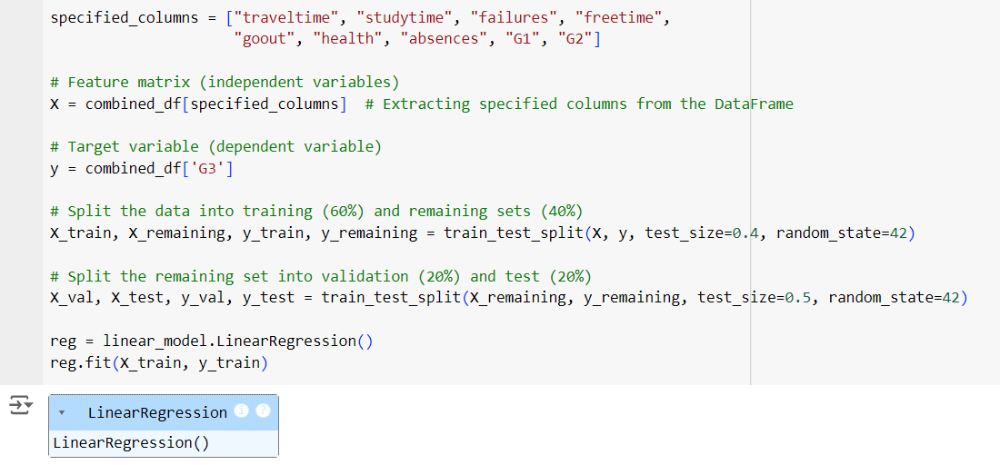
Training the Model
5

Slide 6
Project 2: Predicting The Price Of Cars Using Random Forest Classifier
Summary
Dataset: Kaggle, biggest dataset for my needs, 12000 rows
Target: Price category prediction
Objective: To be able to check dealer prices to see if they’re good deals
Users: Car buyers, car sellers
Key Performance Indicator: Confusion Matrix
Technologies: Excel, Python, NumPy, Google CoLab, Pandas, sklearn, Confusion matrix and Accuracy score.
Data Cleaning: Removed a column that is unlikely to have high importance. Removed null value rows.
Model Evaluation: 92% accuracy score
Conclusion: The model had a high precision with a good accuracy score. The column that had the highest importance for the price was the year followed by engine hp

Slide 7
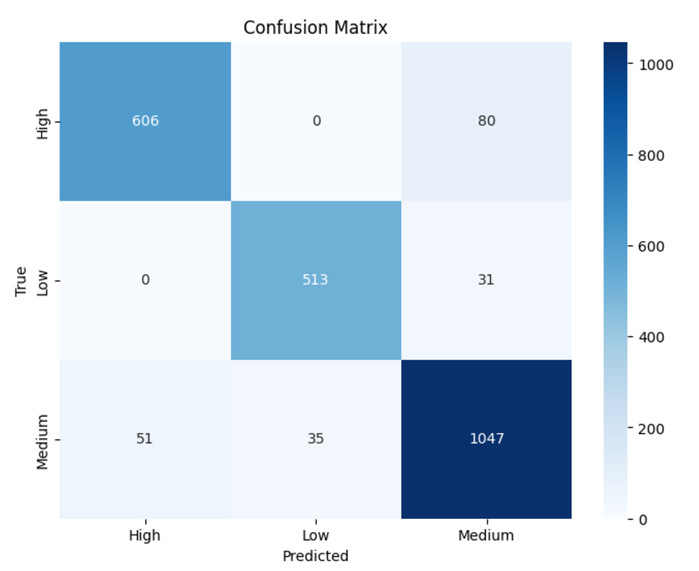
Model Evaluation Confusion Matrix
From the confusion matrix we can conclude that the model is reasonably accurate
7

Slide 8
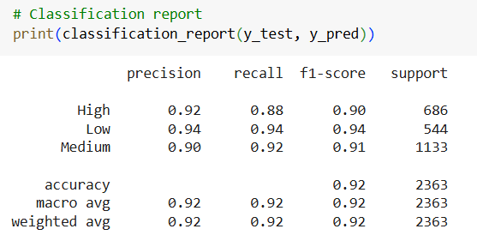
Model Evaluation
We can see that the accuracy score is 92% percent
8

Slide 9
Project 3: Object Detection For Helmets Using Convolutional Neural Networks (CNNs)
Summary
Dataset: Roboflow, 7000 annotates images of helmet and no helmet
Target: Helmet, noHelmet
Objective: Detect for no helmets on safety critical locations through live video monitoring
Users: Safety personnel
Key Performance Indicator: Confusion Matrix, F1-score, Precision-score and Recall-score
Technologies: Ultralytics YOLO, OpenCV, Google CoLab and Python
Data Cleaning: Going though all the annotations to check accuracy

Slide 10
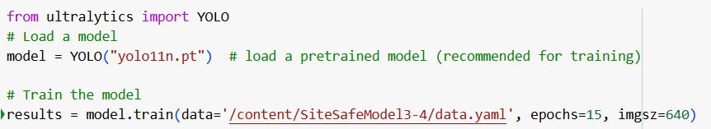
Training the Model
10

Slide 11
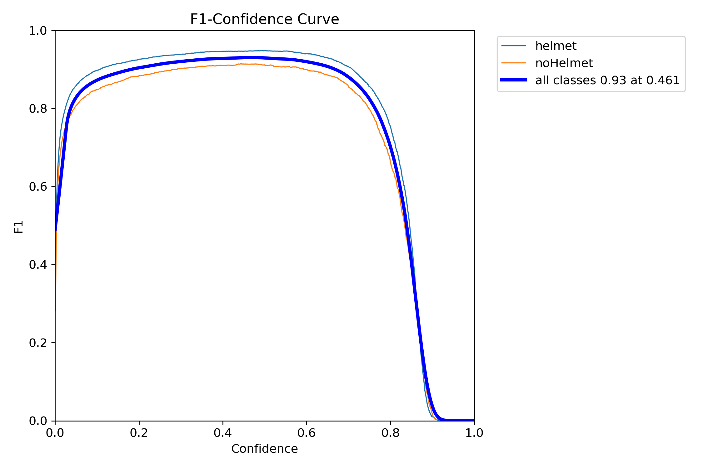
Model Evaluation F1-score
From the F1 graph we can conclude that at 46% confidence the f1 score was the best at 93% while when confidence is over 90% the f1 score is low due to overfitting
11

Slide 12
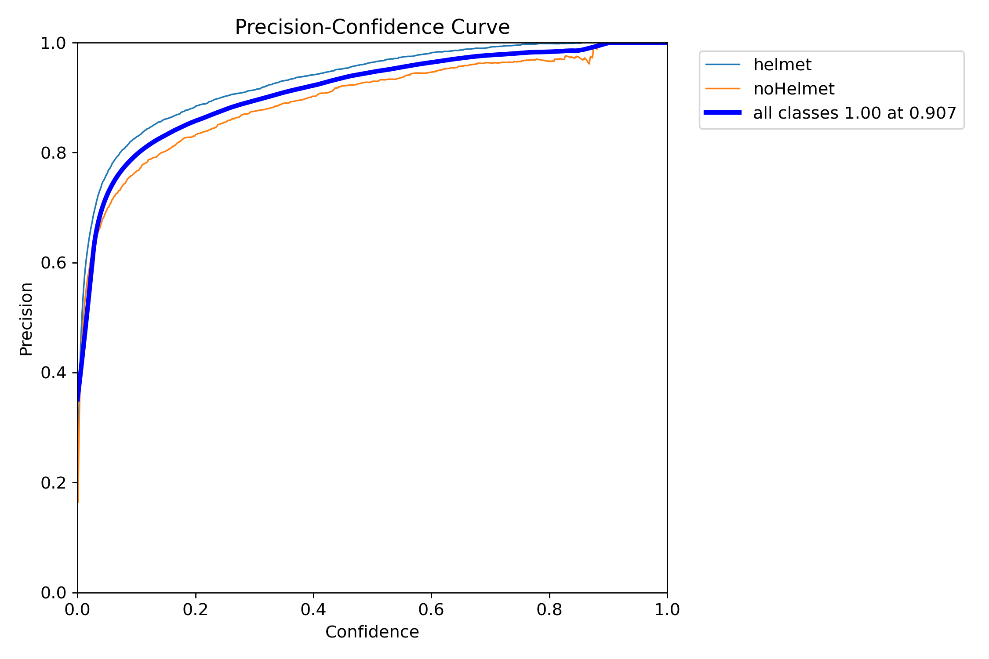
Model Evaluation Precision
From the Precision graph we can conclude that at > 90.7% confidence the model has a 100% chance of predicting the correct detection
12

Slide 13
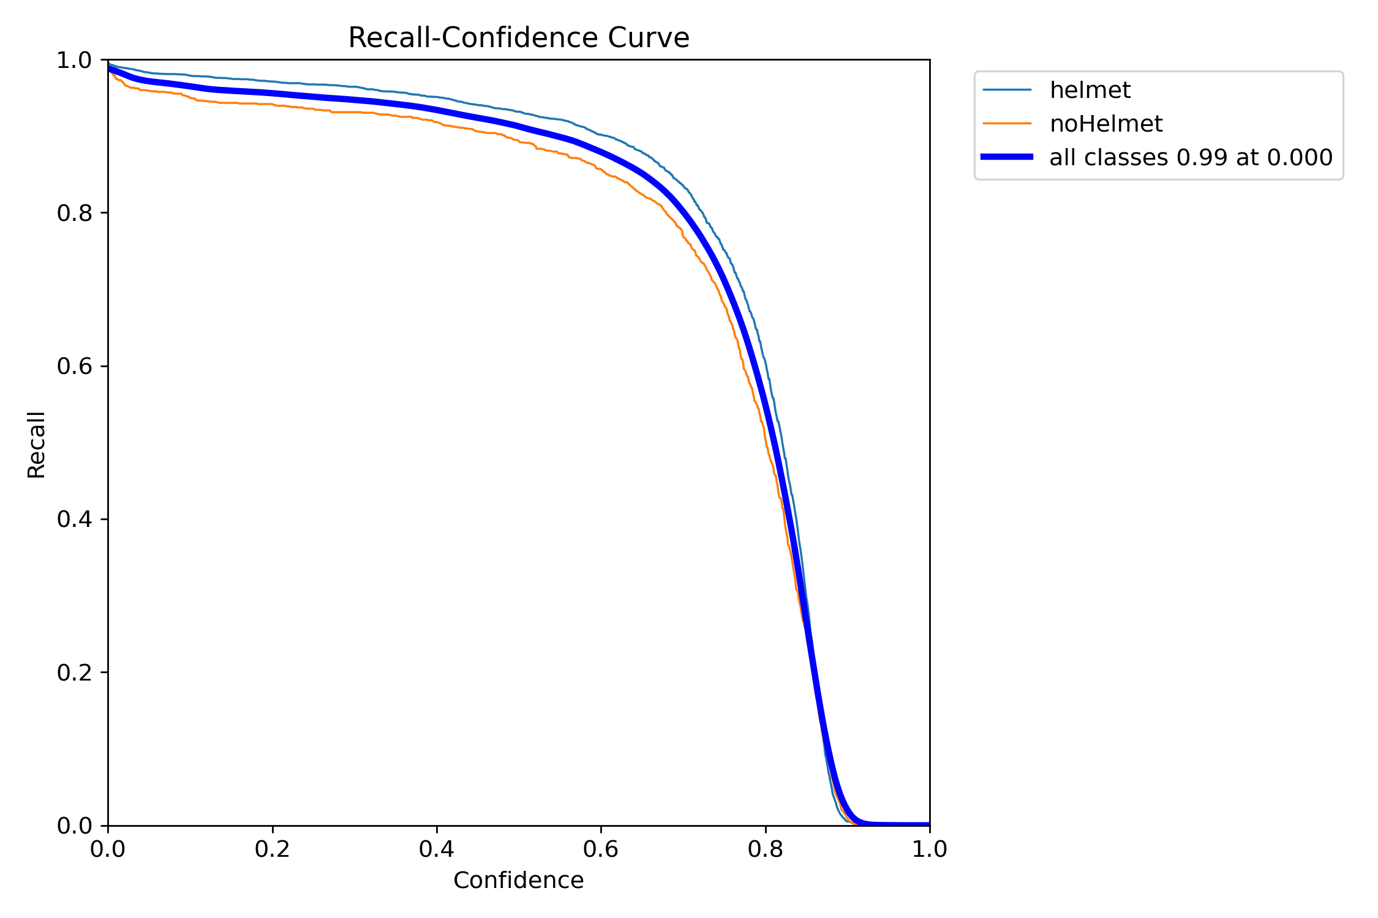
Model Evaluation Recall
From the Recall graph we can conclude that the model accurately predicts actual instances at a 99% rate, this means the inaccuracy is in the false predictions
13

Slide 14
Conclusion
The model demonstrated high accuracy in detecting helmets and no helmets in diverse environments
The results affirm the system’s capability to monitor safety effectively
14

Slide 15
References
Questions?
Website Demo Link
Dataworld: https://data.world/
Kaggle: www.canva.com
Lecturer Dr. Greg Doyle's notes
Jake Vanderplas: https://github.com/jakevdp/PythonDataScienceHandbook
Ultralytics: https://docs.ultralytics.com/
OpenCV: https://opencv.org/

