Slide 1


Software Development Year 4 Project Presentation Project Title: SiteSafeAI
By Tomas Smitas
Student No: C00276177
Date: 2024
Supervisor: Dr Oisin Cawley

Slide 2

My Background
6 Month Internship

Slide 3

Industry Perspective
Paul McGrath
Construction Site Manager @ Frisby Homes
“This project has real potential to make a difference in construction safety. By detecting safety issues in real-time, it could actively support compliance and help prevent accidents before they happen.”
Eoin Malone
Live Monitoring Specialist
“Excellent idea. It would be helpful in identifying helmets and high visibility jackets on construction sites.”

Slide 4
SiteSafeAI is there anything similar?
Currently, there is no solution like this in Ireland.
Globally, a company called Synaedge, based in Switzerland, offers AI-based video surveillance that includes PPE detection.
Synaedge provides this service through their AI-powered analytics, but the exact workings of their PPE detection system remain unclear.
My system uses live video processing and can trigger immediate alerts when a safety violation occurs, providing more actionable insights.

Slide 5
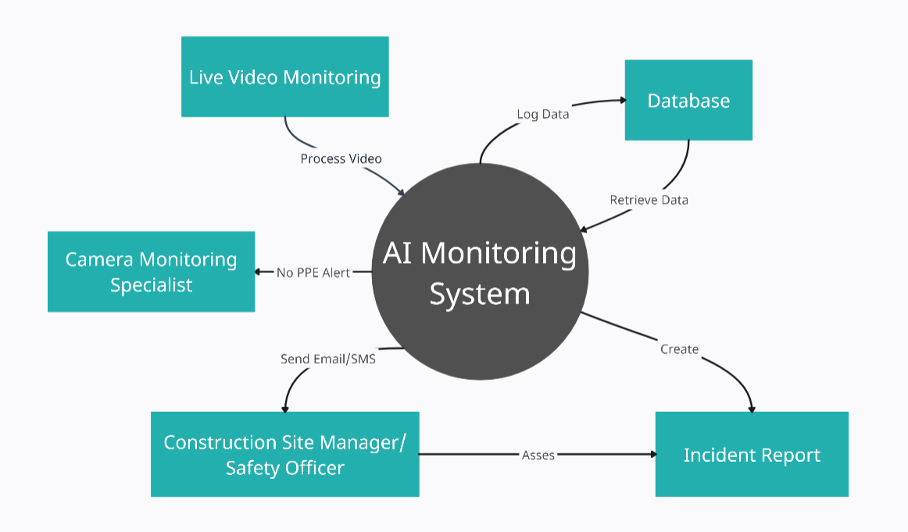
How Will SiteSafeAI Work?

Slide 6








Technologies used in SiteSafeAI
Python - Main Programming Language
YOLO - Object Detection
Ultralytics - Framework
OpenCV – Computer Vision Library
Flask – Web Framework
React – Front End
SMTP – Email Service
MySQL - Database

Slide 7
Progress so far in SiteSafeAI
Finalised Technologies
Functional Specifications
Poster, Presentation, Design Doc
Model Trained on 500 images
Model Implemented for helmets
First Official Release

Slide 8
References
Questions?
Netwatch logo: www.netwatchsystem.com
SiteSafeAi logo creation: www.canva.com
Context diagram creation: www.creately.com
Technology logos: www.iconscout.com
Similar company: www.synaedge.com/en
Frisbys Homes logo: www.frisbyhomes.com

