Slide 1
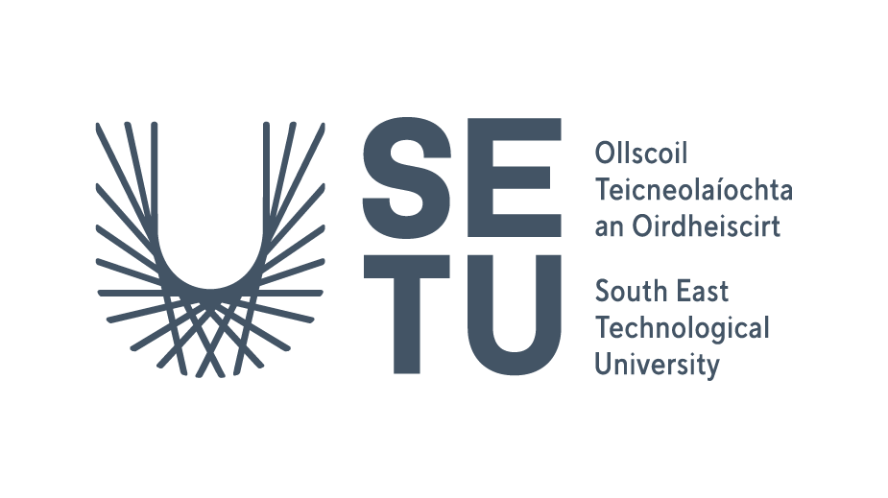
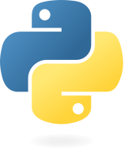

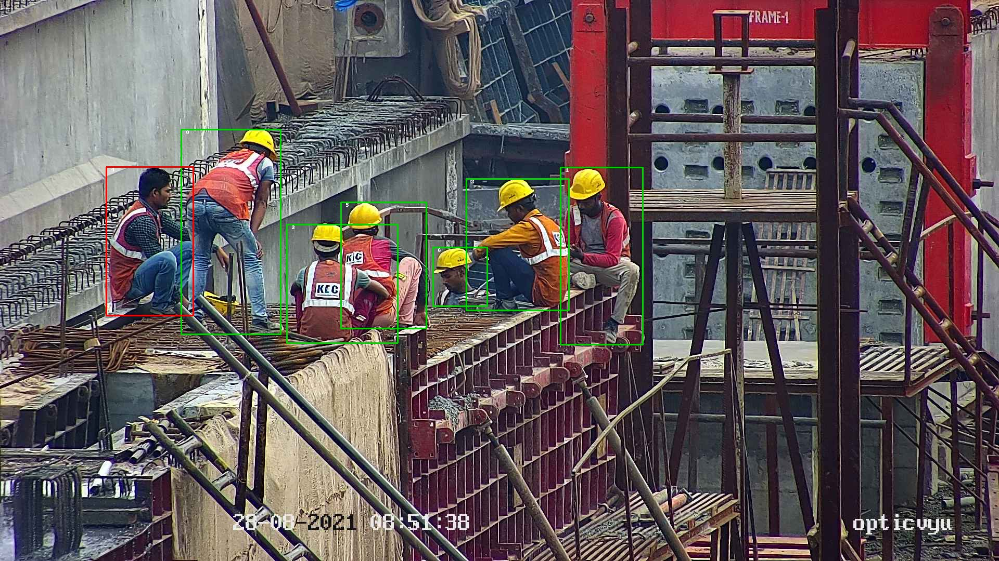






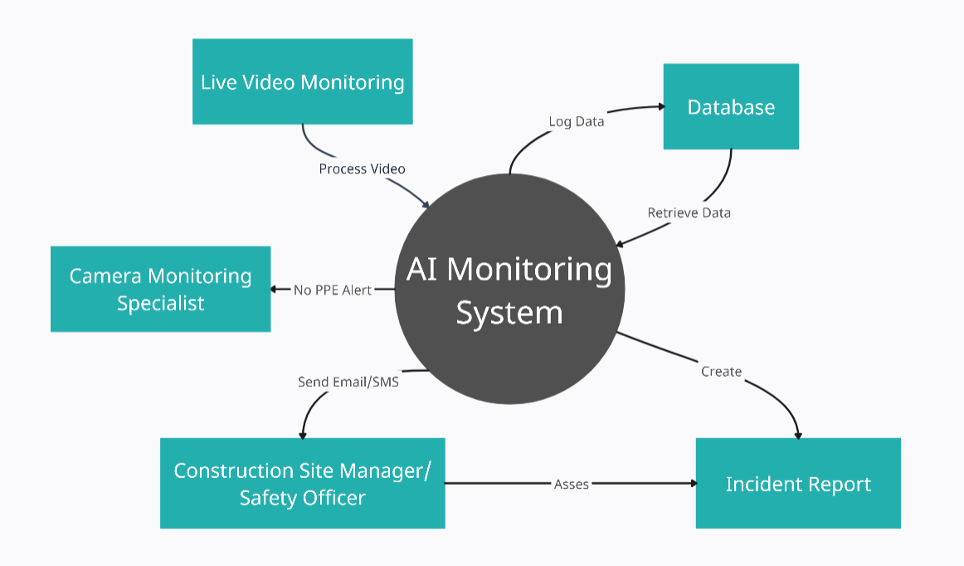
Construction Site Safety - SiteSafeAI
South East Technological University Carlow
By: Tomas Smitas Email: C00276177@SETU.ie
AI-Powered Helmet and High Visibility Jacket Detection on Construction Sites Through Live Video Monitoring
Can You See Anything Missing?
Technologies Used
Is There Anything Similar?
Currently, there is no solution like this in Ireland. However, globally, a company called Synaedge, based in Switzerland, offers AI-based video surveillance that includes PPE detection. While they provide this service through their AI-powered analytics, the exact workings of their PPE detection system remain unclear.
My system uses live video processing and can trigger immediate alerts when a safety violation occurs, providing more actionable insights.
Python - Main Programming Language
YOLO - Object Detection
Ultralytics - Framework
OpenCV – Computer Vision Library
Flask – Web Framework
React – Front End
SMTP – Email Service
MySQL - Database
Industry Perspective
Paul McGrath, Construction Site Manager
“This project has real potential to make a difference in construction safety. By detecting safety issues in real-time, it could actively support compliance and help prevent accidents before they happen.”
Eoin Malone, Live Monitoring Specialist
“Excellent idea. It would be helpful in identifying helmets and high visibility jackets on construction sites.”
How It Works
Why?
Protect the construction staff
Ensuring safety compliance on construction sites is critical to preventing accidents and injuries. Manual monitoring can be inconsistent and inefficient. This AI-powered solution automates the detection of helmets and high-visibility jackets, helping to ensure that all workers adhere to safety regulations in real time, improving safety and reducing risks.
Acknowledgements
Supervisor Dr Oisin Cawley
Poster Design DesignLabs
Construction Image www.opticvyu.com
Technology Icons www.iconscout.com
Context Diagram www.creately.com
www.synaedge.com

