Slide 1
The Enigma Machine
&
Encryption
By Caroline Read
Committee Member: Dr. Kenneth Levasseur
Honors Mentor: Frau Anna Maria Harrod

Slide 2

Cryptography & Cryptanalysis
Scytale
Substitution Ciphers
Transposition Ciphers
Polyalphabetic
Notes:
Sub: Caesar ciphers→ shift letters in the alphabet like a clock, think of the alphabet A- Z and shift it over twice, then the alphabet becomes C-B
Transposition Ciphers: basically you map one letter to another, often using numbers as well to define the placement, thend to decrypt you use the inverse process.

Slide 3
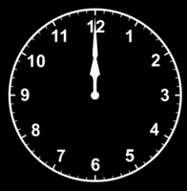
Substitution: Caesar Cipher
Modular Arithmetic
Vectors
Indexing
0 | A | B | C | D
1 | D | A | B | C
2 | C | D | A | B
3 | B | C | D | A
4 | A | B | C | D

Slide 4
Transposition: Permutation Encryption
H | E | L | L | O
W | O | R | L | D
1 | 2 | 3 | 4 | 5
3 | 1 | 4 | 5 | 2
E | O | H | L | L
O | D | W | R | L
Write a message
Assign a value to each position
Scramble the positions
Re-assign Letters

Slide 5
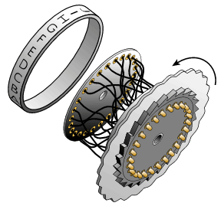
The Rotor Machine
1915- Dutch Naval Officers create a rotor machine
1918- The Enigma Machine officially invented by Arthur Scherbius
Marketed his “cipher machine” as an “Enigma Machine” to ramp up business
Commercially sold initially
1926- German Navy
1928- German Army
1935- German Air Force

Slide 6
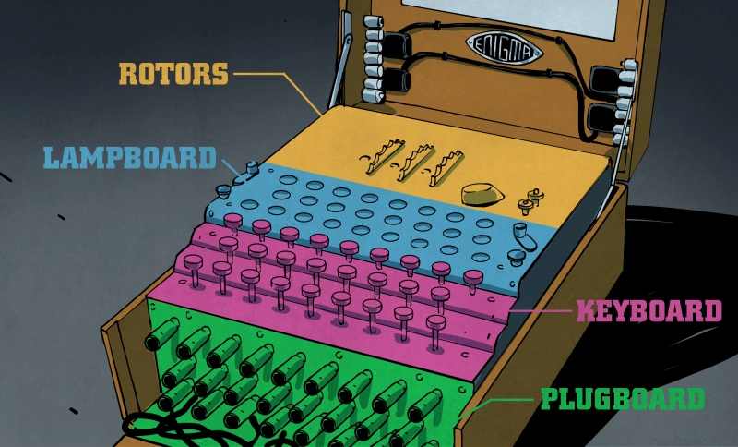
The German “Unbreakable Code”

Slide 7
Differences between all the Enigmas
Commercial Enigma: A-D evolved each generation
Enigma C: lighterweight, reflector, no typewriter
Enigma D: Used by Sweden, Netherlands, UK, Japan, Italy, Spain, US, and Poland
1927: British cryptanalyst Hugh Foss broke the commercial enigma
Enigma H: High-security German military intelligence transfer
8 rotors, no plugboard
Jammed frequently
Funkschlüssel C: German Navy 1926
Keyboard, lampboard, 3 rotors
Enigma G: German Army 1928-30
Incremented each step of the rotors
Wehrmacht Enigma I: 1930-38
3 Incremental rotors,, lampboard, plugboard, keyboard
M3 & M4: German Navy 1934 & 1942
Introduced 4th rotor, lampboard, plugboard, keyboard

Slide 8
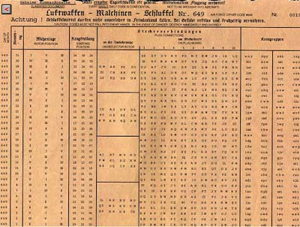
Encoding with Enigma
Date
Plugboard Set-Up
Rotor Choice
Rotor Position
Reflector Choice
Message
Monthly Code Calendars

Slide 9
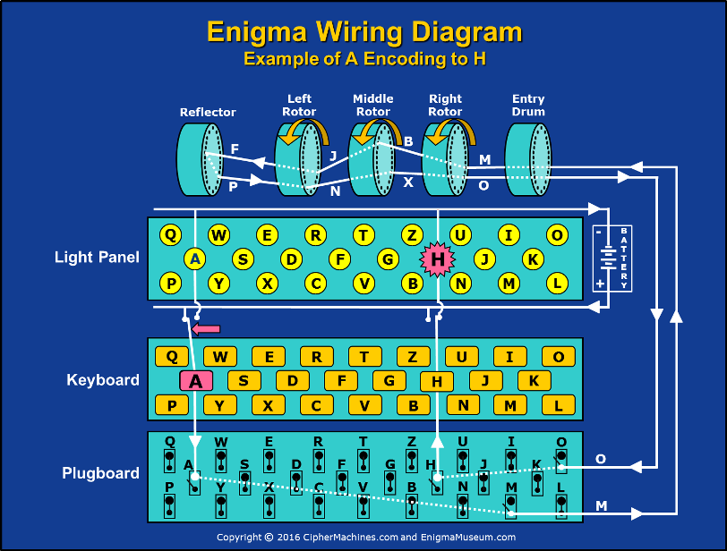

Slide 10
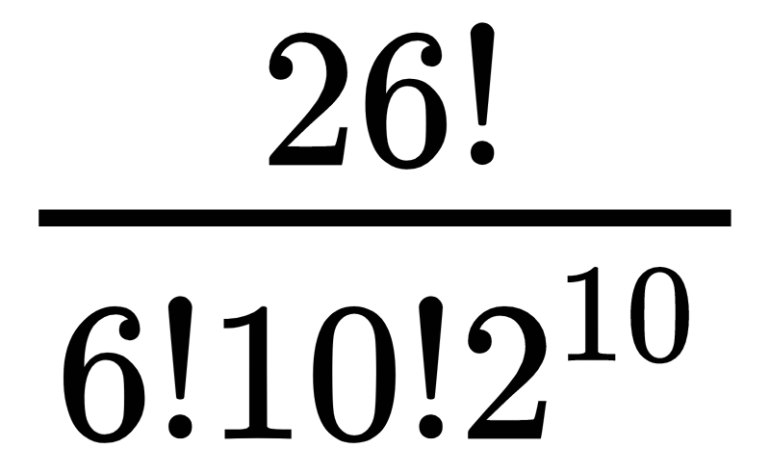
Beauty and Fall of the Enigma Machine
German Army Enigma ~1939
Rotor: (5)(4)(3) = 60 possibilities!
Starting Position: (26)(26)(26) = 17,576 possibilities
Plugboard: = 150,238,274,937,250 possibilities
26 possible inputs, only 10 possible pairings(hence the 6!), the 10 pairs can be any order, and 10 pairs are binary
Total: 158,962,555,217,826,360,000 possibilities!

Slide 11
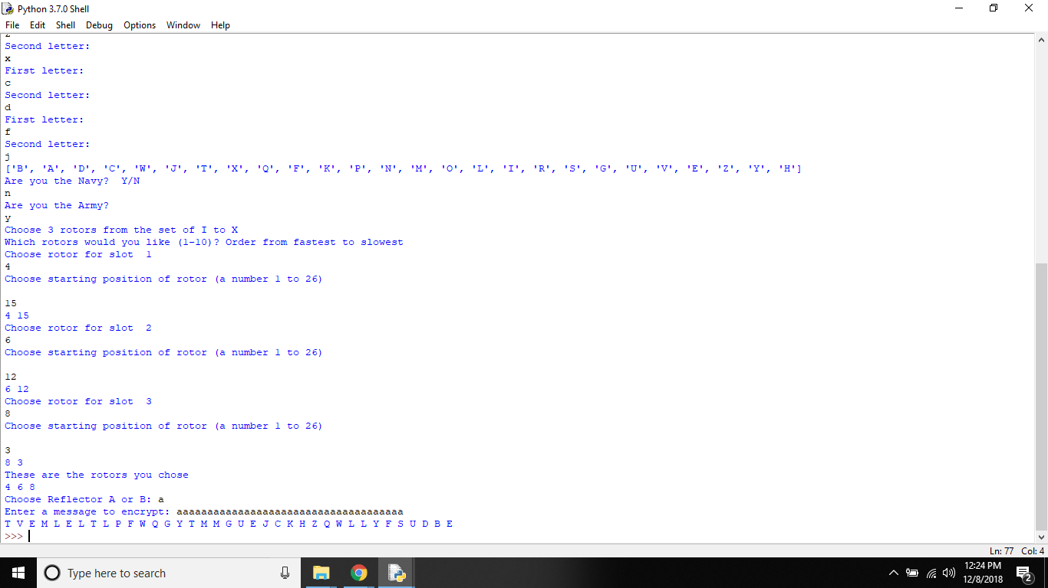

Fall of Enigma
Results: No “a”!
Notes:
Letters could not map to themselves
Breaking the code was a matter of using German procedural errors: the weather report every morning, standard salutations, etc.
Not using the same set of rotors in few day span or using an easy to guess starting position for rotors: a,b,c ect

Slide 12
How Allies Broke the Enigma
Letters could not map to themselves
A ≠ A
German procedural errors:
Weather report
Standard salutations
Not using the same set of rotors in few day span or using an easy to guess starting position for rotors: a,b,c

Slide 13

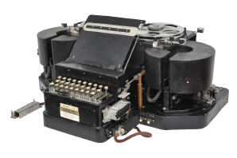
TypeX Machine

Slide 14
My Enigma Machine
Python 3.7.0
Choose:
Plugboard: up to 13 pairs
10 Rotors from various original machines
2 Reflectors: A or B
Army and Navy options

Slide 15
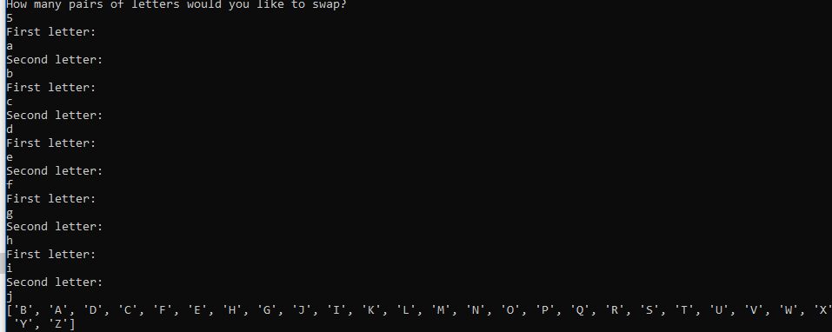
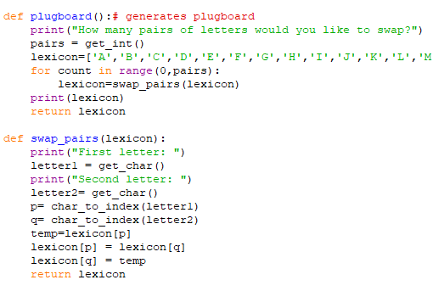
Plugboard: Scrambling Alphabet

Slide 16
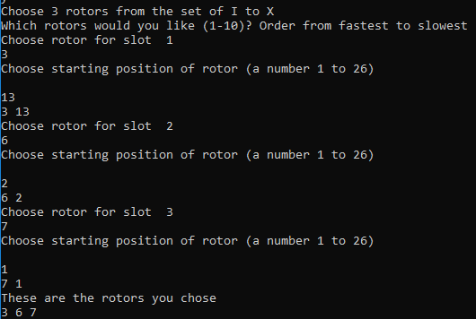
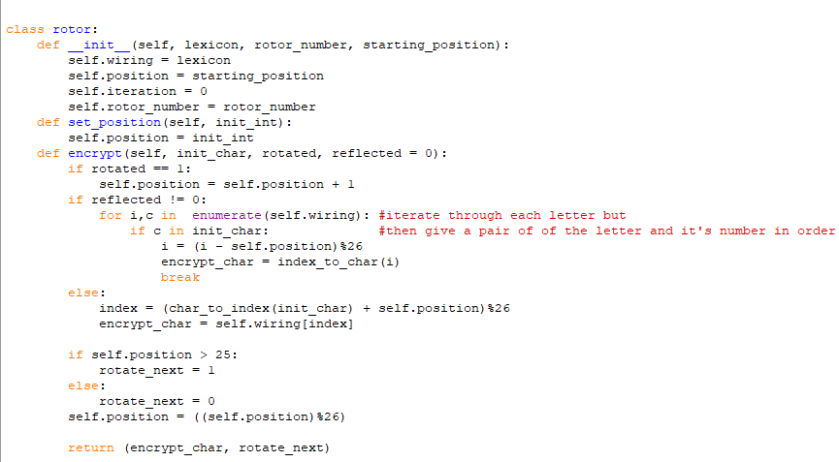
Rotor Set-Up

Slide 17
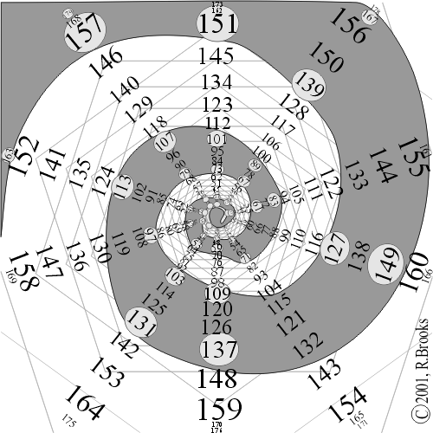



Modern Encryption: Prime Numbers
Fermat’s Little Theorem
Some multiple of P, where P is prime

Slide 18
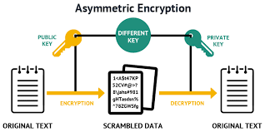
Public and Private Keys
P₁ X P₂ = C
P₁: Prime Number 1
P₂ = Prime Number 2
C = Public Key

Slide 19
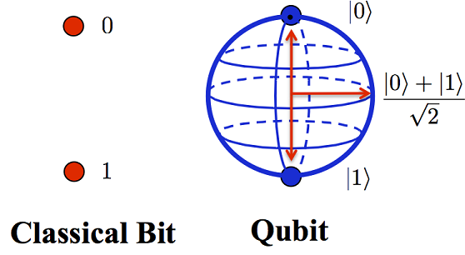
Revolutionary Processes:
Quantum Computing
1
0
Relative Superposition: We don’t know which state is which until measures
Saving:
Time
Memory space
Scientific Modeling:
Physics
Biology
Pharmaceuticals
Engineering

Slide 20
Summary
Encryption has been around as long as humans had secrets to share
Technological break-through: Enigma Machine
Advent of computers, security is vital to national, medical, and personal privacy

Slide 21

Special Thanks
Dr. Levasseur
Frau Harrod
CS and Math Departments
Honors College
ACM
Friends and Family

Slide 22
Works Cited
Images In order of Appearance:
Scytale Drawing. Digital Image. Toebes. https://toebes.com/Flynns/Flynns-19241213.htm
Clock. Digital Image. Giphy. https://giphy.com/gifs/video-clip-transparency-KGD1TNpsl5yFy
The Engima Enigma. Digital Image. Hackaday.
https://hackaday.com/2017/08/22/the-enigma-enigma-how-the-enigma-machine-worked/
Enigma. Digital Image. CryptoMuseum.
https://www.cryptomuseum.com/crypto/enigma/working.htm
Monthly Key Sheets. Digital Image. Plus Maths.
https://plus.maths.org/content/exploring-enigma
Wiring Diagram. Digital Image. Enigma Museum.
https://enigmamuseum.com/enigma-computer/
TypeX Machine. Digital Image. Crypto Museum. 2 August 2003.
https://www.cryptomuseum.com/crypto/uk/typex/index.htm
British Flag. Second Life Marketplace.
https://marketplace.secondlife.com/p/Vintage-British-Flag/11249937
Prime Number. Digital Image.Rhizone.
http://archive.rhizome.org/artbase/26910/webpage/Reginald_Brooks/Code/Html/PIN2+.htm
Asymmetric Encryption. Digital Image. Cheap SSL Shop.
https://www.cheapsslshop.com/blog/demystifying-symmetric-and-asymmetric-methods-of-encryption
Quantum Computing. Digital Image. Autodesk.
https://www.autodesk.com/products/eagle/blog/future-computing-quantum-qubits/
Muller, Derek. “How Does Quantum Computing Work.”://www.youtube.com/watch?v=g_IaVepNDT4
Crypto Museum. “History of Enigma.” https://www.cryptomuseum.com/crypto/enigma/hist.htm
Kahn, David. Seizing the Enigma: The Race to Break the German U-Boat Codes, 1939-1943. London: Frontline Books, 2012. Internet resource.

