Slide 1


Gamer Management
Presented by : Scion Software Solutions
ITIL Framework

Slide 2
CPL-5559-CSAT-CSAC-0093-V2-WINTER-2020
Team Members
ABOUT US
Amandeep Kaur
(C0744703)
Gurpreet Chahal
(C0742780)
Scion Software Solutions (S3) is a software development company located at Richmond Hill, Ontario.
The S3 company handles its IT functions and operations based on the ITIL framework.
ITIL is the collection of best practices for IT Service Management which is Published by the UK government
Navneet Singh
(C0749303)
Karanvir Singh
(C0745204)
ITIL Framework

Slide 3
Role - Software Analyst
Week -1
TASK
Preparing SRS document - Analysing the requirements of Gamer Management Module
Purpose, Software Requirements, Intended Audiance
Product Scope, Product Perspective
Product Functions - flow diagrams representation
OUTCOME
Purpose - Developed an User Interactive Web application named Gamer management based on ITIL framework.
Product Scope - User interactive that fulfills all user requirements.Includes three types of users- Administrator, Elevated Access user, Regular user.
Authority Levels - Administrator (Higher), Elevated Access user(Middle), Regular user(Lower or Entry level).
* Admin- Add, Edit, Delete, View(Search), Provide Access to other users.
* Elevated Access User - View, Edit other users.
* Regular Access User- Edit own info.
Product Perspective- Allow users to Create profile and store data in database.
FLow of app : New User - SIGN-UP, Registered User- LOGIN . also represented in a Flow Diagram.
Departments - Real Time Strategy, Technology, Board Games, Card Games, Arcade Game ---> assigned by ADMIN.
Product Functions- Implementing client-server model providing Better results to clients.
Filing Requirements - Service Level Agreement managed properly.
Intended Audience- Team members and Users.
Risk Factors- Change management and risk factors should be easily managed.

Slide 4
Role - Software Analyst
Week -2
TASK
Convert basic layout of web pages into computer-designed user-interface mock-ups
Use Axure RP framework - create an interactive prototype for your web application
External Interface Requirements
Logical characterstics, User interface specifications
OUTCOME
Wireframe tool - Axure RP used to design the interactive web pages.
Preview all web pages in browser.
Designed Pages- Login/Signup, Welcome Pages.
Design elements : Side tabs like Welcome, My profile, Users, Access Request, Logout.
Text boxes : for enterning credentials or data,
Check boxes for selecting data, Buttons to perform different functions like LOGIN, SIGNUP, SAVE, EDIT etc .
Dropdown list for selecting departments, Toggle buttons for Approve/Decline requests.
Input controls : Iinteractive components - Date Picker, Captcha, Dropdown List, Search box.
Error messages : message will be displayed to show errors.
Logical characterstics : Function performed by all designing elements.
Linking Process : navigation from one page to another amongst buttons, tabs.

Slide 5
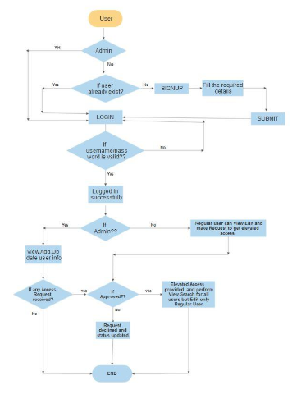
Role - Database Analyst
Week -3
OUTCOME
Database Requirements :
Flexibility -supports any Operating System like Windows,
Linux, MacOS etc.
Scalability- supports heavy coded application,
open source.
High Performance - Incredible storage and high speed.
Robust transactional support- Data Integrity, Deadlock
detection.
Strong data protection- Data authentication and
security.
Database selected - MySQL
Database created to store user data.
ERD diagram - explains working
and flow of web application.
Tables - created tables to store
into the database.
Task :
Database Requirements
Select Database
Create tables
Create ERD

Slide 6
Role - Programmer Analyst
Week -4
TASK
Outcome
SMS
GITHUB
server used that is used to save our data or projects
GITHUB Repository - Create account -> New Repository with name CSAC-0093.
Repository - Private or Public
GItHUB Functions
Commit , Push, Pull
Collaborators - it allows to add team members and share data.
Cloning A Repository- clone our repository to our workstation or pc.
choose a Source code management systems.
GITHUB
Create an account
on GITHUB
Create a ReadMe
Repository in it.
@

Slide 7
Role - Software Developer
Week -5
Outcome
Outcome
Login Button created for already registered users.
User has to fill Username and Password and click on LOGIN butto to Login in tohis account.
My Welcome page has made to allow user to see his own profile with filled details.
Here, User can Edit his own information by using Edit button.
nn
Task
Task
Task
Task
Sign up
Login
Welcome
Profile
Page
Page
Page
Page
Outcome
Outcome
SIGN-UP page has been made for new user.
User has to click on SIGNUP button.
User has to fill further details like Email, Firstname, Lastname, DOB, Address, Postal, Captcha.
New user will be registered.
Already registered user will login into his account, will be able to see Welcome screen.
User will see Welcome message on welcome screen.

Slide 8
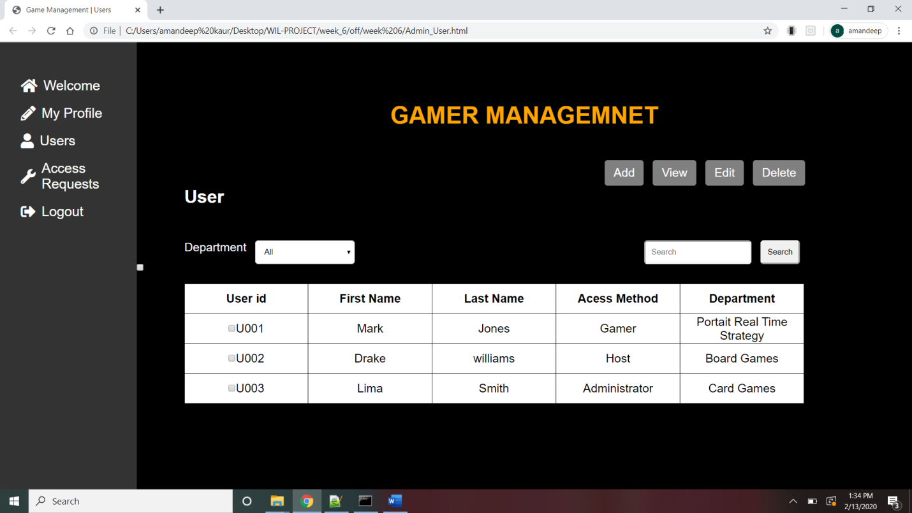
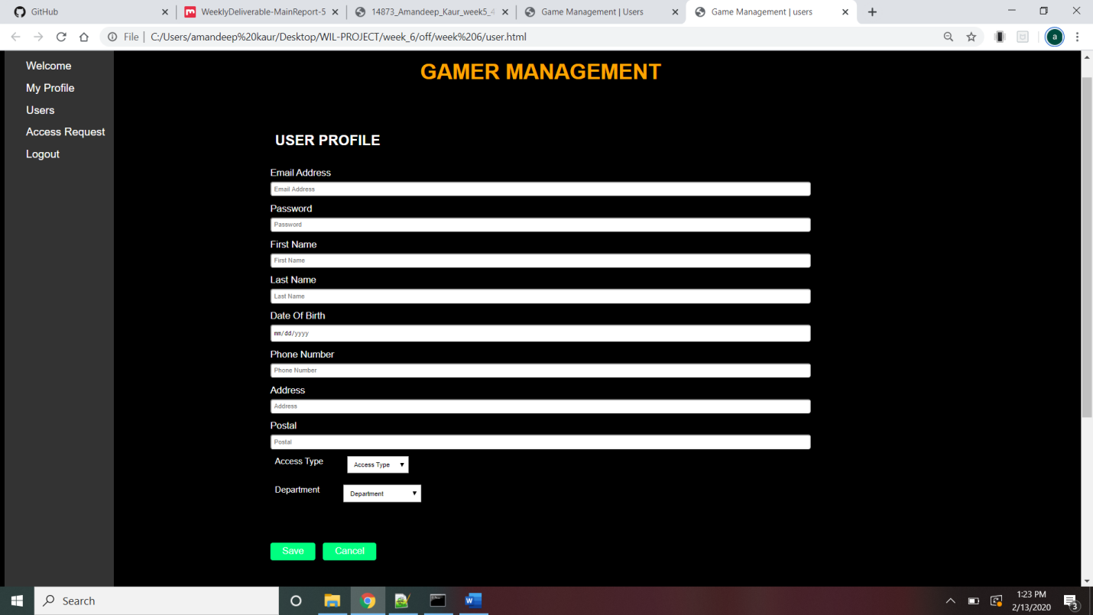
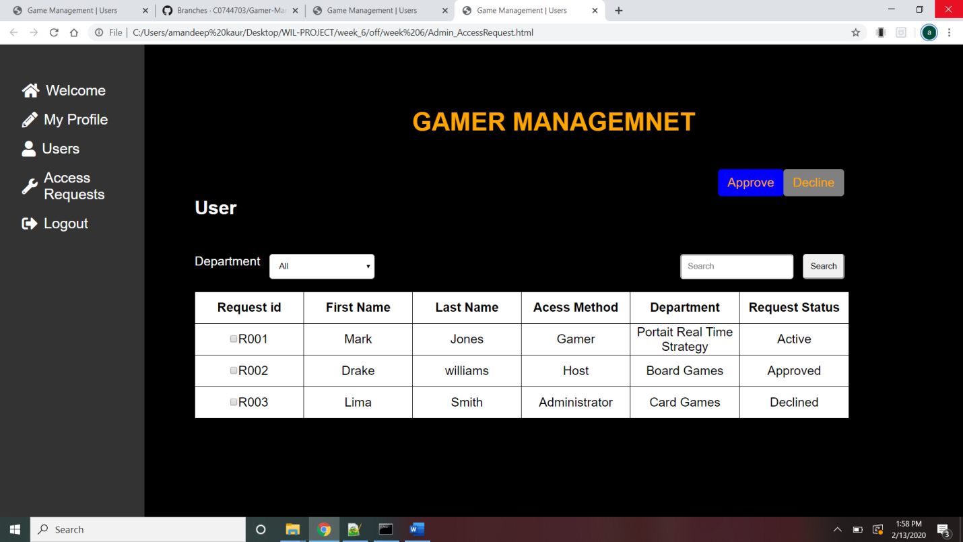
Role - Software Developer
Week -6
User tab - buttons - ADD, VIEW, EDIT, DELETE
ADD - can add new user,
VIEW - view user's information
EDIT- edit user's information
DELETE - Admin can delete user's information
Check boxes used - display user's info (View)
Under Users tab , user can performant operation like Add, View, Edit, Delete (According to the authoritylevel)
By selecting View- User can view - according to Department.
By selecting View - User can view - using Search Box.
check boxes used- to perform Edit, Delete.
Access Request tab - buttons Accept/Decline
Requests can be viewed - Department
Request can be viewed - Search box
check boxes used to display Requests.

Slide 9
Role - Software Developer
Week -7
For Admin - select Admin (link)
Admin fills - USername and Password to login
For User- Login link - must select User Login for login process
User fills - Username and Password
After Login- navigated to welcome screen
Task
Login
Function
For Sign-UP - User click SIGN UP button.
Fills info - Email, Pass, CPass, FName,LName,Dob, Address, Postal
Pass, Cpass- validation used, DOB- date picker
After filling- click on Sign UP button
Navigated to home page to login
Task
Signup
Function
Login
Profile
Task
Already registered user or Admin - Login into account
Navigated to welcome screen
All User and Admin will see Welcome message on welcome page
Users will see his Information - able to edit also
Welcome
Function
Task
Logout function - at side bar
Admin can Logout to exit
Users can Logout to exit
Once Logout - login again to enter in the app.
Logout
Function

Slide 10
Role - Software Developer
Week -8
For ADD function - Only Admin can perform this function
Users tab has ADD button - click to add new user
Admin has to add new user by providing- Department and AccessType
Task
ADD
Function
For EDIT Function - all user can perform this function
Admin can Edit all user's Info - click EDIT to edit info
Elevated User can Edit his own Info
Regular User can Edit his Own Info- Accept Department and AccessType
Task
EDIT
Function
Login
Profile
Task
For VIEW Function -
Admin can view other users Info, to EDIT, DELETE,
Elevated User can view all other users
Regular User can cannot view other users
VIEW
Function
Task
Department dropdown list - to view users according to Departments
Admin can View-using dropdown list - to perform any function
Elevated Users can View - using dropdown list - only to view info of other user.
Department
Function

Slide 11
Role - Software Developer
Week -9
Admin has to Login - View profile of other users - using View button
Users can see his own Profile - using My Profile tab
Regular user will see Elevated Access Request button
Only Elevated Users can view other User’s Profile -using My Profile tab
01
Profile
Outcome
Admin Login - go to ACCESS REQUEST tab - View Requests to get Elevated Access
Admin - check the checkboxes - to select the user Requests
Admin can APPROVE or DECLINE using button - for selected Users
Request Access
02
Outcome
Admin can Search other Users using SEARCH box
Admin can Search - by entering user name
Regular user cannot use search until get access to Eleveted
03
Search
Outcome
Sort
Admin and Elevated users- can sort data using Department
Admin and Elevated users- can sort using Search box -
entering Username .arch
04
Sort
Outcome

Slide 12
Role - Software Developer
Week -10
TaskE
Admin can perfom DELETE function - under USERS tab
DELETE button navigates to next screen
Enter User ID to Delete
01
DELETE
Outcome
TaskE
Admin Login - go to ACCESS REQUEST tab - View Requests to get Elevated Access
Requests will be displayed in a table form - following with checkboxes
Admin - check the checkboxes - to select the user Requests
Request Access
02
Outcome
TaskE
Admin select checkboxes - to Approve or Decline requests
pop up message - for Approved or Decline request
03
Approve/Decline
Outcome
TaskE
Requests Status - ACTIVE, APRROVED, DECLINEDa
Active - pending requests
Approved - for approved requests
Declined - for declined requests
Display Rquest Status
04
Outcome

Slide 13


Role - Software Developer
Week -11
Task - SLACK
Task - Trello
Outcome
Outcome
Install SLACK -collaboration HUB
Created account and channels @TeamQA-CSAC0093 and @InternalQA-CSAC0093
Team collaborated on SLACK
work from home or anywhere
can share data or ideas
Disscussed different criteria of project
Installed TRELLO - where word can be done by collaboration
Created account on Trello
Collaborated Team by inviting them
Created Board and added 5 tasks
Integrated SLACK and TRELLO
changes from Trello - notified in SLACK

Slide 14

Role - Software Developer
Week -12
Bootstrap
Task
Outcome
Install Bootstrap
Use bootstrap
Create new Branch in GITHUB
Get the code from old Branch
Installed Bootstrap - made our Web application responsive
Tested on different browsers
New Branch created in GITHUB - version-1
Got code into new branch

Slide 15
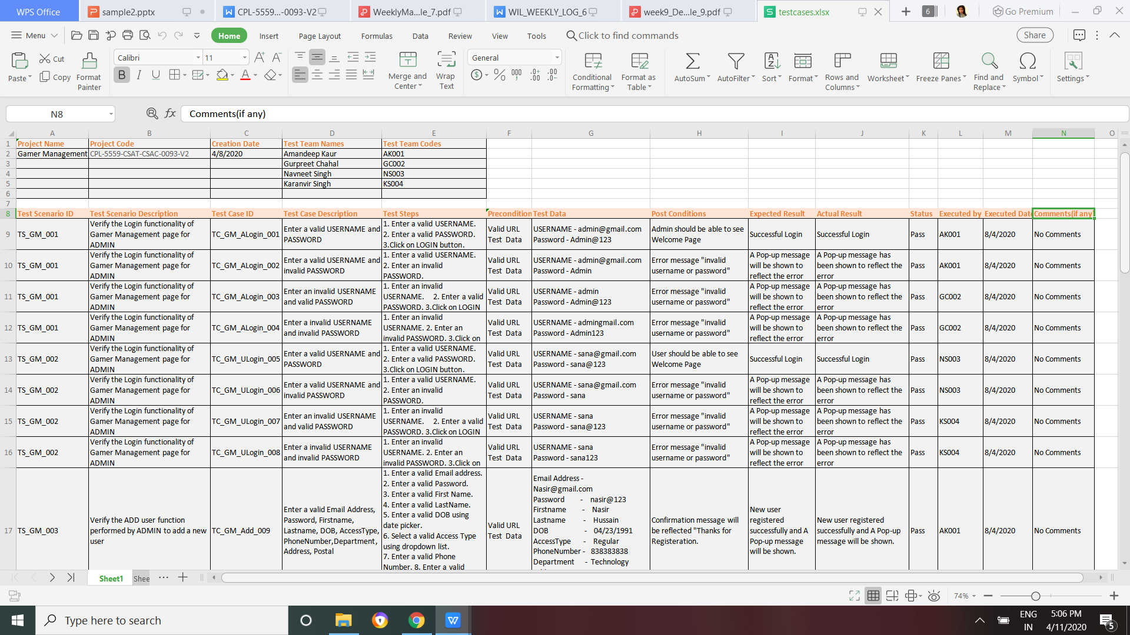
Role - Software Tester
Week -13
Outcome
Testing process- to check the errors
Done Manual Testing by all team
Took various 20 Test case scenerios
In order to check validation and constraints.
Web app worked smoothly and Bugs free
TESTING
Task - Testcases

Slide 16

ITIL Framework
THANK YOU

