Slide 1

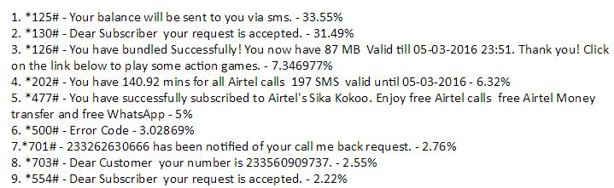
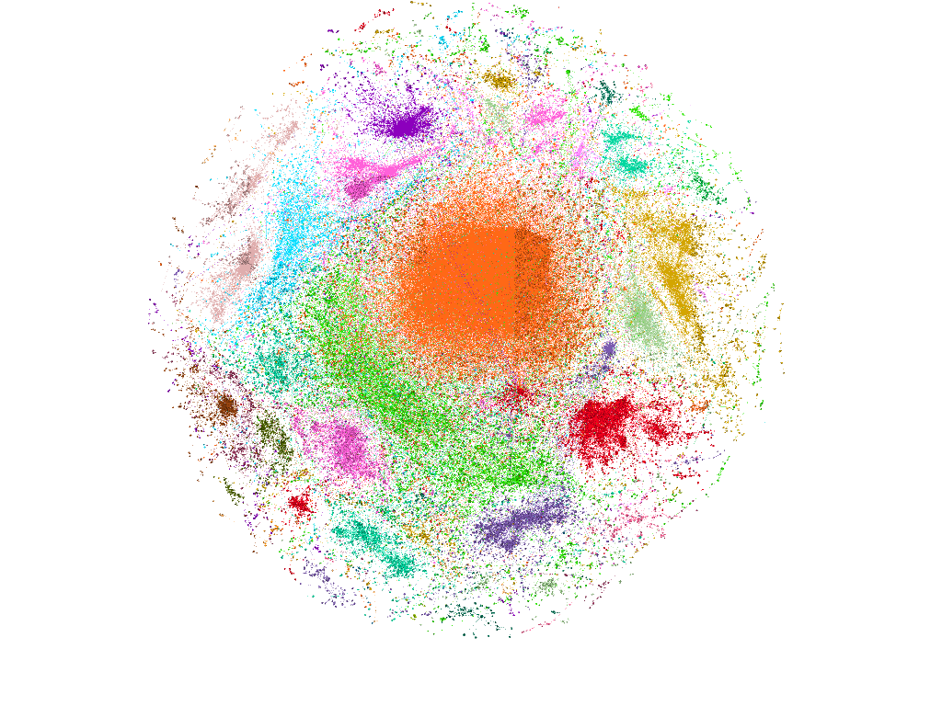
A Framework for the analysis of Mobile Network CDRs for the analysis of Subscriber behaviour
Conor Donohue | 13404068 | National University of Ireland
Project Outline
USSD Codes
Predictions of Wealth
Create a framework to provide statistical analysis and the creation of prediction models to classify wealth amongst users in a mobile dataset.
Tools Used
Python & Pymongo Weka
MongoDB Sci-Kit Learn
Gephi
Matlab
Database
Procedure
Include results based on your experiments
Result 2
Result 3
Step 1
Research Databases.
MySQL
Vs No-SQL
Step 2
Parse Data into the database
Step 3
Find USSD code functionality
Step 4
Remove errors from the database
Step 1
Describe this step in your experiment
Step 2
Describe this step in your experiment
Step 3
Describe this step in your experiment
Step 4
Describe this step in your experiment
Conclusion
Brief summary of what you discovered based on results
Indicate and explain whether or not the data supports your hypothesis
USSD Codes
Analysing Communities
Controlled variables
These are kept the same throughout your experiments
Decide how you will measure the change
The measure of change observed because of independent variable
Dependent variable
Independent variable
The one variable you purposely change and test
Acknowledgements
I’d like to thank my supervisor, Mr. Liam Kilmartin, for all his help and advice throughout the project
I’d also like to mention and thank Professor Gearoid O’Laighin, my co-supervisor
Finally, Mr. Martin Burke and Mr. Myles Meehan must also be thanked for their help over the past academic year

