Slide 1
LPIC-1: Linux Professional Institute Certification Study Guide,
5th Edition
  Chapter 1:
  Exploring Linux Command-Line Tools

Slide 2
Chapter 1 Objectives
103.1 Work on the command line (weight: 4)‏
103.2 Process text streams using filters (weight: 3)‏
103.4 Use streams, pipes, and redirects (weight: 4)‏
103.7 Search text files using regular expressions (weight: 2)‏
103.8 Basic file editing (weight: 3)

Slide 3
Command Line Basics
  Linux Shell Options
  bash
  sh
  tcsh
  csh
  zsh

Slide 4
Command Line Basics
(continued)‏
  Linux Shell Options
  Using a Shell
  Starting a Shell
  Navigating the Directory Structure
  Using Internal and External Commands
  Shell Command Tricks

Slide 5
Command Line Basics
(continued)‏
  Linux Shell Options
  Using a Shell
  Shell Configuration
  Using Environment Variables
  PS1="My New Prompt: "
  export $PS1
  echo $PS1

Slide 6
Command Line Basics
(continued)‏
  Linux Shell Options
  Using a Shell
  Shell Configuration
  Using Environment Variables
  Getting Help
  man command
  man man
  man -P /bin/more command
  man -k keyword
  info and help

Slide 7
Editing Text Files
  Looking at Text Editors
  emacs
  nano
  vim

Slide 8
Processing Text Using Filters
  File Combining Commands
  cat
  join
  paste

Slide 9
Processing Text Using Filters
(continued)‏
  File Combining Commands
  File-Transforming Commands
  expand
  od
  sort
  split
  tr
  unexpand
  uniq

Slide 10
Processing Text Using Filters
(continued)‏
  File Combining Commands
  File-Transforming Commands
  File-Formatting Commands
  fmt
  nl
  pr

Slide 11
Processing Text Using Filters
(continued)‏
  File Combining Commands
  File-Transforming Commands
  File-Formatting Commands
  File-Viewing Commands
  head
  tail
  less

Slide 12
Processing Text Using Filters
(continued)‏
  File Combining Commands
  File-Transforming Commands
  File-Formatting Commands
  File-Viewing Commands
  File-Summarizing Commands
  cut
  wc
  md5sum
  sha256sum, sha512sum

Slide 13
Using Regular Expressions
  Understanding Basic Regular Expressions
  Using grep
  Using sed

Slide 14
Using Regular Expressions
(continued)
  Understanding Basic Regular Expressions
  Understanding Extended Regular Expressions
  Using egrep

Slide 15
Using Streams, Redirection, and Pipes
  File Descriptors
  Standard Input
    STDIN
    0 (zero) or blank
  Standard Output
    STDOUT
    1
  Standard Error
    STDERR
    2

Slide 16
Using Streams, Redirection, and Pipes
(continued)‏
  File Descriptors
  Redirecting Input and Output
  Piping Data Between Programs
  Generating Command Lines
  xargs
  backtick (`)
  $()

Slide 17
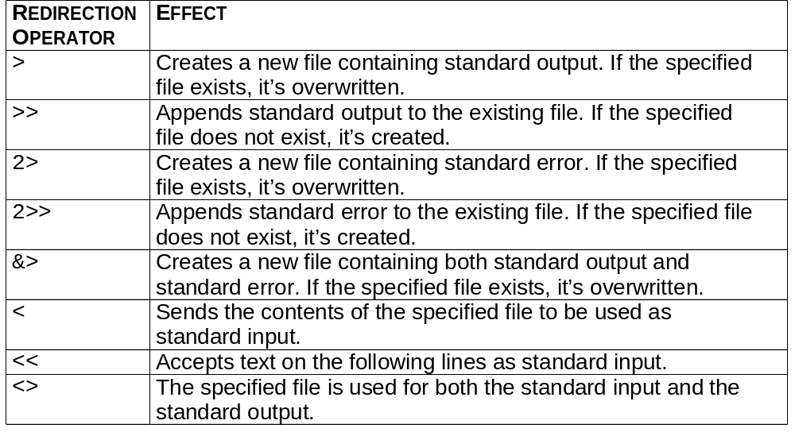
Redirection Operators

