Slide 1
FOOD WASTAGE MANAGEMENT SYSTEM
BHUMIREDDY YASWANTH (21BCI0224)
BODDU SRINIVAS(21BCE3614)
ALLURI PRASHANTH(21BCE3627)
MANJESH BOYAPATI(21BCE0604)

Slide 2
ABSTRACT
To develop a Web Based application that reduces the amount of food wastage produced in restaurants, functions and mess. The current system only provides information on amount of food wasted and does not provide an interface to donate and provide data analysis. Using data analysis, to visualize the impact. Donating the excess food that consists of the following details, first, providing the location of where excess food is available & details of the food quantity available. Immediate Alerts to nearby orphanage, volunteers to collect them. According to a recent survey, 1.3 billion tons of food is being wasted each year and one third of food consumed are leftover. To produce a system that reduces the amount of food being wasted the focus of the project is to develop a web application that uses data analysis to visualize the impact of excess food, thus reducing food wastage. It also enables to give away the excess food produced by notifying the nearby users with details of the food available

Slide 3
INTRODUCTION
As we know food industry is the one of the largest industries in the world ,the dramatic increase in worlds population demands increase of food production in next 50 years
According to the report of the Food and Agriculture Organization (FAO, 2011a), roughly one-third of food produced for human consumption is lost or wasted globally
Taking in account of increasing number of hungry people and restricted natural resources waste management systems will become one of the most important challenges of the twenty-first century
This system helps to minimize the waste rather than managing waste

Slide 4
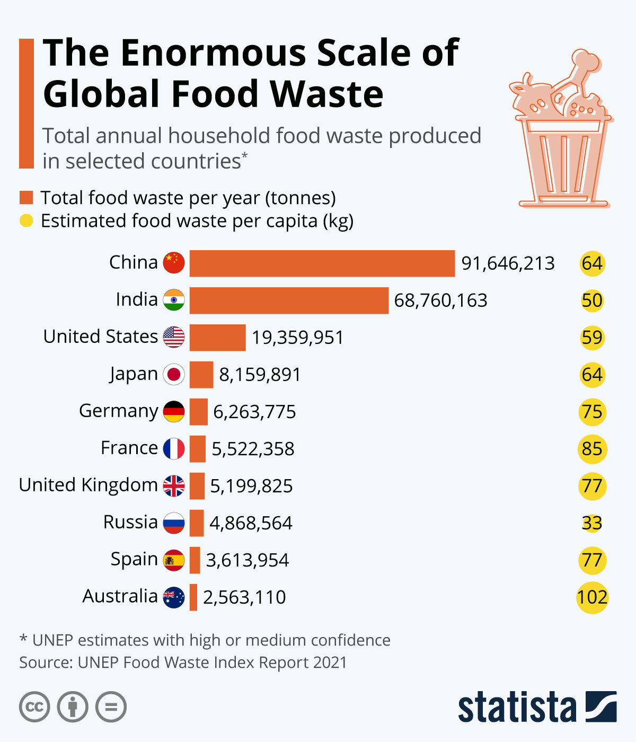
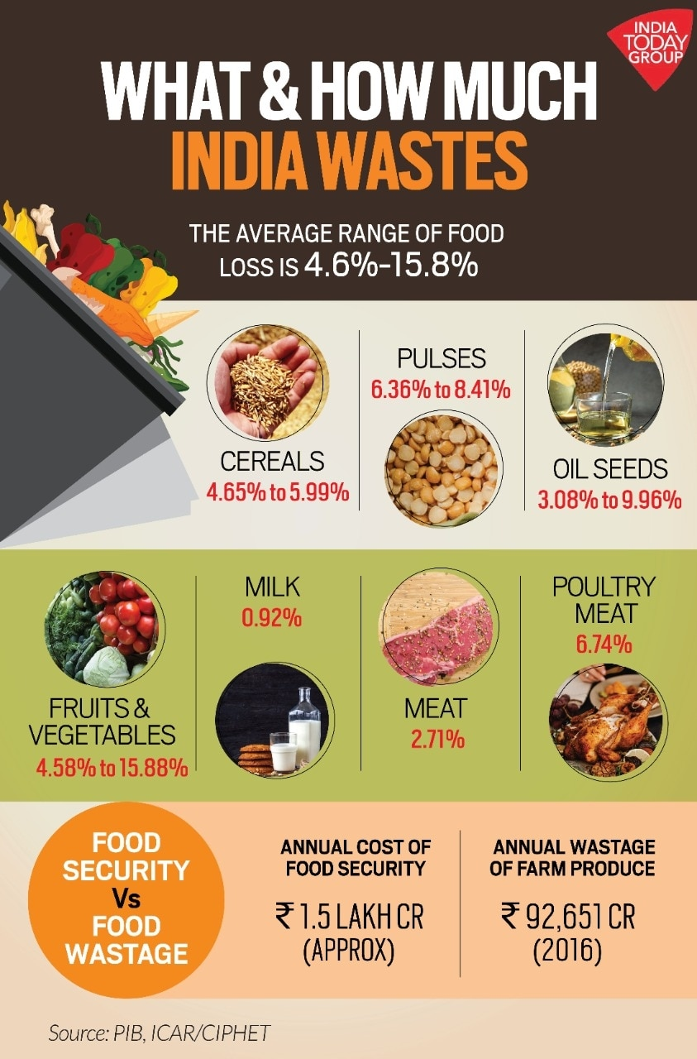
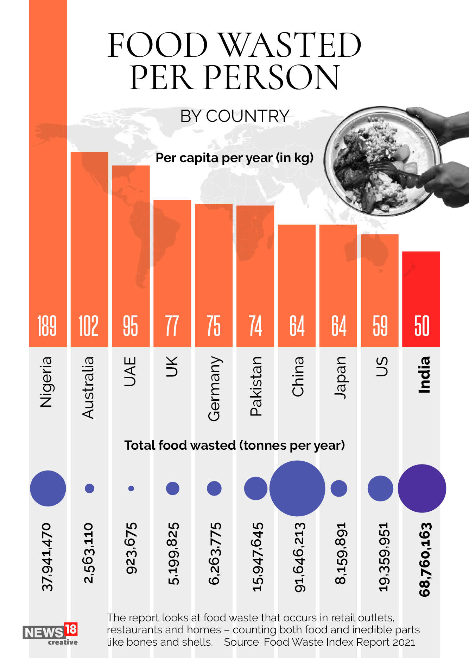
Stats on food wastage

Slide 5
Working of this system
In this system, we have tried to reduce restaurant food wastage by giving waste
food to NGOs. NGOs will raise a request, in case of any leftover food restaurants
have. This request is sent to the restaurant manager of that particular restaurant.
The NGO Manager then approves the request and assigns it to one of the NGO
employees for takeaway and forwards the request to the restaurant. The leftover
food at the restaurant can be given to NGOs at the end of the day. The admin can
track the history of restaurants and NGOs for the leftover foods

Slide 6
Benifits
Benefits will be both the restaurant (reducing food wastage), and the needy
Keep track of wastage food for restaurant
User can play role in saving food wastage and help the needy

Slide 7
system modules
User Register
Login
View Food Item
Add Food Item
Update/Delete Food
Update Google geo location
Search Nearby food items
Add Items To Cart
Remove An Item From The Cart
View New Order
View My Order
My Profile
Log Out

Slide 8
Module description
Users Register
This module is used to create a user registrations form. After registering application form the users able to enter into process. To register the form following details should be given by the user, the details that should be filled by the user is their personal details and the required details by the secret password, location, address etc.
Login
User can login using username and password
View Items
Search location wise and book the food items

Slide 9
4 .Add Items
Create a new food item with details of quantity, location, address contact
5.Add images
Add images to the food items
6.Add Items To Cart
Add multiple food items to cart for booking
7.Remove An Item From The Cart
Delete food items to cart for booking

Slide 10
THANK YOU

