Slide 1
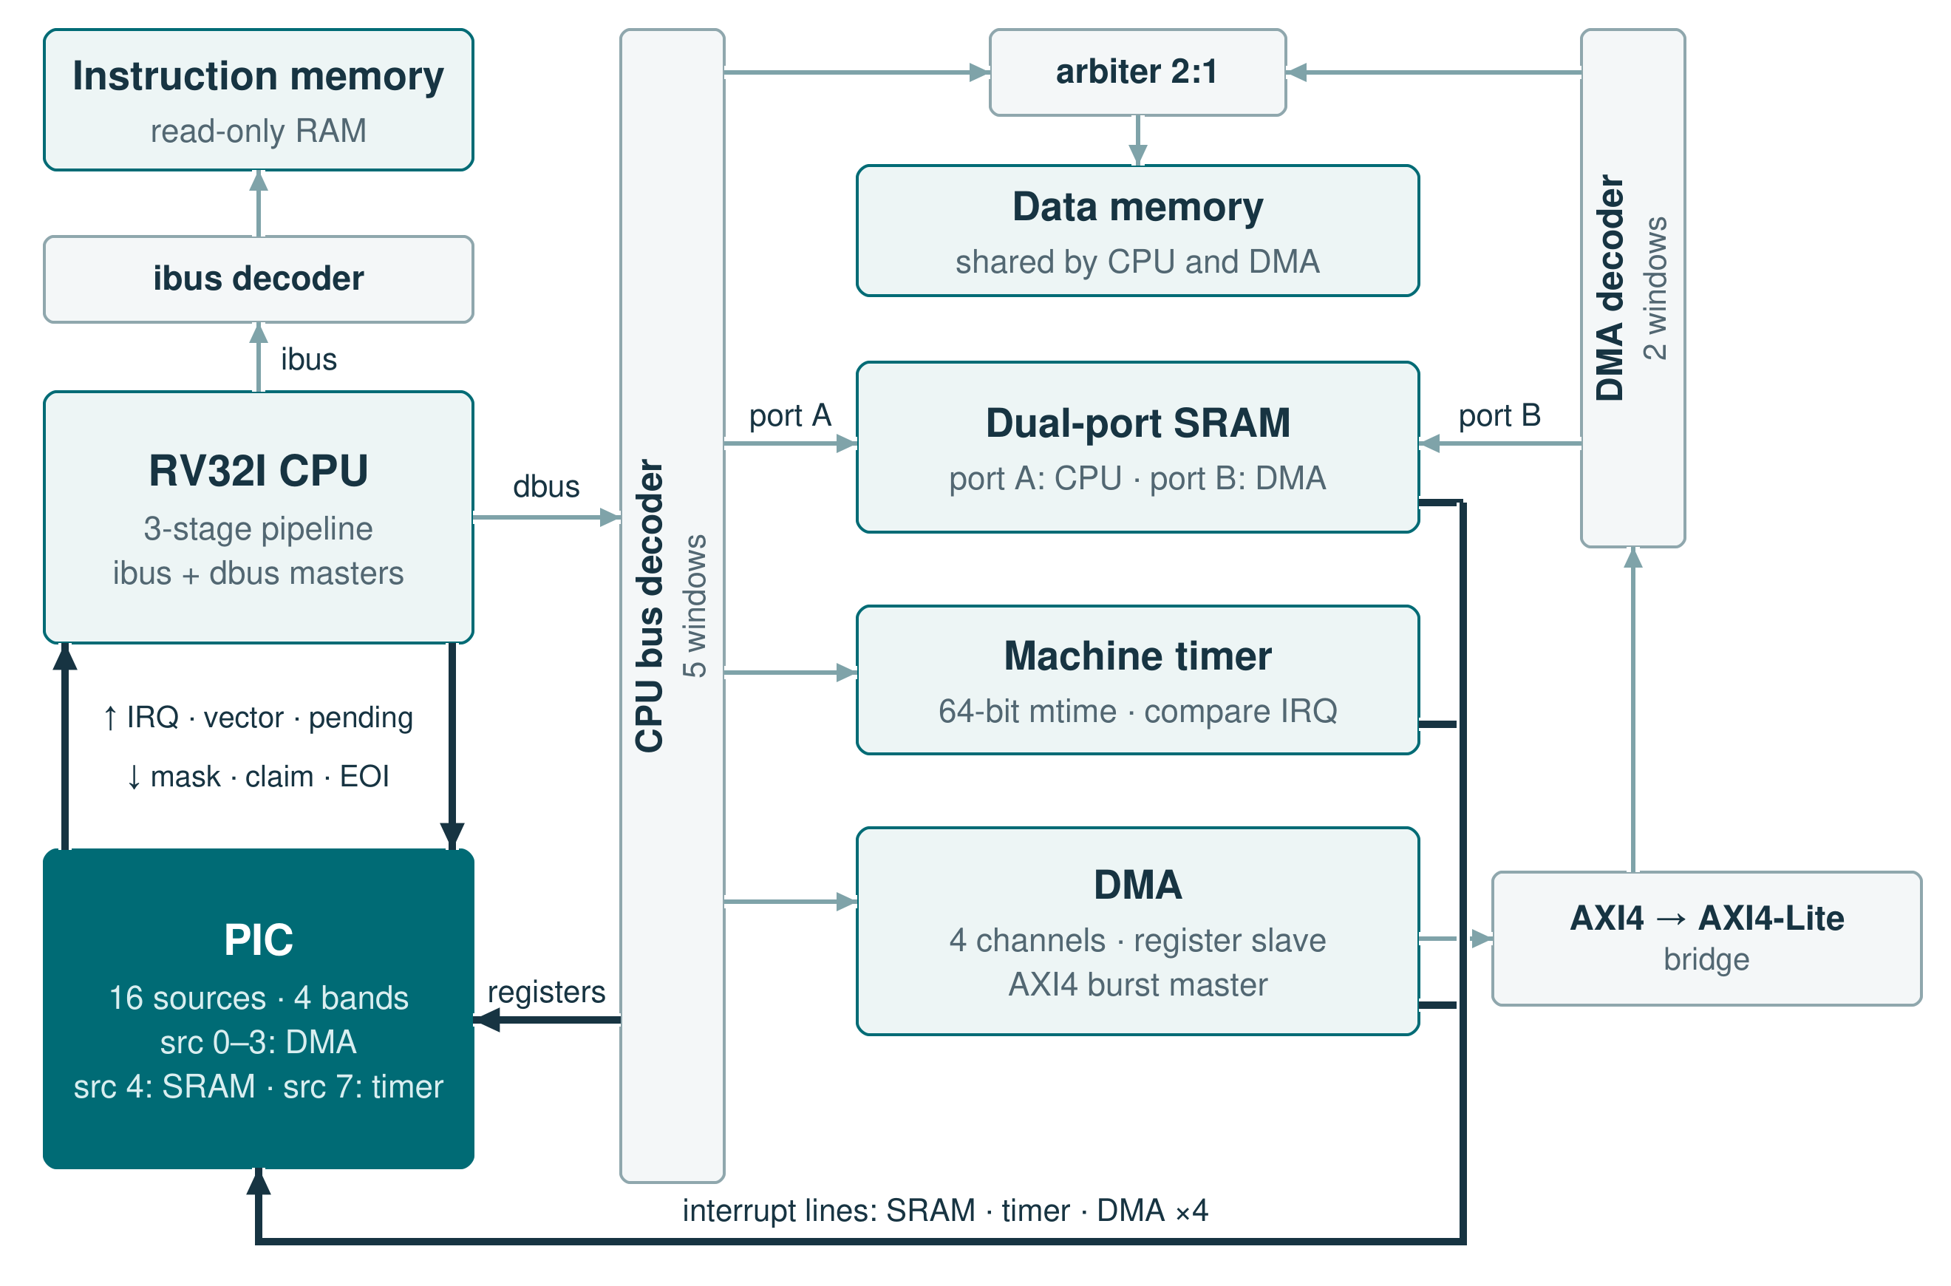
INTERNSHIP · SIEMENS · 2026
Interrupt Controller
Programmable priority and preemption
Bunea Cosmin-Andrei
Computer Engineering, year III
Academic year 2025–2026
Transilvania University of Brașov
RTL implementation · interfaces · verification
Notes:
0:30. The project is the interrupt controller of the SoC: I specified it, wrote the RTL, connected it to the CPU and verified it. In the figure the PIC has a register port on the interconnect and a direct link to the CPU; its sources are the DMA, the SRAM and the timer.

Slide 2
The brief asks for a PIC with priority bands, nesting and deadlines
01
16 hardware sources, each level- or edge-triggered
05
Spurious interrupts detected, handled and logged
02
16 software triggers, safe against accidental
writes, arbitrated exactly like hardware
06
A deadline per source,
with automatic priority escalation
03
Priority bands, with arbitration inside each band
07
One request + 4-bit vector to the CPU,
acknowledged by a claim
04
Preemption with nesting;
the interrupted context is kept
08
AXI4-Lite register map:
11 registers, OKAY / SLVERR / DECERR
PIC · 02 / 07 · Requirements
Notes:
1:00. These are the eight requirements from the PIC brief. Sixteen hardware sources, each level- or edge-triggered, and sixteen software triggers that must be safe against accidental writes and, once pending, behave exactly like hardware; together they share sixteen arbitration slots. Priority bands instead of a flat priority, preemption with nesting, spurious detection with logging, and a deadline per source with automatic escalation. Towards the CPU, one request with a 4-bit vector, acknowledged by a claim; towards software, eleven registers over AXI4-Lite.

Slide 3
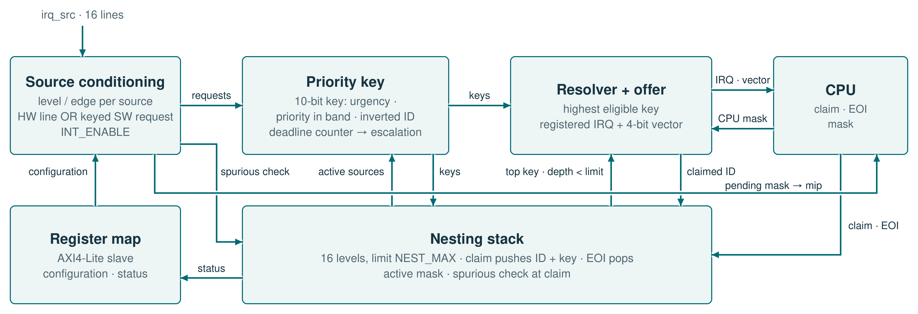
A request is conditioned, ranked by its key and offered to the CPU
THE BRIEF LEFT 21 QUESTIONS OPEN · THE FIVE THAT SHAPED THE CONTROLLER
Bands
Reconfiguration
Nesting
Spurious
Escalation
4 bands, 2-bit urgency each (BAND_CONFIG). 10-bit key: urgency · priority in band · inverted ID, so the lower ID wins ties.
Claim pushes ID + key onto the stack. An active source keeps its saved key; a new band counts from its next request.
16-entry stack, NEST_MAX 1–16 (reset 8). Only a strictly higher key preempts; at the limit no offer, overflow flag.
Detected at claim, when the request is gone. The level still opens and EOI closes it; logged in SPURIOUS_LOG.
16-bit deadline counter per source. On a miss: jump to a target band or one urgency step up; optional repeat.
PIC · 03 / 07 · Architecture and decisions
Notes:
2:30. The figure is the controller as built: a request is conditioned (level or edge, software trigger, enable), gets a 10-bit priority key, and the resolver offers the best eligible one to the CPU through a register; the nesting stack below holds the claimed contexts, and the register map configures everything over AXI4-Lite. The brief asked 21 questions about bands, nesting, spurious interrupts, deadlines and software triggers, and left the answers to me. Follow a request from the left: source conditioning, the priority key, the resolver and the registered offer to the CPU; a claim pushes the context on the nesting stack and EOI pops it. Bands: four bands, each with a 2-bit urgency in BAND_CONFIG; the 10-bit key is urgency, priority inside the band and the inverted ID, so one comparison decides and the lower ID wins ties. Reconfiguration: the claim stores the ID and the key on the stack, so changing the band of an active source affects only its next request. Nesting: 16 physical levels, NEST_MAX from 1 to 16, and only a strictly higher key may preempt; at the limit nothing is offered and the overflow flag is set. Spurious: a claim whose request has disappeared still opens a level, so the CPU and the PIC stay in step, and the event is logged. Escalation: a 16-bit counter per source measures the wait; on a missed deadline the source jumps to a target band or moves one urgency step up, optionally again.

Slide 4
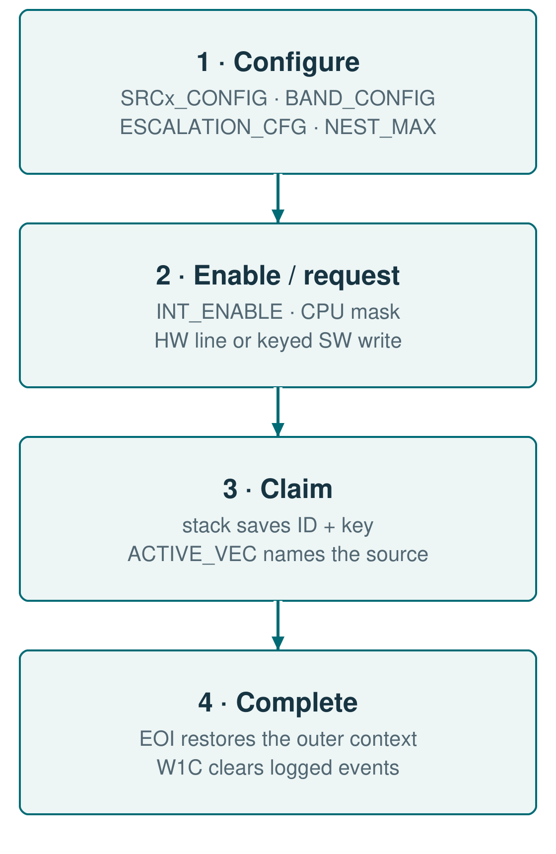
The registers set the policy and make the state observable
Register
What it does
SRCx_CONFIG ×16
Level / edge, band, priority in band, 16-bit deadline
SRCx_SW_TRIG ×16
Software request: key 0xA5A5 + both upper strobes; cleared by claim or write
SRCx_STATUS ×16
Pending, active, escalated, spurious, elapsed cycles, effective band
BAND_CONFIG
2-bit urgency for each of the 4 bands
ESCALATION_CFG
Jump to a target band or one step up; single or repeated
NEST_MAX
Nesting limit 1–16, reset 8; out-of-range writes clamped
INT_ENABLE
Per-source enable before arbitration
NEST_STATUS · ACTIVE_VEC
Depth, source on top, overflow · source in service
SPURIOUS_LOG · INT_STATUS
Sticky events, write 1 to clear; a hardware set wins
PIC · 04 / 07 · Registers
Notes:
1:00. These are the eleven registers the brief asked for, as I defined them. Each source has its configuration (level or edge, band, priority, 16-bit deadline), a software trigger and a status word with the elapsed time and the effective band. A software request needs the key 0xA5A5 written with both upper byte strobes, so a partial write cannot arm a channel; the claim clears it. BAND_CONFIG and ESCALATION_CFG set the shared policy, NEST_MAX the depth, INT_ENABLE the enables. NEST_STATUS and ACTIVE_VEC show the context in service; the logs are write-1-to-clear, and a hardware event in the same cycle wins. On the right is the order of use.

Slide 5
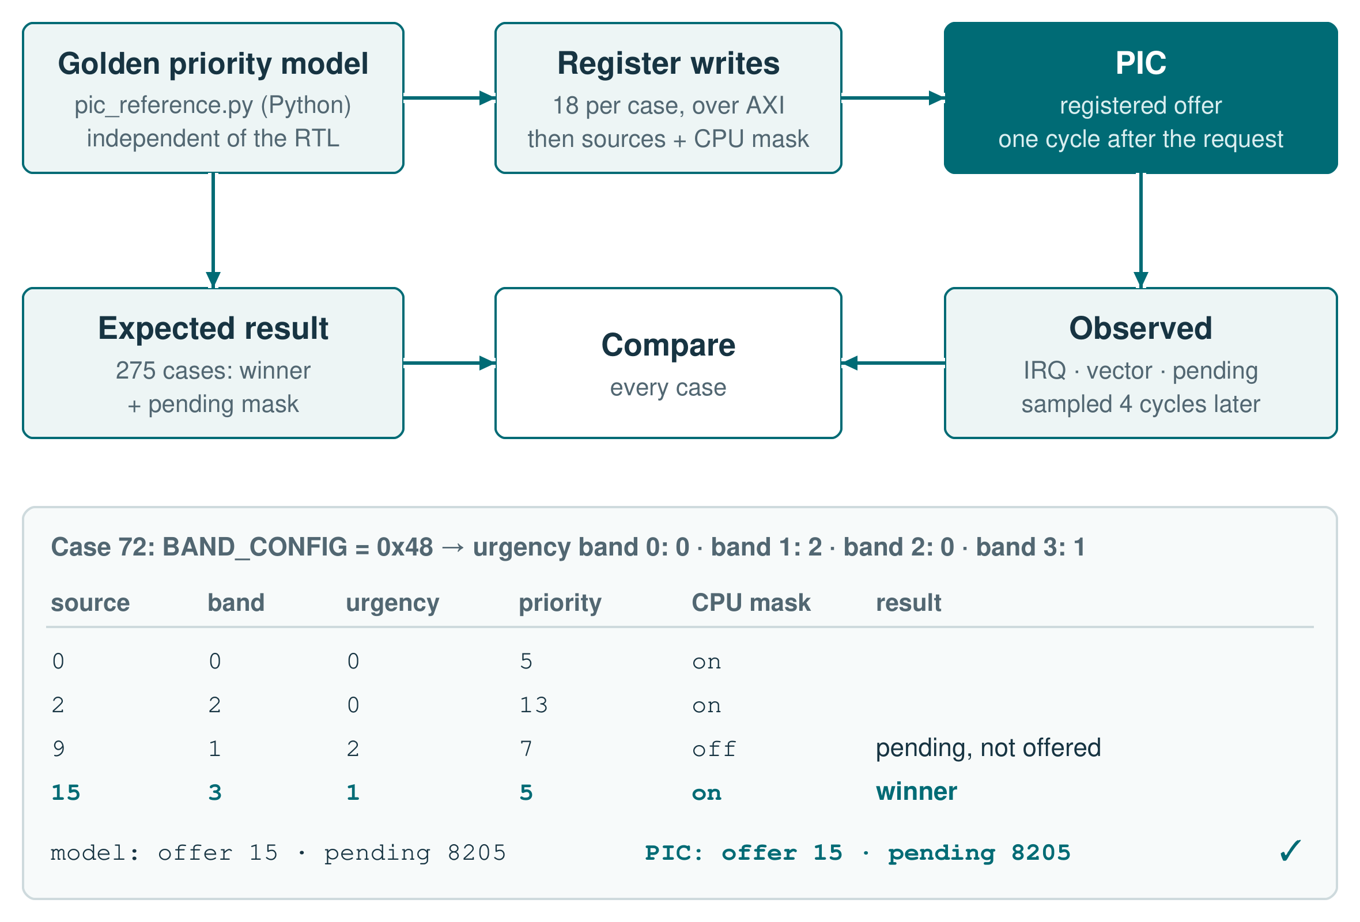
An independent model predicts every priority decision
THE PIC ALONE
275
golden-model cases: all 256 BAND_CONFIG values + 19 corners · 5,741 checks
15
random runs of 20,000 cycles, each cycle equal to a Python cycle model
171
feature and same-cycle checks: nesting, spurious, escalation, triggers
1,290
register checks: access rules 478
status 424 · reset 388
96
AXI4-Lite writes vs PULP axi_lite_regs: 16 WSTRB × 3 orders × 2 stalls
10
properties proven with SymbiYosys; 5 / 5 injected defects fail the proof
32
SVA properties attached with bind: 12 PIC, 20 AXI protocol
4 / 4
mutation testing: mask, tie-break, empty EOI, nesting limit
PIC · 05 / 07 · Verification · block
Notes:
1:45. On the right is one test end to end. The golden model is a Python script written from the priority rule, independently of the RTL. It produces 275 cases, every BAND_CONFIG value plus corner cases: the configuration of all 16 sources, the enables, the CPU mask and the active sources, with the expected winner and pending mask. The bench writes the 18 registers over AXI, drives the sources and the mask, and compares four cycles later; the offer itself is registered one cycle after the request. In case 72 source 9 is in the most urgent band but the CPU masks it, so it stays pending and source 15 wins; model and PIC agree. On the left, per type: the golden-model cases; the random traffic, fifteen runs of 20,000 cycles in which random register writes, sources, claims and EOIs drive the PIC and a separate Python cycle model must give the same outputs and state on every cycle; the feature and same-cycle benches; the register benches; the AXI front-end compared with PULP axi_lite_regs; ten properties proven with SymbiYosys for every input sequence, for example that the stack never exceeds sixteen levels and that a claim at the limit changes nothing, where each of five injected defects makes the proof fail; the SVA properties attached with bind; and mutation testing.

Slide 6
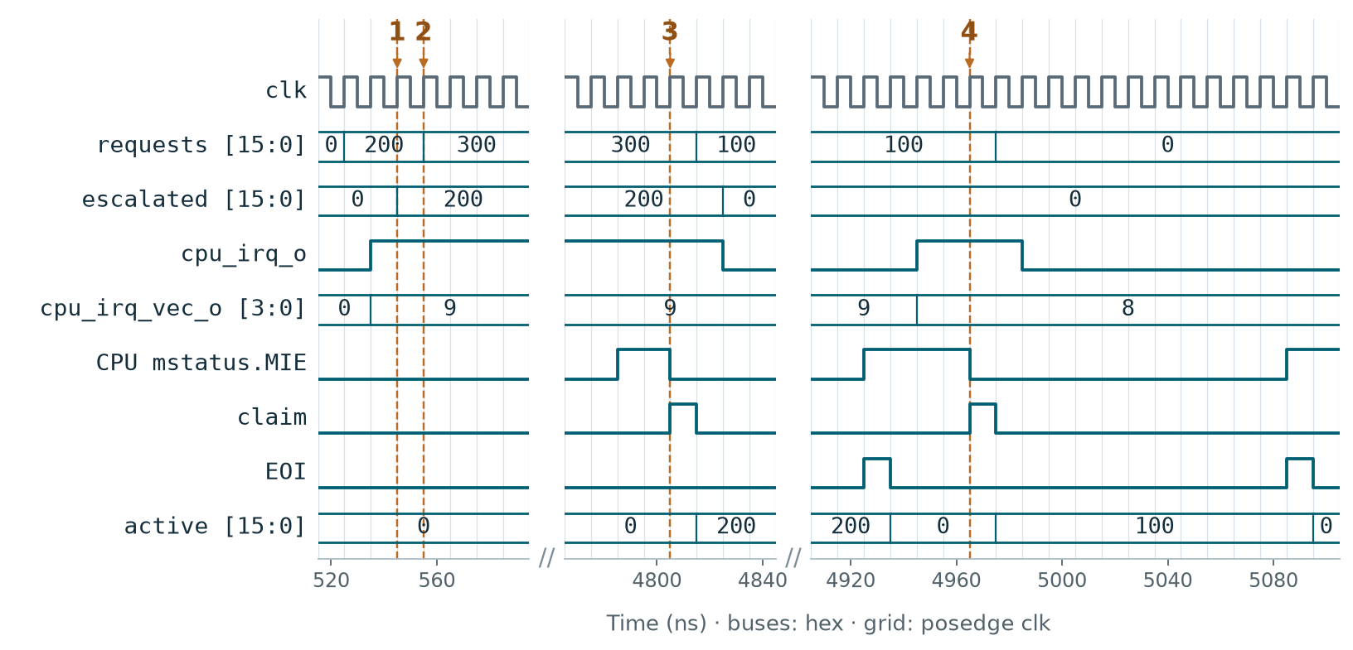
A missed deadline makes the CPU serve the escalated source first
THE PIC WITH THE CPU
382
checks, CPU + PIC + mtimer program: priority, in-service suppression, masked source
36
all 16 software-triggered sources claimed by the CPU with the right vector
70
nesting checks through the CPU: 2 levels (16) and all 16 levels (54)
15
spurious claim with the real CPU: logged, EOI balanced, next source served
12
escalation through the CPU: service order reversed
PIC SVA properties bound in all 23 SoC benches
1 · Source 9 escalates
2 · Source 8 arrives
3 · CPU takes source 9
4 · Then source 8
12
It has waited past its 2-cycle deadline: escalated = 200 (bit 9), and it moves to band 0, the most urgent.
requests = 300 (8 and 9). Band 1 would beat band 3, but 9 is now in band 0, so the vector stays 9.
The CPU sets MIE and claims vector 9 first; active = 200 (source 9 in service).
After the EOI of 9 the vector changes to 8 and the CPU claims it; active = 100 (bit 8).
CI
every push: lint, all PIC / CPU / SoC benches with SVA, coverage and cover gates
PIC · 06 / 07 · Verification · system
Notes:
2:15. This case comes from the SoC run, where the CPU itself claims the sources. Source 8 is in band 1 and source 9 in band 3, so 8 is nominally more urgent; only 9 has a deadline, two cycles, and ESCALATION_CFG jumps to band 0. Both are raised while the CPU still has MIE cleared. At 1 source 9 misses its deadline and escalates to band 0. At 2 source 8 arrives, and the offer stays on 9. At 3 the CPU sets MIE and claims 9 first; the stack saves its ID and key. At 4, after the EOI of 9, the offer moves to 8 and the CPU claims it. The escalation changes which handler the processor runs first. On the left are the system-level numbers: sixteen nested interrupts climb and unwind in order with the real CPU, and a source that drops in the claim cycle is logged as spurious while its EOI still closes the level. All of it runs in CI on every push: lint, every bench with SVA, the coverage gate and the cover gate.

Slide 7
Result: configurable arbitration with verified preemption
WHAT I BUILT
WHAT I LEARNED
–
A priority encoder looks simple until two requests tie or arrive in the same cycle. I learned to write down a rule for every such case before touching the RTL.
1.
4 bands with programmable urgency and a 10-bit priority key
–
Saving the key at claim was a small idea with a big effect: software can reconfigure a source at any moment and the stack stays correct.
2.
16-level nesting stack, spurious detection, deadline escalation
–
Looking at the PIC and the CPU together showed me where the mask belongs: inside the PIC, so a source the CPU ignores never holds back the others.
3.
Golden priority model, cycle model and formal proofs of the stack
–
Writing the priority model in Python, apart from the Verilog, meant understanding every rule twice, and that is where the design became clear to me.
Thank you! Questions are welcome.
PIC · 07 / 07 · Conclusions
Notes:
1:00. On the left is what I built: four bands with programmable urgency and a 10-bit key, the nesting stack with spurious detection and escalation, and the checks around it: a priority model over every band configuration, a cycle model for random traffic and formal proofs of the stack. On the right is what I take away from it, in my own words: ties and same-cycle events need a rule before the RTL; saving the key at claim keeps the stack correct under reconfiguration; the CPU mask belongs inside the PIC; and a separate Python model made every rule clear twice.

