Slide 1
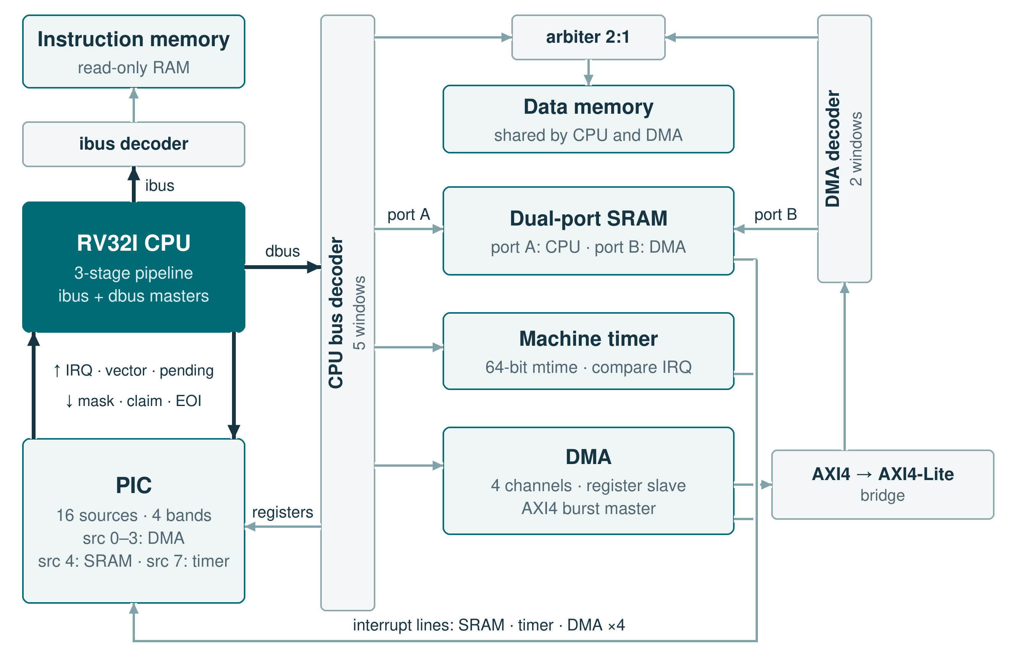
INTERNSHIP · SIEMENS · 2026
RV32I Processor
Three-stage pipeline
Bunea Cosmin-Andrei
Computer Engineering, year III
Academic year 2025–2026
Transilvania University of Brașov
RTL implementation · interfaces · verification
Notes:
0:30. The project is the RV32I core of the SoC: I specified it, wrote the RTL, connected it to the PIC and verified it. In the figure the CPU has an instruction port, a data port on the interconnect and a direct interrupt link to the PIC.

Slide 2
The brief asks for a three-stage RV32I core with prediction and traps
01
Full RV32I instruction set;
FENCE as a no-op, ECALL / EBREAK as traps
05
Exceptions and external interrupts,
taken only between instructions
02
Three stages; a load or store completes inside S2
06
Machine-mode CSRs: mstatus, mie, mip,
mtvec, mepc, mcause, mscratch
03
32 × 32-bit registers: 2 read ports, 1 write port, x0 = 0
07
One central unit for every stall and flush
04
Branch predictor with a 1-bit counter per entry
08
Two AXI4-Lite masters (instruction, data)
and an interrupt link to the PIC
RV32I · 02 / 07 · Requirements
Notes:
1:00. These are the eight requirements from the CPU brief that shaped the design. The full RV32I set, with FENCE treated as a no-op and ECALL and EBREAK handled as traps. Three stages, where a load or store finishes inside S2, so S2 waits for the data bus. A register file with two read ports, one write port and x0 fixed at zero. A predictor with a 1-bit counter per entry. Exceptions and external interrupts, taken only between instructions. The machine-mode CSRs the brief lists. One central unit that decides every stall and flush. And the interfaces: two independent AXI4-Lite masters and the interrupt link to the PIC.

Slide 3
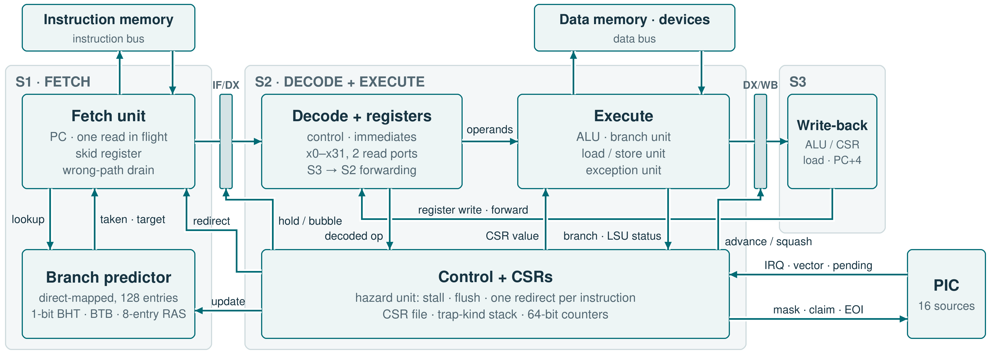
Three stages: S1 fetches, S2 decodes and executes, S3 writes back
THE BRIEF LEFT 23 QUESTIONS OPEN · THE FIVE THAT SHAPED THE PIPELINE
Predictor
Stalls
Redirect order
Nested traps
Precise errors
Direct-mapped, 128 entries: index PC[8:2], tag PC[31:9]. 1-bit BHT + BTB + 8-entry RAS. Miss → not taken; trained at commit.
Only a data access or WFI stalls S2. Load-use costs 0 cycles (S3 → S2 forwarding). S1 parks one word in a skid register.
Resolved in S2, one redirect per instruction: interrupt > exception > MRET > misprediction. Flush = valid bit cleared.
Entry saves mepc, mcause, mtval and MIE → MPIE. A 16-level trap-kind stack: MRET sends EOI only for an interrupt.
Fetch fault → cause 1, load / store fault → 5 / 7, misaligned → 4 / 6 before the bus, bad CSR → illegal. No write-back.
RV32I · 03 / 07 · Architecture and decisions
Notes:
2:30. The figure is the core as built: S1 fetches with the predictor beside it, S2 decodes, reads the registers and executes, including loads and stores, S3 writes back and forwards into S2; the control block with the CSRs sits under S2, and the PIC is on the right. The brief asked 23 questions about the predictor, traps, the buses, the CSRs and stall/flush control, and left the answers to me. Read the figure left to right; the five decisions below follow the same order. Predictor: direct-mapped with 128 entries, indexed by PC bits 8 to 2 and tagged with the upper bits, so a branch that only shares the index misses instead of taking a wrong target; a 1-bit direction, a BTB target and an 8-entry return-address stack for calls and returns. A miss predicts not taken, and only committed branches train it. Stalls: S2 stalls only while a data access is on the bus or during WFI; a load finishes inside S2, so a dependent instruction takes the value from S3 by forwarding and pays no extra cycle. While S2 waits, S1 keeps the fetched word in a skid register, and after a redirect it drains the wrong-path read. Redirects are resolved in S2, one per instruction, in the order interrupt, exception, MRET, misprediction; a flushed stage has its valid bit cleared and becomes a bubble. Traps: entry saves mepc, mcause and mtval and moves MIE into MPIE; a 16-level trap-kind stack remembers whether each open level is an interrupt, so MRET sends an EOI to the PIC only when it closes one. Errors are precise: fetch and data faults, misaligned accesses caught before the bus, and illegal CSR accesses trap without writing back. Parameters: RESET_PC, HART_ID, BP_ENTRIES, RAS_DEPTH.

Slide 4
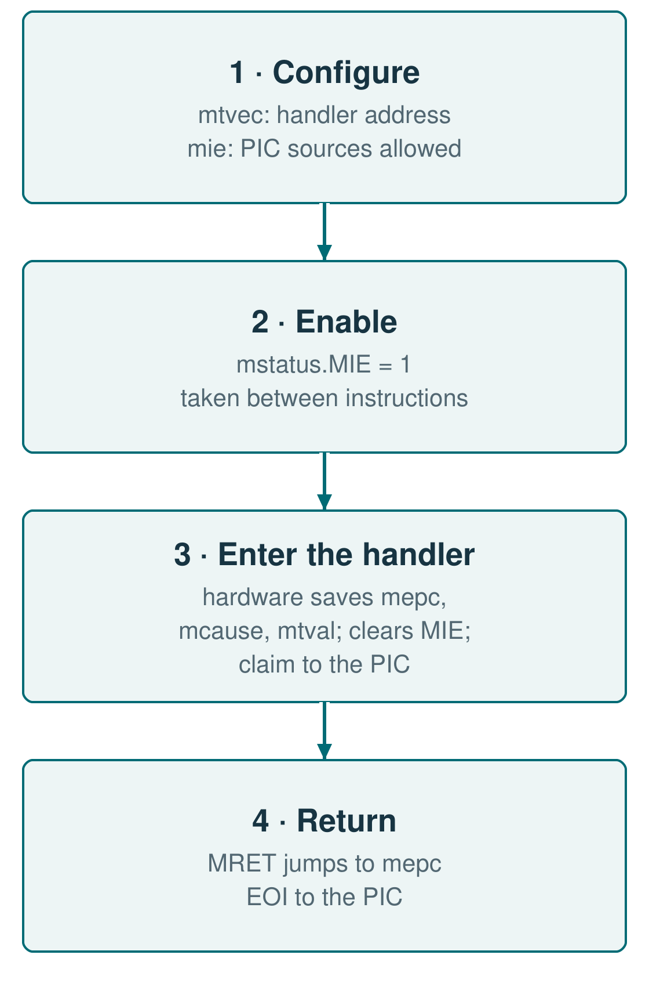
The CSRs connect software to traps, counters and the PIC
CSR
What it does
mstatus
MIE global enable; MPIE holds it during a trap, MRET restores it
mtvec
Handler base: direct, or vectored with one entry per interrupt
mepc · mcause · mtval
Return PC · cause, bit 31 = interrupt · faulting address or instruction
mscratch
Free word for the handler to save context
mie
One enable bit per PIC source; also drives the PIC mask
mip
Every source pending in the PIC; read-only
mcycle · minstret
64-bit cycle and retired-instruction counters; each half writable
mhpmcounter3–7
Event counters: mispredictions, fetch waits, data stalls, traps, WFI sleep
misa · mhartid · IDs
RV32I in misa; mhartid from HART_ID, tested with two harts
RV32I · 04 / 07 · Registers
Notes:
1:00. These are the CSRs the core needed. mstatus, mtvec, mepc, mcause, mtval and mscratch carry trap entry and return: MIE is copied into MPIE on entry and restored by MRET; mcause bit 31 separates interrupts from exceptions; vectored mtvec gives each interrupt its own entry. mie and mip are the link to the PIC: mie has one bit per PIC source and also drives the PIC mask, so a masked source never blocks the others; mip shows every pending source. mcycle and minstret are 64-bit, and five event counters measure mispredictions, fetch waits, data stalls, traps and WFI sleep. mhartid comes from the HART_ID parameter, tested with two cores on one shared memory. On the right is the order software uses them in.

Slide 5
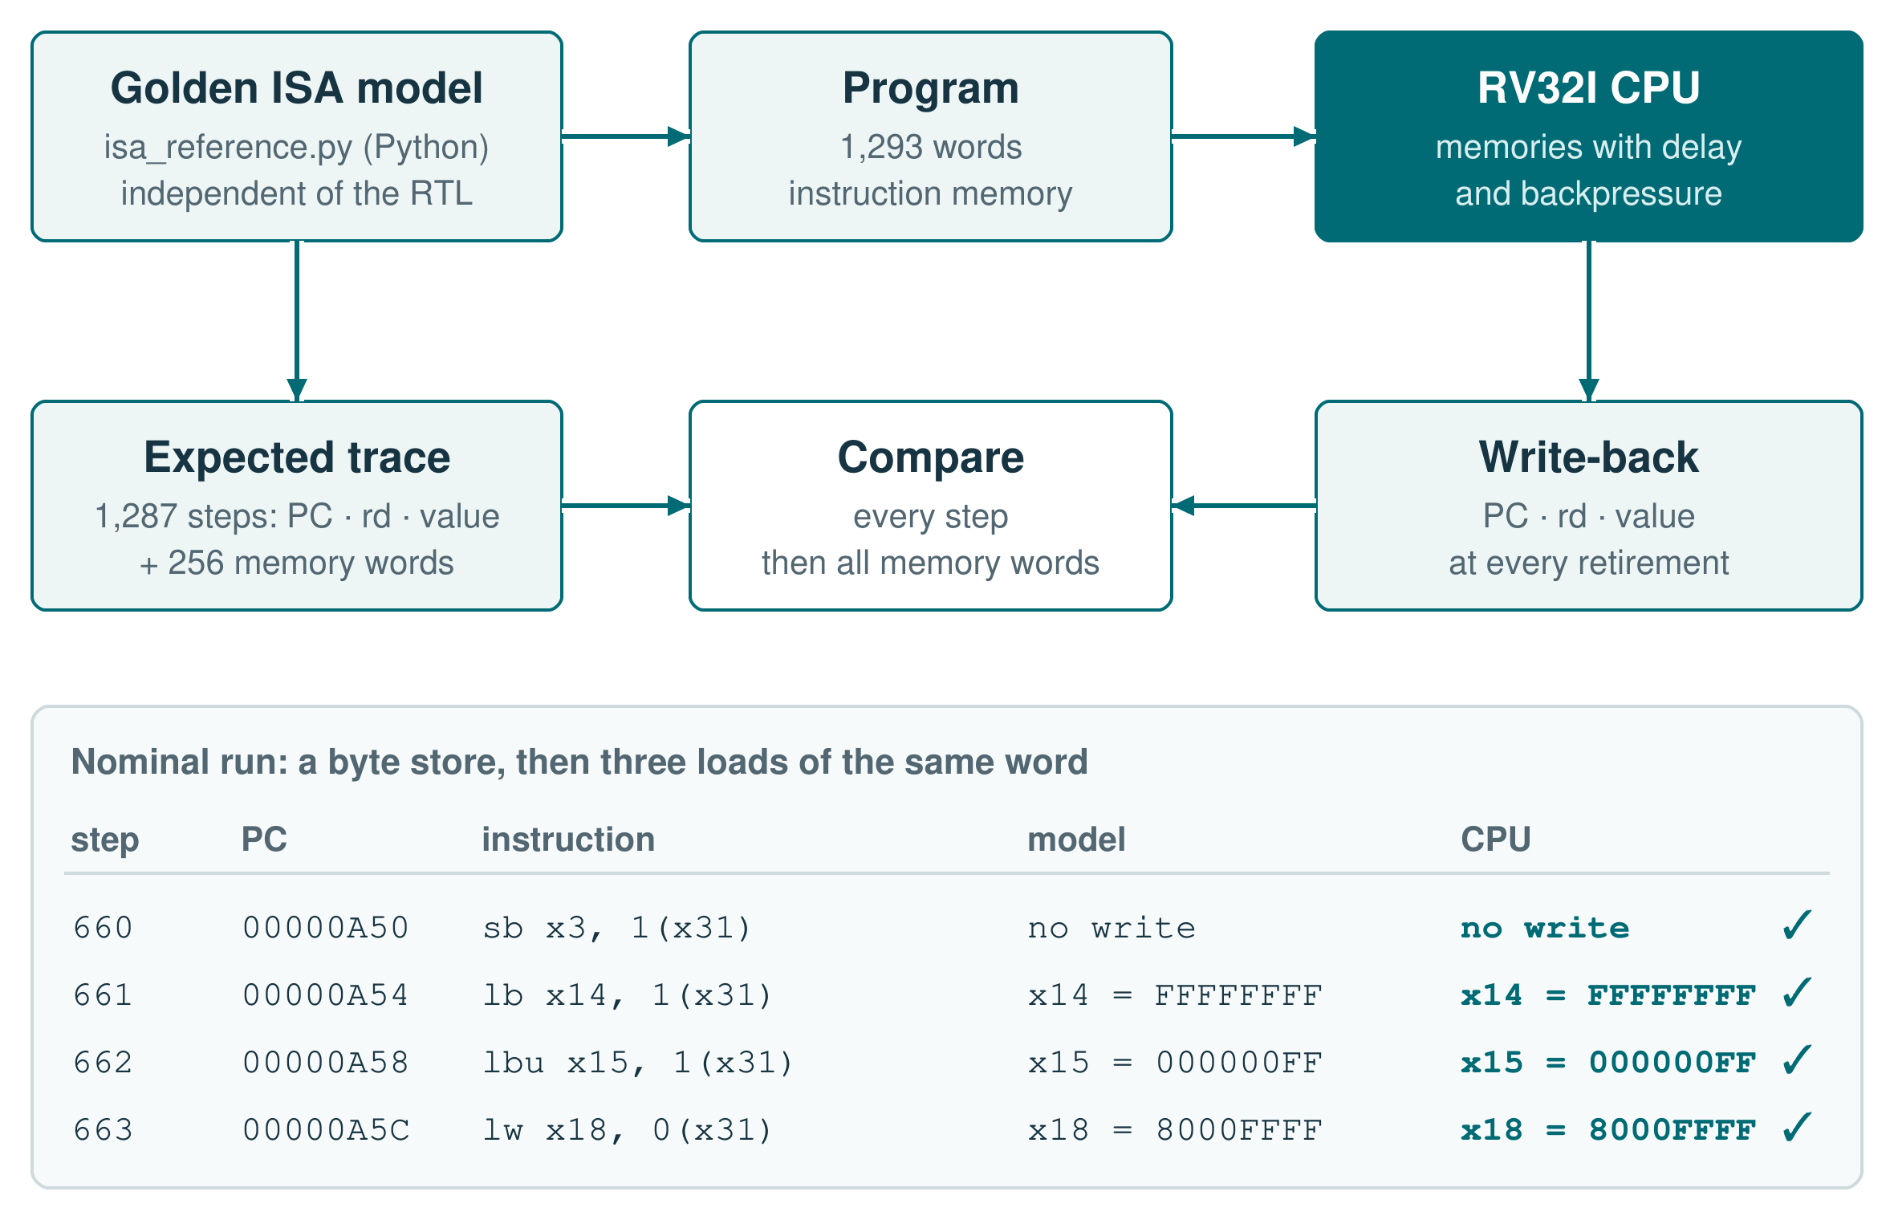
An independent model checks every instruction the core retires
THE CPU ALONE
11
programs vs the golden ISA model: 49,149 instructions, each checked at write-back
53
official riscv-tests pass (rv32ui + rv32mi), nominal and 40% backpressure
50
instruction kinds · all 32 shift amounts
every byte lane · 256 memory words
925
directed checks: CSRs 293 · reset 217
counters 159 · traps 131
predictor 68 · ALU 57
37
SVA properties attached with bind: 17 pipeline / trap, 20 AXI protocol
90
coverage bins, all hit over 28 runs: instructions, traps, predictor, PIC claims
9 / 9
mutation testing: injected ALU, LSU, counter and trap defects, each caught
RV32I · 05 / 07 · Verification · block
Notes:
1:45. On the right is one test end to end. The golden model is a Python RV32I interpreter written independently of the RTL: it generates the program and the expected PC, destination register and value of every instruction, plus the final data memory. The CPU runs the same program; the bench compares the three values at every write-back and, at the end, all 256 memory words. The table is from the nominal run: a byte store, then LB, LBU and LW of the same word, so sign extension and byte lanes in four lines; model and CPU agree. Besides this directed program, the model generates ten seeded random programs of about five thousand instructions each, 49,149 instructions in all, and every program also runs with extra read latency or random backpressure. On the left, per type: the golden-model programs; the official riscv-tests, rv32ui and rv32mi, where 53 pass at nominal timing and under 40 percent backpressure and the other five of those suites target extensions this core does not include, such as FENCE.I and PMP; the directed benches; the SVA properties attached with bind and run under Verilator; the functional coverage, 92 bins merged over 28 runs, where all 90 reachable bins are hit and the two bins of a source the program masks must stay at zero; and mutation testing, where every injected defect is caught by a named bench.

Slide 6
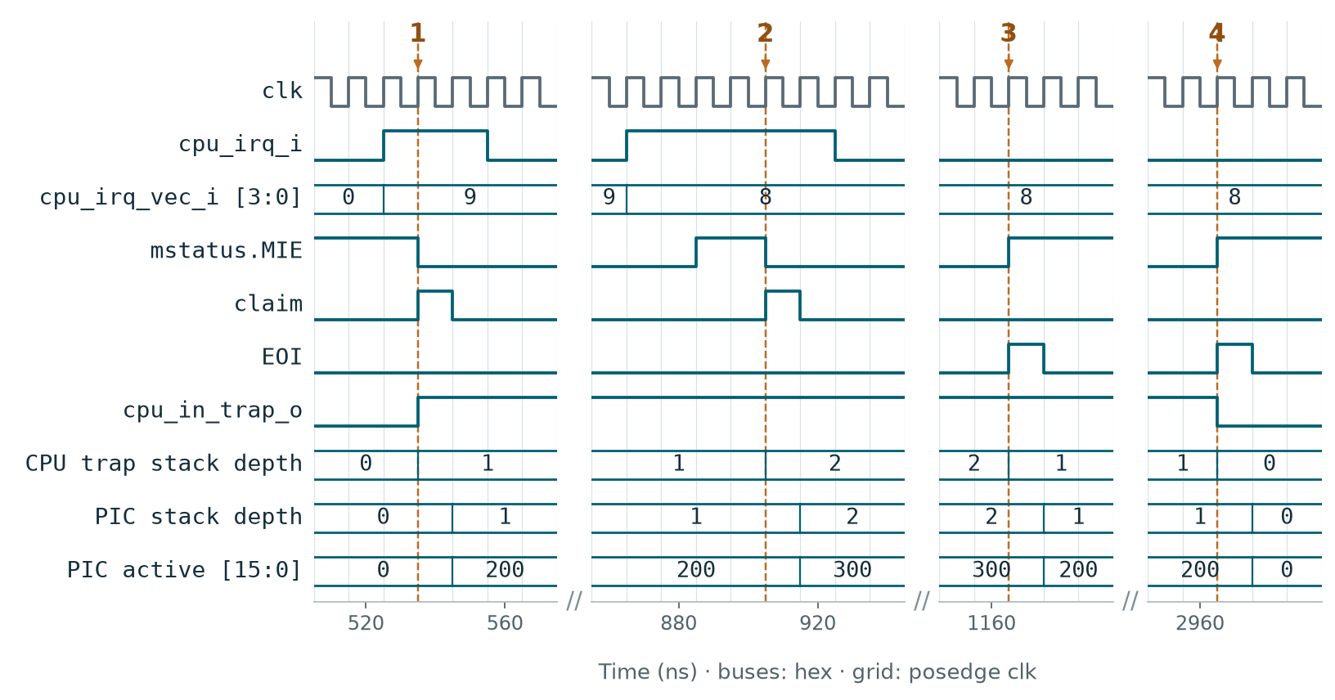
A nested interrupt opens two levels; each MRET closes one
THE CPU WITH THE PIC
checks, one program on CPU + PIC + mtimer: 9 exception causes, 8 interrupts, WFI wake-up; 4 memory timings
382
34
SoC runs, 767 checks; the CPU runs 16 programs: DMA, timer, PIC, isolation, reset, races
interrupt checks through the CPU: SW sources 36 · 16 levels 54 · nesting 16 · spurious 15 · escalation 12
133
29
CPU + PIC SVA properties bound in all 23 SoC benches, 51 Verilator runs
1 · CPU takes source 9
2 · Source 8 preempts
3 · Handler 8 returns
4 · Handler 9 returns
claim pulses, cpu_in_trap rises, MIE drops to 0. Both stacks now hold 1 level; active = 200 (bit 9).
Handler 9 sets MIE back to 1. Source 8 is more urgent and gets claimed too: 2 levels, active = 300 (8 and 9).
Its MRET sends one EOI. Both stacks drop to 1 and active is back to 200; the CPU stays in the trap.
Its MRET sends the last EOI. Both stacks reach 0, active is 0 and cpu_in_trap falls.
CI
every push: lint, all CPU / PIC / SoC benches with SVA, coverage and cover gates
RV32I · 06 / 07 · Verification · system
Notes:
2:15. This case comes from the SoC run, where claim and EOI come from the CPU itself; the windows are cut from one run and each keeps its own time axis. At 1 the CPU claims source 9: trap entry clears MIE and opens level 1 in the CPU trap-kind stack and in the PIC nesting stack. The handler saves mepc and mstatus in registers and sets MIE again. At 2 source 8, with a higher key, is offered and claimed inside that handler: two levels on both sides; PIC active is a bitmask in hex, so 300 means sources 8 and 9 are both in service. At 3 the inner MRET restores MIE from MPIE and sends exactly one EOI; the PIC pops back to source 9, and cpu_in_trap stays high because a level is still open. At 4 the outer MRET sends the last EOI and both stacks are empty. On the left are the system-level numbers: the CPU, PIC and mtimer program; the SoC regression, which also drives the error paths, such as accesses outside every window, DMA faults, reset in the middle of traffic and the CPU and the DMA writing the same words; and the interrupt checks that go through the CPU, up to sixteen nested levels and a spurious claim. All of it runs in CI on every push: lint, every bench with SVA, the coverage gate and the cover gate.

Slide 7
Result: an integrated core, checked instruction by instruction
WHAT I BUILT
WHAT I LEARNED
–
Most of the thinking went into the moments when several things happen in one cycle: an interrupt, a stall and a wrong branch together. Writing their order down before the RTL made everything after it easier.
1.
3-stage RV32I: S3 → S2 forwarding, direct-mapped predictor, precise traps
–
Interrupts made me think about two blocks at once. The CPU and the PIC each keep their own stack, and nesting works because the two move in step, one level at a time.
2.
CSR file, 64-bit counters, CPU–PIC link: mask, pending, claim, EOI
–
Writing the golden model in Python, apart from the Verilog, meant understanding every instruction twice: once for the model, once for the hardware.
3.
Golden ISA model with random programs, riscv-tests, SVA, mutation testing
–
I stopped trusting a passing test by default. Injecting a defect into the RTL and watching the right test go red is what gave me confidence in the rest.
Thank you! Questions are welcome.
RV32I · 07 / 07 · Conclusions
Notes:
1:00. On the left is what I built: the three-stage core with forwarding, the direct-mapped predictor and precise traps; the CSR file and the link to the PIC; and the verification around it. On the right is what I take away from it, in my own words. Most of the design work was in the cycles where several events meet, and writing their order down first paid off. The interrupt path taught me to think about the CPU and the PIC as one system, each with its own stack. Writing a separate Python model made me understand every instruction twice. And mutation testing changed how I read a passing test.

