Slide 1
INTERNSHIP · SIEMENS · 2026
Interrupt Controller
Programmable priority and preemption
REQUESTS
→
ARBITRATION
→
SERVICE
Bunea Cosmin-Andrei
Computer Engineering · year III · academic year 2025–2026
Transilvania University of Brașov
RTL implementation · interfaces · verification
Notes:
0:20. Introduce the project and my own contribution: defining the behaviour, writing the RTL, integrating it and verifying it. Total planned time: 10 minutes.

Slide 2
The task: a PIC with priority bands, nesting and deadlines
01
16 hardware sources + 16 software triggers
06
Detection and reporting of spurious requests
02
Level / edge selection for every source
07
Per-source deadline and automatic escalation
03
Priority bands and intra-band arbitration
08
Protected software trigger and a defined clear rule
04
Preemption that preserves the active contexts
09
AXI4-Lite: configuration and status registers
05
Programmable limit for the nesting depth
10
SW interrupts identical to HW once they enter arbitration
The 32 HW/SW inputs merge into 16 source identities.
PIC · 02 / 07 · Requirements
Notes:
1:20. The requirement goes well beyond a priority encoder: it asks for grouping, nesting, spurious events, deadlines and software injection. Stress that 16 hardware plus 16 software means two origins for each of the 16 arbitration slots. The number of bands, the exact policy and the context-saving mechanism all had to be defined. Arbitration is a combinational comparison followed by a registered offer.

Slide 3
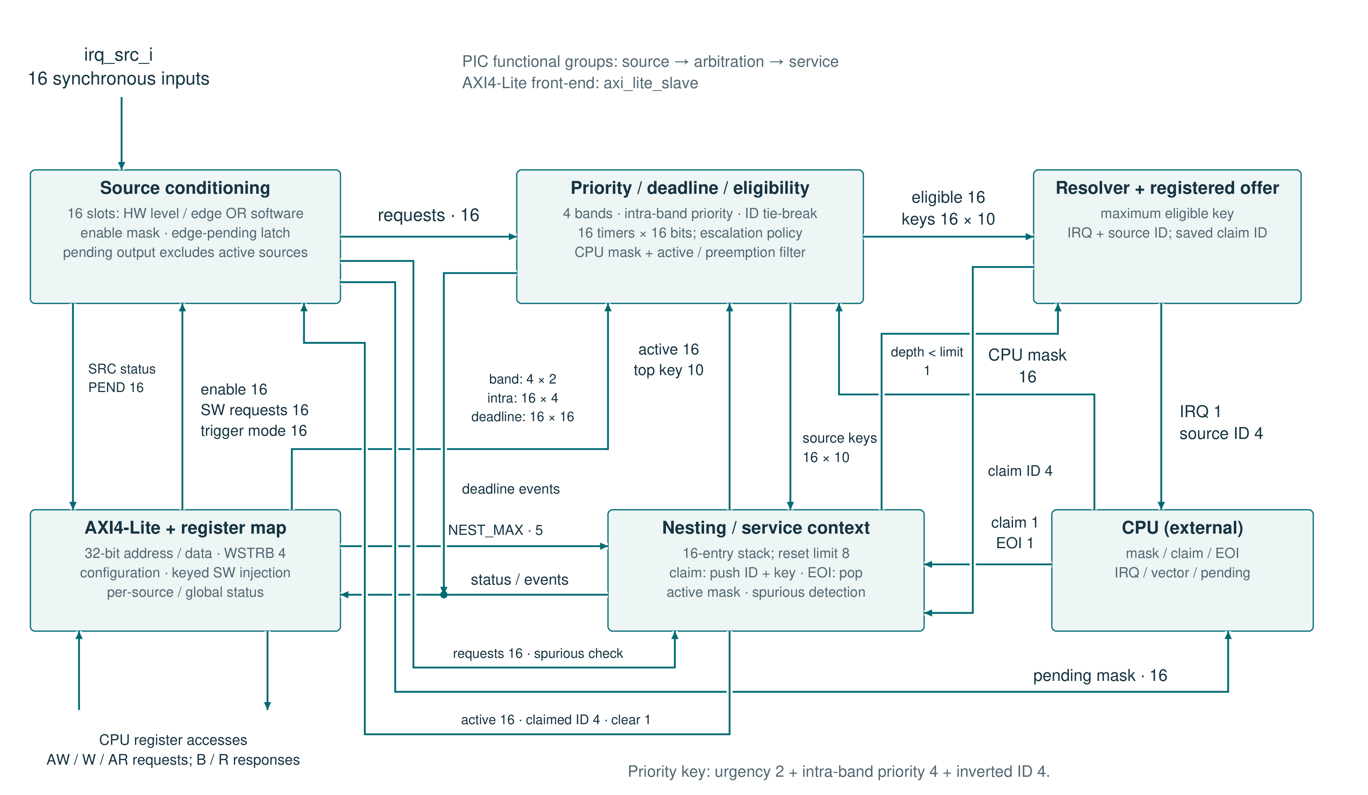
The selected request becomes an active context only at claim
Notes:
2:20. Follow the request from the top left: level/edge plus software, enable, eligibility and the priority key. The 10-bit key compares band urgency, intra-band priority and the inverted ID. The offer is registered. A claim uses the saved ID and pushes that ID plus the current key onto the stack; an EOI pops the inner context. Show the feedback paths: top key, active mask and depth limit. Reconfiguring an active source does not change the key already saved. The registers control the policy, and pending is separate from the selected offer. The blocks are functional groups inside pic.v; the AXI front-end is axi_lite_slave. The PIC module has no Verilog parameters.

Slide 4
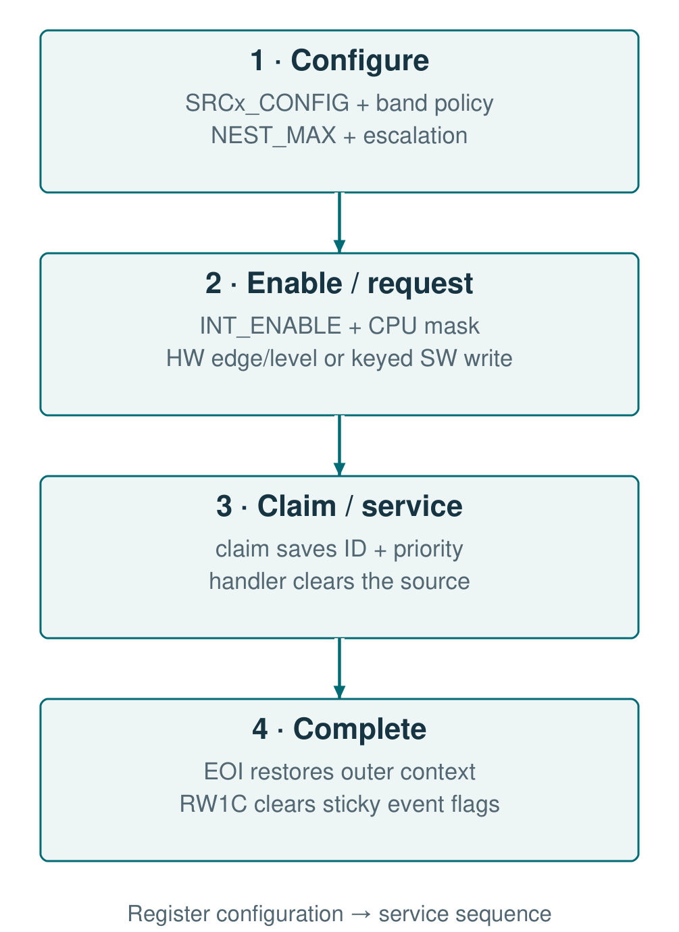
The registers set the policy and make the state observable
Address
Register / group
Role in use
0x00 + 4n
SRCn_CONFIG
Trigger, band, priority, deadline
0x40 + 4n
SRCn_SW_TRIG
Injection with key 0xA5A5; clear
0x80 + 4n
SRCn_STATUS
Pending, active, escalated, spurious
0xC0 / D4
BAND_CONFIG / ESCALATION_CFG
Band urgencies and escalation policy
0xC4 / C8 / CC
NEST_STATUS / NEST_MAX / ACTIVE_VEC
Active context and nesting limit
0xD8
INT_ENABLE
Per-source enable
0xD0 / DC
SPURIOUS_LOG / INT_STATUS
Logged events; cleared by RW1C
PIC · 04 / 07 · Software interface
Notes:
1:20. Follow configuration, enabling, claim and EOI. SRCn_CONFIG fixes the behaviour of each source; BAND_CONFIG and ESCALATION_CFG set the shared policy. NEST_MAX limits the active services, and the status registers expose the context. A software trigger writes 0xA5A50001 with the strobes for the key bytes and the set bit. The handler removes the cause before the EOI. RW1C clears the logged events; a hardware event arriving in the same cycle is kept. Every address in the table is an offset inside the 256-byte window; n is 0 to 15.

Slide 5
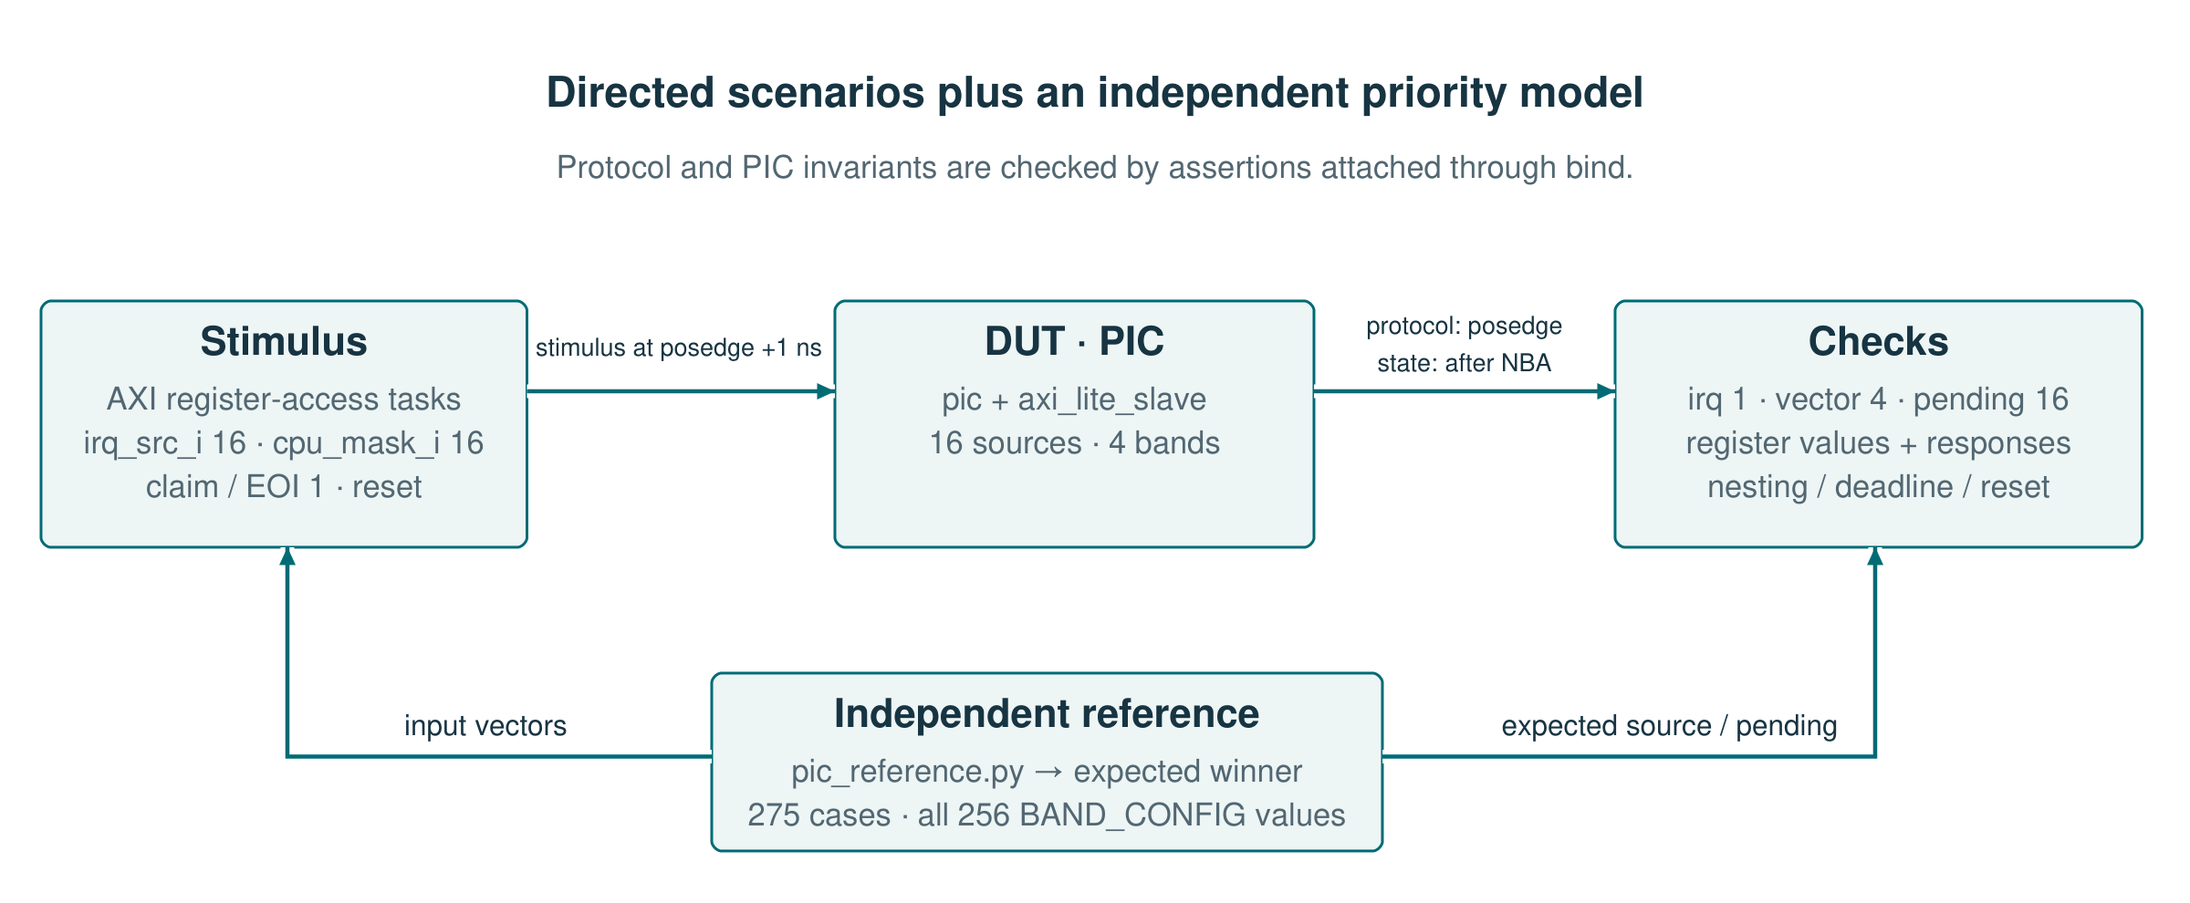
The functional result and the bus protocol are checked separately
Independent model
Protocol + state
Critical cases
24 urgency permutations + masks + ties
AXI monitors, registers, stack and SVA through bind
edge + claim · nesting · deadline · async reset
ModelSim: 39 CPU/PIC runs · Verilator: 17 benches, 53 runs with assertions
PIC · 05 / 07 · Verification
Notes:
1:40. Follow the independent reference into the stimulus and the checks. The Python model computes the winner for 24 orderings of the bands, together with masks and ties. The directed tests add the temporal part: claim, EOI, a coincident edge, the stack limit, deadlines and reset. AXI is checked separately; the PULP comparison covers the decoder and a register profile with 96 WSTRB / AW-W / backpressure combinations, plus error and reset cases.

Slide 6
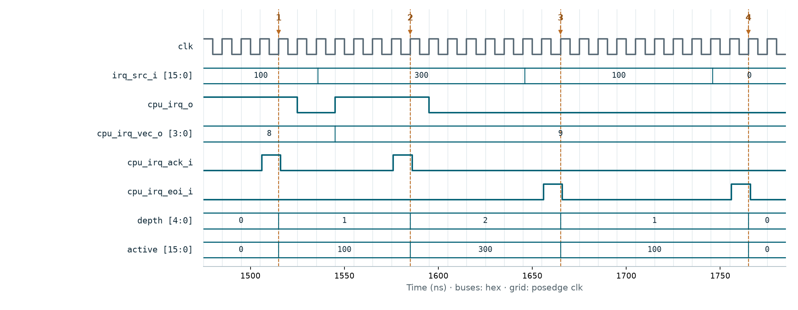
Preemption keeps the context; two EOIs close it in order
1 · Claim 8
2 · Claim 9
3 · Inner EOI
4 · Outer EOI
depth 1 · active 0x100
depth 2 · active 0x300
depth 1 · source 8 stays active
depth 0 · active 0
Bus values are hexadecimal; the offered vector is valid while IRQ = 1.
PIC · 06 / 07 · Critical scenario
Notes:
2:00. Walk through the four markers. Claim 8 saves the first context; claim 9 adds the more urgent one and active stays 0x300. The first EOI closes source 9 and restores the context of source 8. The second EOI empties the stack. Seeing two IRQ pulses is not enough: depth and active show whether the state was preserved correctly. State changes on the rising edge; the testbench stimulus is driven 1 ns after it.

Slide 7
Result: configurable arbitration with verified preemption
WHAT I BUILT
WHAT I LEARNED
1. Banded priority, nesting and deadlines, all configurable
I defined tie cases and the priority of simultaneous events.
2. Registers and CPU handshake integrated with arbitration
I tracked the saved context, not only the winning vector.
3. Policy checked independently and in concurrent tests
I checked arbitration against a model independent of the RTL.
My contribution: design decisions → RTL → integration → verification
PIC · 07 / 07 · Conclusions
Notes:
1:00. The result is a PIC with a configurable policy and verified preemption, not just an isolated priority resolver. I learned to define the tie case, the simultaneous events and the lifetime of an active context explicitly. The independent model gave me a reference for arbitration, and the directed tests checked the event sequences. This is my contribution, from requirements through RTL to verification.

