Slide 1
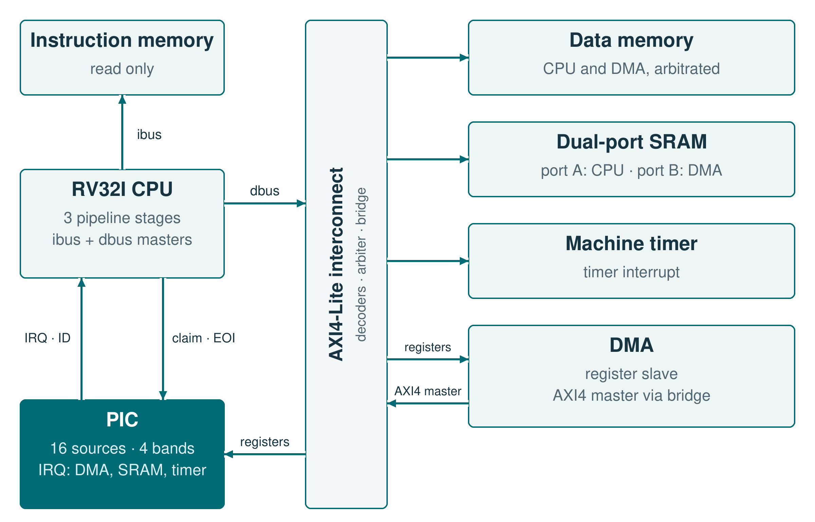
INTERNSHIP · SIEMENS · 2026
Interrupt Controller
Programmable priority and preemption
Bunea Cosmin-Andrei
Computer Engineering, year III
Academic year 2025–2026
Transilvania University of Brașov
RTL implementation · interfaces · verification
Notes:
0:30. The project is the interrupt controller of the SoC, which I specified, wrote in RTL, integrated with the CPU and verified. In the figure, the PIC has a register port on the interconnect and a direct link to the CPU; its sources are the DMA, the SRAM and the timer. Total time: 10 minutes.

Slide 2
The task: a PIC with priority bands, nesting and deadlines
01
16 hardware sources + 16 software triggers
06
Deadline-based priority escalation
02
Level or edge mode for every source
07
Software-triggered interrupts
03
Priority bands, not a flat priority
08
AXI4-Lite register map, 11 registers
04
Preemption with nesting
09
One request + vector to the CPU
05
Spurious interrupt detection
10
SW interrupts identical to HW once they enter arbitration
The 32 HW/SW inputs merge into 16 source identities.
PIC · 02 / 08 · Requirements
Notes:
1:00. These come from the PIC brief. It asks for more than a priority encoder: bands, nesting, spurious detection, deadlines and software triggers, all configured through AXI4-Lite registers. The 16 hardware and 16 software inputs share the same 16 arbitration slots.

Slide 3
The brief left 21 questions open; five of them shaped the design
Question from the brief
What I decided
1
How many bands, and how is a tie resolved?
→
4 bands with programmable urgency; one 10-bit key per source; the lower ID wins a tie
2
What if an active source is moved to another band?
→
The key saved at claim stays; the new band applies to the next request
3
What happens when the nesting limit is reached?
→
No new offer and the overflow flag is set; active contexts are kept
4
When is a request spurious, and is it visible?
→
Checked at claim; the context is kept and closed by EOI; logged per source and globally
5
What does escalation mean?
→
Jump to a target band or bump one urgency step; may repeat; cleared when served
PIC · 03 / 08 · Design decisions
Notes:
1:40. The brief asked 21 questions and left the answers to me; these five shaped the design most. How bands and ties work; what happens to an active source that is reconfigured; what the nesting limit does; when a request counts as spurious; and what escalation means in practice.

Slide 4
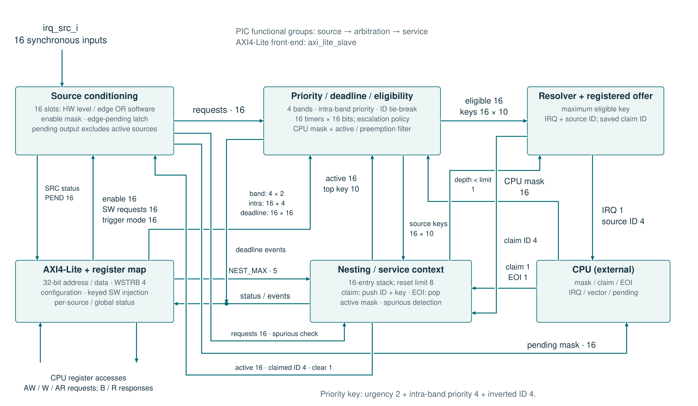
A request becomes an active context only at claim
Notes:
1:50. Follow a request from the top left: conditioning, then eligibility and the priority key, then the registered offer; claim pushes the context and EOI pops it. The decisions from the previous slide sit in these blocks: the priority block builds the key and applies escalation; the resolver stops offering at the nesting limit; the nesting block keeps the saved key and marks spurious claims. The module has no Verilog parameters.

Slide 5
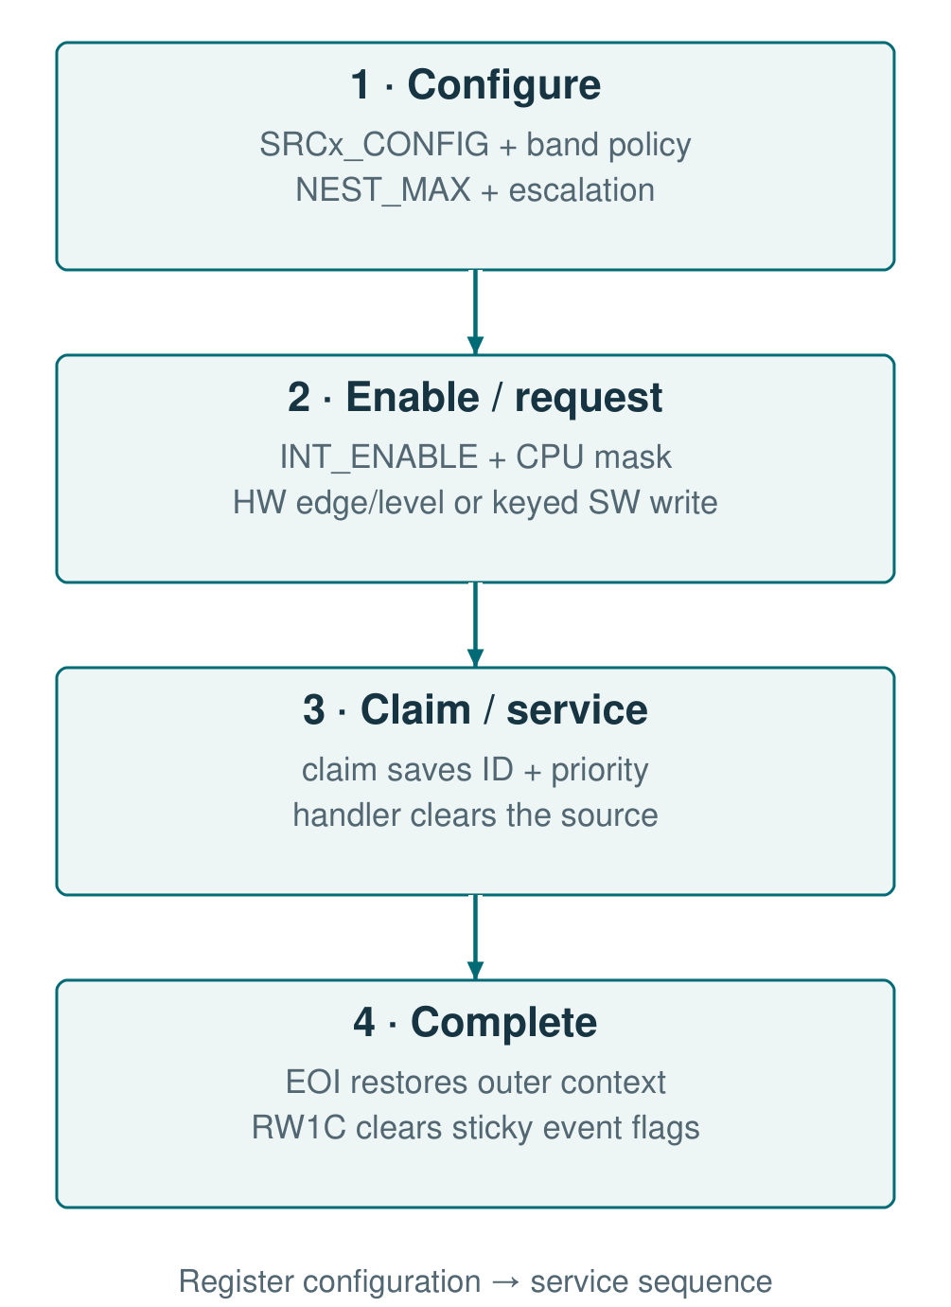
The registers set the policy and make the state observable
Address
Register / group
Role in use
0x00 + 4n
SRCn_CONFIG
Trigger, band, priority, deadline
0x40 + 4n
SRCn_SW_TRIG
Set with key 0xA5A5 in both upper byte lanes
0x80 + 4n
SRCn_STATUS
Pending, active, escalated, spurious
0xC0 / D4
BAND_CONFIG / ESCALATION_CFG
Band urgencies and escalation policy
0xC4 / C8 / CC
NEST_STATUS / NEST_MAX / ACTIVE_VEC
Active context and nesting limit
0xD8
INT_ENABLE
Per-source enable
0xD0 / DC
SPURIOUS_LOG / INT_STATUS
Logged events; cleared by RW1C
PIC · 05 / 08 · Software interface
Notes:
1:20. Every register here is defined by the project. SRCn_CONFIG sets trigger, band, priority and deadline for each source; BAND_CONFIG and ESCALATION_CFG set the shared policy; NEST_MAX limits the depth. A software trigger needs the key 0xA5A5 written with both upper byte strobes, so a partial write cannot arm a channel. RW1C clears logged events, and a hardware event in the same cycle is kept. Addresses are offsets in a 256-byte window; n is 0 to 15.

Slide 6
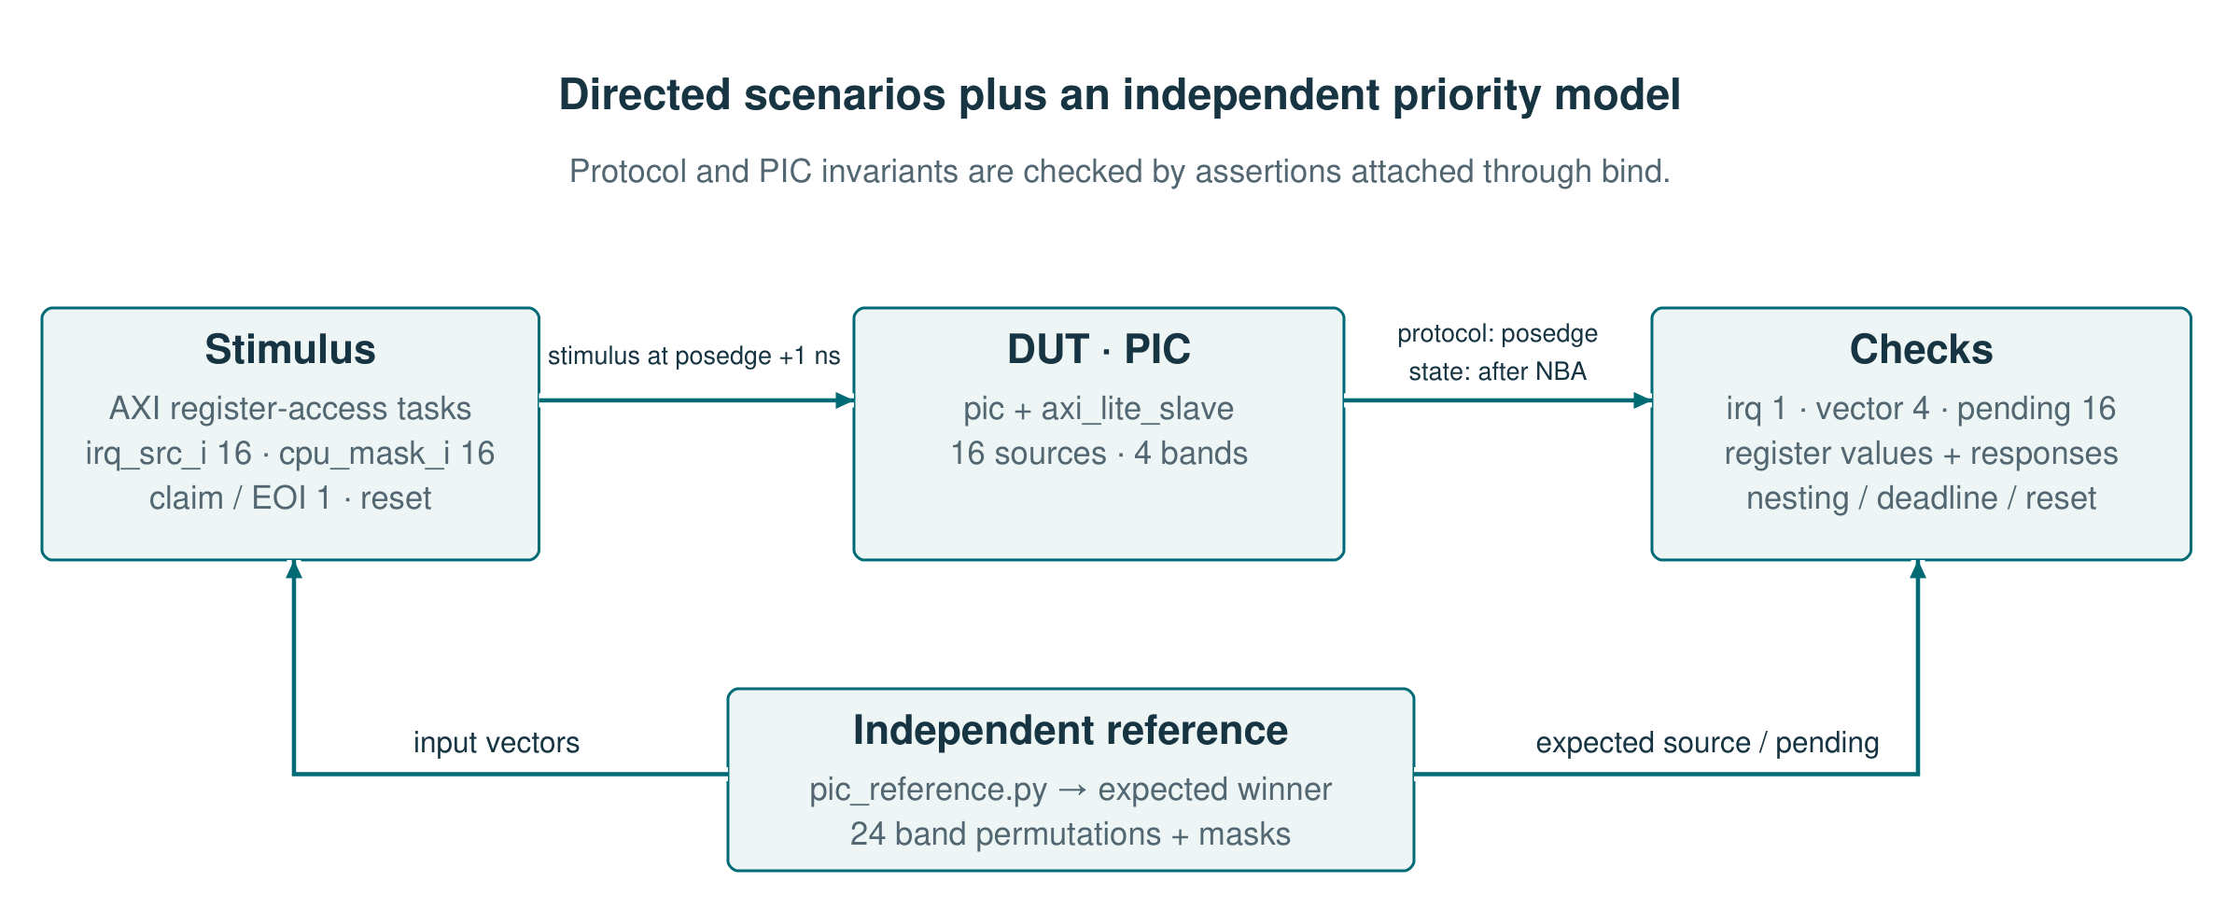
The priority rules are checked against an independent model
Independent model
Same-cycle events
External AXI reference
All 24 band orders, with masks and ties
Edge at claim, masked source, strobed key
Front-end compared with PULP: 96 cases
ModelSim: 22 CPU/PIC configurations · Verilator: 16 benches with assertions bound to the RTL
PIC · 06 / 08 · Verification
Notes:
1:30. The Python model computes the expected winner and pending set for all 24 orders of band urgency, with enable masks, CPU masks and ties. Directed tests cover the timing cases the model cannot: a new edge in the claim cycle, a masked source next to lower-priority ones, a key written with partial strobes, nesting, deadlines and reset. The AXI4-Lite front-end is compared with the PULP axi_lite_regs module on 96 strobe, order and stall cases. The three PIC cases of the mutation suite are all rejected.

Slide 7
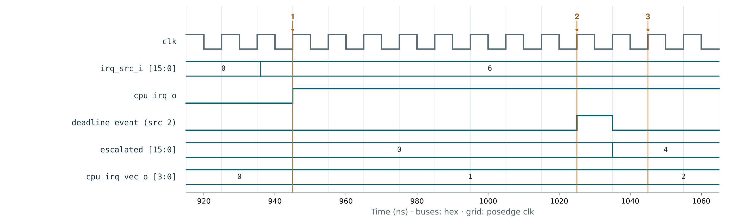
Escalation follows the programmed urgency, not the band number
1 · Source 1 offered
2 · Source 2 deadline
3 · Offer moves to 2
Same band: the lower ID wins the tie
10 cycles pending → escalation
Bumped to band 3, the next urgency
Bands reordered: band 0 is the least urgent. Bus values are hexadecimal.
PIC · 07 / 08 · Critical scenario
Notes:
1:30. The test reorders the bands so band 0 is the least urgent. Sources 1 and 2 are both in band 0 and requested together; source 1 wins the tie. At marker 2, source 2 reaches its 10-cycle deadline and escalates. It moves to the next more urgent band in the programmed order, band 3, not to band 0 minus one. At marker 3 the registered offer changes to source 2 on the next edge. This is decision 5 in practice.

Slide 8
Result: configurable arbitration with verified preemption
WHAT I BUILT
WHAT I LEARNED
1.
Banded priority with programmable urgency
–
Ties and same-cycle events need a written rule.
2.
Nesting stack, spurious handling, deadline escalation
–
Saving the key at claim keeps the stack valid after reconfiguration.
3.
Priority model covering all 24 band orders
–
The CPU mask belongs inside the PIC, or a masked source holds back the others.
Internship: brief → specification → RTL → verification, with a review at each step.
PIC · 08 / 08 · Conclusions
Notes:
0:40. The result is a PIC with a configurable policy and verified preemption. What I keep from the project: ties and same-cycle events need a written rule; the key saved at claim keeps the stack correct when software reconfigures a source; and the CPU mask has to act inside the PIC. The internship followed the path of a real block, from brief to verification, with reviews in between.

