Slide 1
INTERNSHIP · SIEMENS · 2026
RV32I Processor
Three-stage pipeline
FETCH
→
DECODE / EXECUTE
→
WRITEBACK
Bunea Cosmin-Andrei
Computer Engineering · year III · academic year 2025–2026
Transilvania University of Brașov
RTL implementation · interfaces · verification
Notes:
0:20. Introduce the project and my own contribution: defining the behaviour, writing the RTL, integrating it and verifying it. Total planned time: 10 minutes.

Slide 2
The task: a three-stage RV32I core with two AXI4-Lite ports
01
RV32I set: arithmetic, logic, control transfer, memory
06
Two AXI4-Lite ports: instruction and data
02
Three stages: fetch, decode + execute, writeback
07
CSRs for control, traps and IRQ state
03
32 × 32-bit register file; x0 hardwired to zero
08
Centralized control for stall, flush and hazards
04
Branch prediction with one direction bit
09
Defined behaviour for AXI latency and errors
05
Exceptions and interrupts at instruction boundaries
10
Interrupt link to the PIC
RV32I · 02 / 07 · Requirements
Notes:
1:20. Start from the requirements in the RV32I brief: pipeline, ISA, register file, predictor, traps, AXI ports, CSRs and stall/flush control. The brief left the predictor capacity, the order of concurrent events and the reaction to bus errors to be defined. Those decisions are my design contribution. The interrupt link to the PIC has 16 sources, a 4-bit ID and scalar claim and EOI.

Slide 3
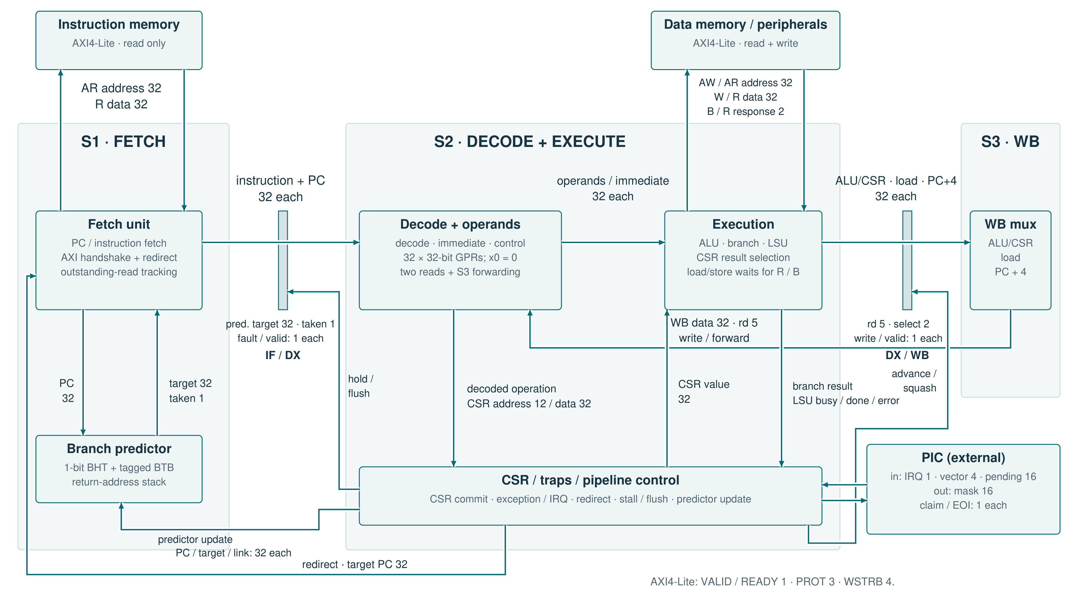
Three stages; the memory access completes inside S2
Notes:
2:20. Follow the main path: fetch and prediction in S1, the IF/DX boundary, decode and operands and execution in S2, then DX/WB and the S3 mux. The LSU finishes its transfer before S2 advances. S3 feeds back into the register file and the forwarding path. Then show the feedback along the bottom: the branch result and the LSU status reach the control block, which issues the redirect and the valid bits of the pipeline registers. The predictor is updated when a valid branch or jump completes. S1 drains the wrong-path response. The PIC and the memories are external; the numbers on the links are widths in bits. The parameters are RESET_PC, HART_ID, BP_ENTRIES and RAS_DEPTH.

Slide 4
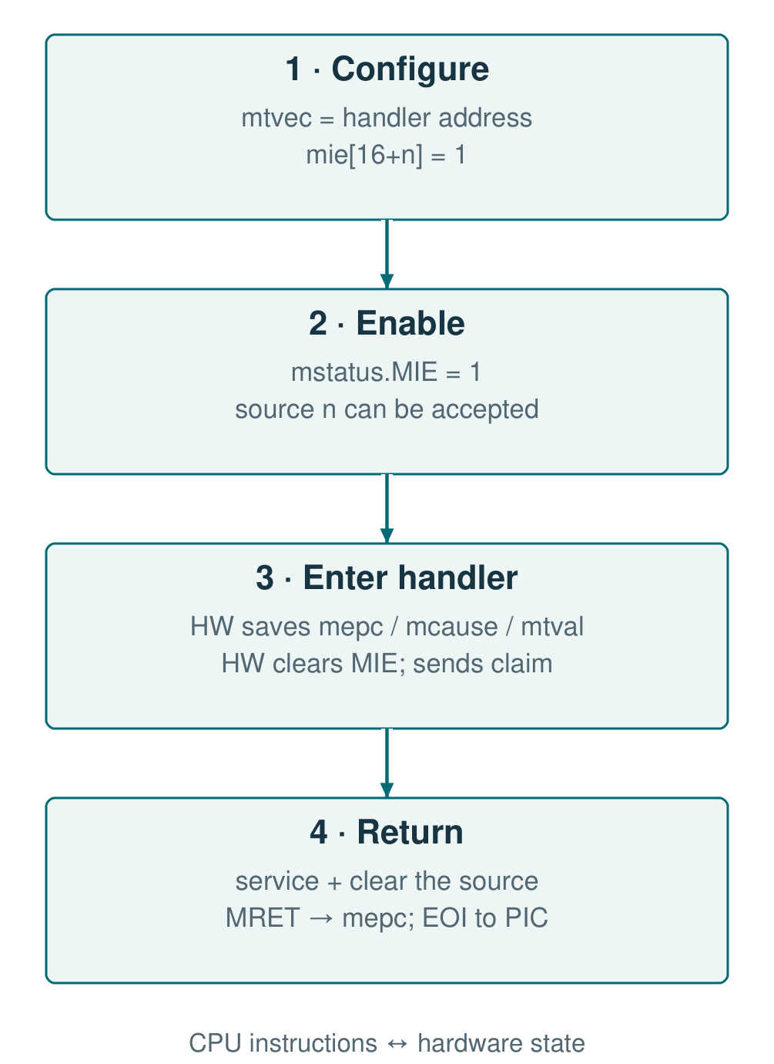
The CSRs link configuration to trap entry and return
Address
Register / group
Role in use
0x300
mstatus
Global MIE; state on entry / return
0x304 / 344
mie / mip
Per-source mask / pending requests
0x305
mtvec
Handler base; direct or vectored
0x341–343
mepc / mcause / mtval
Return PC; cause; fault payload
0x340
mscratch
Context managed by software
0xB00 / B02
mcycle / minstret
Cycles and retired instructions
RV32I · 04 / 07 · Software interface
Notes:
1:20. This is the software-interface slide. CSRs are reached through CSR instructions, not over AXI. Follow the four steps: mtvec and mie, then global MIE; on acceptance the hardware saves mepc, mcause and mtval and clears MIE; the handler removes the cause, MRET returns to mepc and emits an EOI when it returns from an interrupt. For nesting, software saves and restores the CSR context before re-enabling MIE. The specification lists every address and field, including the identity and counter registers.

Slide 5
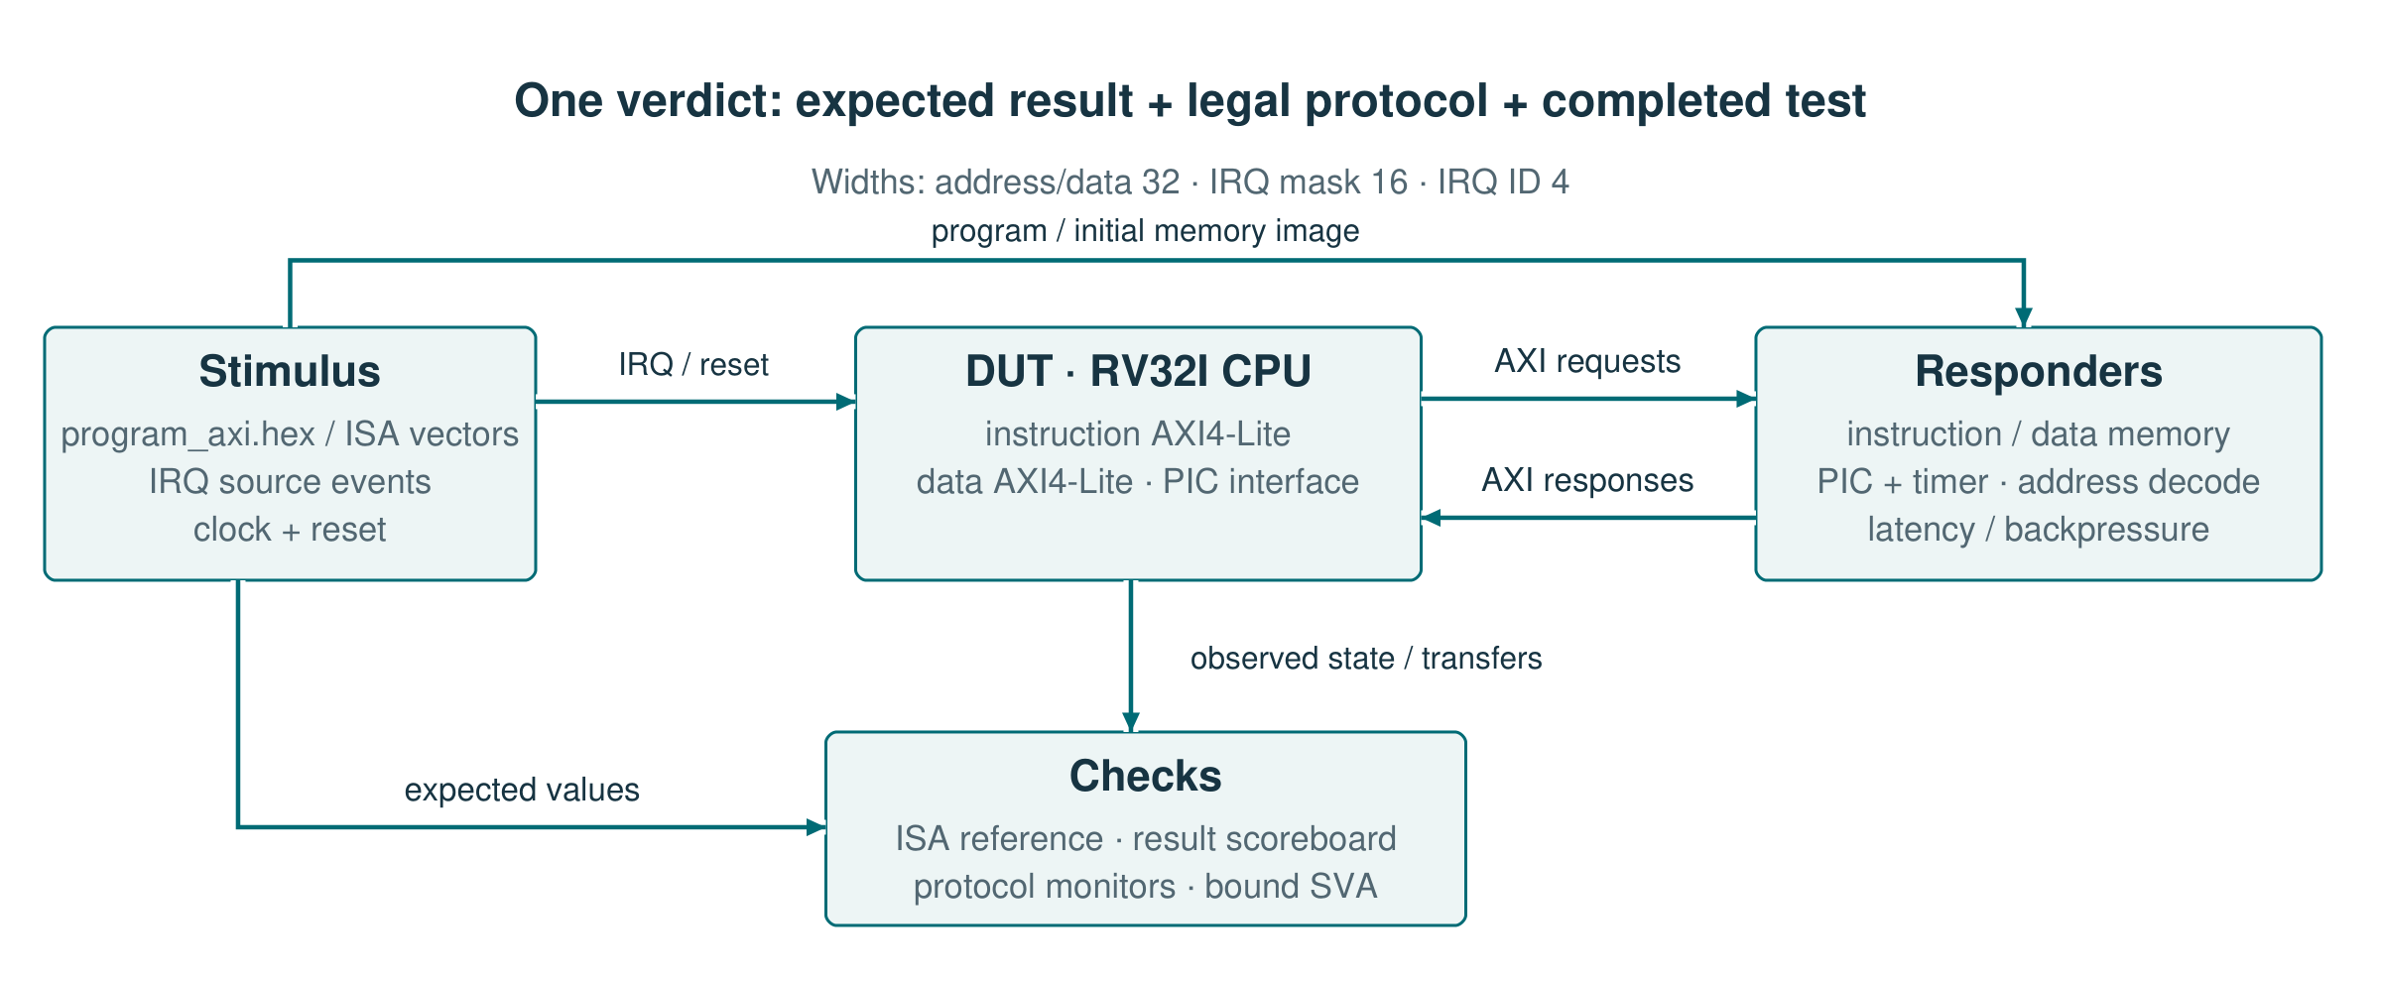
The functional result and the bus protocol are checked separately
Independent model
Protocol + state
Critical cases
1,287 instructions with expected results
AXI monitors, scoreboard and SVA through bind
IRQ in stall · flush with AXI response · async reset
ModelSim: 22 CPU/PIC configurations · Verilator: 16 benches with assertions
RV32I · 05 / 07 · Verification
Notes:
1:40. Show the two paths in the diagram: program and stimulus into the DUT, expected results and observations into the checks. The ISA model is independent of the RTL; the memories can delay responses and apply backpressure. The monitors check the transfers, the scoreboard checks the architectural effect, and the SVA attached through bind check the pipeline rules. The hardest cases combine events: an IRQ during a load, a response arriving after a redirect, a counter write meeting an increment. Reset is asserted 2 ns after a rising edge and checked at plus 3 ns, including from an active state. The next slide shows one complete case.

Slide 6
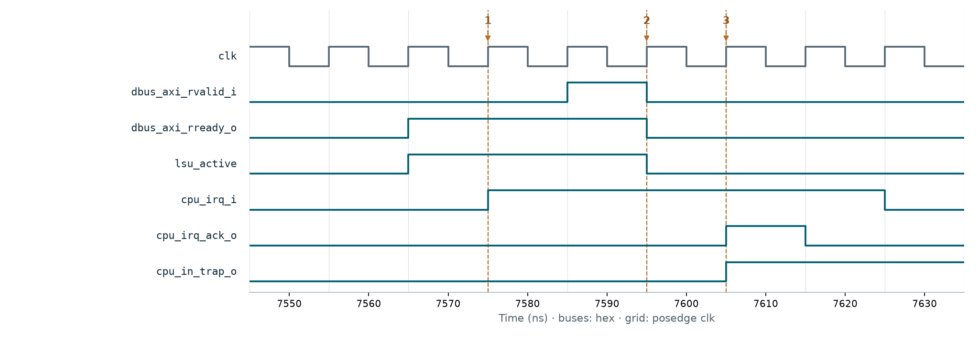
The IRQ waits for the load to finish before the claim
1 · New IRQ
2 · R handshake
3 · Claim
LSU busy → claim = 0
Load complete → S2 may advance
Trap entry; one-cycle pulse
The markers follow the same instruction and the same IRQ request.
RV32I · 06 / 07 · Critical scenario
Notes:
2:00. Use the markers and the arrows. At 7575 ns the IRQ appears, but lsu_active is still 1, so there is no claim. At 7595 ns RVALID and RREADY are evaluated on the rising edge and the load response is accepted. At 7605 ns the claim and cpu_in_trap appear. A response cannot be abandoned to enter the handler sooner. The test also checks the loaded value and mepc; the waveform shows the ordering behind that result.

Slide 7
Result: an integrated core, checked instruction by instruction
WHAT I BUILT
WHAT I LEARNED
1. RV32I pipeline, predictor and forwarding integrated
I defined the stall / flush / trap order before integration.
2. CSRs, traps and AXI access with explicit rules
I separated protocol checking from the architectural effect.
3. Execution compared against an independent ISA model
I used concurrent scenarios to test the boundaries between blocks.
My contribution: design decisions → RTL → integration → verification
RV32I · 07 / 07 · Conclusions
Notes:
1:00. Close with what I built and what I learned. The result is an integrated CPU whose execution is compared against an independent model. The hard part was defining the ordering at the boundary between memory, pipeline and traps. The internship taught me to turn incomplete requirements into precise contracts, and to write tests that check those contracts. My contribution covers the architectural decisions, the RTL, the integration and the verification.

