Slide 1
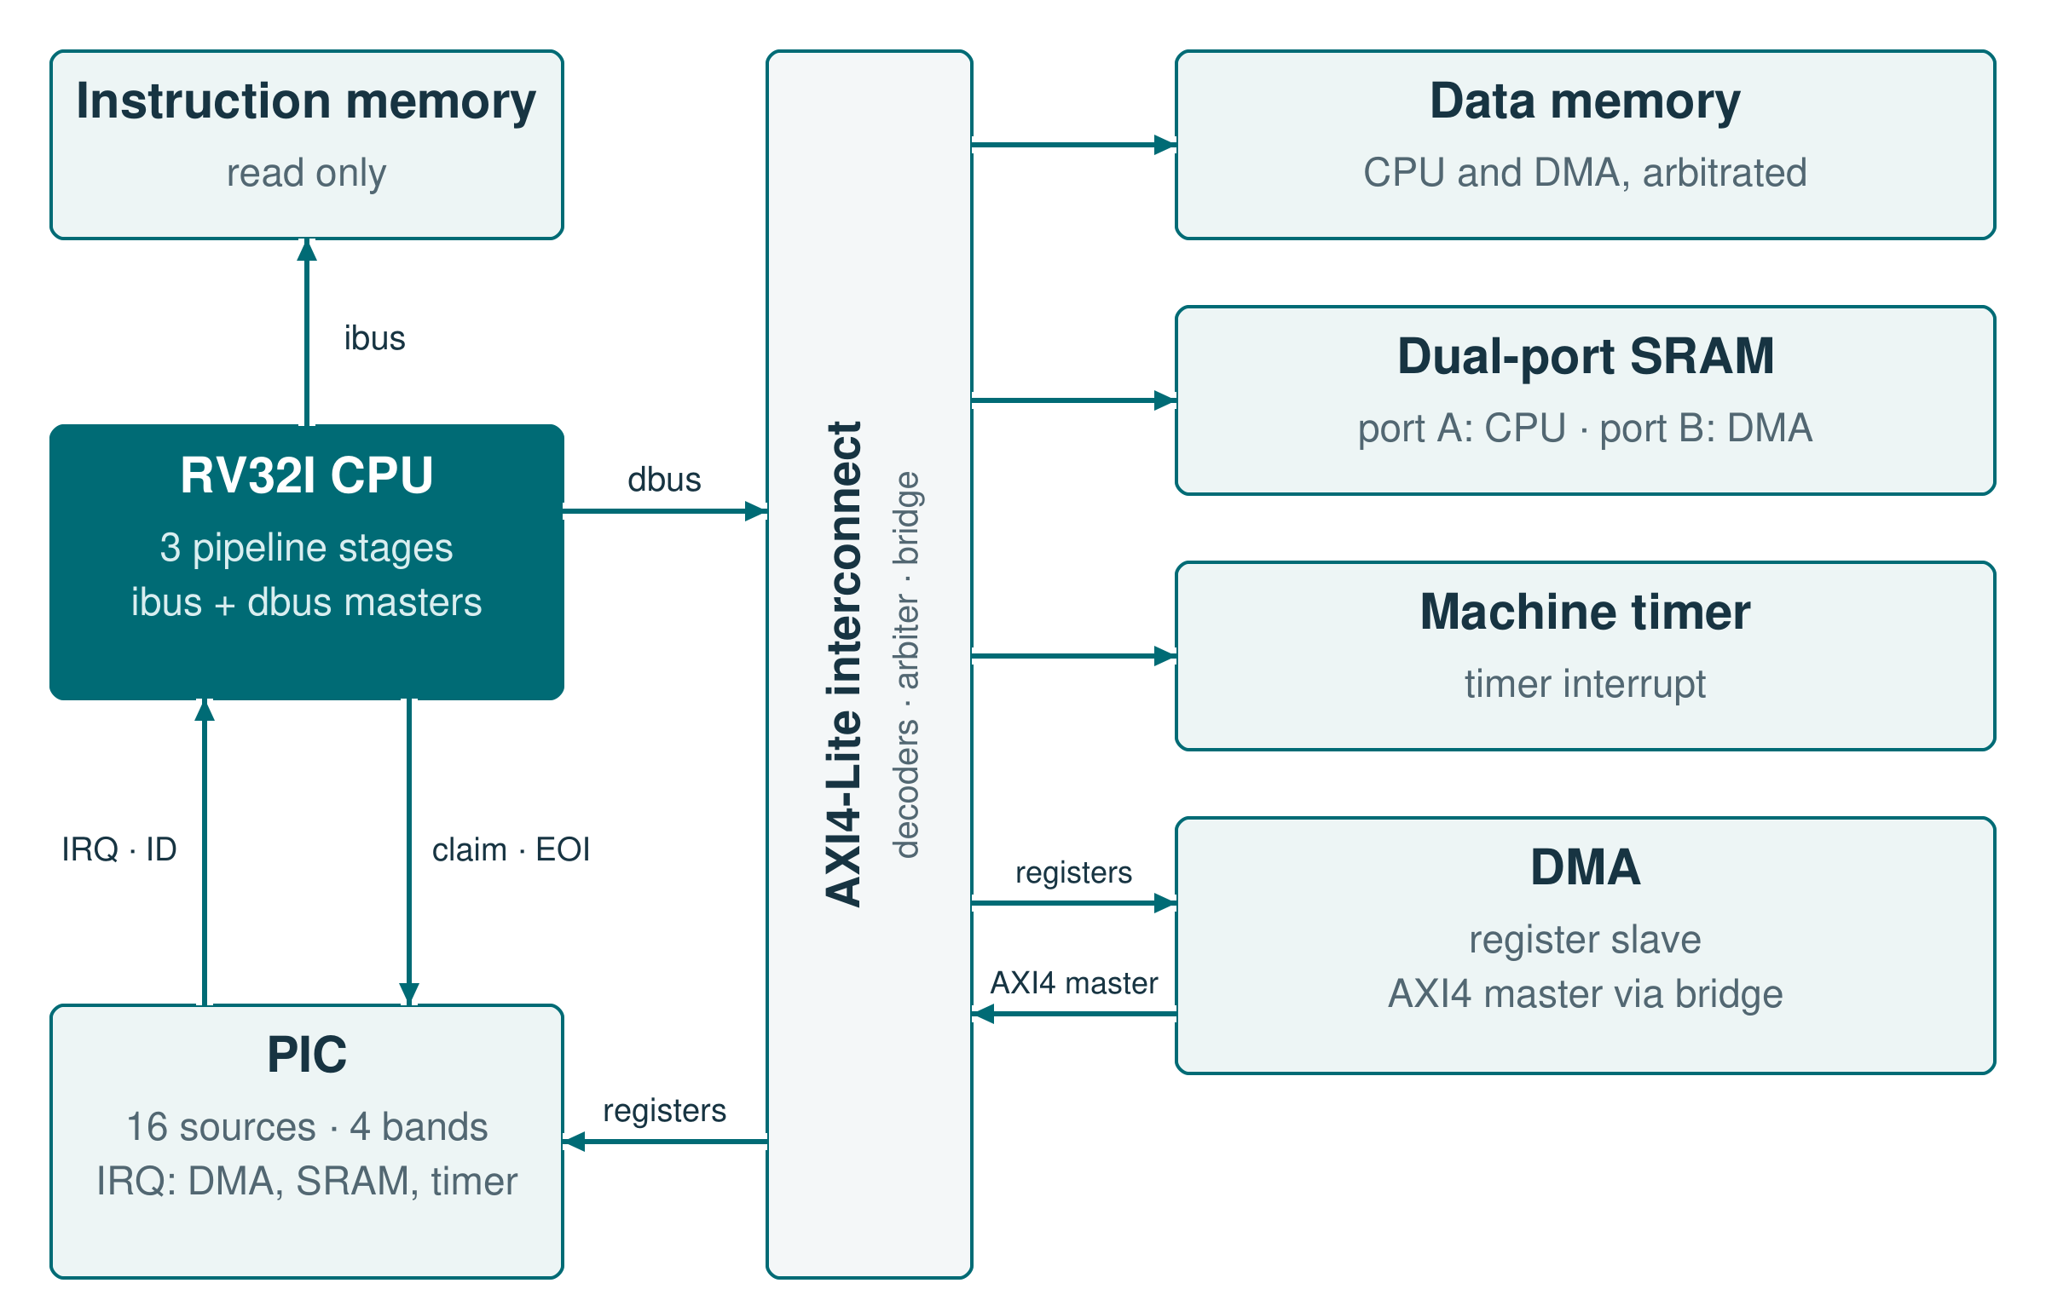
INTERNSHIP · SIEMENS · 2026
RV32I Processor
Three-stage pipeline
Bunea Cosmin-Andrei
Computer Engineering, year III
Academic year 2025–2026
Transilvania University of Brașov
RTL implementation · interfaces · verification
Notes:
0:30. The project is an RV32I core that I specified, wrote in RTL, integrated and verified. The figure is the SoC from the kick-off: the CPU has an instruction port, a data port on the interconnect and a direct link to the PIC. Total time: 10 minutes.

Slide 2
The task: a three-stage RV32I core with two AXI4-Lite ports
01
RV32I base ISA; no multiply or divide
06
CSRs for traps and interrupt control
02
Three stages: fetch, decode + execute, writeback
07
Two independent AXI4-Lite masters
03
32 × 32-bit register file; x0 reads as zero
08
Central stall and flush control
04
Branch predictor with one direction bit
09
Interrupt link to the PIC
05
Exceptions and external interrupts
10
Interrupts taken only at instruction boundaries
RV32I · 02 / 08 · Requirements
Notes:
1:00. These are the requirements from the kick-off and the CPU brief: the ISA, the three stages, two AXI4-Lite ports, a simple predictor, traps, CSRs and central stall/flush control; interrupts are taken only at instruction boundaries. The interrupt link to the PIC uses 16 sources, a 4-bit ID, a claim and an EOI.

Slide 3
The brief left 23 questions open; five of them shaped the design
Question from the brief
What I decided
1
How large is the predictor, and how is a branch mapped?
→
128 entries, direct-mapped by PC, with a tag; a miss predicts not taken
2
Trap, MRET and misprediction in the same cycle?
→
One redirect, only when S2 completes: IRQ, then exception, then MRET, then branch
3
What happens on an AXI error response?
→
Access-fault exception (cause 1, 5 or 7); the destination register is not written
4
During a stall, how is a wrong fetch avoided?
→
S1 holds one instruction until S2 is free; a redirect waits for S2, and a wrong-path response is drained
5
How is a new trap blocked while a handler runs?
→
Trap entry clears MIE; a 16-level stack tells MRET whether to send an EOI
RV32I · 03 / 08 · Design decisions
Notes:
1:40. The brief asked 23 questions and left the answers to me; these five shaped the design most. The predictor size and mapping; the order when several redirects are requested together; what an AXI error turns into; how S1 avoids a wrong fetch while S2 is stalled, including a read that is already on the bus; and how a second trap is kept out while a handler runs.

Slide 4
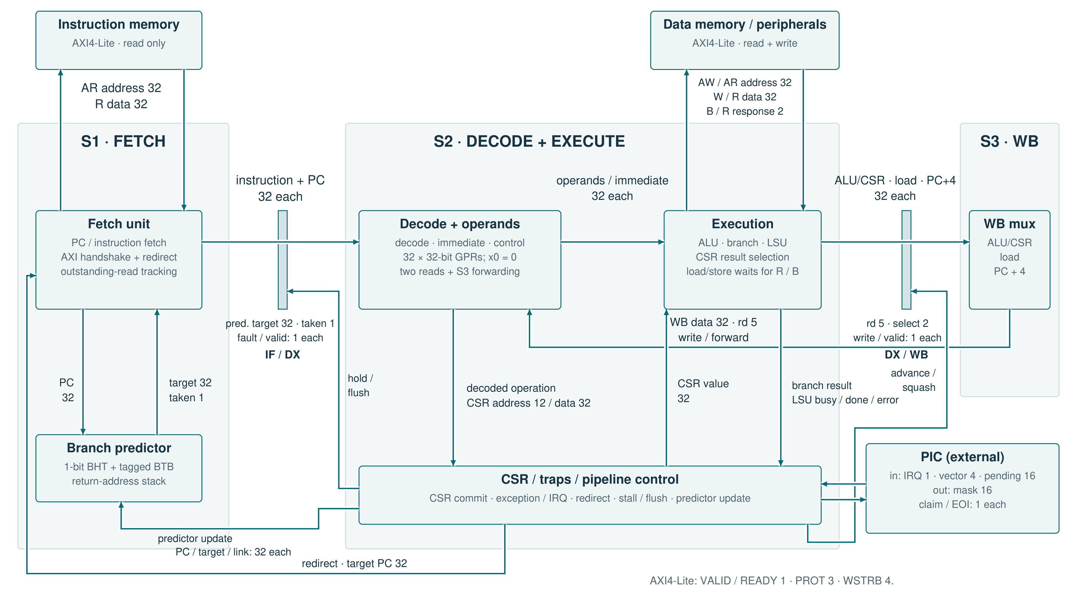
Three stages; S2 decides when an instruction is complete
Notes:
1:50. Follow the main path from S1 to S3. Loads and stores finish inside S2, so a dependent instruction gets the value by forwarding from S3, with no extra bubble. The decisions from the previous slide sit in these blocks: the predictor next to fetch; the fetch unit, which holds an instruction during a stall and drains a wrong-path response; the LSU inside execution, which turns an AXI error into an exception; and the control block, which orders redirects and keeps the trap state. Parameters: RESET_PC, HART_ID, BP_ENTRIES and RAS_DEPTH.

Slide 5
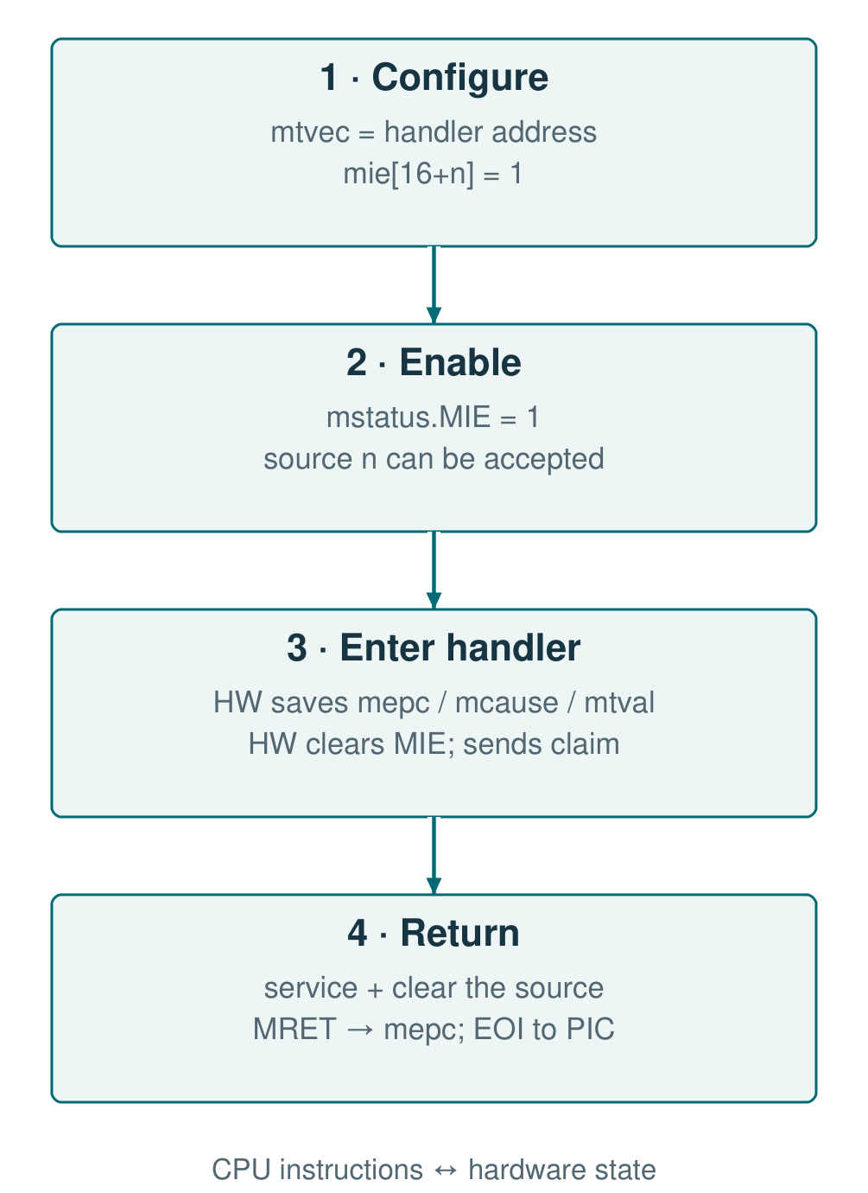
CSR bits 16 to 31 connect software to the PIC
CSR / event
PIC signal
Rule
mie[16+n]
cpu_mask_i[n]
Masked sources are skipped by the PIC
mip[16+n]
pending_o[n]
Every pending source is visible
mcause
cpu_irq_vec_o
0x8000_0000 + 16 + n
mtvec, MODE = 1
—
Handler at BASE + 4 × (16 + n)
Trap entry
cpu_irq_ack_i
One-cycle claim
MRET
cpu_irq_eoi_i
EOI only after an interrupt
RV32I · 05 / 08 · Software interface
Notes:
1:20. The CSRs follow RISC-V; the part specific to this project is bits 16 to 31, one per PIC source. mie bit 16+n goes to the PIC as a mask, so a masked source is skipped in arbitration and cannot hold back the others. mip shows every pending source, not only the one offered. On trap entry the CPU saves cause 16+n and sends one claim; with vectored mtvec the handler address follows from n. MRET sends an EOI only when it closes an interrupt.

Slide 6
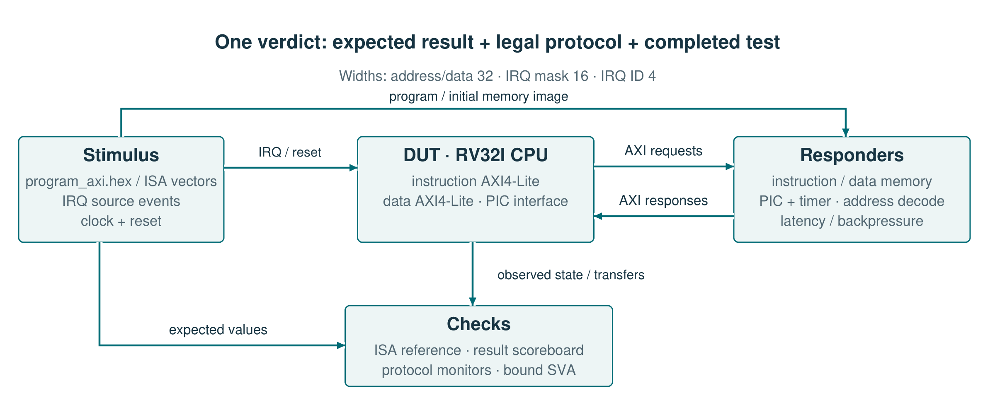
The environment checks results, bus protocol and its own tests
Independent model
Latency and backpressure
Mutation suite
1,287 instructions compared step by step
Memories delay replies and stall channels
16 injected RTL defects; each makes a named bench fail
ModelSim: 22 CPU/PIC configurations · Verilator: 16 benches with assertions bound to the RTL
RV32I · 06 / 08 · Verification
Notes:
1:30. Stimulus and program go into the DUT; expected values and observations go into the checks. The ISA model is written separately from the RTL and gives the expected state after each of 1,287 instructions. The memories add delay and backpressure, so the same program also exercises stalls. Assertions are attached with bind and check pipeline and AXI rules. The mutation suite inserts a known defect into the RTL and requires a named bench to fail; all 16 are rejected.

Slide 7
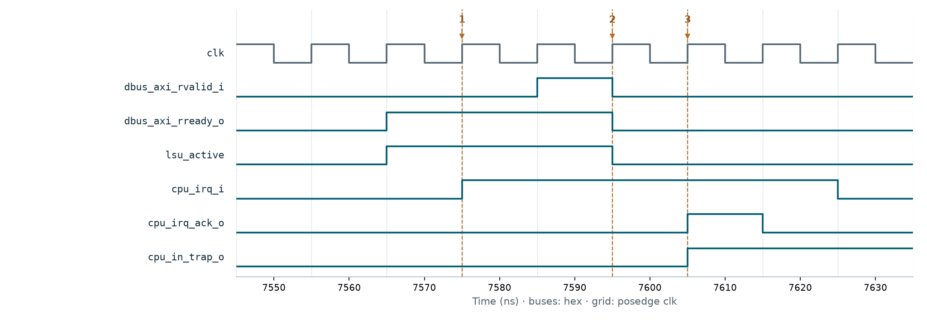
The IRQ waits for the load to finish before the claim
1 · New IRQ
2 · R handshake
3 · Claim
LSU busy → claim = 0
Load complete → S2 may advance
Trap entry; one-cycle pulse
The markers follow the same instruction and the same IRQ request.
RV32I · 07 / 08 · Critical scenario
Notes:
1:30. At 7575 ns the IRQ appears, but lsu_active is still 1, so there is no claim. At 7595 ns RVALID and RREADY are high on the same edge and the load response is accepted. At 7605 ns the claim and cpu_in_trap appear. An accepted response cannot be dropped to reach the handler sooner. The test also checks the loaded value and mepc.

Slide 8
Result: an integrated core, checked instruction by instruction
WHAT I BUILT
WHAT I LEARNED
1.
RV32I pipeline with predictor, forwarding and traps
–
Simultaneous events need a written order; the brief only lists them.
2.
CPU–PIC link: mask, pending, claim and EOI
–
An accepted AXI transfer cannot be cancelled, and that decides when a trap can start.
3.
Checks: ISA model, bound assertions, mutation suite
–
A test counts only if a real defect makes it fail.
Internship: brief → specification → RTL → verification, with a review at each step.
RV32I · 08 / 08 · Conclusions
Notes:
0:40. The result is an RV32I core connected to the PIC and checked against an independent model. What I keep from the project: simultaneous events need a written order; bus rules shape the pipeline control; and a test is useful only if a real defect makes it fail. The internship followed the path of a real block, from brief to verification, with reviews in between.

