Slide 1

Ecommerce Product Categorization
Knowledge-Hut AI Hackathon
Diksha Kumari

Slide 2
Project Overview
Objective: Develop a multi-class text classifier for product categorization.
Importance: Enhances customer experience, reduces search friction, and increases product discoverability.

Slide 3
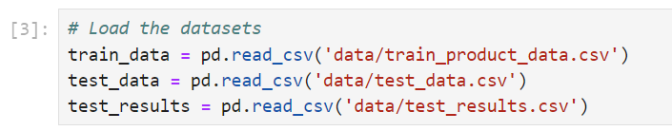
Dataset Description
Training Data: train_product_data.csv (15,000 records, 15 features)
Test Data: test_data.csv (2,500 records, 14 features)
Target Variable: product_category_tree

Slide 4

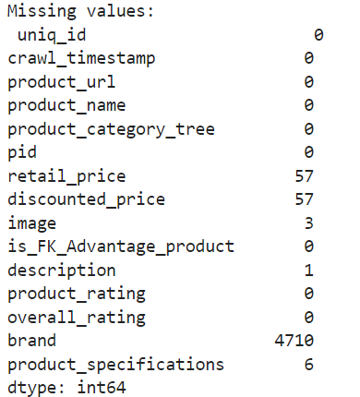
Data Preprocessing
Steps:
Handled missing values
Dropped unnecessary columns
Ensured data consistency
Key Transformations:
JSON parsing of product_specifications
Encoding categorical variables

Slide 5
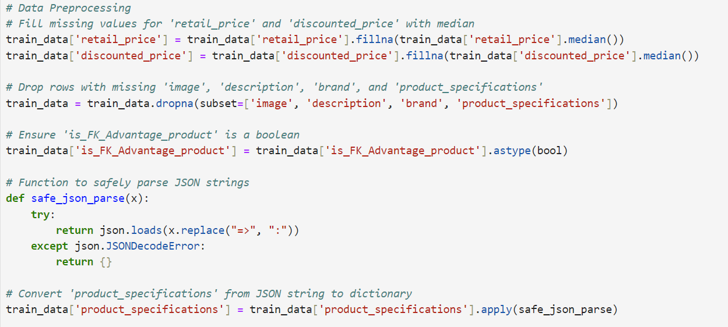
Data Preprocessing

Slide 6
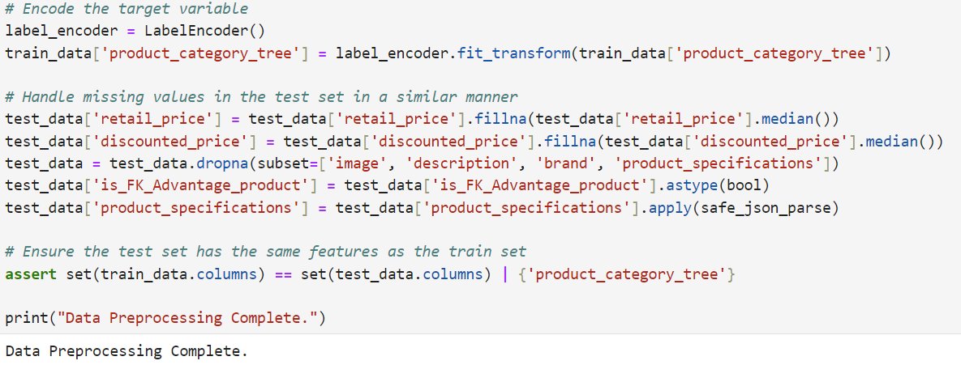
Data Preprocessing

Slide 7
Exploratory Data Analysis (EDA)
Summary Statistics: Provided insights into data distribution
Visualizations:
Category distribution
Retail and discounted price distributions
Insights: Identified trends and patterns in the data

Slide 8
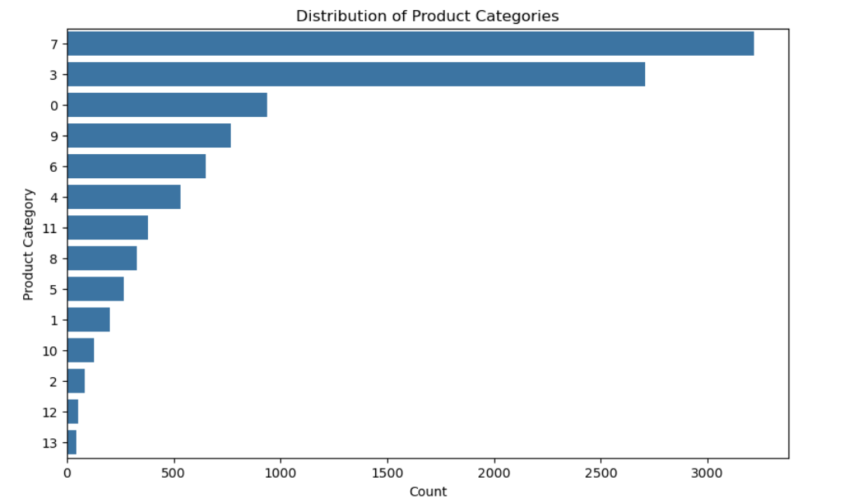
Exploratory Data Analysis (EDA)

Slide 9
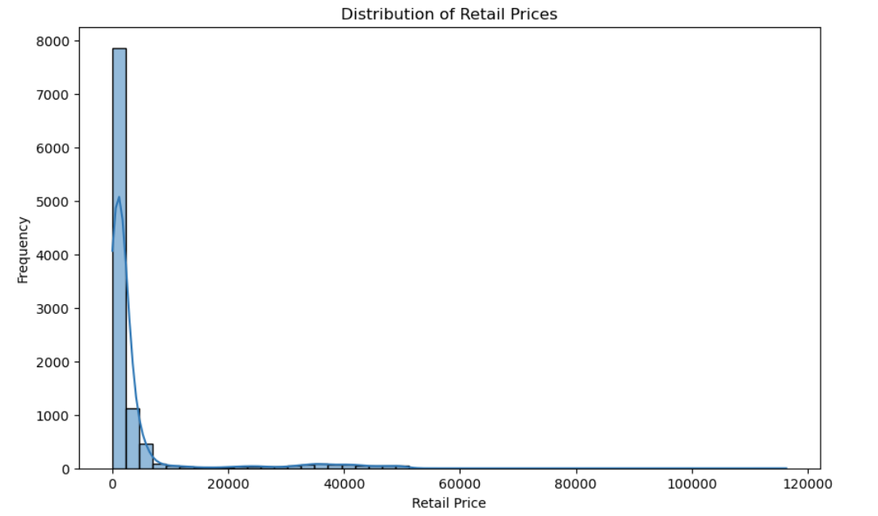
Exploratory Data Analysis (EDA)

Slide 10
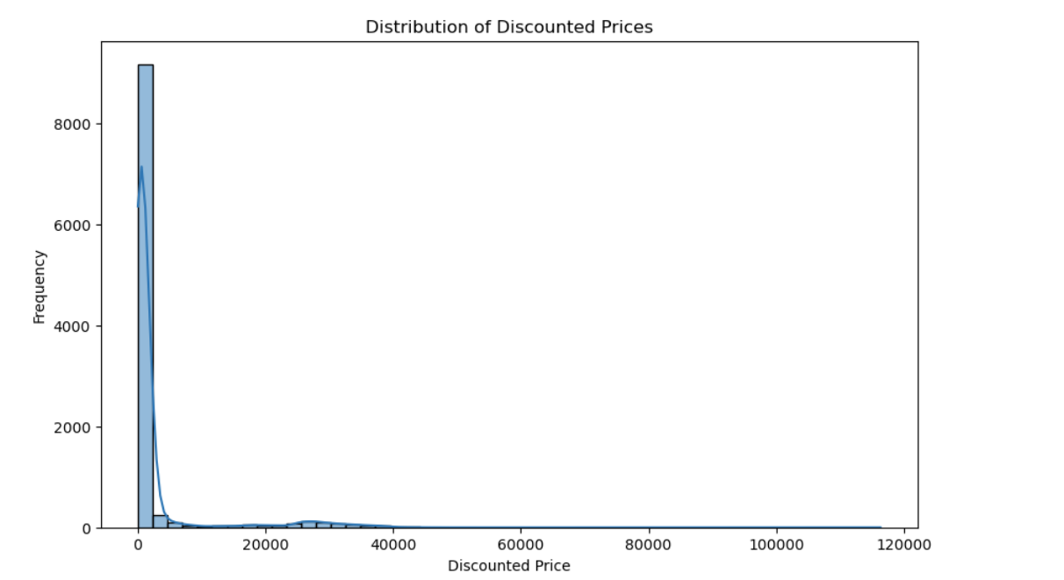
Exploratory Data Analysis (EDA)

Slide 11
Feature Engineering
Text Features: Combined product_name and description
Categorical Encoding: Used one-hot encoding for brand and is_FK_Advantage_product
TF-IDF: Vectorized text data for model input

Slide 12
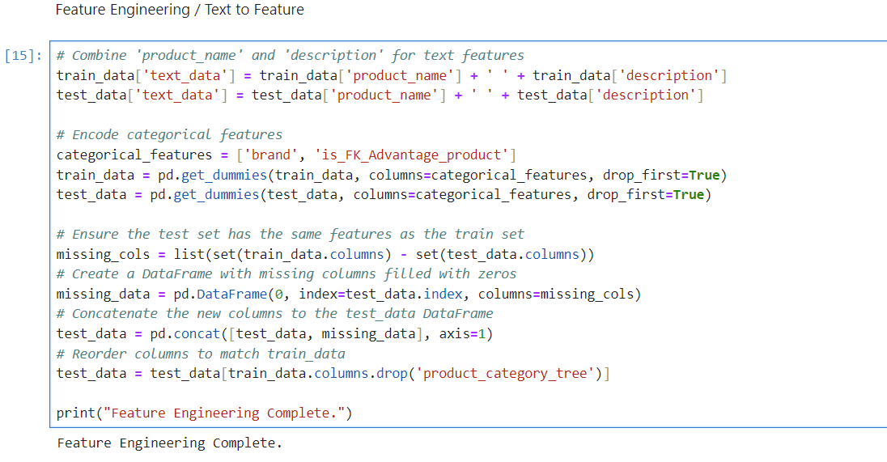
Feature Engineering

Slide 13
Model Building
Pipeline:
TF-IDF Vectorizer
Logistic Regression with balanced class weights
Hyperparameter Tuning: Grid search for optimal parameters
Model Evaluation: F1-score, cross-validation

Slide 14
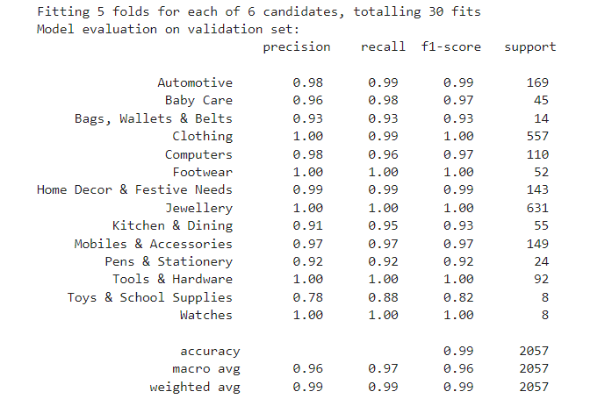
Model Building

Slide 15
Handling Imbalanced Classes
Issue: Class imbalance in product categories
Solution: Used class weights in Logistic Regression to handle imbalance

Slide 16
Results and Evaluation
Metrics: Classification report, F1-score, confusion matrix
Cross-Validation: Ensured model generalization
Best Model: Achieved weighted F1-score of 0.98840

Slide 17
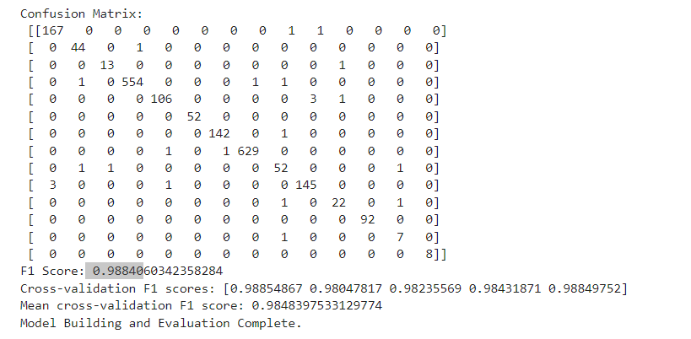
Results and Evaluation

Slide 18
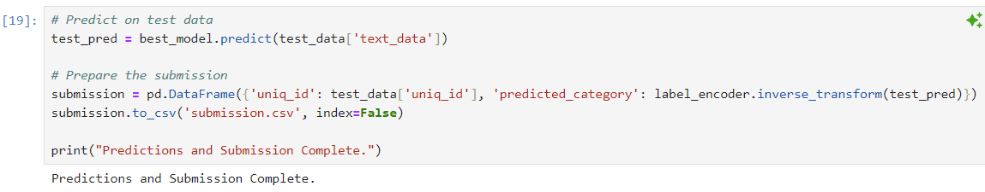
Predictions and Submission
Test Predictions: Generated and saved predictions for test data
Submission: Prepared submission.csv

Slide 19
Thank you

