Slide 1
Mood for Music:
Intelligent Mood Detection and Music Recommendation System
Diksha Kumari

Slide 2
Problem Statement
The goal of this project is to develop an intelligent system that detects a user’s mood from images and provides personalized music recommendations based on the detected mood. The system uses Convolutional Neural Networks (CNNs) to classify moods from images and then leverages this classification to recommend music tracks that align with the detected mood.

Slide 3
Data Sources
Image Data
Train Images: The dataset consists of labeled images corresponding to various moods: happy, sad, angry, neutral, fear, disgust, and surprise.
Test Images: Used to evaluate the model’s performance on unseen data.
Music Data
Data File (data_moods.csv): Contains information about music tracks and their associated moods. However, this dataset includes only four mood types: happy, sad, energetic, and calm, which may not directly align with all mood categories from the image dataset.

Slide 4
Data Preprocessing
Image Preprocessing
Loading Data: The images are loaded using numpy and reshaped to a consistent size of (48, 48, 3).
Normalization: Pixel values are normalized to a range of 0 to 1 by dividing by 255.
Encoding Labels: Moods are encoded using LabelEncoder from sklearn, converting categorical labels into numeric values.

Slide 5
Data Preprocessing
Music Data Preparation
Mapping Moods: The music dataset's moods are mapped to the corresponding mood categories detected by the model. This mapping helps in generating appropriate recommendations.

Slide 6
Feature Engineering
Image Features
Data Augmentation: Applied transformations such as rotation, width and height shifts, shearing, zooming, and horizontal flipping to increase the diversity of the training dataset and improve model generalization.

Slide 7
Model Selection: Convolutional Neural Network (CNN)
Architecture: Layers:
Conv2D: Initial convolutional layer with 64 filters, followed by 128 and 256 filters in subsequent layers.
MaxPooling2D: Down-sampling layers to reduce dimensionality.
Flatten: Converts 2D matrix to 1D vector.
Dense: Fully connected layers with 512 units and a dropout rate of 0.5 to prevent overfitting.
Output Layer: Dense layer with 7 units (one for each mood) and a softmax activation function to produce probability distributions.
Optimizer: Adam: Used for optimizing the model’s performance.
Loss Function: Sparse Categorical Cross Entropy: Suitable for multi-class classification problems.

Slide 8
Evaluation Metrics
Accuracy
The model achieved an accuracy of 60.76% on the test dataset. This metric measures the proportion of correctly classified images out of the total number of images.
Confusion Matrix
A confusion matrix was used to visualize the model's performance across different mood classes, providing insights into the classification errors and areas for improvement.

Slide 9
User Interface

Slide 10


Slide 11

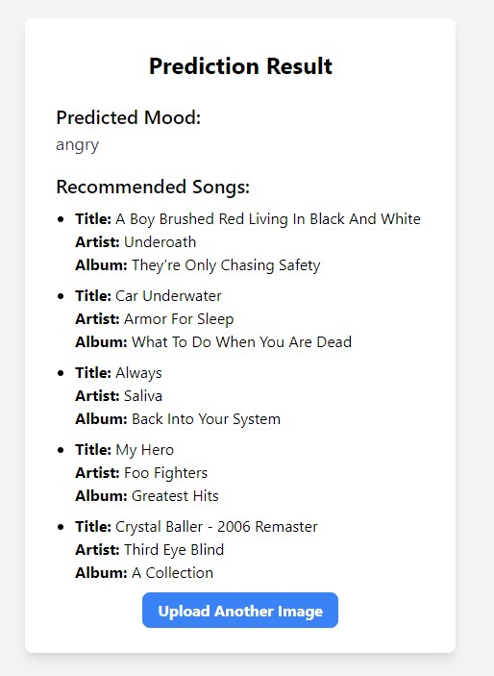

Slide 12

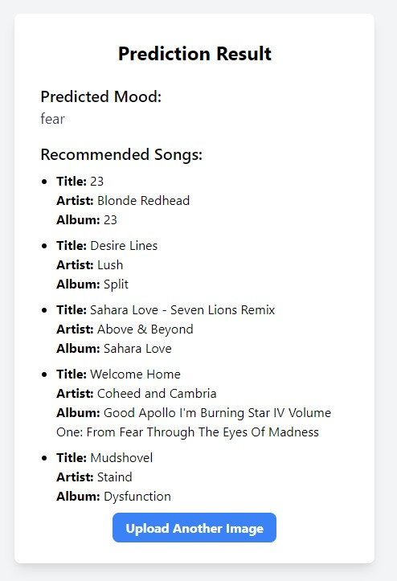

Slide 13

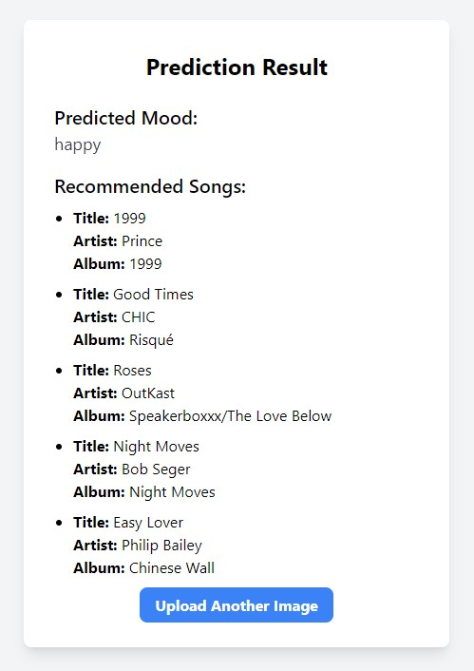

Slide 14
Future Work
Model Improvement
Explore more complex architectures like ResNet or EfficientNet and fine-tune pre-trained models to improve accuracy.
Experiment with different hyperparameters, such as learning rates, batch sizes, and network depths, to optimize model performance.
User Interface Improvement
Improve the user interface of the Flask application to provide a more engaging and interactive experience for users.

Slide 15
Thank you.

