Slide 1
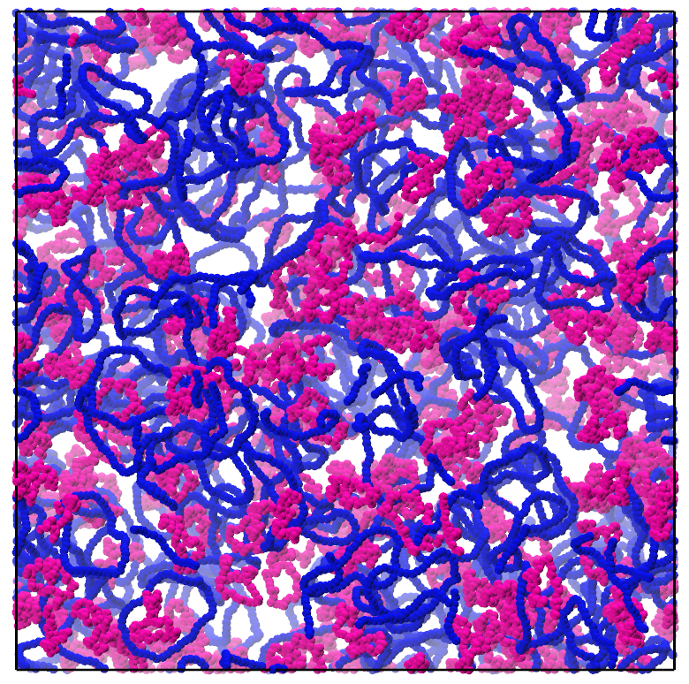
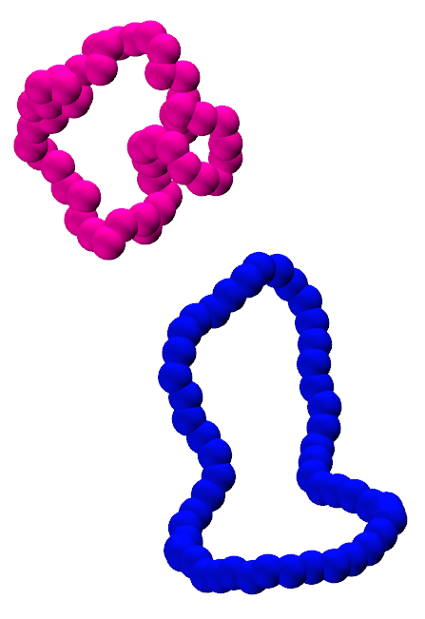
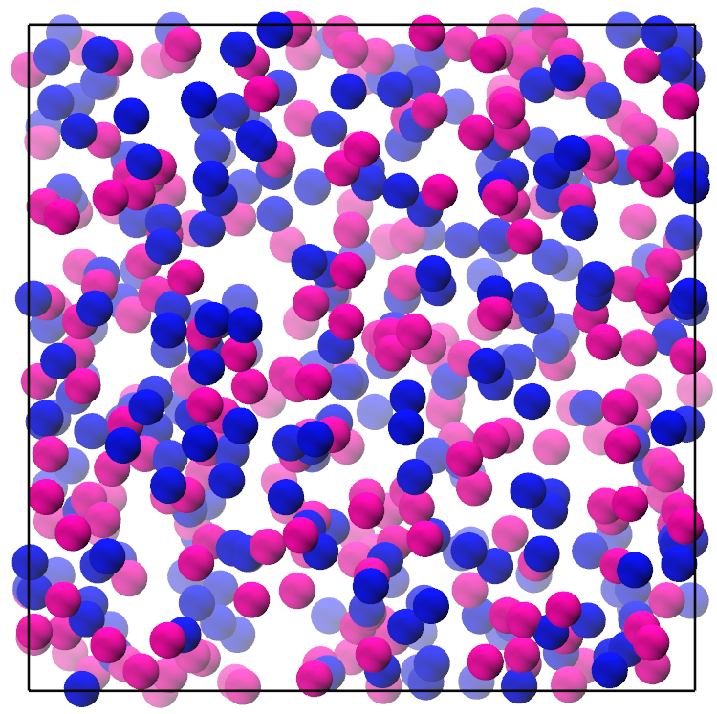
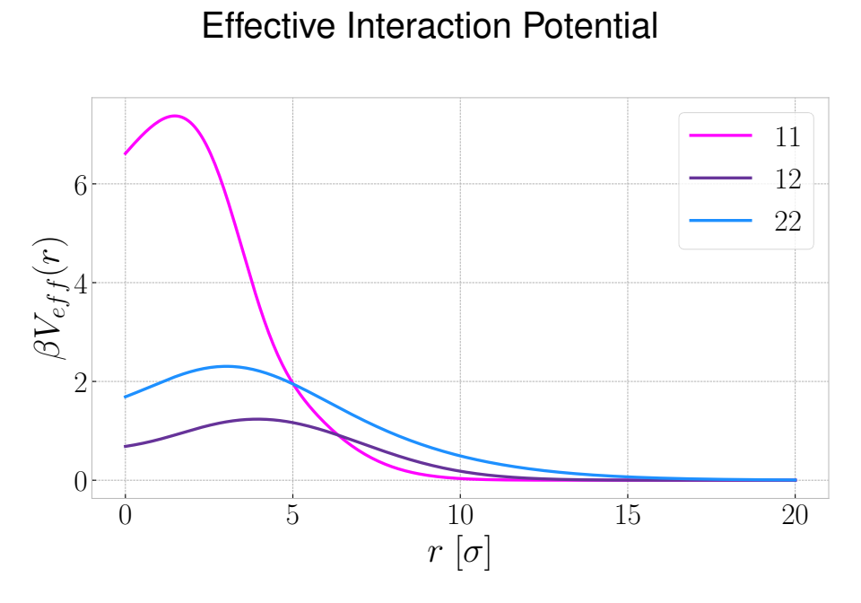
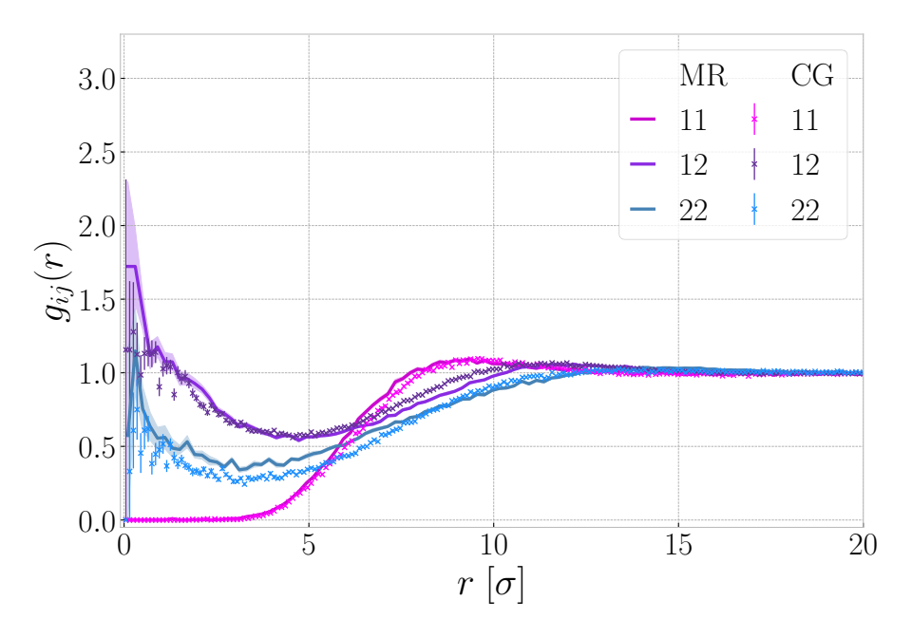
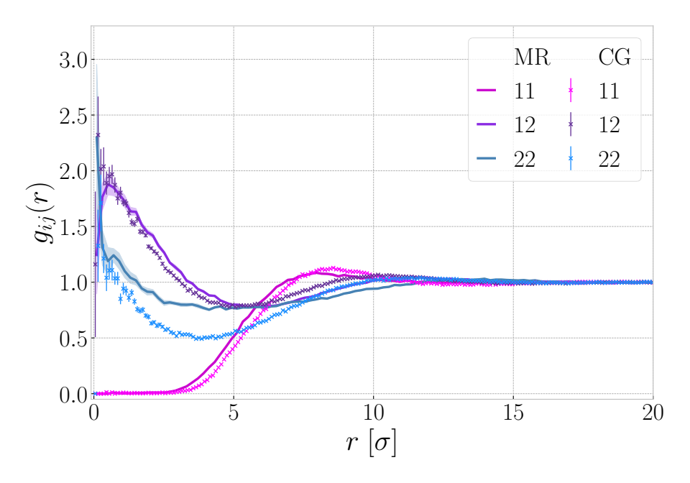
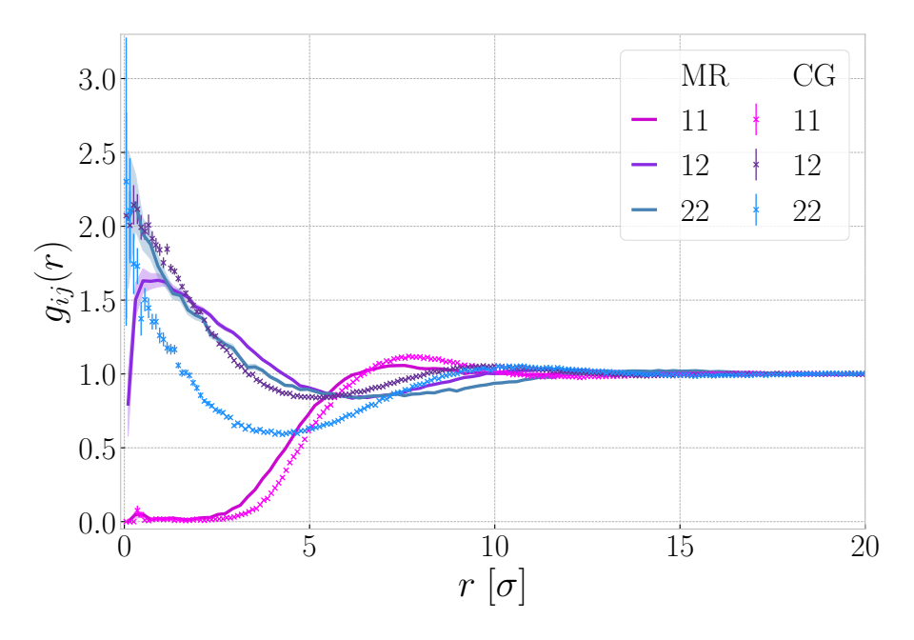
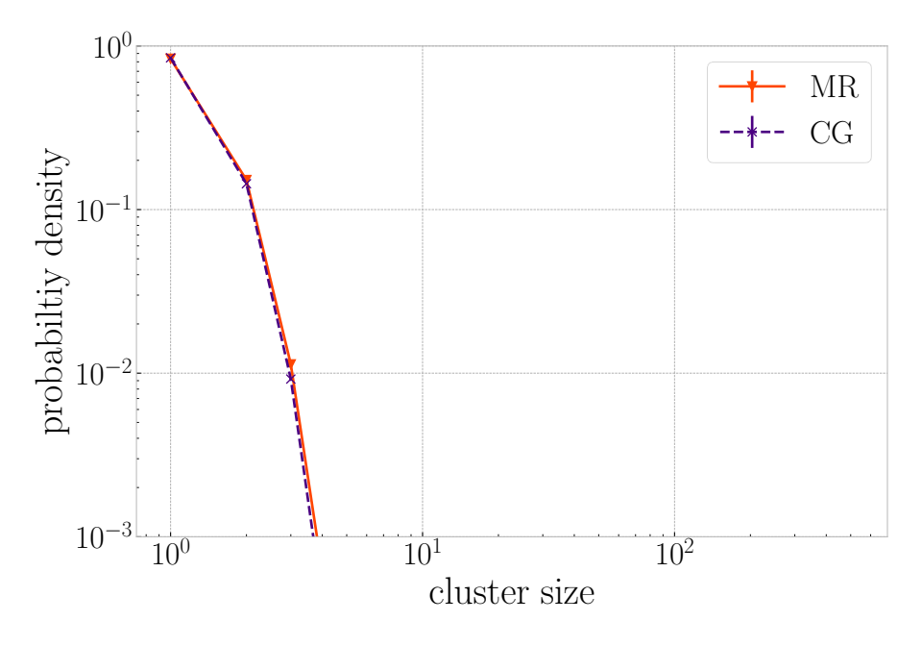
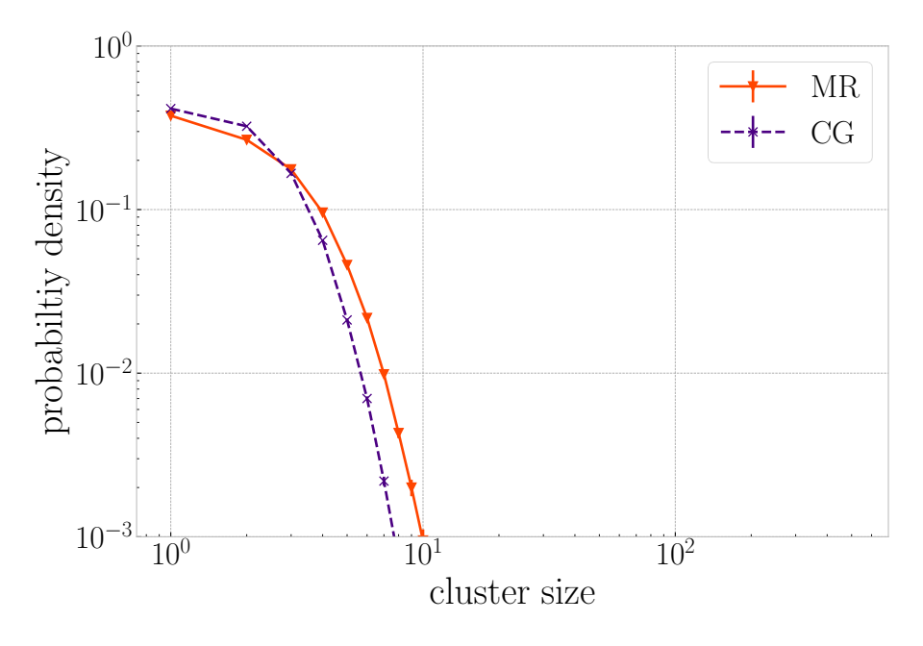
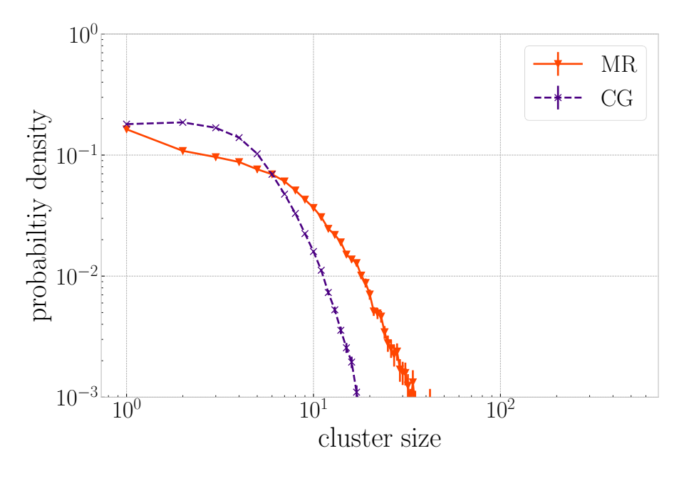
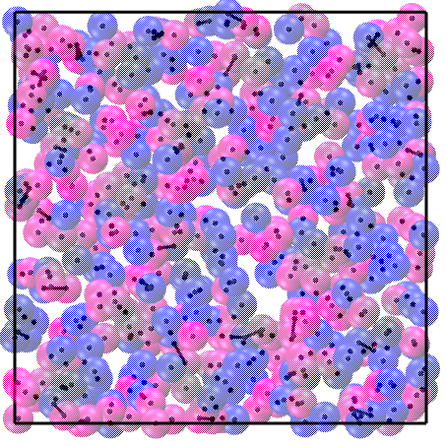
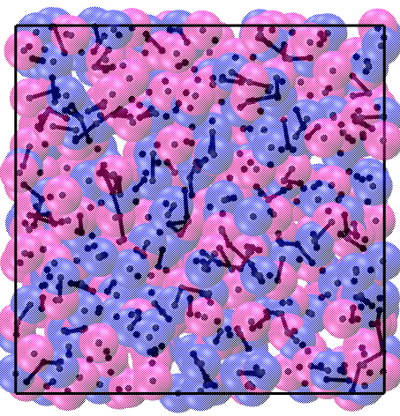
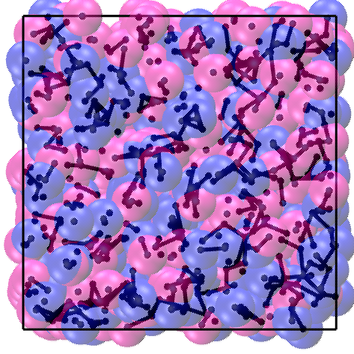
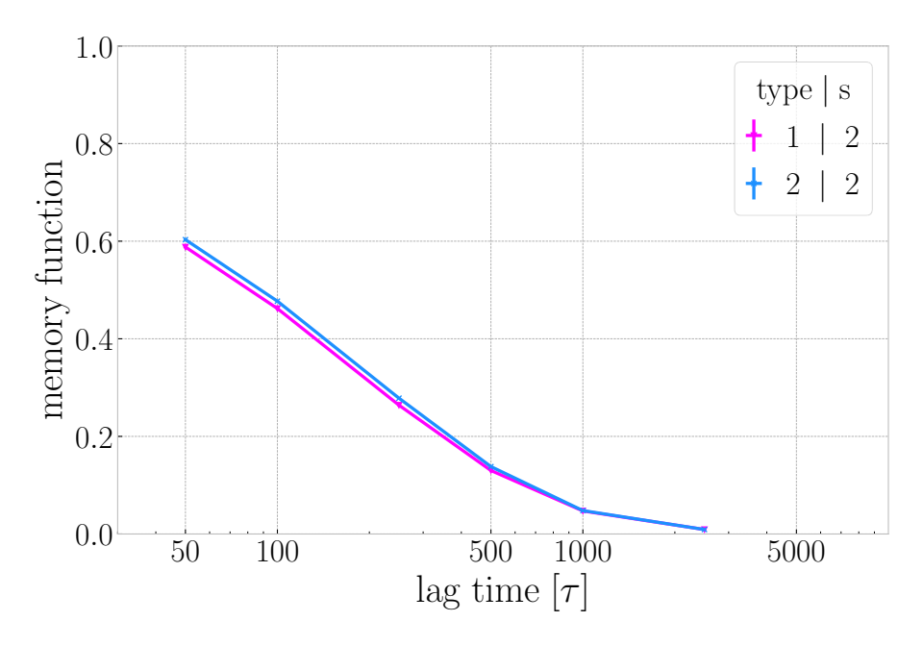
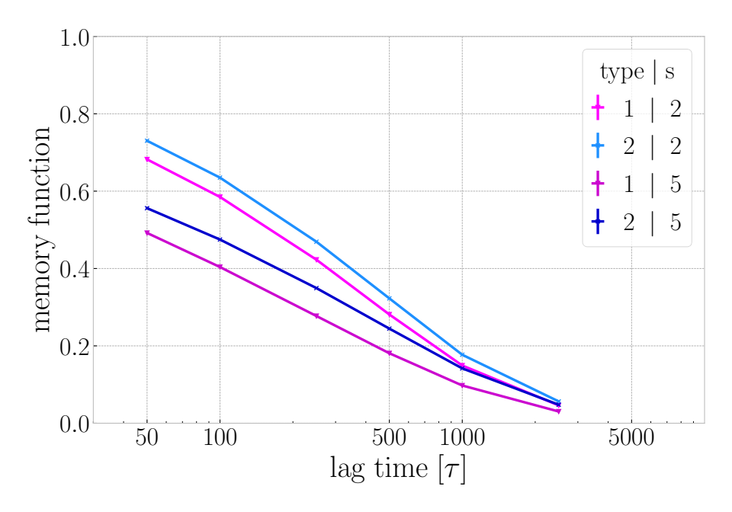
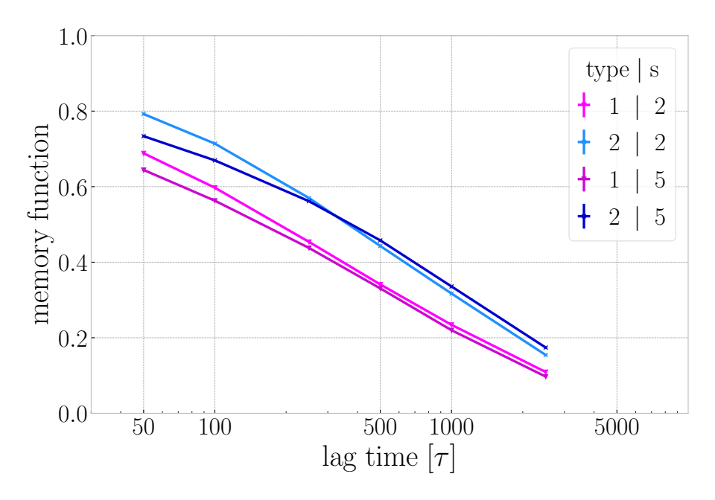

Dynamics and Structure of a Mixture of Ring Polymers:
Clusters and their Time Evolution
Motivation
understanding of ring polymers can be applied to questions in biology, such as how ring-shaped plasmids within bacteria behave or the organization of chromatin within the cell nucleus – the chromatin chains are so long that they can be assumed to act as if they had no ends
traditionally, pure systems of rings are studied, but mixed ring polymer systems are often encountered in nature and technological applications
Monomer-Resolved Model
Coarse-Grained Model
coarse-grain flexible ring polymers 1 and semiflexible ring polymers 2 to obtain effective interaction potentials
perform NVT molecular dynamics simulations for 50/50 mixtures of flexible and semiflexible rings at varying volume fractions ϕ using
both models
Methods
1
Result I: Structure obtained from Coarse-Grained reproduces Monomer-Resolved results
low density (ϕ = 0.11)
medium density (ϕ = 0.33)
high density (ϕ = 0.55)
peaks in the pair correlation function at r=0 for flexible rings 1 with semiflexible rings 2 and for semiflexible rings 2 with other semiflexible rings 2
indicates existence of flexible-semiflexible and semiflexible-semiflexible clusters and absence of flexible-flexible clusters
2
Result II: Cluster formation is observed
low density (ϕ = 0.11)
medium density (ϕ = 0.33)
high density (ϕ = 0.55)
1
as density increases, cluster size and the probability to observe clusters increases
at low densities mostly free rings, rings in pairs or triplets - for higher densities clusters of up to ~10 rings
3
Result III: Tracking the time evolution of Clusters in Monomer Resolved systems
low density (ϕ = 0.11)
medium density (ϕ = 0.33)
high density (ϕ = 0.55)
study how long rings of different types stay within clusters of different initial sizes s
at low density pairs between flexible rings 1 and semiflexible rings 2 are the most long lived - at higher densities semiflexible rings 2 leave clusters more slowly than flexible rings 1
Konstantin Moser*, Vittoria Sposini*, Christos N. Likos*, Roman Staňo†*
(a12024323@unet.univie.ac.at)
* University of Vienna, Faculty of Physics, Computational and Soft Matter Physics, Kolingasse 14-16, 1090 Vienna, Austria
† University of Vienna, Vienna Doctoral School in Physics, Boltzmanngasse 5, 1090 Vienna, Austria

