Slide 1

Machine learning/ artificial intelligence Sentimental analysis in amazon book reviews
By
Aqib ullah
Notes:
I used sentiment analyisi is a new topic, which means I am going beyond the teaching of undergraute.
Lots of intelligent challenge

Slide 2
Introduction
What is Sentiment Analysis?
A tool to decode emotions and opinions in text data.
Why Amazon Reviews?
Rich source of consumer sentiment.
Impact on purchasing decisions.
Dissertation Focus:
Analysing sentiment trends in book reviews.
Evaluating different sentiment analysis techniques.
Methodology at a Glance:
Data from Amazon reviews.
Techniques: Text Blob, Vader, LDA.
Objective and Relevance:
Uncover sentiment patterns.
Inform marketing and product strategies.
Progress & Plans:
Current stage: Data collection & preliminary analysis.
Next steps: In-depth sentiment modelling.

Slide 3
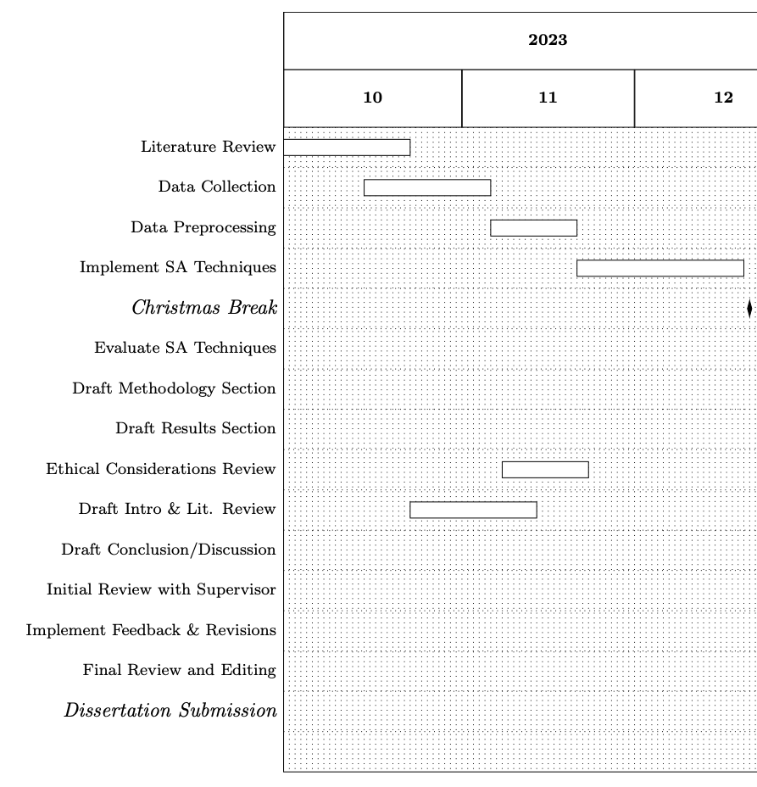
Research proposal to show independence
Under the guidance of my supervisor, Dr. Harris, I crafted a focused research proposal on sentiment analysis of Amazon book reviews. This self-driven project uses advanced NLP tools and sentiment analysis models, structured into clear phases with Gantt charts. My work balances technical precision with ethical research standards.

Slide 4
Sentimental analysis

Slide 5
Objectives
Sentimental Analysis

Slide 6
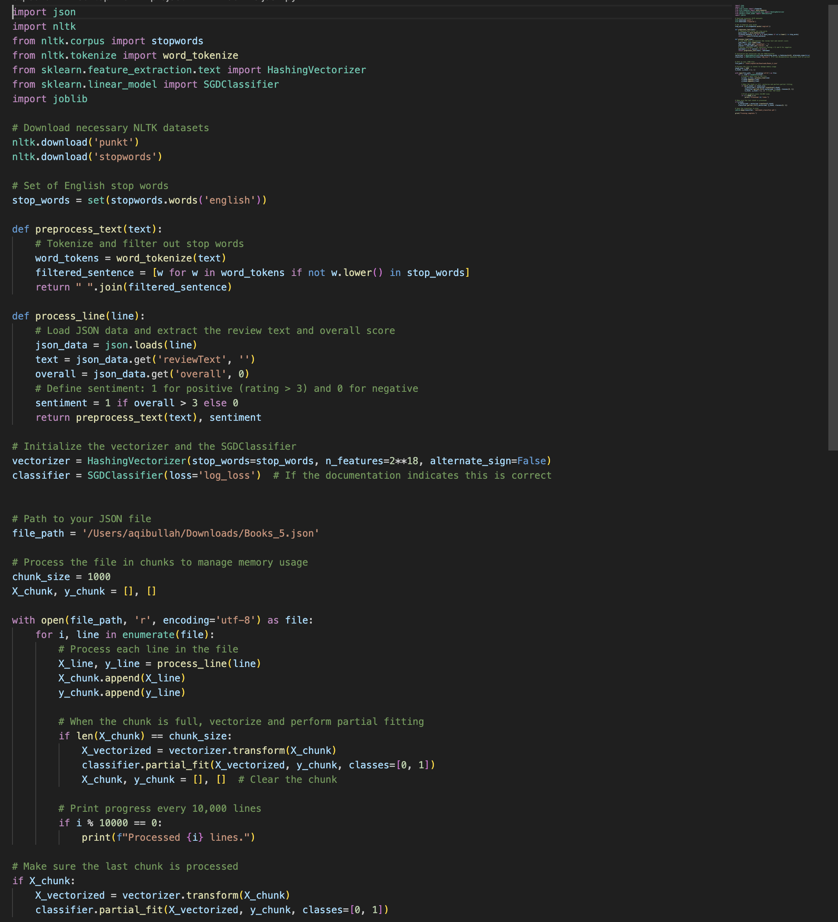
What progress I've made(with evidence)

Slide 7
Methodology

Slide 8

The challenges
Facing technical constraints with the 8GB RAM of my iMac, I encountered limitations in machine learning performance and data handling capacity. This bottleneck affected the training and analysis phases, requiring strategic data batching and code optimization to manage the memory demands. Moving forward, upgrading hardware or employing cloud computing services may be necessary to overcome these challenges.
Notes:
Part of the completity im doing is the amount of reviews im doing
Solution, increasing ML and AI by doing dummy test of the random sample. To reduce its size

Slide 9

What my next steps are(plans for semester 2)
In the next semester, I aim to harness MATLAB's Deep Learning Toolbox to deepen the training of my machine learning model. Clustering to use called latent Dirichlet allocation, inferring topic from a set of book reviews
This step is intended to refine the model's analytical acumen. I also plan to test the model's adaptability and accuracy on diverse datasets, ensuring it delivers robust analytical insights.

Slide 10

Q&A
Notes:
Ask follow up question if I am puzzled
Reduce the amount words I have

