Slide 1
PRODUCT OVERVIEW · VEDHASOFT AI
WHY THIS EXISTS
Clairo*
The gap SAP left open
80,000+ SAP B1 companies
AI-powered business intelligence
for SAP Business One.
Every one of them has managers who can't access their own data without IT help or Crystal Reports.
SAP Joule doesn't cover B1
SAP's own AI (Joule) is enterprise S/4HANA only. SAP Business One SME customers get nothing.
Type a question. Get a chart.
No SQL. No reports. No consultant.
Zero competitors in this space
No prompt-to-chart AI exists for SAP B1 today. This is an uncontested market gap.
CIBI
SAP B1 License ✓
BEFORE vs WITH CLAIRO
WHAT IT DOES
BEFORE
WITH CLAIRO
1
2
3
4
Open Crystal Reports
Type the question
Call IT for a query
Chart in 3 seconds
User types a plain-language question →
AI writes TypeScript to query SAP B1 →
Sandboxed VM runs it safely →
Chart or KPI card renders instantly
Wait 2 days
No IT. No SQL.
Get a static PDF
Interactive & live
Can't ask follow-up
Ask follow-ups
v1.0 · June 2026 · Confidential
Notes:
Slide 1: Open with the market gap — 80k SAP B1 companies, zero AI chat interface. This is the product that doesn't exist yet.

Slide 2
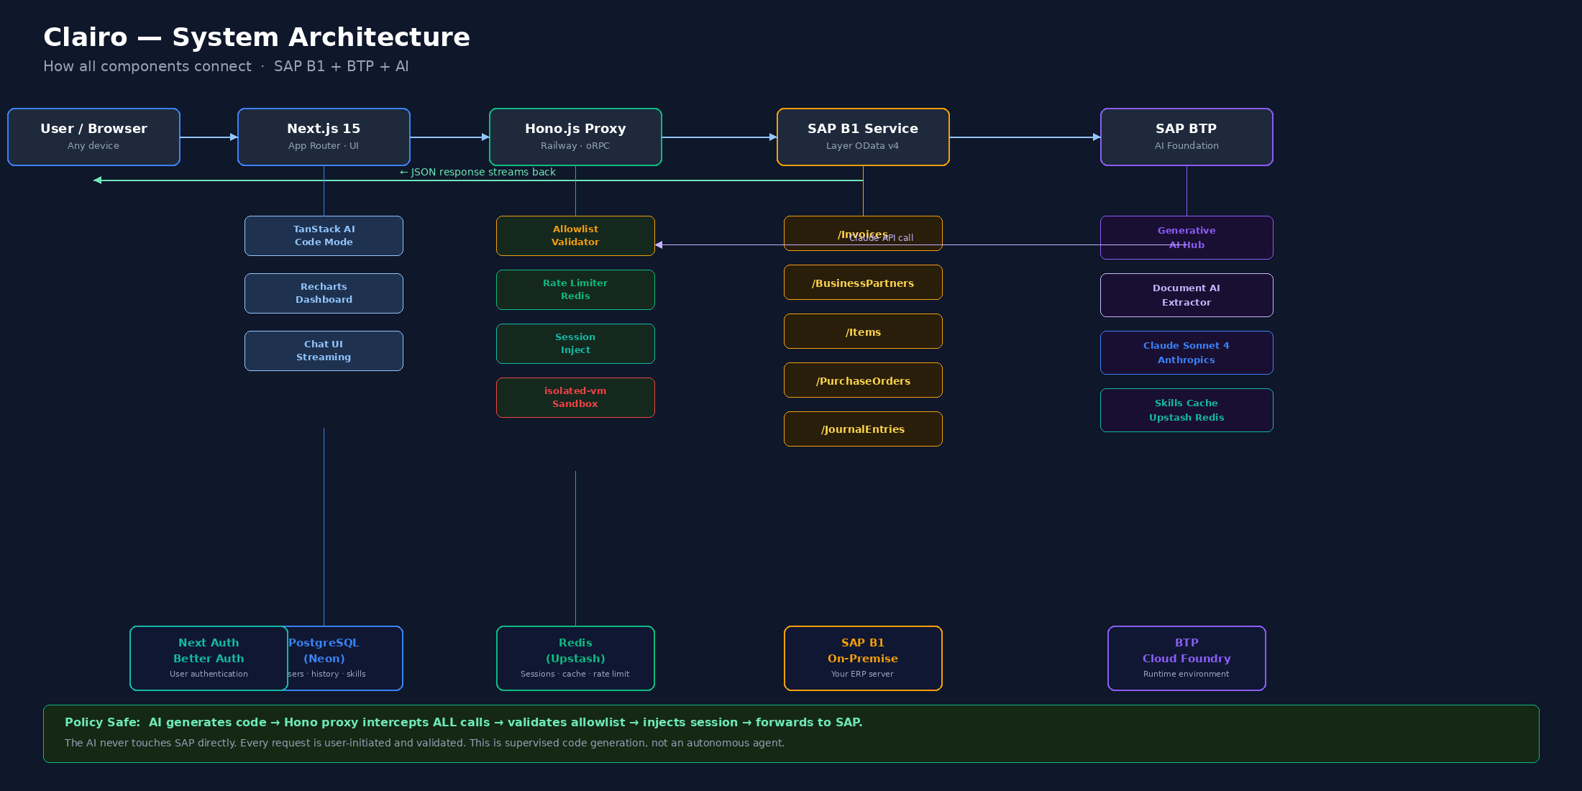
SYSTEM ARCHITECTURE
How everything connects — SAP B1 + BTP + AI
① User types prompt
② AI generates code
③ Proxy validates & calls SAP
④ Chart renders instantly
Any business question in plain language
Claude writes TypeScript via TanStack AI Code Mode
Hono checks allowlist, injects session, forwards OData
Recharts streams result — bar, line, pie, or KPI card
Notes:
Slide 2: Walk through top row L→R: User → Next.js → Hono → SAP B1 → BTP. Key point: AI never touches SAP. Hono proxy is the gatekeeper.

Slide 3
MARKET IMPACT & SALABLE VALUE
Why this sells — and how big it can get
80,000+
₹0
₹5,999
₹30k+
SAP B1 companies worldwide
Competing AI chat tools for B1
Target MRR per company (Pro)
MRR target at 5 Pro customers
COMPETITIVE LANDSCAPE
SAP Joule
Crystal Reports
Power BI
Clairo
Works with SAP B1?
✗ No
✓ Yes
Partial
✓ Yes
AI / Chat interface?
✓ Yes
✗ No
✗ No
✓ Yes
Setup time
Months
Weeks
Days
Minutes
Price for SME
₹₹₹₹
₹₹₹
₹₹
₹
No IT help needed?
✗ No
✗ No
Partial
✓ Yes
TAM
80,000 SAP B1 companies x Rs3,000 avg = Rs24 Cr/month potential. Even 0.1% share = Rs24 lakh MRR. India-first = defensible moat.
Notes:
Slide 3: Competitor table kills the 'doesn't SAP already do this?' question. Clairo is the only option that works with B1, has AI chat, and is priced for SMEs.

Slide 4
TECH STACK & COST MODEL
Every tool, its cost, and what it does
Layer
Technology
Role
Dev Cost
Prod/mo
Frontend
Next.js 15 + Vercel
App Router, streaming UI, deploy
Free
₹0–₹1,800
AI Engine
TanStack AI Code Mode
LLM writes TypeScript query programs
Free OSS
₹0
VM Sandbox
isolated-vm (Node 24)
Runs AI code safely, V8 isolate
Free OSS
₹0
Backend
Hono.js on Railway
SAP proxy, oRPC, middleware
Free tier
₹600–₹2,400
LLM
Open Models
Code gen, query understanding
Pay per use
Based On Models
SAP API
Service Layer v2 OData v4
Official SAP B1 REST API
Existing
₹0 (licensed)
Database
PostgreSQL — Neon
Users, history, skills metadata
Free tier
₹0–₹600
Cache
Redis — Upstash
Sessions, skills cache, rate limits
Free tier
₹0–₹400
Auth
Better Auth
User sessions, B1 credential store
Free OSS
₹0
Payments
Razorpay
Subscription billing for SaaS
Free
2% per txn
SAP Partner
PartnerEdge Build
Required to sell commercially to others
Free tier
₹1.8L/yr (Yr 2+)
Dev Phase Cost
MVP Prod/month
Break-even
Gross margin
~₹0–₹2,000
~₹3,000
5 customers
~75–85%
Using free tiers across the board
Vercel + Railway + Neon + Redis + LLM
Pro plan (₹5,999) covers all infra costs
At 10+ customers on Pro plan
Notes:
Slide 4: Nearly zero dev cost using free tiers. Break-even at 5 Pro customers. Existing SAP B1 license = zero SAP API cost during dev.

Slide 5
TEAM · ROLES · TIMELINE
Who does what — and when it ships
TEAM & ACCESS
CIBI
Functional Team
External Access
Full-stack Next.js + Hono build
UAT on each phase release
Phase 3 only — after internal sign-off
TanStack AI Code Mode wiring
Validate prompts against real SAP B1 data
Beta SAP B1 customers (read-only their data)
SAP Service Layer proxy & sandbox
Report wrong charts or bad query results
Each tenant gets isolated credentials in proxy
AI prompt engineering & skills cache
Test on company's own invoices & stock
SAP PartnerEdge partner registration required
Deployment · DevOps · billing (Razorpay)
Write example business questions to seed the app
No external access during Phase 1 or 2
Uses Cursor + Claude for 60% of code
Sign off before any external beta user access
Optional: SAP B1 VAR resellers as channel
First paying customer
16-WEEK DELIVERY TIMELINE
★
PHASE 1 — Proof of Concept
Wk 1
Wk 2
Wk 3
Wk 4
Week 1 – 4
SAP B1 Service Layer auth via Postman. Confirm session cookie + OData response shape.
Hono proxy scaffold: allowlist, session inject, rate limit. First /Invoices call working.
TanStack AI Code Mode wired. isolated-vm sandbox running. First prompt → code → result.
3 prompts end-to-end: total invoices, top customers, stock levels. Functional team UAT #1.
Cibi
PHASE 2 — Beta-Ready Product
Wk 5–6
Wk 7–8
Wk 9
Wk 10
Week 5 – 10
Schema sidebar. Skills cache (Redis). All 4 data domains: Sales, Inventory, Finance, Purchasing.
Recharts rendering (bar, line, pie, KPI cards). Metrics sidebar. Multi-company DB selector.
Better Auth user login. Role-based scoping. Mobile-responsive UI polish.
3 internal beta users testing on real company data. Bug fix sprint. UAT #2 sign-off.
Cibi + Functional Team
PHASE 3 — SaaS Launch
Wk 11–12
Wk 13
Wk 14
Wk 15–16
Week 11 – 16
Razorpay subscription billing. Tenant onboarding flow. Usage metering per query.
SAP PartnerEdge Build registration. Docs site + 3-min demo video recorded.
5 external beta SAP B1 customers onboarded. Feedback loop. Query success rate tracked.
First paying customer go-live. MRR target ₹5,999+. SAP App Centre listing research.
Cibi + External Beta
Notes:
Slide 5: Three roles — Cibi builds, functional team tests, external access in Phase 3 only. Timeline is 16 weeks to first paying customer. Start with Day 1 SAP connection.

