Slide 1
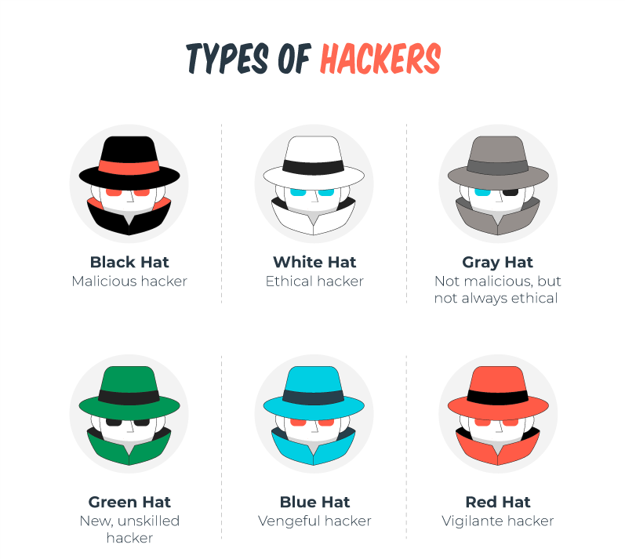

Slide 2
Black hat
-Malicious cybercriminals
Break into systems illegally for personal gain
Cause damage, steal data, or disrupt services
"The classic villains" of hacking

Slide 3
White Hat
-Ethical security professionals
Work legally to strengthen cybersecurity
Hired by organizations to find vulnerabilities
"The good guys" of hacking

Slide 4
Grey Hat
Operate in the ethical gray area
May hack without permission but without malicious intent
Often expose vulnerabilities publicly to force fixes
"The rule-bending activists"

Slide 5
Green Hat
Beginners and learners
New to hacking and developing skills
Exploring cybersecurity fundamentals
"The aspiring hackers in training"

Slide 6
Blue Hat
External security testers
Hired by companies to test specific systems
Similar to white hats but often more specialized
"The contracted security consultants"

Slide 7
Red Hat
Aggressive cybersecurity defenders
Use hacker techniques against black hats
May actively disrupt or disable attackers' systems
"The vigilante defenders"

