Slide 1
CS 341
Computer Architecture and Organization
Lecturer: Dr. Ronald Cheung
Office: S-3-073
Phone: 617-287-6483
Email: cheungr@cs.umb.edu

Slide 2
Welcome to CS341
This course teaches computer architecture and organization from the embedded system point of view
Textbooks are:
  Professional Assembly Language
  Shaum’s Outline Series, Digital Principles
The course syllabus is posted on: www.cs.umb.edu/~cheungr/cs341/CS341_syllabus.doc
Go over syllabus

Slide 3
Getting Started
Linux Account
  Apply for CS341 ASAP! (Science 3rd Floor Linux/PC Lab)
  Upload mp files from your tutor-vserver VM for grading
  Don’t use chown, chgrp, or chmod on any of your mp directories or files! That could enable cheating.
Remote Internet access from your own PC
  Use Secure Shell 2 or putty for secure remote access
  Login into “users.cs.umb.edu” with Linux ID and password
Remote Internet access from your tutor-vserver VM
  Use SCP to download starting mp files
  Use SCP to upload finished mp files

Slide 4
Homework
Familiarize yourself with the course syllabus
Locate and start reading course references:
  Web Based / Linked from syllabus web page
First reading assignment:
  Professional Assembly Language Programming, pp 1-16
  Familiarize yourself with my CS341 site linked references
Read the instructions on the course website for installing the VMWare tutor environment on your own PC

Slide 5
Textbook Commentary
This textbook is one of the few books that uses the GNU (aka ATT) syntax for i386 assembly language instructions
We’ll be using the GNU syntax in this course
Most other books (e.g. the previous textbook) require learning and using a translation for the syntax which was always a pain to deal with
However, it has a couple disadvantages

Slide 6
Textbook Commentary
The textbook teaches Intel i386 assembly language programming and development tools from the point of view where the code is being run on the Linux O/S where it is being developed
The text material on the development tools must be adapted for cross compilation and cross assembly to run under Tutor which is simulating an embedded system

Slide 7
Textbook Commentary(cont’d)
The book assumes that you will write your assembly language programs to run on the development host with a Linux O/S
It shows you how to use Linux system calls for I/O operations that we will not be using
We will run our assembly language programs on an embedded system virtual machine under Tutor – not Linux
We need to use direct I/O instructions (e.g. in and out) that are not covered in the book

Slide 8
Embedded Systems
Embedded processors are inside a system that is not usually thought of as a computer
There are many more processors in embedded systems than there are in IT applications such as laptops, desktops and servers (99% / 1%)
There are complex challenges for embedded system programming and these programmers need specialized knowledge and are well-paid

Slide 9
Embedded Systems
Examples:
  Automobile engine controls, GPS systems, etc.
  Appliances such as microwave ovens, TVs, etc.
  Manufacturing plants / robotic machines
  Chemical and petroleum plants - control systems
  Aircraft/Ships/Rockets - guidance and control
  Building HVAC, elevator, and security systems
  Communications – routers, switches, and modems
  Medical instrumentation and implanted devices

Slide 10
Embedded Systems
Considerations for embedded system software
  The processors are NOT powerful Pentiums with Gigabytes of memory / disk and Gigabit networks
  Code/data space and bandwidth are critical resources
  Cost may be critical for high volume products
  There may be hard real time constraints so the SW efficiency and timing are usually critical factors
  The cost of a bug in the SW may include injury or death for a person or even worse many people

Slide 11
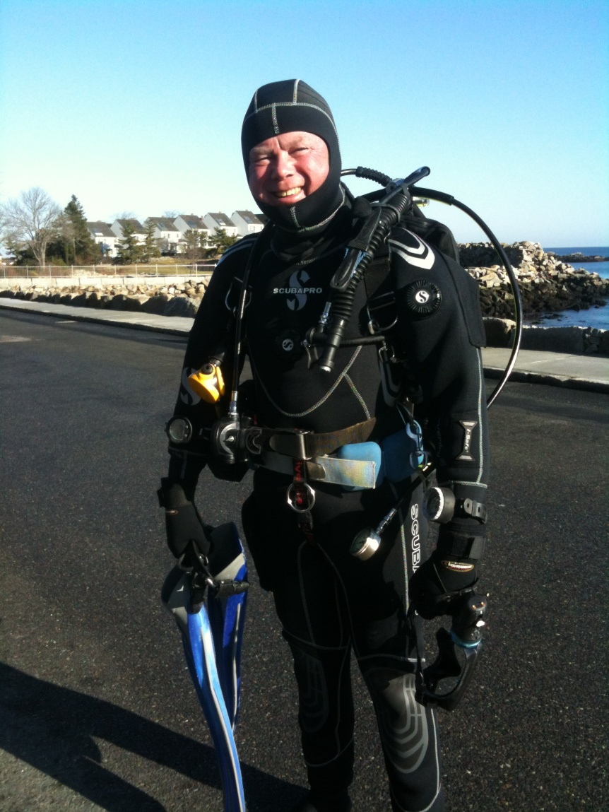
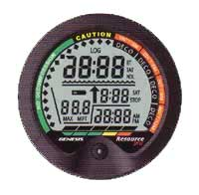
Embedded System Example
SCUBA Diving “Computer”

Slide 12
Embedded System Example
SCUBA Diving Computer Block Diagram
Water
Sensor
Push
Button
LCD
Display
Depth
Sensor
CPU
RT
Clock
Temp
Sensor
Program
Memory
LOG
Memory

Slide 13
Embedded System Example
Diving Computer Software Functionality
  Automatically turn on when in the water
  Track/display times and depths during the dive
  Calculate the amount of Nitrogen absorbed
  Display the safe remaining dive time
  Pace the diver’s ascent, e.g. deco/safety stops
  Record dive data in non-volatile log memory
  Keep track of surface interval before next dive
  Keep track of safe time before flying

Slide 14
Embedded System Example
Diving Computer HW/SW Constraints
  Small hockey puck sized device (wrist mounted)
  Waterproof case (no fans for cooling with air)
  Battery powered (no replacement under water)
  Software in ROM (no hard drive to boot from)
  Self-test code so diver can rely on its operation
  Timing constraints (must provide real time information to the diver – not just a message to head for “the chamber” after the dive is over!)

Slide 15
Embedded System Example
Team 1: How would you develop and install the software in the diving computer?
Team 2: How would you test the software in the diving computer?

Slide 16
Embedded System Example
What are the possible consequences of bugs in the diving computer software?
  Diver gets “the bends” or an air embolism in blood
  Diver’s buddies get injured/killed trying to rescue
  Diver dies a painful death
A bad example of a corporate cover up:
http://www.sfgate.com/news/article/Corporate-coverup-exposed-divers-to-grave-risk-2615088.php#page-2
YouTube video:
http://www.youtube.com/watch?v=eNqPTOb31S8&NR=1

