Slide 1
Homework
Reading
  Professional Assembly Language, pp 17-32, 34-37
  Selecting Intel Registers
  http://www.swansontec.com/sregisters.html
Lab with your assigned section starts next week

Slide 2
General Computer Architecture
Processor
  Controls fetching and execution of instructions
  Moves data between memory, registers, the arithmetic / logic unit (ALU), and I/O devices
Memory
  Stores instructions and data
I/O Devices
  Bring data into system
  Send data out from system

Slide 3
General Computer Architecture
Control Bus
Processor
C-Bus (M/IO#, W/R#, and D/C# Signals)
Fetch and
Execute
Control
Address Bus
Arithmetic
Logic Unit
I/O
Devices
Memory
Registers
Data Bus

Slide 4
Signals and Busses
A “signal” is a logical value represented as a voltage on a wire inside the machine
A signal is binary (two states – on and off)
There is a specific meaning assigned to each value of a signal, e.g. M/IO#
  M/IO# = 1 means access memory
  M/IO# = 0 means access an I/O device
A “bus” is a group of signals with one purpose

Slide 5
Processor Model
An assembly language programmer usually thinks of the processor in terms of its:
  Registers
  Arithmetic Logic Unit (ALU)
  Instructions
  Address and data bus sizes
An example of a Generic Processor: PIPPIN
http://www.cs.drexel.edu/~introcs/Fa02/lectures/06.3_Pippin/WhatIsPIPPIN.html?CurrentSlide=1

Slide 6
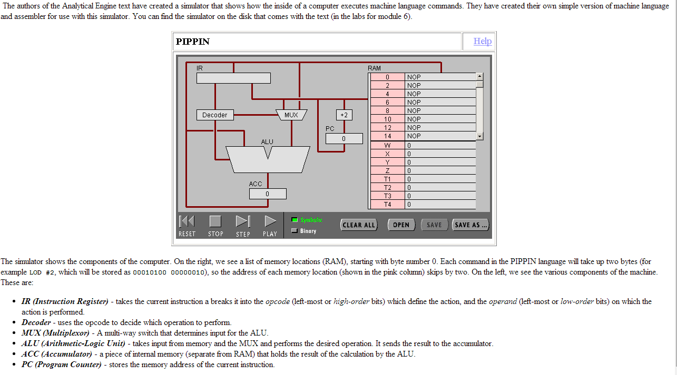
The PIPPIN Machine

Slide 7
80386Processor Model - Registers
%ax
%eax
%ah
%al
Memory
Address
%bx
Memory
%ebx
%bh
%bl
0x00000000
%cx
%ecx
%ch
%cl
M/IO#
%dx
W/R#
%edx
%dh
%dl
D/C#
A-Bus
(32 bits)
%esp
%sp
%ebp
%bp
D-Bus
(32 bits)
%esi
%si
%edi
%di
0xFFFFFFFF

Slide 8
Processor Model - Registers
Additional status and control registers
  Instruction Pointer/Extended Instruction Pointer
  Extended Flags Register
%eip
%ip
%eflags

Slide 9
Arithmetic Logic Unit(ALU)
Capable of performing arithmetic
  Addition, Subtraction, Multiplication, Division
Capable of performing logic operations
  and, or, exclusive or
Takes operands from source(s) specified in the instruction
Delivers results to destination specified in the instruction

Slide 10
Processor Model - Instructions
Instructions to move a constant into a register
  movb $54, %al Move 54₁₀ to al register
  movb $0x36, %al Move 36₁₆ to al register
  movb $'6', %al Move digit 6 to al register
Instructions to move data between registers
  movl %ebx, %eax
  movw %bx, %ax
  movb %bh, %ah
  movb %bl, %al
AT&T Convention:
Destination
AT&T Convention:
Source

Slide 11
Processor Model - Instructions
Instructions to add or subtract a constant to a register
addb $10, %bl
subb $10, %bl
Instructions to add or subtract a register to another register
addb %bh, %bl
subb %bh, %bl

Slide 12
Busses
Address Bus
  Driven by the processor (Simplified for now)
  Processor presents address of memory location or I/O device being accessed on the busses
  Each memory or I/O device determines if the value on the address bus and M/IO# signal selects it or not
  When selected, memory or I/O device gets data from data bus or puts data on data bus based on W/R#

Slide 13
Busses
Data Bus
  Used as a conduit for data between devices
  Specific operations performed on the data bus are driven by control and address bus signals
  Can be driven by processor, memory, or an I/O device depending on the type of transfer done
  Interfaces to data bus require a special kind of “tri-state” logic which we will discuss later

Slide 14
Busses
Control Bus Signals
  M/IO# signal selects
    Memory when set (= 1)
    I/O devices when reset (= 0)
  W/R# signal moves data from
    Processor to memory or I/O device when set (= 1)
    Memory or I/O device to processor when reset (= 0)
  D/C# signal indicates
    Data (instruction execute phase) when set (=1)
    Control (instruction fetch phase) when reset (=0)

Slide 15
Fetch Cycle
Processor
C-Bus (M/IO# = 1, W/R# = 0, D/C# = 0)
Fetch and
Execute
Control
Address From EIP Register
Arithmetic
Logic Unit
I/O
Devices
Memory
Registers
Data Bus (Instruction)

Slide 16
Fetch Cycle
On each fetch cycle, processor
  Puts signal M/IO# = 1 on control bus
  Puts signal W/R# = 0 on control bus
  Puts signal D/C# = 0 on control bus
  Puts address of next instruction from the EIP register on address bus signals
  Reads next instruction on data bus

Slide 17
Execute Cycle (Memory Read)
Processor
C-Bus (M/IO# = 1, W/R# = 0, D/C# = 1)
Fetch and
Execute
Control
Address
I/O
Devices
Arithmetic
Logic Unit
Memory
Registers
Data Bus (Data From Memory)

Slide 18
Execute Cycle
On each execute cycle, processor
  May or may not need to access memory or I/O
  Some instructions act inside processor only, e.g. instruction to move a constant to a register
When processor accesses memory or an I/O device during execute cycle, there are four possible combinations:

Slide 19
Execute Cycle (Memory Write)
Processor
C-Bus (M/IO# = 1, W/R# = 1, D/C# = 1)
Fetch and
Execute
Control
Address
I/O
Devices
Arithmetic
Logic Unit
Memory
Registers
Data Bus (Data To Memory)

Slide 20
Execute Cycle (I/O Read)
Processor
C-Bus (M/IO# = 0, W/R# = 0, D/C# = 1)
Fetch and
Execute
Control
Address
Arithmetic
Logic Unit
I/O
Devices
Data
In
Memory
Registers
Data Bus (Input Data)

Slide 21
Execute Cycle (I/O Write)
Processor
C-Bus (M/IO# = 0, W/R# = 1, D/C# = 1)
Fetch and
Execute
Control
Address
I/O
Devices
Data
Out
Arithmetic
Logic Unit
Memory
Registers
Data Bus (Output Data)

Slide 22
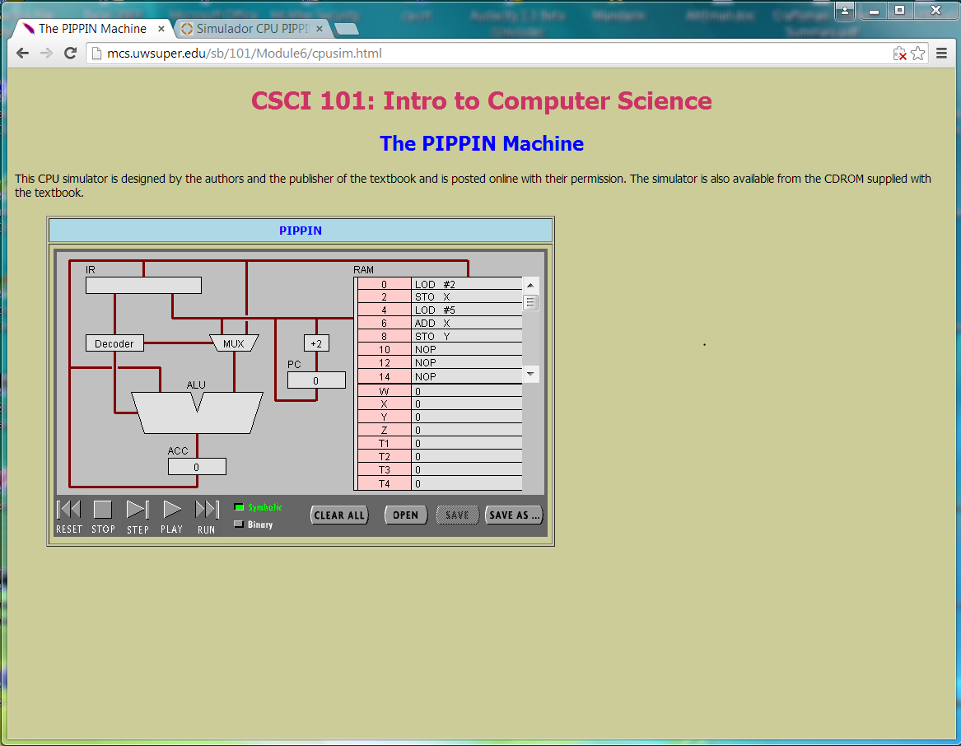
Simulation of a Generic Processor PIPPIN

Slide 23
Run the PIPPIN simulation applet on a PC
Change security setting in Control Panel/Java/:
  High
  Edit Exception Site List to include:
    http://mcs.uwsuper.edu/sb/101/Module6/cpusim.html
Use IE to enter into the site. Enter the program:
  Program Counter Program Comments
  0 LOD #2 Load literal value 2 in ACC reg
  2 STO X Store it in memory location X
  4 LOD #5 Load literal value 5 in ACC reg
  6 ADD X Add location X to ACC reg
  8 STO Y Store it in memory location Y
Run simulation by clicking STEP (single step)

Slide 24
Run the PIPPIN simulation applet on a MAC
Change security setting in System Preferences/Java /Security to:
  High
  Edit Exception Site List to include:
    http://mcs.uwsuper.edu/sb/101/Module6/cpusim.html
Use Safari to enter into the site. Enter the program:
  Program Counter Program Comments
  0 LOD #2 Load literal value 2 in ACC reg
  2 STO X Store it in memory location X
  4 LOD #5 Load literal value 5 in ACC reg
  6 ADD X Add location X to ACC reg
  8 STO Y Store it in memory location Y
Run simulation by clicking STEP(single step)

