Slide 1
Homework
Reading
  Tokheim, Chapter 3, 4, and 6.1 - 6.3
  Logisim: Logic Design and Simulation Tool
Machine Projects
  Continue on mp4
Labs
  Continue in labs with your assigned section

Slide 2
Digital Logic
Two types of digital logic design
  Combinational Logic – has no memory elements
  Sequential Logic – contains memory elements
Combinational logic design is sometimes called Boolean algebra after George Boole
  Based on binary logic
  Uses AND, OR, XOR, NOT, etc.
  Develop truth tables and implement a design

Slide 3
Boolean Algebra
Variables / Expressions
  Two Values Only (0 or 1)
Basic Operators
  AND *
  OR +
  XOR +
  NOT Bar over the variable or expression
  Or # after variable name

Slide 4
Boolean Algebra
Precedence of Operators
  Parentheses ( ) (highest)
  NOT (high)
  AND * (medium)
  OR/XOR + (low)
Parentheses to force precedence
  A * (B + C) is not the same as A * B + C

Slide 5
Boolean Algebra
Multiplicative Identities
  A * 0 = 0
  A * A = A (Note: Not A squared)
  A * A = 0
Additive Identities
  A + 1 = 1
  A + A = A (Note: Not 2A)
  A + A = 1

Slide 6
Boolean Algebra
Negative Identity
  A = A
Commutative Property
  A * B = B * A
  A + B = B + A
Distributive Property
  A * (B + C) = A * B + A * C

Slide 7
Boolean Algebra
Common Reductions of Sums of Products (Also called a “Minterm” expression)
  A * B + A * B + A * B = A + B OR
  A * B + A * B = A + B XOR
Common Reductions of Products of Sums (Also called a “Maxterm” expression)
  (A + B) * (A + B) * (A + B) = A * B AND

Slide 8
Basic Logic Gates
For a two input, one output gate, how many possibilities are there?
Assume a basic understanding of AND, OR, NOT, XOR and the negated forms: NAND and NOR
x
y
?
z
x y z
0 0 0 0 0 0 0 0 0 0 ... 1
0 1 0 0 0 0 1 1 1 1 ... 1
1 0 0 0 1 1 0 0 1 1 ... 1
1 1 0 1 0 1 0 1 0 1 ... 1

Slide 9
Binary Logic Symbols/Tables
NOT
AND
0
1
NAND
0
1
0
1
0
0
0
0
1
1
1
0
1
0
1
1
1
0

Slide 10
Binary Logic Symbols/Tables
OR
0
1
NOR
0
1
XOR
0
1
0
0
1
0
1
0
0
0
1
1
1
1
1
0
0
1
1
0

Slide 11
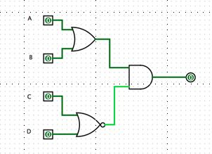
Boolean Algebra / Logic Diagram
Sample Boolean Equation
  Y = (A + B) * (C + D)
Equivalent Logic Diagram

Slide 12
Truth Table for (A + B) * (C + D)
A B C D Y
0 0 0 0 0
0 0 0 1 0
0 0 1 0 0
0 0 1 1 0
0 1 0 0 1
0 1 0 1 0
0 1 1 0 0
0 1 1 1 0
1 0 0 0 1
1 0 0 1 0
1 0 1 0 0
1 0 1 1 0
1 1 0 0 1
1 1 0 1 0
1 1 1 0 0
1 1 1 1 0

Slide 13
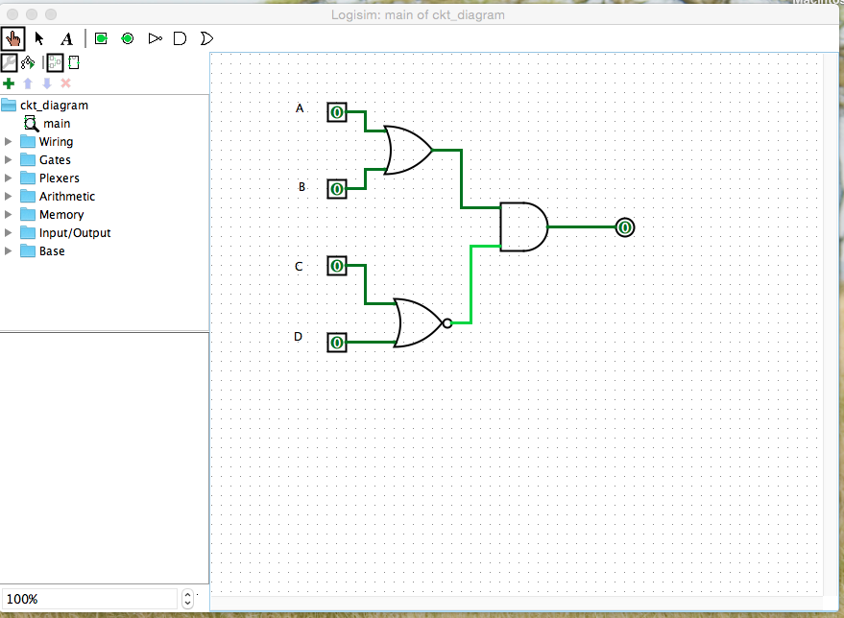
Logisim- Logic Design and Simulation Tool
Download from https://sourceforge.net/projects/circuit/ and install it.
To run it, you need to install java 5 or above
Good logisim tutorial in https://www.youtube.com/watch?v=ATPqpFMlVdw

Slide 14
Basic Logic Gates
Can look at pulse trains over time as inputs rather than just constant inputs
???

Slide 15
Timing Considerations
Things don’t happen instantaneously
  Each signal arrives at some unique time
  Gate logic takes some time to react (rise time)
  Changes in the output appear some time after changes to the inputs (at nanosecond level)
Example, an AND gate
A
A
Y
B
B
Y

Slide 16
Timing Considerations
Things don’t happen instantaneously
  As clock speed increases, the “skew” due to differential delays narrows output pulses
  Beyond the designed maximum clock speed, the circuit may fail
Example, an AND gate
A
A
Y
B
B
Y

Slide 17
Practical Logic Implementation
Transistor-Transistor-Logic (TTL) Chips
  Small Scale Integration (SSI) < 12 gates/chip
  Medium Scale Integration (MSI) 12 - 99 gates/chip
7400 series – Low Power Schottky (LS)
  A good compromise between speed and power
Chips are generally 14- (or 16-pin) package
  V_{cc} (+5 volts) usually on pin 14 (or pin 16)
  Ground (0 volts) usually on pin 7 (or 8)
  BUT NOT ALWAYS TRUE

Slide 18
Practical Logic Implementation
Logic Levels mapped to voltages in 2 ways:
Normal Logic Signal (name w/o a bar or #)
  Logic 0 is < 0.8 volt
  Logic 1 is > 2.0 volt
Inverted Logic Signal (name with a bar or #)
  Logic 0 is > 2.0 volt
  Logic 1 is < 0.8 volt

