Slide 1
Homework
Reading
  Tokheim, Chapter 3, 4, and 6.1 - 6.3
  Logg-o on Analytical Engine Website
Machine Projects
  Continue on mp4
Labs
  Continue in labs with your assigned section

Slide 2
Combining Basic Logic Gates
Decoders
Encoders
Selectors - Multiplexers
ALUs
Control Units
Buses
Simple computers

Slide 3
Binary Decoder
Logic with n input lines and 2^{n} output lines
Only one output is a 1 for any given input
Binary
Decoder
n
inputs
2^{n} outputs

Slide 4
Building a Binary Decoder
Start with a 2-bit decoder:
AND
Y₀
AND
X₀
Y₁
X₁
AND
Y₂
X₀ X₁ Y
0 0 Y₀=1
0 1 Y₁=1
0 Y₂=1
1 1 Y₃=1
AND
Y₃
Enable

Slide 5
Then Add Two to Make Three...
X₀
2-bit
Decoder
Y₀
Y₁
Y₂
X₁
Y₃
X₂
NOT
2-bit
Decoder
Y₄
Y₅
Y₆
Y₇

Slide 6
Developing an Encoder
If we can decode, then we need to encode
Encode from 1 out of n into a binary weighted form
A keyboard encoder does this
X₀
NC
X₁
OR
Y₀
X₂
OR
X₃
Y₁
X₄
OR
...
Y₂
X₇

Slide 7
Next Comes a Selector
Like a switch; also called a multiplexer or MUX
Again, build it up from simple basic logic gates
S₁
S₂
a
MUX
or
Selector
b
y
c
d

Slide 8
A 1-bit Selector
S₁
S₂
Decoder
O
R
a
AND
b
AND
y
c
AND
d
AND

Slide 9
A 4-bit Selector
S₀
S₁
S
A
MUX
a₀
B
b₀
Y₀
Y
c₀
C
d₀
D
Y₁
S
2
Y₂
4
MUX
A
4
B
4
a₃
4
Y
b₃
Y₃
C
c₃
4
d₃
D

Slide 10
The ALU Is Next
Logical and arithmetic operations
Variations in
  Base
    Binary
    Decimal
    BCD
    (binary coded decimal)
  Implementation
    Serial
    Parallel
    Pipelined
A
B
Control
Signals
ALU
CCs
f(A,B)

Slide 11
Simple Example - Binary Adder
Develop a half-adder (HA)
Use two HA’s to build a full-adder (FA)

Slide 12
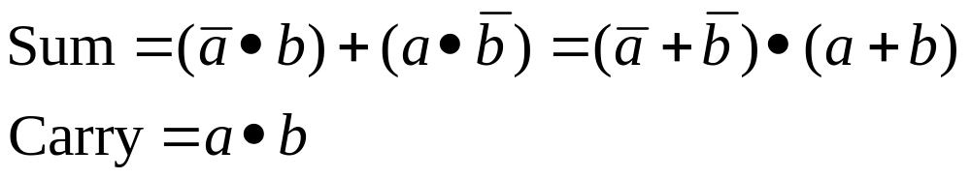
The Half-Adder
and
or
not
a b Sum Carry
0 0 0 0
0 1 1 0
1 0 1 0
1 1 0 1
a
b
HA
Sum
C_{out}
a
b
XOR
Sum
AND
C_{out}

Slide 13
From HA to FA
a b c_{in} Sum C_{out}
0 0 0 0 0
0 0 1 1 0
0 1 0 1 0
0 1 1 0 1
1 0 0 1 0
1 0 1 0 1
1 1 0 0 1
1 1 1 1 1
a
b
c_{in}
Full
Adder
Sum
c_{out}
sum
a
Half
Adder
b
C_{out}
OR
C_{out}
Half
Adder
C_{out}
c_{in}
Sum

Slide 14
Using Full Adders for 2-bit Addition
a b C_{in} Sum₀ C₀
LSB
0 0 0 0 0
0 1 0 1 0
1 0 0 1 0
1 0 0 1
MSBs C_{n-1} Sum_{n} C_{n}
0 0 0 0 0
0 0 1 1 0
0 1 0 1 0
0 1 1 0 1
1 0 0 1 0
1 0 1 0 1
1 1 0 0 1
1 1 1 1 1
0
a₀
b₀
Full
Adder
Sum₀
C₀
C₀
a₁
b₁
Full
Adder
Sum₁
C₁
0 0 0 0 1 1 1 1
+ 1 1 + 0 1 + 0 1 +1 1
(0) 1 1 (0) 0 1 (1) 0 0 (1) 1 0
Note: The carry flag value after the addition
represents the N+1 bit value in the result

Slide 15
Using Full Adders for Subtraction
Difference = a - b
= a + (-b)
= a + (~b + 1)
= a + ~b + 1
a ~b C₀ Sum C₁
LSB
0 0 1 1 0
0 1 1 0 1
1 0 1 0 1
1 1 1 1
MSBs C_{n-1} C_{n}
0 0 0 0 0
0 0 1 1 0
0 1 0 1 0
0 1 1 0 1
1 0 0 1 0
1 0 1 0 1
1 1 0 0 1
1 1 1 1 1
1
a₀
~b₀
Full
Adder
Sum₀
C₀
C₀
a₁
~b₁
Full
Adder
Sum₁
C₁
(1) 0 0 0 0 (0)1 1 1 1
- 1 1 + 0 1 - 0 1 + 1 1
0 1 (0) 0 1 1 0 (1) 1 0
Note: The carry flag value after the ~ and addition
is the opposite of the subtract borrow condition

Slide 16
Configurable Add/Subtract ALU
Subtract/Add #
From
Instruction
Decoding
Logic
(0 for add
1 for subtract)
Full
Adder
Sum₀
EFlags
Register
a₀
XOR
C₀
b₀
.
.
.
Zero
Flag
NOR
.
.
.
.
.
.
.
.
.
Sign
Flag
C_{n-2}
Full
Adder
Sum_{n-1}
C_{n-1}
a_{n-1}
Overflow
Flag =
C_{n-2}*C_{n-1}#
XOR
b_{n-1}
Carry
Flag
XOR

