Slide 1
Homework
Reading
  Tokheim Chapter 9.1 – 9.6
Machine Projects
  Continue on mp4
Labs
  Continue in labs with your assigned section

Slide 2
Sequential Circuits
A sequential circuit is constructed using a combinational circuit with memory circuits
Similar to a C function with static internal variables (state memory)
One additional input is a clock signal
Input(s)
Combinational
Logic
Output(s)
Memory
Elements
Clock

Slide 3
Simple Memories (Flip-Flops)
Simplest is Reset-Set (R-S type)
Note the inverted signal inputs
Can buy a standard TTL R-S flip-flop (LS279)
S R Q Q
0 1 1 0 (set)
1 0 0 1 (reset)
1 1 no change (hold)
0 0 unpredictable
S
Q
R
Q
S
NAND
Q
NAND
Q
R

Slide 4
Simple Memories (Flip-Flops)
Timing Diagram
S
R
Q
Q
No
Effect
No
Effect
Hold
Set
Hold
Reset
Hold
Hold
1
0
1
0
1
0
1
0

Slide 5
Synchronous Flip-Flops
Use of a clock to make the circuit synchronous
Syn (with) + chronous (clock) => with a clock
Level-triggered (changes state while clock high)
S
NAND
S
TRUTH TABLE
S R Clock Q
0 1 0
1 0 1
0 0 No Chg
1 1 Prohibited
R-S
Flip Flop
Q
Clock
NAND
Q
R
R

Slide 6
The D-Type Flip-Flop
Single data input and edge-triggered clock
Also called a “Delay” flip-flop (D-type)
Changes state on either rising or falling edge
D
(Data)
S
TRUTH TABLE
D Clock Q
0 0
1 1
NAND
R-S
Flip Flop
Q
NAND
Q
C
R
Clock
A
Edge To Pulse Converter
A B C
0 1 0
1 1 (Due to delay through inverter)
1 0 0
AND
B

Slide 7
Actual D-Type Flip-Flop
Has preset (PR) and clear (CLR) inputs which can be set asynchronously (but not both at same time)
Nomenclature use > for an edge-triggered input
D
PR
Q
> Clk
Q
CLR
PR goes to 0, Q=1 independent of D and Clk
CLR goes to 0, Q=0 independent of D and Clk
If PR=1, CLR=1, D and Clk will operate normally

Slide 8
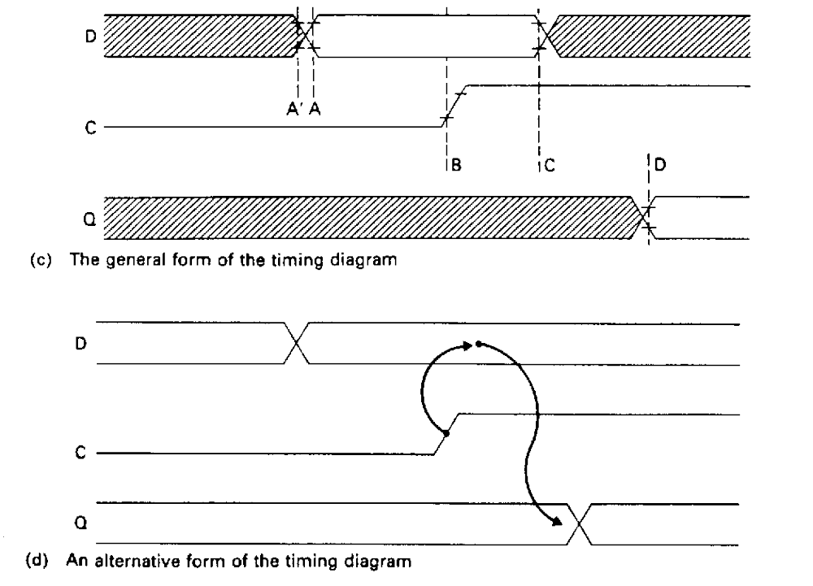
Timing Diagrams for D Flip-Flop

Slide 9
Clock - Divide by Two Counter
Connect Q output back to D input
Timing Diagram (after starting with Q = 0)
D
PR
Q
> Clk
Q
CLR
Clk
Q
Q is an output clock at ½ the frequency of the input clock

Slide 10
Shift Registers
Serial in, Parallel out:
Four Bit Parallel Output Available After Four Clocks/Shifts
Serial
Data In
D
Q
D
Q
D
Q
D
Q
FF1
FF1
FF1
FF1
Clock In

Slide 11
Shift Registers
Parallel in, Serial out:
Four Bit Parallel Input Presented for One Clock Edge while “Load” Signal is True
Load/Shift#
M
U
x
M
U
x
M
U
x
M
U
x
1
Serial
Data Out
D
Q
D
Q
D
Q
D
Q
FF1
FF1
FF1
FF1
Clock In

Slide 12
The J-K or Universal Flip-Flop
Named for Jack Kilby (TI Engineer / Inventor of IC)
Three synchronous inputs (plus preset and clear)
J-K flip-flop is available as a 7473 chip
Can be edge-triggered or level-triggered
Example shown is falling “edge triggered”
TRUTH TABLE
J K Clock Q
0 0 Stays same
0 1 0
1 0 1
1 1 Toggles
J
PR
Q
>Clk
K
Q
CLR

Slide 13
J-K Flip-Flop Internals
Avoids an invalid input such as 0 0 to the R-S Flip Flop
AND
S
K
R-S
Flip Flop
Q
Clock
Edge
Detect
AND
J
Q
R

Slide 14
Using J-K Flip-Flops
Primary use is for storage registers and counters
Mod-16 counter also known as a ripple counter
X₃ X₂ X₁ X₀ counts 0x0 ... 0xF (Hexadecimal) sequentially
X₀
X₁
X₂
X₃
J
Q
J
Q
J
Q
J
Q
Clk
>
>
>
>
K
K
K
K
Vcc (+5 V)

Slide 15
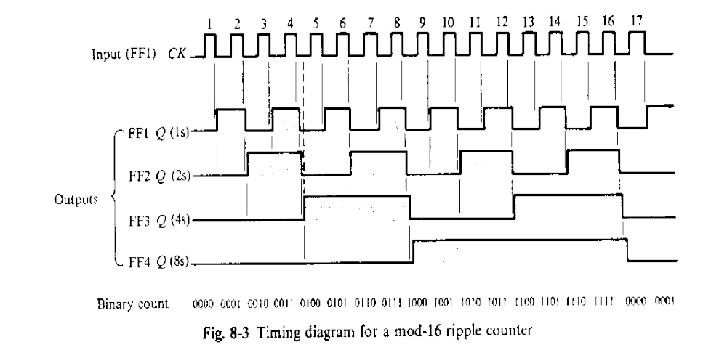
Timing diagram for Mod-16 Counter
Note that the counter actually serves to divide down the input clock!

Slide 16
Counter Range != 2^{N}
X₀
X₁
X₂
NAND
Vcc (+5 V)
J
Q
J
Q
J
Q
>
>
>
K
K
K
Reset
Clk
Can we we make it count to something different than 2^{N}?
  Ans. Yes, using a combinational logic (a NAND Gate in this case)
  Counts: 0, 1, 2, 3, 4, 5, 0, 1, …

Slide 17
Synchronous BCD up/down counter
BCD Up/Down Counter is available as a 74192
BCD stands for Binary Coded Decimal
Counts 0000 -1001, then carries
LED Bit Display
D
Q_{D}
C
Q_{C}
B
Q_{B}
74192
BCD
Up/Down
Counter
A
Q_{A}
Load Data
Count Up
Borrow
Count Down
Clear
Carry

Slide 18
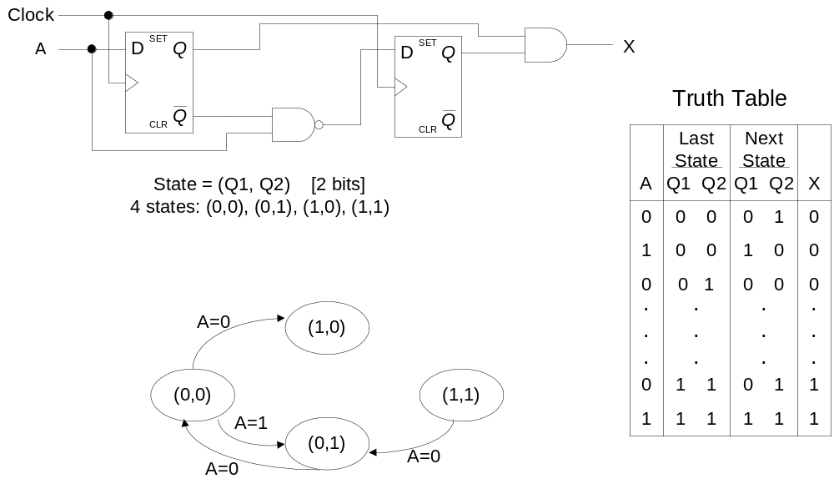
Describing Sequential Circuits
In general,
  Next state = f(inputs, current state)
  Outputs = f(inputs, current state)
Example:
State diagram:

Slide 19
Digital Logic Summary
Combinational circuits:
  Made from gates without feedback
  Have no internal states
  Outputs depend only on current inputs
  Fully defined by truth table on the inputs
  Passes clocks (if any) as wave trains
  Output states constantly change with inputs

Slide 20
Digital Logic Summary
Sequential circuits:
  Have feedback among the gates
  Can have internal states
  Outputs depend on inputs and past inputs (via values of internal states)
  Not completely described by pure truth table on inputs
  Usually one input is a clock signal
  Outputs usually change on one clock edge only

